Slide 1
BAN612 Final Project
Group 6

Slide 2

Introduction
Keywords: Hot investment spot | Valuable correlations | Business insights & applications | Stakeholders
Objectives
Data Preparation
Collect: comprehensive dataset
Clean: data collection
Propose: reasonable questions
Deliver: data visualization and statistical analysis
Summarize: research findings and provide takeaways
Missing value: imputing and dropping
Outliers: identify and handle
Consistency: repair inconsistency
Conformity: assigned properly
Data Collection
Methodology
Quantity: 600+ distinct properties
Source: Redfin.com
Locations: San Francisco, Milpitas, San Jose, Fremont, Union City, Cities in Tri-Valley, ect.
Types: price, livability scores, and property features
Programming language:Python
Web Scraping: Beautiful Soup, re, etc.
Data Preparation: NumPy, Pandas, Matplotlib, etc.
Result delivery: Statistical tests and regression models; data visualizations
Introduction
Web Scraping
Data Preparation
Insight & application
Key Takeaway
Conclusion

Slide 3
Introduction
Keywords: Hot investment spot | Valuable correlations | Business insights & applications | Stakeholders
Objectives
Data Preparation
Collect: comprehensive dataset
Clean: data collection
Propose: reasonable questions
Deliver: data visualization and statistical analysis
Summarize: research findings and provide takeaways
Missing value: imputing and dropping
Outliers: identify and handle
Consistency: repair inconsistency
Conformity: assigned properly
Data Collection
Methodology
Quantity: 600+ distinct properties
Source: Redfin.com
Locations: San Francisco, Milpitas, San Jose, Fremont, Cities in Tri-Valley, ect.
Types: price, livability scores, and property features
Programming language:Python
Web Scraping: Beautiful Soup, re, etc.
Data Preparation: NumPy, Pandas, Matplotlib, etc.
Result delivery: Statistical tests and regression models; data visualizations
Introduction
Web Scraping
Data Preparation
Insight & application
Key Takeaway
Conclusion

Slide 4
Introduction
Keywords: Hot investment spot | Valuable correlations | Business insights & applications | Stakeholders
Objectives
Data Preparation
Collect: comprehensive dataset
Clean: data collection
Propose: reasonable questions
Deliver: data visualization and statistical analysis
Summarize: research findings and provide takeaways
Missing value: imputing and dropping
Outliers: identify and handle
Consistency: repair inconsistency
Conformity: assigned properly
Data Collection
Methodology
Quantity: 600+ distinct properties
Source: Redfin.com
Locations: San Francisco, Milpitas, San Jose, Fremont, Union City, Cities in Tri-Valley, ect.
Types: price, livability scores, and property features
Programming language:Python
Web Scraping: Beautiful Soup, re, etc.
Data Preparation: NumPy, Pandas, Matplotlib, etc.
Result delivery: Statistical tests and regression models; data visualizations
Introduction
Web Scraping
Data Preparation
Insight & application
Key Takeaway
Conclusion

Slide 5
Introduction
Keywords: Hot investment spot | Valuable correlations | Business insights & applications | Stakeholders
Objectives
Data Preparation
Collect: comprehensive dataset
Clean: data collection
Propose: reasonable questions
Deliver: data visualization and statistical analysis
Summarize: research findings and provide takeaways
Missing value: imputing and dropping
Outliers: identify and handle
Consistency: repair inconsistency
Conformity: assigned properly
Data Collection
Methodology
Quantity: 600+ distinct properties
Source: Redfin.com
Locations: San Francisco, Milpitas, San Jose, Fremont, Union City, Cities in Tri-Valley, ect.
Types: price, livability scores, and property features
Programming language:Python
Web Scraping: Beautiful Soup, re, etc.
Data Preparation: NumPy, Pandas, Matplotlib, etc.
Result delivery: Statistical tests and regression models; data visualizations
Introduction
Web Scraping
Data Preparation
Insight & application
Key Takeaway
Conclusion

Slide 6
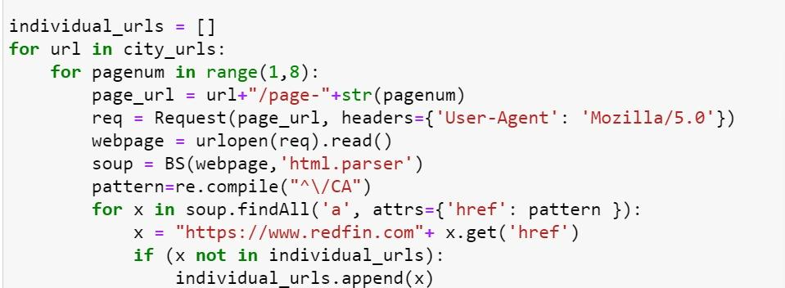
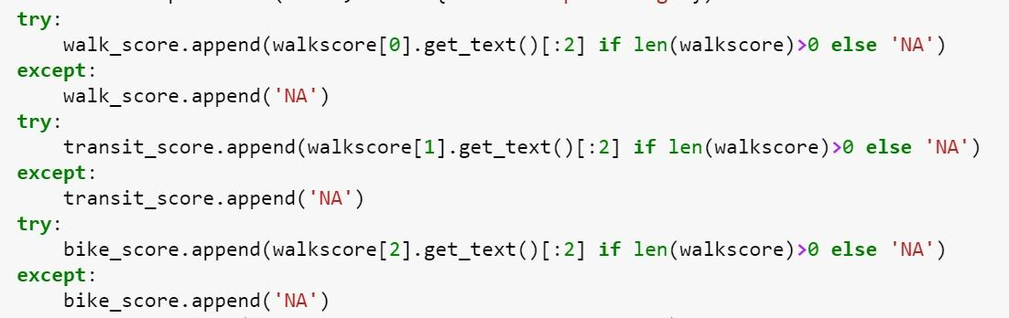
Web Scraping
4th-largest publicly traded residential real estate company in the U.S. by revenue in 2022*
Transparency: more friendly for web scraping compare with other sites
Comprehensive property information
Redfin.com
617 rows (distinct properties) and 16 columns (features and livability scores)
Libraries used: Regular expression, Beautiful Soup, urllib, Numpy, pandas
Constructure used: for loop, try-except
Dataset
*Mariotti T., (2023, March 15).Redfin Company Stats: Revenue & Competitors (2023).https://www.rubyhome.com/blog/redfin-stats/.
Introduction
Web Scraping
Data Preparation
Insight & application
Key Takeaway
Conclusion

Slide 7
Web Scraping
Challenges
Universal logic for Multiple Cities: Struggled to design a singular logic to efficiently scrape data across various city pages on Redfin due to differences in layout and content structure.
Faced difficulties in extracting information due to nested and complex hierarchical structures on the webpage.
The varied placement and organization of data across different pages increased the intricacy of the scraping process.
*Mariotti T., (2023, March 15).Redfin Company Stats: Revenue & Competitors (2023).https://www.rubyhome.com/blog/redfin-stats/.
Introduction
Web Scraping
Data Preparation
Insight & application
Key Takeaway
Conclusion

Slide 8
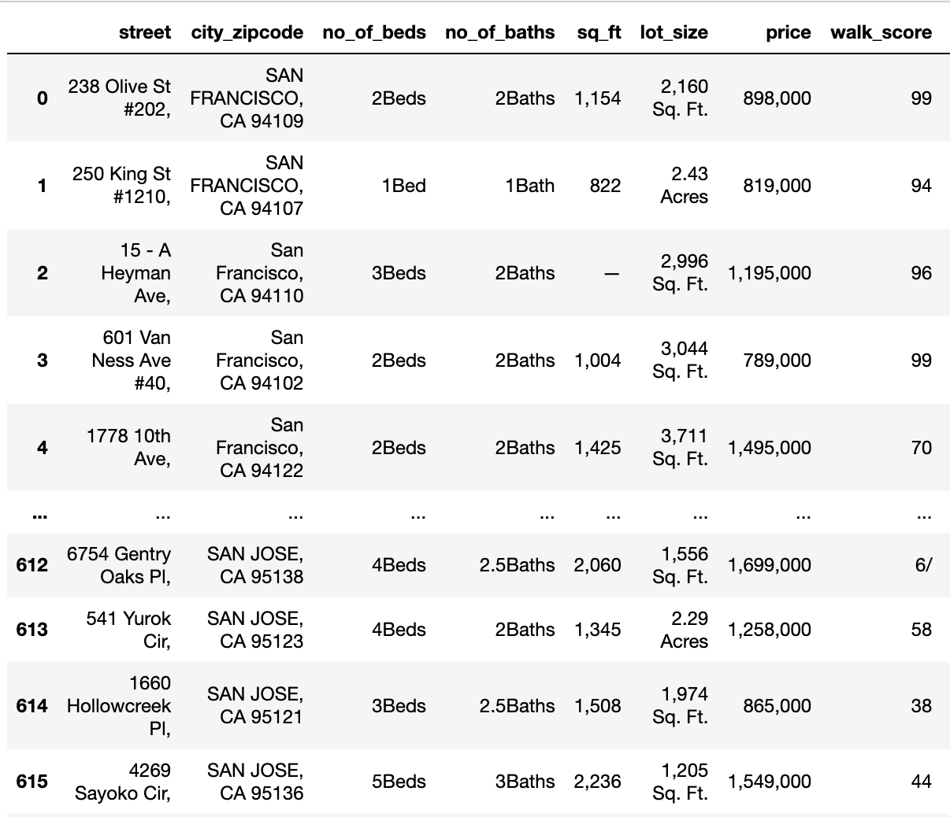
Data Preparation
Step 1
Separating city and zipcode
Create new column using x.split
Step 2
Handling missing values
Replacing placeholder '—Beds', '—Baths' and '—' with NaN
Step 3
Dropping redundant column
For example: street name
Step 4
Conforming data types
Removing dollar sign, comma, string, etc.
Convert to float
Introduction
Web Scraping
Data Preparation
Insight & application
Key Takeaway
Conclusion

Slide 9
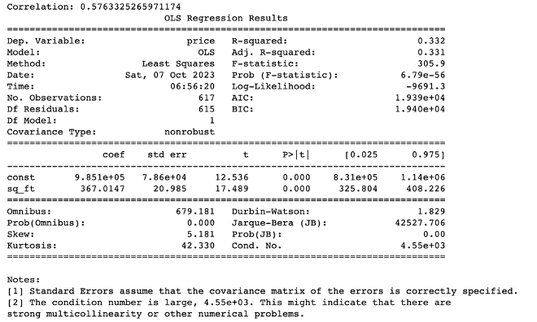
Relationship between property size and its price
Correlation: 0.576
Positive but moderate
R-squared: 0.322
Approximately 33.2% of the variability in property prices can be explained.
One sentence summarization
There is a moderate positive relationship between property size and its price, but other factors at play also influence property prices.
Introduction
Web Scraping
Data Preparation
Insight & application
Key Takeaway
Conclusion

Slide 10
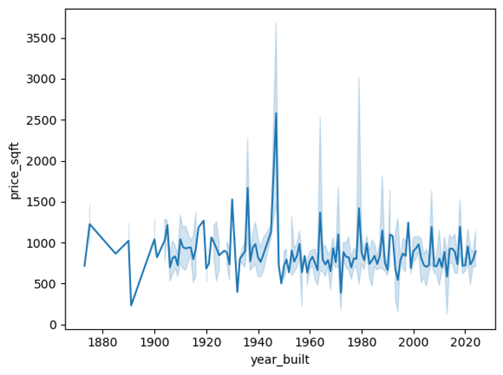
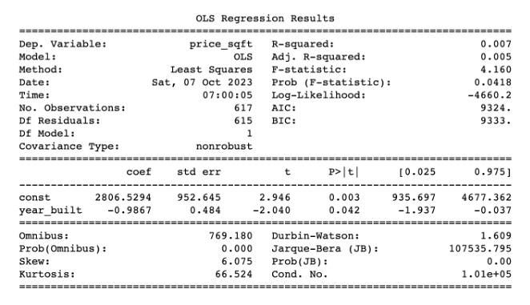
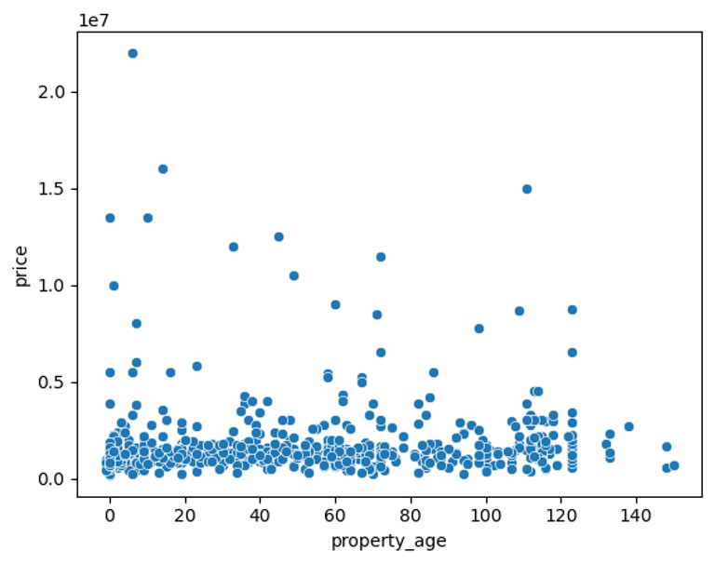
Influence of year of built on price per square foot
R-squared: 0.007
0.7% of price/sq.ft variability.
Coefficient: -0.9867
Negative relationship
P-value: 0.042 < 0.05
Limited practical impact n summarization
One sentence summarization
Very weak relationship, counter intuitive!
Introduction
Web Scraping
Data Preparation
Insight & application
Key Takeaway
Conclusion

Slide 11
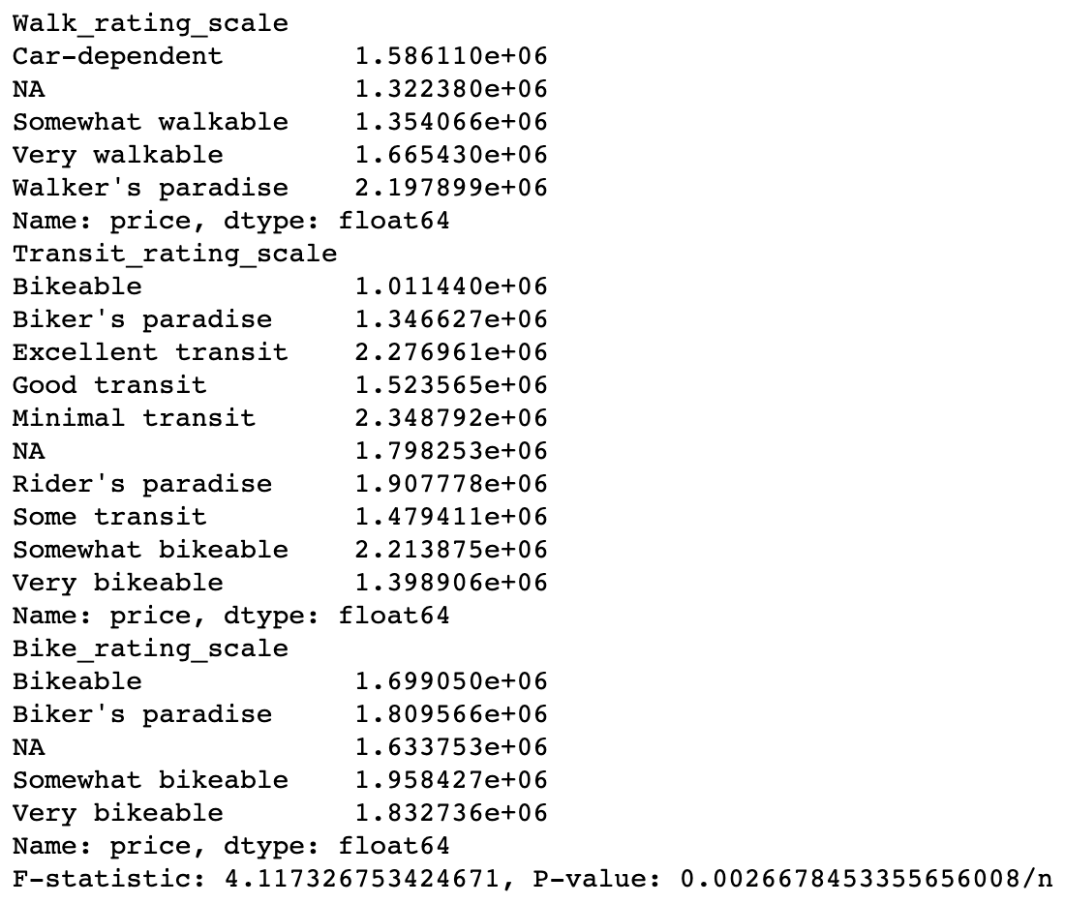
Properties with higher walk, transit, and bike scores
P-value: 0.0026678 < 0.05
The small p-value implies: independent variables collectively have a meaningful relationship with the price
F-statistics: 4.11732 >1
There is some variability in housing prices that can be explained by the independent variables
One sentence summarization
Properties located in areas with higher walk, transit, and bike scores tend to have higher average prices.
Introduction
Web Scraping
Data Preparation
Insight & application
Key Takeaway
Conclusion

Slide 12
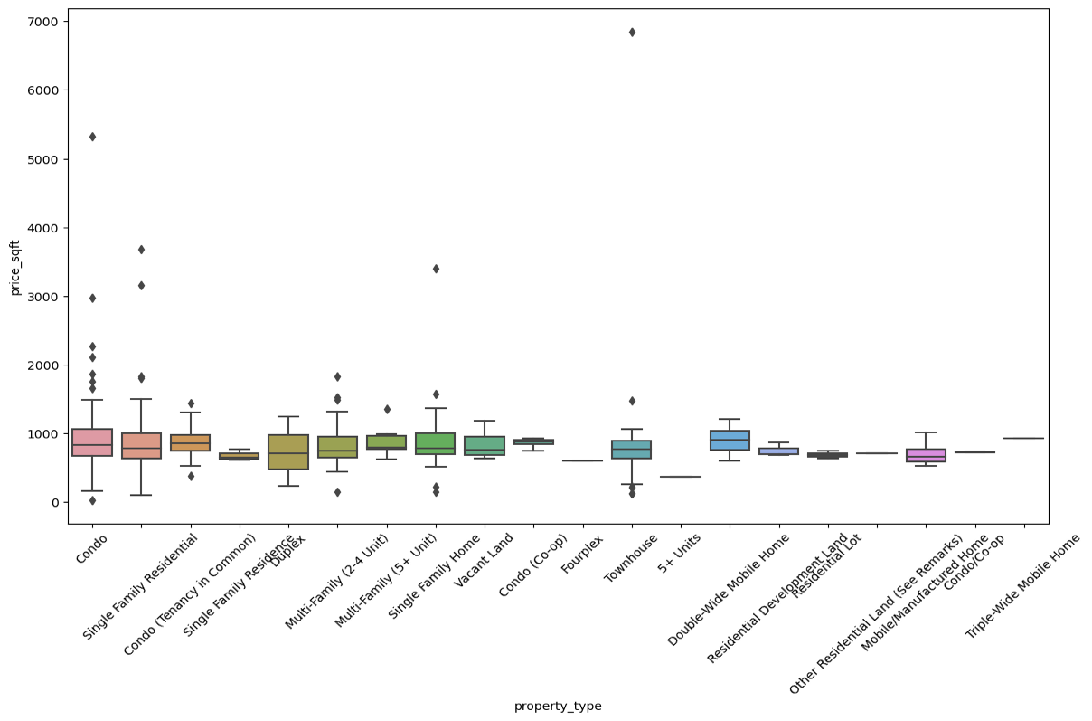
Impact of property type on price per square foot
P-value: 0.9986>0.05
Likely represents that property type has no significance effect on the price
F-Statistics: 0.2949
Non-significant ANOVA further supports the notion that there is no significant impact on price
One sentence summarization
High P-value, low F-statistic indicates that property type doesn’t have a statistically significant impact on the price per square foot, counter intuitive!
Introduction
Web Scraping
Data Preparation
Insight & application
Key Takeaway
Conclusion

Slide 13
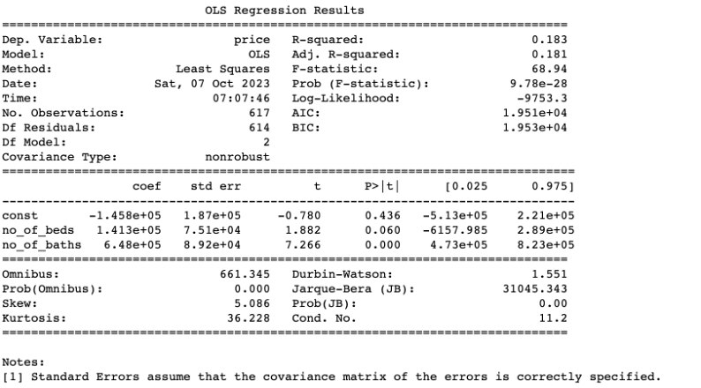
Influence of number of beds and baths on price
Coefficient
Number of beds: 1.413e+05
Number of baths: 6.48e+05
One sentence summarization
Both the no. of beds and the no. of baths have a statistically significant positive impact on property prices, bathrooms appears to have a stronger influence on property prices compared bedrooms.
Counter intuitive? Maybe!
Introduction
Web Scraping
Data Preparation
Insight & application
Key Takeaway
Conclusion

Slide 14
Key Takeaways
Web Scraping
Powerful tool for fetching real-time data.
Requires consistent updates.
Dependent on website structure; changes can disrupt the scraping logic.
Raw data typically requires substantial cleaning and formatting.
Clean, well-formatted data is vital for all further analytical processes.
Impacts exploratory data analysis, statistical inference, and machine learning.
Data Cleaning
Introduction
Web Scraping
Data Preparation
Insight & application
Key Takeaway
Conclusion

Slide 15
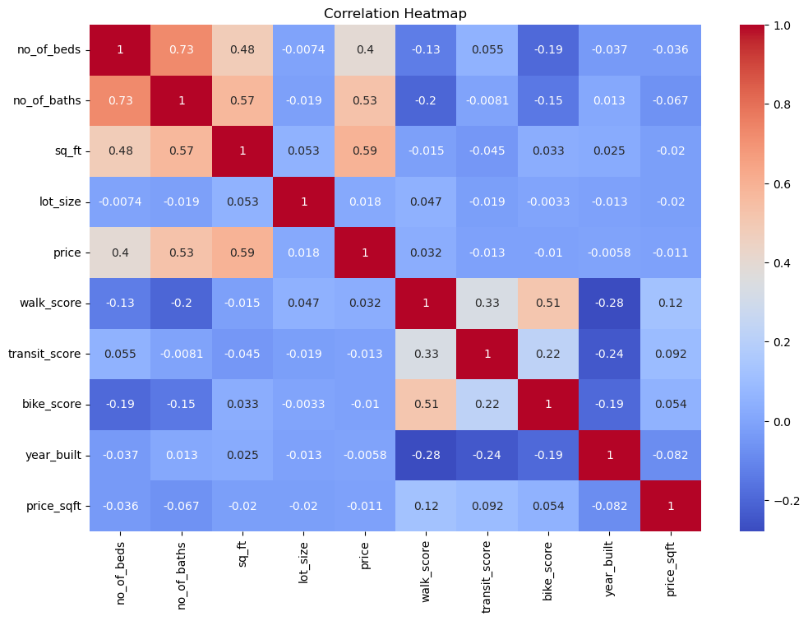
Key Takeaways
Introduction
Web Scraping
Data Preparation
Insight & application
Key Takeaway
Conclusion

Slide 16
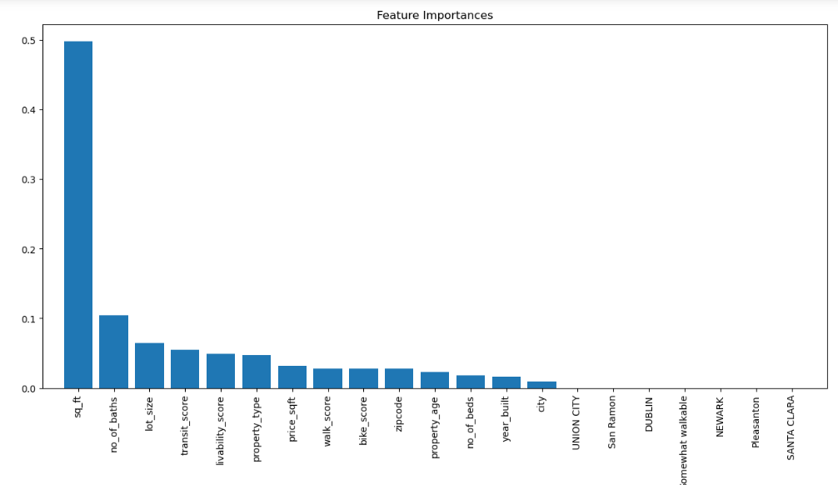
Key Takeaways
Feature Importance
sq_ft: Top predictor, indicating property size directly relates to price.
no_of_baths: More bathrooms often mean higher price, indicating luxury.
lot_size: Larger outdoor spaces can significantly elevate property value.
year_built: While the construction year can offer historical significance, it's less pivotal in predicting prices.
Introduction
Web Scraping
Data Preparation
Insight & application
Key Takeaway
Conclusion

Slide 17
Conclusion
Enhance web scraping for detailed property data
Refined approach for deeper insights
Unlock more trends in real estate
Feature importance analysis provides key insights.
Valuable for realtors, investors, and buyers.
Highlights crucial factors in property valuation.
Guiding smarter property decisions for the future.
Introduction
Web Scraping
Data Preparation
Insight & application
Key Takeaway
Conclusion

