Slide 1


Team Details
  Team name: LegisiMate
  Team leader name: Vachaspati Goutam
  Problem Statement: Accessible, evidence-backed legal case preparation (Social Good)

Slide 2
Brief about the idea
LegisiMate turns a person's case facts into an evidence-backed preparation file before they meet an advocate.
Problem: in Indian cheque-dishonour cases (Section 138, NI Act), strict statutory clocks, missing proof of notice and confused dates decide cases long before any argument. Generic chatbots guess dates and invent citations.
Solution: deadlines are checked in code, Gemini on Vertex AI researches a local corpus of Indian law, three independent mock hearings test both sides, and a readiness brief lists what to collect and what to ask.
For: individuals, small businesses (MSMEs), junior advocates, law students and legal-aid clinics.
Boundaries: preparation support, not legal advice. No verdict prediction; missing facts stay visibly missing.
7,143
statutory provisions indexed
1,600
judgments / 10,139 searchable chunks
3 x 22
independent hearing paths x statements
Proof of concept: one Indian case type. Vision: constitutions, legislation and case law for every country with a constitution.

Slide 3
Opportunities
How different is it from any of the other existing ideas?
Legal chatbots answer from model memory, guess dates and can invent citations. LegisiMate splits the work: code computes every statutory deadline, the model may only quote passages it retrieved, and the server attaches and verifies the exact source text. Unknown facts are never filled in.
How will it be able to solve the problem?
A guided intake separates confirmed from unconfirmed dates; a bounded research agent finds statutes and precedents; three fresh-memory hearings test the case from both sides; the brief lists missing evidence, next steps and questions for an advocate. Users arrive at a consultation with a better file.
USP of the proposed solution
Source-verified, adversarially rehearsed preparation instead of a verdict. Every quote is traceable, every date rule is code, and a 'chance of winning' is deliberately absent.

Slide 4
List of features offered by the solution
Guided intake and tour
Six-step tour on a fictional sample. Consent required before any AI call.
Deterministic calendar review
30-day notice, 15-day payment window, one calendar month to file. Missing dates stay unresolved.
Agentic legal research
Gemini chooses statute and precedent searches, source reads and deadline checks (max 4 steps).
Local legal RAG
SQLite FTS5 index of 7,143 provisions and 10,139 chunks from the SC, Delhi HC and Bombay HC.
Three mock hearings
Magistrate, counsel, parties, witnesses and juniors: openings, cross-examination, rebuttals, assessment.
Source-bound quotations
Model cites passage IDs; the server attaches the exact corpus text and checks the match.
Decision tree and courtroom replay
Explore each path by hearing stage; 2.5D replay with play, pause, speed and reduced motion.
Readiness brief and export
Evidence to collect, next steps, questions for an advocate, settlement options; Markdown export.

Slide 5
Process flow diagram or Use-case diagram
1 Case facts
2 Calendar check
3 Research
4 Rehearsal
5 Readiness brief
Anonymised facts, dates, records and notes. User consent.
Statutory periods computed in code. Unknown stays unknown.
Gemini picks searches; the local corpus returns sources.
3 independent hearings, fresh memory per path, quotes verified.
Evidence to collect, next steps, advocate questions, export.
User
Code
Gemini + RAG
Gemini + checks
Output
Use case
A small textile supplier holds a dishonoured cheque for unpaid invoices. Before paying for a consultation, they check whether the demand-notice and complaint dates still work, see which proof of service is missing, rehearse what the drawer's counsel will argue, and leave with a checklist and questions for their advocate.

Slide 6
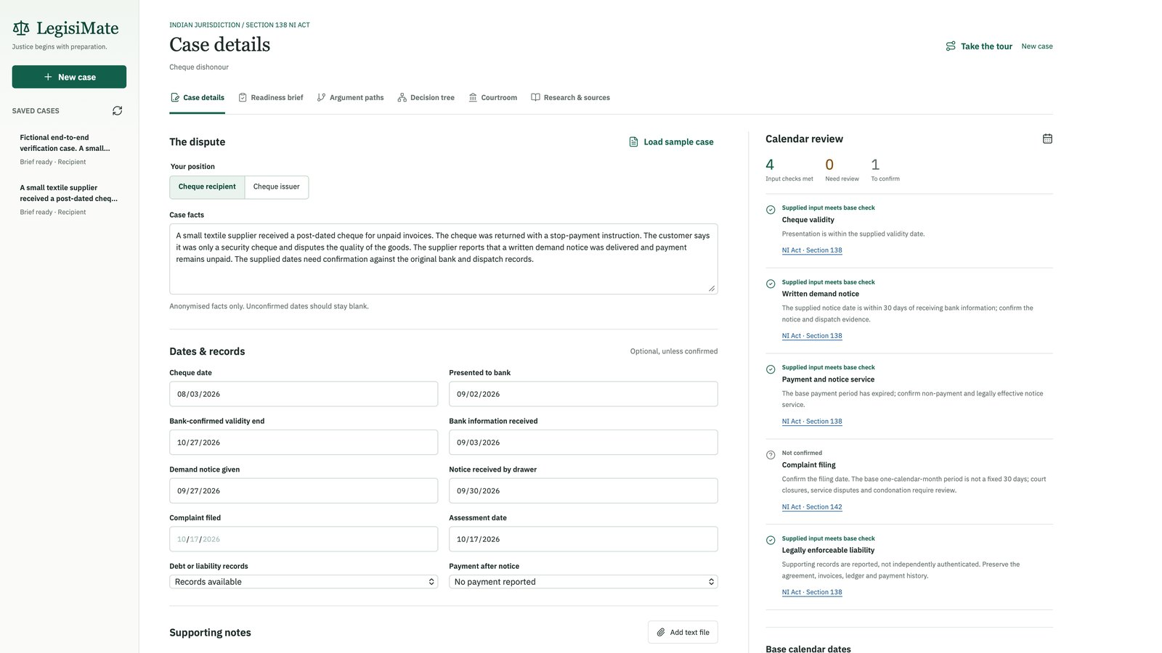
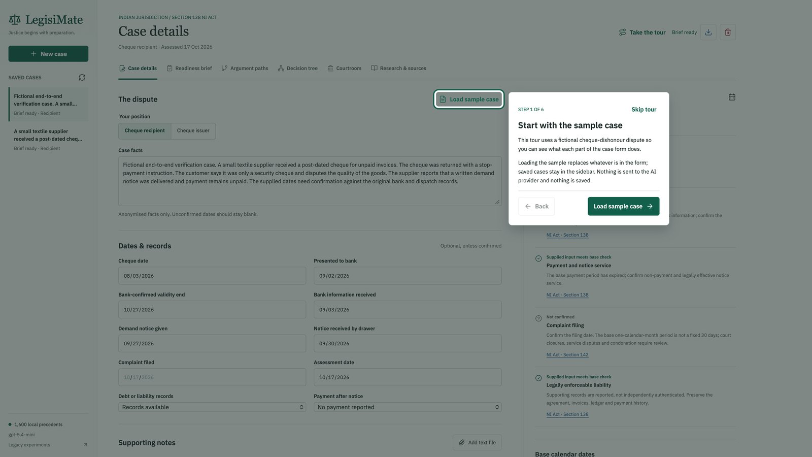
Wireframes/Mock diagrams of the proposed solution (optional)
Case details: dates, records and live calendar review
Guided tour over the real form, using a fictional sample
Six views in one workbench: Case details, Readiness brief, Argument paths, Decision tree, Courtroom, Research & sources. Implemented screens, not mock-ups.

Slide 7
Architecture diagram of the proposed solution
Google Cloud Run | legisimate (europe-west1)
User's browser
Workbench (HTML/JS), six views, consent gate
Python HTTP server
case API, polling
CaseWorkbench controller
3 paths, brief
Vertex AI
Gemini 2.5 Flash
Structured research, hearings, brief. Service-account auth, no stored key.
Calendar rules
Python, not the model
Quote verifier
passage ID to exact text
Legal corpus
SQLite FTS5, built into image
Case store
SQLite
Continuous deployment
GitHub
push to master
Cloud Build
trigger: build + deploy
Artifact Registry
container image
Cloud Run
new revision, public URL

Slide 8
Technologies to be used in the solution
Google Cloud
Vertex AI: Gemini 2.5 Flash with structured JSON output
Cloud Run: serverless container, scales to zero
Cloud Build: CI/CD trigger on GitHub master
Artifact Registry: container images
Also supports a Google AI Studio Gemini API key
Backend and AI
Python 3.12, standard-library HTTP server
Pydantic schemas for model output
SQLite FTS5 (BM25) legal retrieval
PyArrow: Parquet slice of vaquill/open-india-law
Deterministic statutory calendar engine
Frontend and delivery
HTML, CSS and vanilla JavaScript
Cytoscape.js decision tree
Lucide icons, IBM Plex Sans
2.5D courtroom replay renderer
Docker image (python:3.12-slim)

Slide 9
Estimated implementation cost (optional)
Hosting: Cloud Run
Request-based billing with 0 minimum instances, so nothing runs while idle. 1 vCPU / 512 MiB per instance. The legal index ships inside the image, so there is no database to pay for.
Build and storage
Cloud Build runs only on a push to master (about 2.5 minutes per build). One container image kept in Artifact Registry.
AI usage: Gemini 2.5 Flash
The main variable cost, billed per token at Vertex AI list prices. Each analysis has a hard ceiling: 72 model calls by default, 93 at maximum depth.
Cost controls
Consent gate before any model call; one analysis at a time; the call budget is shown before submission; showcase cases replay with zero model calls.
Per-analysis token spend has not been measured yet; it is the next cost benchmark. No fixed infrastructure cost while idle.

Slide 10
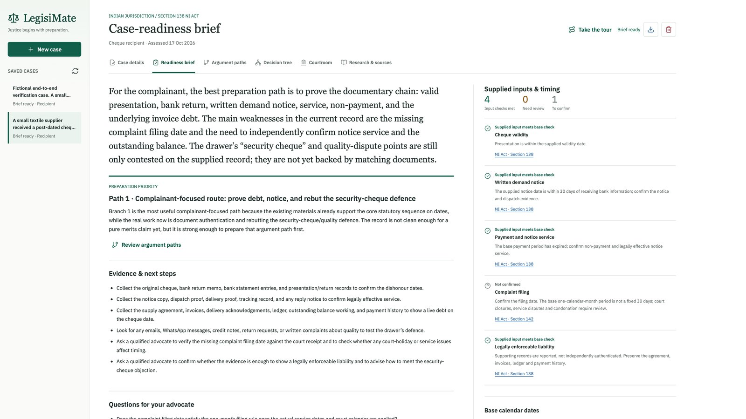
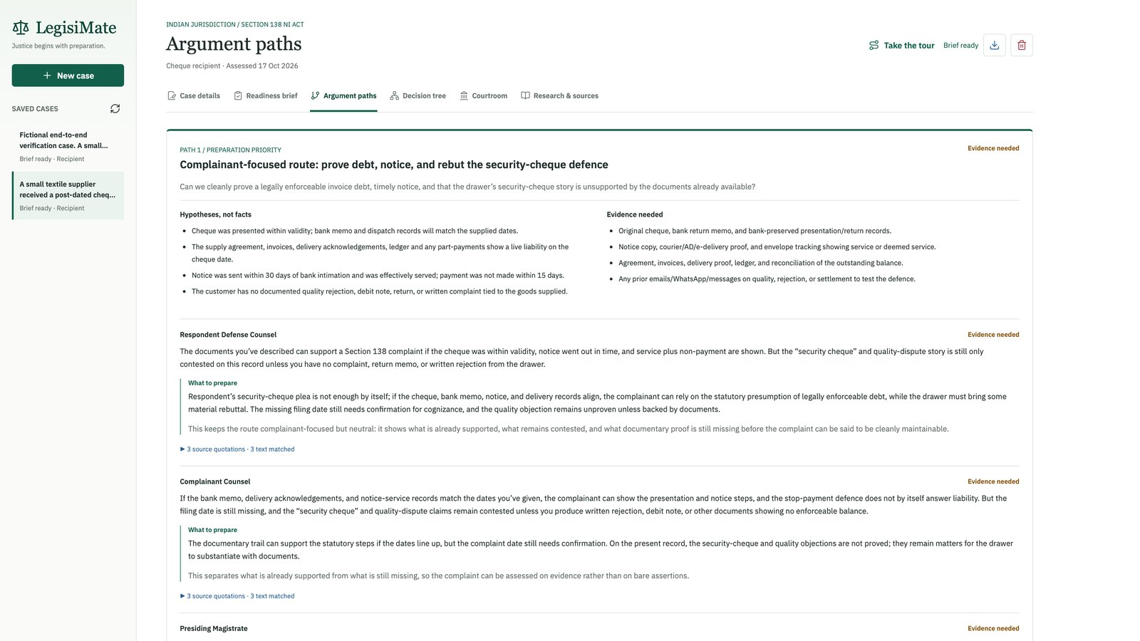
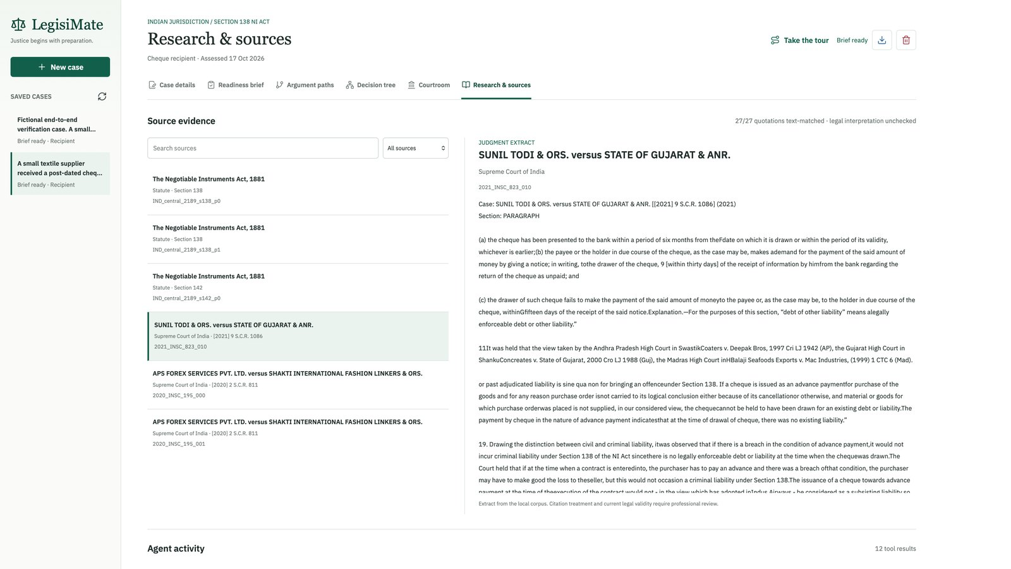
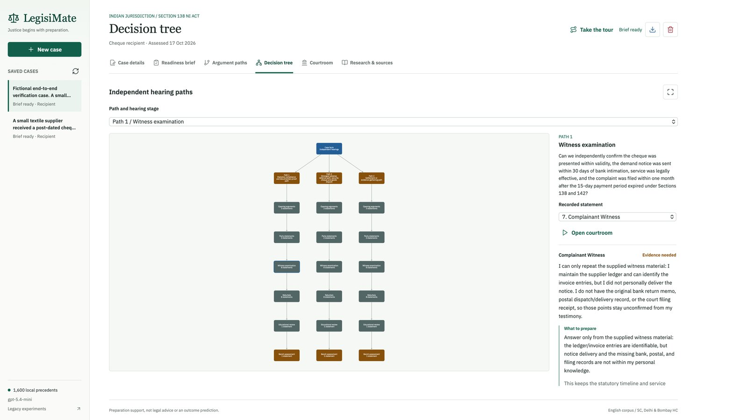
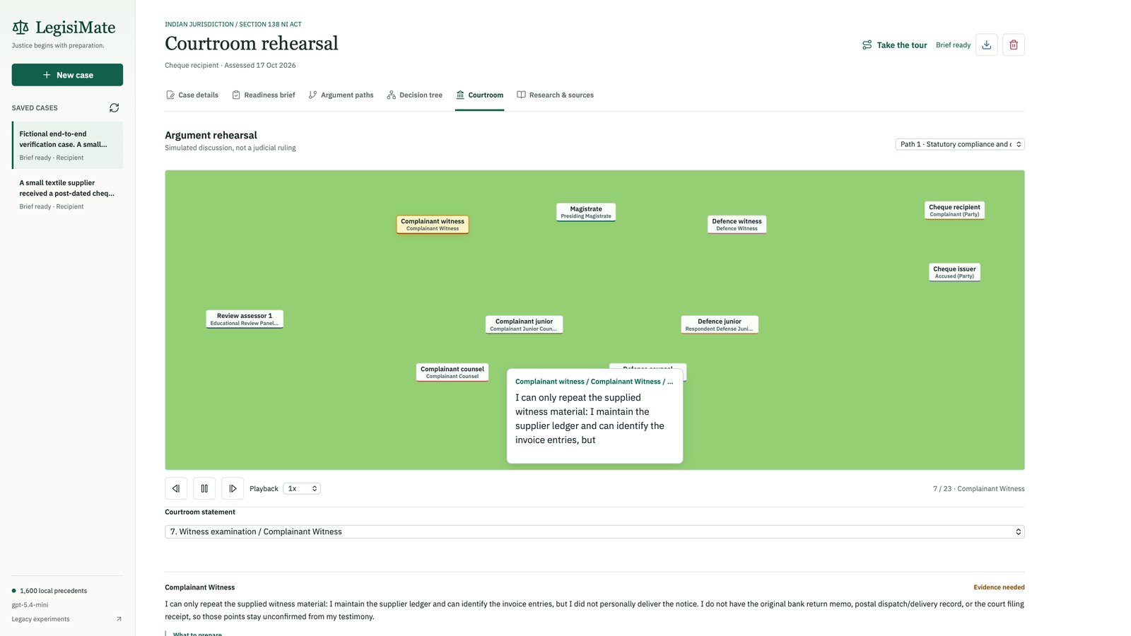
Snapshots of the prototype
Readiness brief
Argument paths
Research and sources
Decision tree
Courtroom rehearsal
Case details and calendar

Slide 11
Prototype Performance report/Benchmarking
Check | Result
Automated tests | 124 / 124 backend tests passed, plus Node graph and playback checks
Full live hearing run | 69 statements, 10 participants, 73 of 75 allowed calls, 206 / 206 quotes matched source text
Gemini 2.5 Flash showcase | 27 / 27 quotes verified across 9 statements and 3 independent paths
Corpus-grounded fallback | 66 actions end to end, 132 / 132 quotes matched source text
Legal index build | About 1.5 s from 11.8 MB of Parquet; built into the container image
Deploy pipeline | GitHub push to live Cloud Run revision in about 2.5 minutes
UI stress and layout | 12 participants / 87 statements; checked at 390 px mobile and 1440 px desktop
Integration and provenance checks. Matching a quote to its source does not prove the legal reasoning is right; legal accuracy needs qualified evaluation.

Slide 12
Additional Details/Future Development (if any)
Next
Read PDFs and photos of return memos and notices (OCR)
Qualified legal evaluation and user studies
Measure Gemini cost and latency per analysis
Evaluate hybrid (embedding + BM25) retrieval
Secure multi-user accounts and retention controls
Indian languages
Vision
Constitutions, legislation, regulations and case law for every country with a constitution
Versioned jurisdiction packs from authoritative, rights-cleared sources (Akoma Ntoso, ELI, USLM)
Country-specific rules and local evaluation before each release
Same engine: code for deadlines, Gemini for reasoning, verified sources
Never a promised win: preparation, human judgement, inspectable evidence

Slide 13
Provide links to your:
GitHub Public Repository: https://github.com/venunayira/LegisiMate
Demo Video Link (3 Minutes): https://youtu.be/-pd5MmUemtE
Final Product Link: https://legisimate-587527883402.europe-west1.run.app/

Slide 14


