Slide 1
ECOMMERCE SALES DASHBOARD

Slide 2
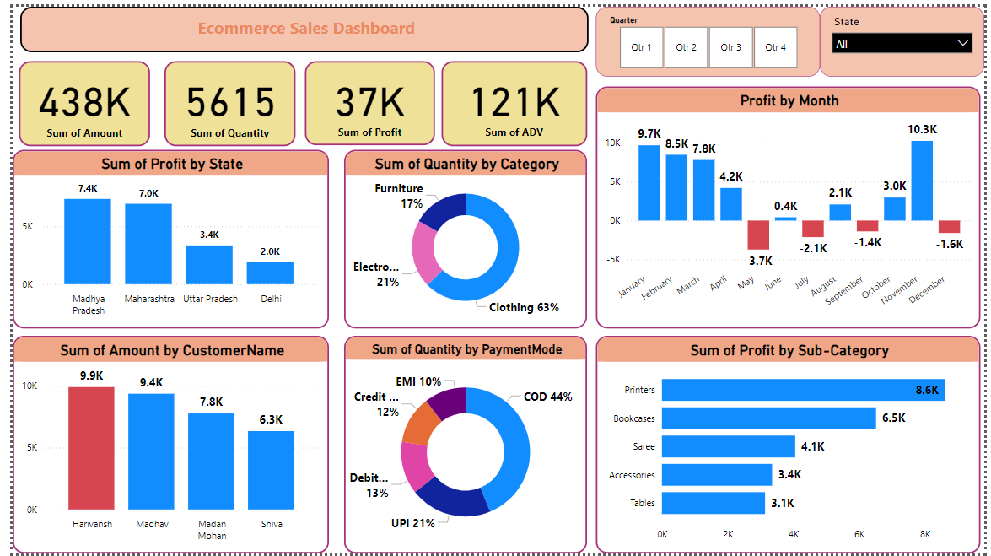

Slide 3
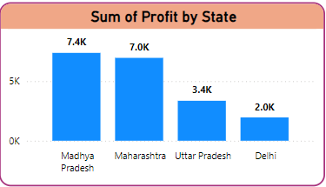
Sum of Profit by State
Madhya Pradesh is the top profit-generating state.
Maharashtra follows closely behind.
Uttar Pradesh has lower profit compared to the top two.
Delhi has the lowest profit among the four states.
Focus on top performers: Invest more in Madhya Pradesh and Maharashtra.
Investigate underperformance: Analyze reasons for Delhi's low profit.
Regional market analysis: Understand each state's market for targeted strategies.

Slide 4
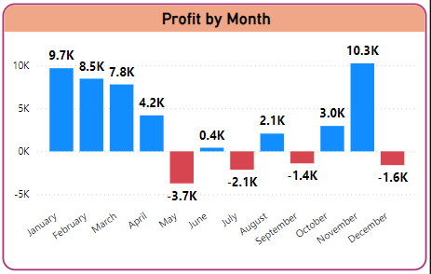
Profit by Month
Peak Profits: February and November show the highest profits.
Losses: May, June, July, August, September, and December show negative profits (losses).
Sharp Drops: There are steep declines in profit between February and March, and between October and November.
Recovery: Profits recover from losses in July and August with a slight increase in September and October before the final December drop.

Slide 5
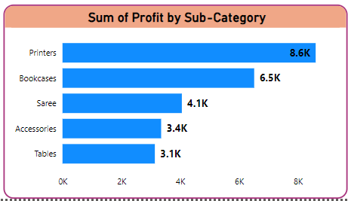
Sum of Profit by Sub-Category
Printers is the most profitable sub-category, generating a substantial sum of 8.6K.
Bookcases follow as the second most profitable, with a profit of 6.5K.
Saree holds the third position, generating a profit of 4.1K.
Accessories and Tables have lower profits, with 3.4K and 3.1K, respectively.

Slide 6
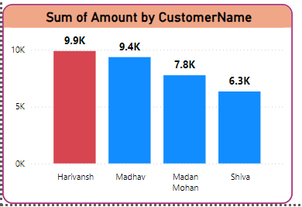
Sum of Amount by CustomerName
Harivansh is the top spender, with a total amount of 9.9K.
Madhav follows closely behind, spending 9.4K.
Madan Mohan spent 7.8K.
Shiva spent 6.3K.

Slide 7
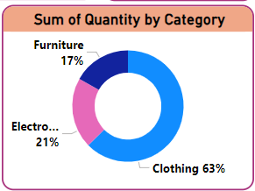
Sum of Quantity by Category
Clothing is the clear leader in terms of quantity sold, constituting 63% of the total sales.
Electronics comes in second with 21% of the total quantity sold.
Furniture has the lowest share with 17% of the total quantity sold.
Overall, the graph highlights the dominance of the clothing category in terms of quantity sold. By focusing on the strengths of the leading category and addressing the challenges in the other categories, the business can optimize its product strategy and enhance overall sales

Slide 8
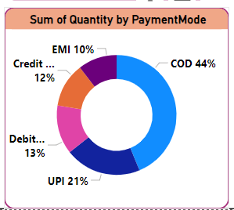
Sum of Quantity by PaymentMode
Cash on Delivery (COD) is the most preferred payment mode, accounting for 44% of the total transactions.
UPI is the second most popular payment mode, with 21% of the transactions.
Debit Card stands at 13% of the total transactions.
Credit Card follows with 12% of the transactions.
EMI has the lowest share with 10% of the transactions.

