Slide 1
COFFEE SALES DASHBOARD

Slide 2
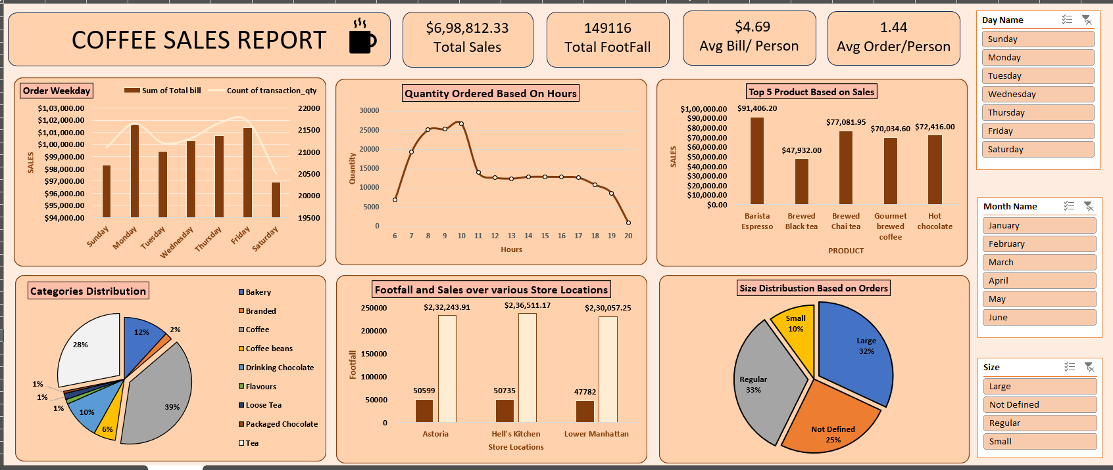

Slide 3
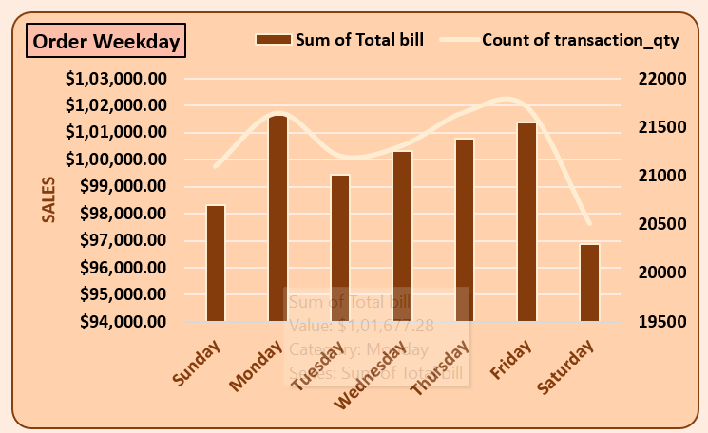
ORDER :WEEKDAYS
Strategic Focus on Weekends:
Understanding why sales are lower on weekends could be crucial. Identifying factors like product offerings, promotions, or customer preferences could help increase weekend sales.
Thursday Optimization:
Analyzing why Thursday is the peak day could provide valuable insights into customer behavior and preferences. Leveraging these insights could potentially boost sales on other days.
Friday Potential:
Building on the momentum of Friday could lead to further sales growth. Exploring strategies to enhance sales on Fridays could be beneficial.

Slide 4
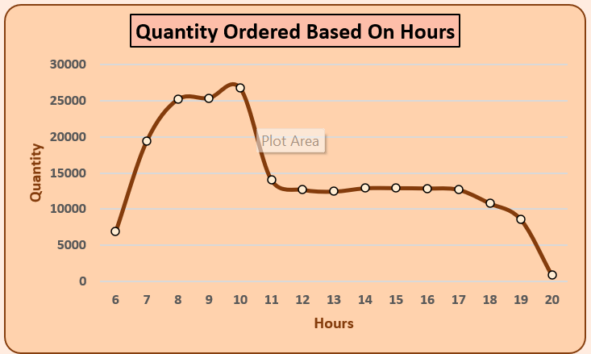
Quantity Ordered Based on Hours
Peak Ordering Period: The graph clearly indicates a significant peak in order quantity between 8 AM and 10 AM. This suggests that a substantial portion of orders is placed during the early morning hours.
Steady Decline: Following the morning peak, there's a consistent decline in order quantity throughout the day. By the evening hours (around 7 PM to 9 PM), the order volume is significantly lower.
Consistent Pattern: The overall shape of the graph suggests a relatively consistent ordering pattern, with a sharp increase in the morning, followed by a gradual decrease.

Slide 5
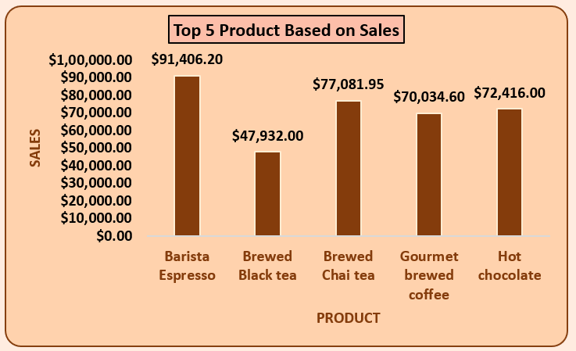
SALES OF THE TOP 5 PRODUCTS
Barista Espresso is a key driver of sales: This product's popularity should be further explored to understand its success factors. It might be the star product that attracts customers.
Product range: The variety of products offered seems to cater to different customer preferences, which is positive. However, the sales performance of the other products compared to Barista Espresso might indicate areas for improvement.
Customer preferences: Understanding why customers prefer specific products can help tailor offerings and marketing strategies accordingly.

Slide 6
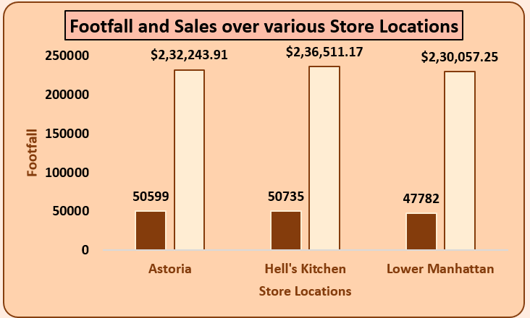
COMPARISON OF FOOTFALL AND SALES ACROSS THREE STORE LOCATIONS
Conversion Rates: The disparity between footfall and sales suggests a significant difference in conversion rates across stores. Hell's Kitchen has a higher conversion rate, while Lower Manhattan has a lower one.
Store Performance: Hell's Kitchen is clearly the top-performing store in terms of sales, despite having a slightly lower footfall than Lower Manhattan. This indicates potential factors like product mix, pricing, customer service, or store ambiance driving higher sales.
Lower Manhattan Underperformance: Lower Manhattan's lower sales despite high footfall warrants further investigation. Analyzing factors like competition, customer demographics, store layout, or product availability could provide insights into the underperformance.

Slide 7
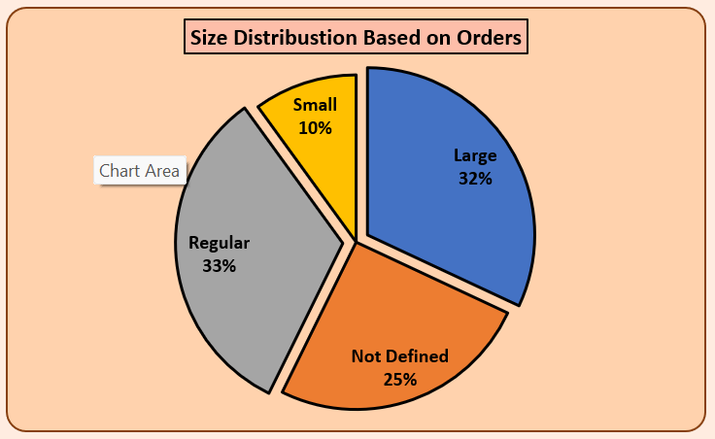
SIZE DISTRIBUTION OF ORDERS
Regular is the most common size: This category accounts for 33% of orders, making it the largest segment.
Large orders follow closely: The "Large" category represents 32% of orders, indicating a significant portion of customers opting for this size.
Small orders are less frequent: The "Small" category comprises only 10% of orders, suggesting a lower preference for this size.
Undefined size is substantial: The "Not Defined" category accounts for 25% of orders, implying a considerable portion of orders without specified size information.

Slide 8
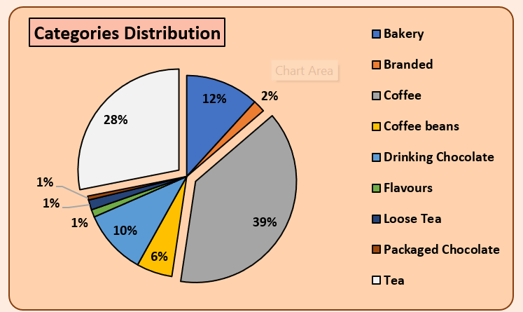
DISTRIBUTION OF PRODUCT CATEGORIES
Dominance of Coffee: Coffee and its related products (coffee beans) constitute the largest portion of the business, accounting for 39% + 6% = 45% of the total.
Tea and Chocolate Significance: Tea and chocolate-related products together make up a substantial portion (39% + 11% = 50%) of the business.
Niche Categories: Bakery, Branded, Drinking Chocolate, Flavors have smaller but significant contributions to the overall business.

