Slide 1
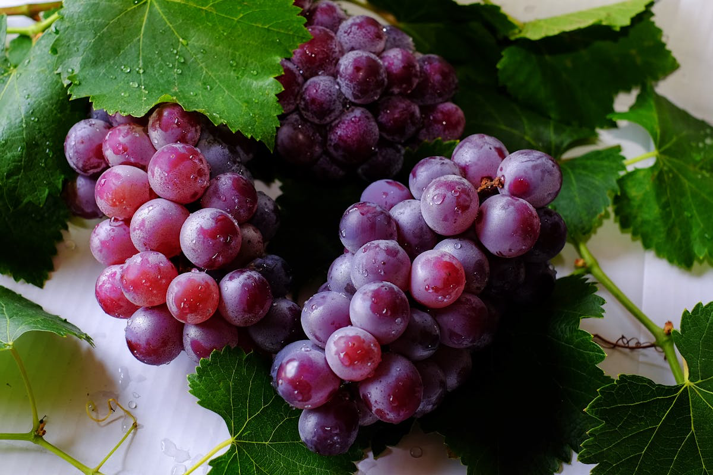
Bacchus Winery Case Study
Presented by DataDay Solutions

Slide 2
Case Study Background
Bacchus Winery thrives with tradition, and tradition is always essential to keep in mind when furthering a business; however, as time continues to change, Stan and Davis Bacchus collectively decided to keep the winery as close to how their father originally envisioned it since recently inheriting it due to his retirement. The goal is to incorporate new elements as well as to stay current. It is essential to keep all their original employees, whom they consider family, and find ways to keep supply deliveries efficient, wine unique, and accurately account for their employees' working hours. DataDay Solutions will keep all of this in mind as we continue to work with them to develop case studies to answer the questions most essential to Bacchus Winery's values.

Slide 3
Team Introductions
Bryan Cabrera
Bryan has 20 years of experience as a production scheduler for the Ritz Carlton; he's looking forward to accurately assessing employee work hours.
Candice Garcia
As a recent grad, Candice is aware that new graduates can initially be underrated; however, combining recent education with passion is what she finds essential to working closely with the marketing team!
Matthew Trinh
Are you looking for a data analytics specialist? Matthew is your guy; specializing in inventory keeps him motivated!

Slide 4
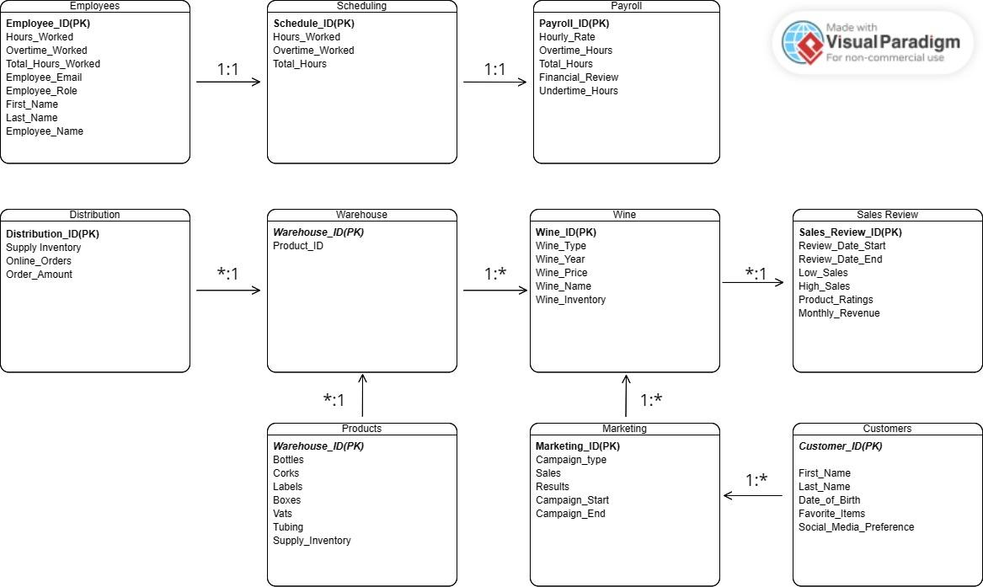
ERD

Slide 5
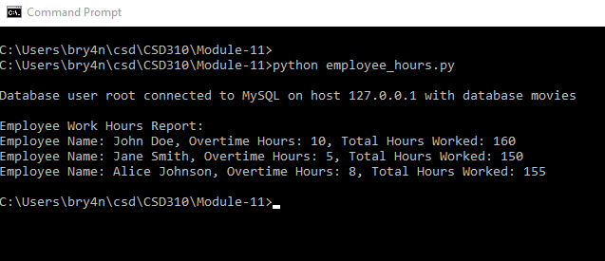
Report 1: Employee Work Hours Report
Brief summary: The Employee Work Hours Report pulls employee names along with their overtime hours worked and total hours worked for payroll/management purposes that will be utilized by Janet Collins (payroll) and Henry Doyle (manages 20 employees).
Results:

Slide 6
Report 2 Sales
After interviewing Rozz Murphy and Bob Ulrich, marketing employees for Bacchus Winery, they had a couple of essential questions they wanted answered, which we focused on in this report; this will help visualize and organize information for their Winery.
Rozz Murphy: Is our wine selling as we thought?
Bob Ulrich: Is one wine not selling?
To assist Bacchus Winery in looking into more feedback, we kept a couple of essential points in mind based on recent feedback, such as STAN Chardonnay is still their top seller.
However, on the opposite spectrum, SONNY Chablis is vastly underrated. We can start by assisting this issue by incorporating the results of their marketing campaign. We can see in the report that the special event offered heavily influenced Chablis's sales.

Slide 7
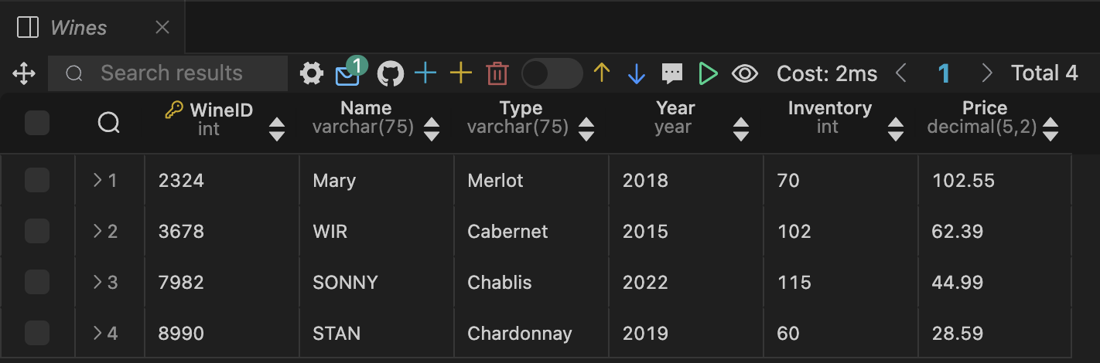
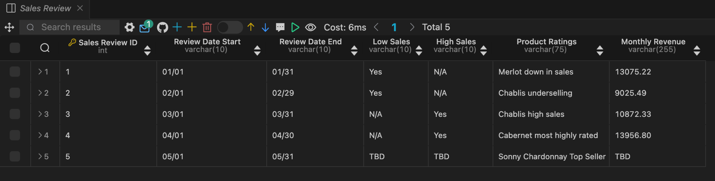
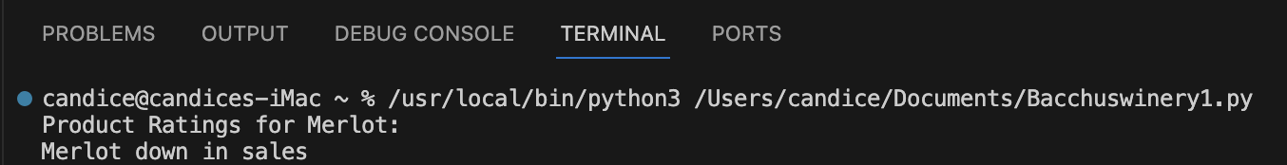
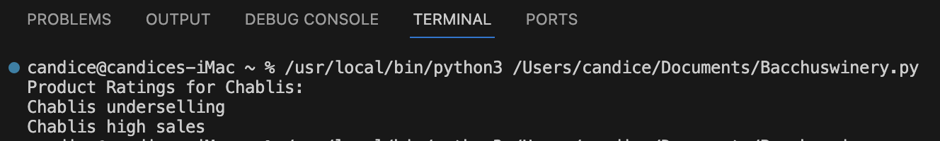
Report 2 continued
According to the results retrieved from this report, Merlot is down in sales; connecting Merlot in the Wines table to the marketing campaign table can be a crucial focus for an upcoming event.
The results from the report show that Chalbis was initially underselling; however, data combined with the most updated report show sales increased after both Roz and Bob agreed to add marketing campaign information to their database.

Slide 8
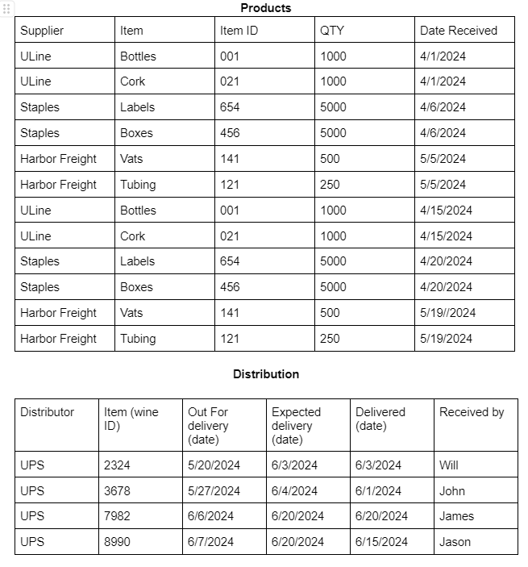
Report 3: Warehouse
An important item that is needed to properly run a business is a proper inventory. After speaking with Henry Doyle and going through the inventory with him we have come to these conclusions
Uline, Staples, and Harbor Freight are the main distributors in our supplies. The warehouse receives supplies from these vendors within a timeframe of every 2 weeks
Also since there is already establishment with UPS as the primary contractor of delivering the product, the company will go ahead and continue utilizing their service for they have consistently met the expected delivery timeframe and on occasion be ahead of schedule.
As long as the upkeep of inventory is properly notated there will be no discrepancies between the amount of supplies that are kept and being utilized. This will help in determining if we need to order more supplies to supplement the demand or if we have enough supplies that can be utilized.

Slide 9
Assumptions
Employees accurately and honestly report their time worked.
For payroll purposes we assume employees earn an hourly rate not salary based.
We assume there’s no cap on overtime hours that employees can work.
Bacchus Wine has provided their most up to date information on sales, distribution, and employees.
There are no discrepancies with the data Bacchus Wine has provided.
As long as there is proper documentation when items are used or damaged, we can keep maintain our costs and keep them low
Bacchus Winery is a small business that sells only a limited number of wine types annually.
Marketing events are currently only scheduled for 2025, and all results are compared to the previous year's sales to compare for any changes.
The number of bottled wines represents A bi-weekly inventory.
Bacchus Winery sells snacks that equate to high sales but are outside this Case Study because they currently need no improvement.
The case study focuses on a limited amount of inventory.

