Slide 1

Technology Value Stream

Slide 2

Lead Time
Way to measure performance in a value stream
Time starts when request is made
Time ends when request is filled

Slide 3

Processing Time
Way to measure how long it takes to do a task
Time starts when work begins
Time ends when work is done

Slide 4
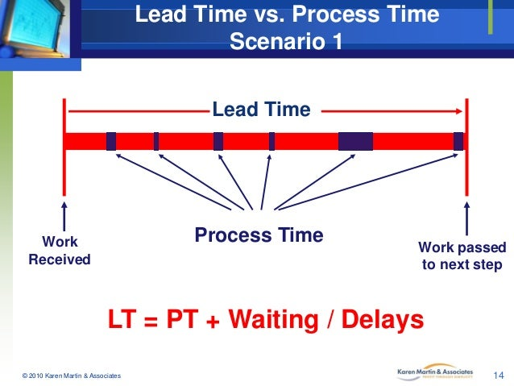
Lead Time vs Processing Time

Slide 5
Common Scenario
Deployment times take a long time to understand
Common to take long time if production is large or organization is large
Value Stream is more complex
Fixing problems takes time since the code is more complex

Slide 6
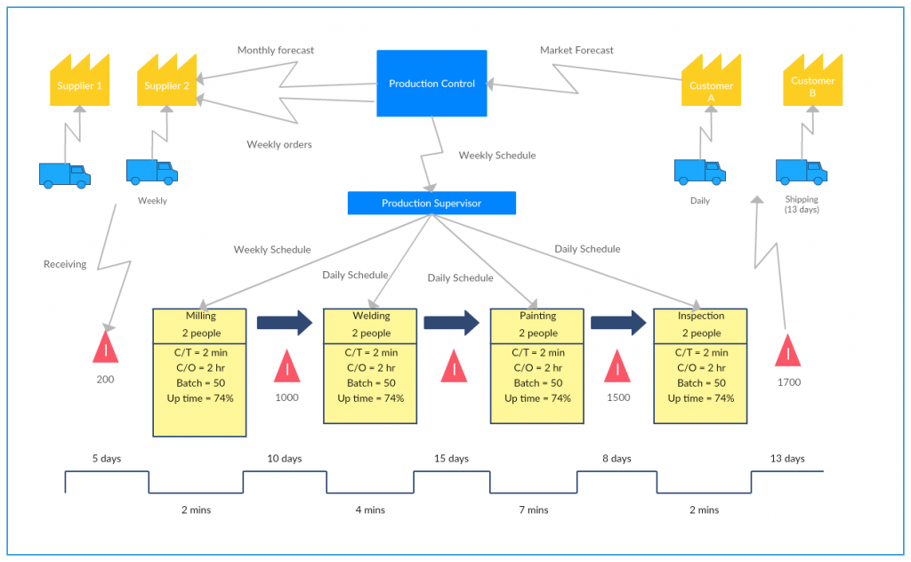
Complex Value Stream Mapping

Slide 7

DevOps Ideal
Feedback regularly
Changes of code are smaller and more often checked
Multiple small teams that can work together on one section of code

Slide 8
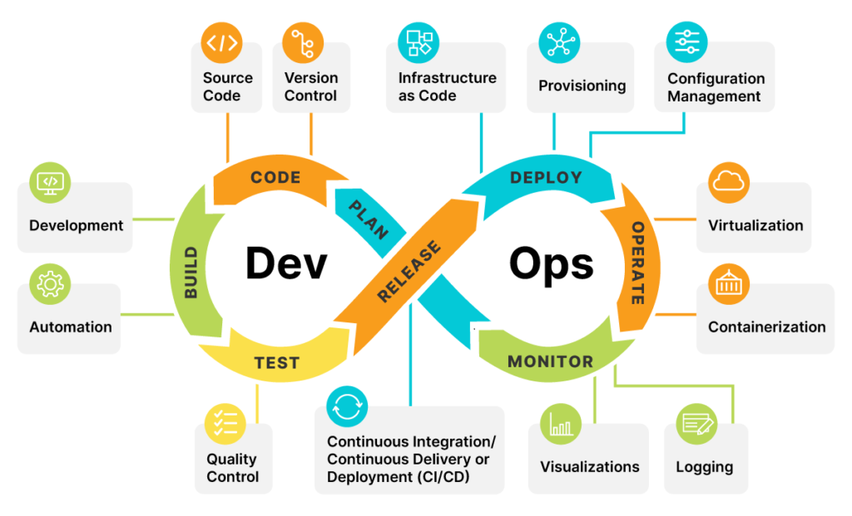
DevOps Best Practices

Slide 9
References
The DevOps Handbook
The DevOps Handbook
Lead Time vs Processing Time
value-stream-mapping-in-office-service-setttings-14-638.jpg(638×479)
Complex Value Stream Mapping
New-Supply-Chain-management-VSM-Template-1024x632.png (1024×632)

