Slide 1

GUARDIAN SECURE Project Synopsis Presentation Date: 26/02/2024
Course Name (Course Code)
Degree : Bsc. IT CTIS
Project Guide:
(Leave blank)
Vicky Bhattacharya (211001112020)
Rupam Chakraborty (211001112022)
Priyanshu Roy (211001112006)
Junaid Ali (211001112030)
Debarati Poddar(211001112029)
TECHNO INDIA UNIVERSITY

Slide 2

Project Brief
Introduction:-
Our main motto is “Do Your Part. Cyber Secured Check!”
"Guardian Secure" is a comprehensive web application dedicated to strengthening digital security and empowering users to protect their online presence. Central to its functionality is a suite of essential tools designed to enhance password strength, encrypt sensitive data, identify vulnerabilities, and offer personalized security assistance.
Objective:-
Deliver tailored assistance on a wide range of security concerns.
Provide expert guidance on secure browsing, data encryption, and cybersecurity best practices.
Its capabilities encompass evaluating password robustness, transforming plain text into encrypted forms such as MD5 and SHA256, and incorporating a vulnerability matcher tool.
2

Slide 3
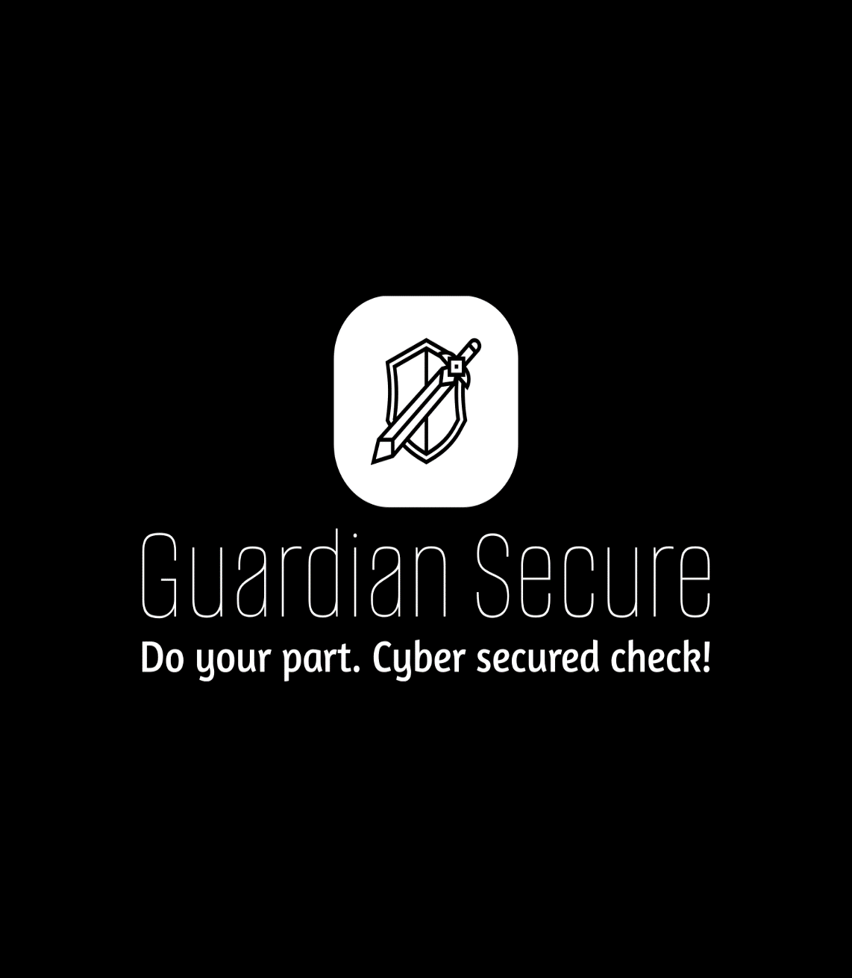
Project Outcomes
Outcomes:-
Increased password security through rigorous testing mechanisms, leading to stronger protection against unauthorized access.
Enhanced data protection and confidentiality achieved through the encryption of sensitive information using industry-standard algorithms.
Improved system security by enabling users to identify and address potential vulnerabilities, resulting in a proactive approach to mitigating security risks.
Enhanced user experience with personalized assistance and guidance on security-related concerns provided by the AI-powered chatbot, fostering greater user confidence in navigating cybersecurity challenges.
2

Slide 4
Technologies
1. Python Flask
Framework for developing the web application backend.
Provides tools and libraries for handling HTTP requests and responses.
2. SQLAlchemy
Python SQL toolkit and Object-Relational Mapping (ORM) library.
Enables interaction with the database using high-level Python objects.
3. HTML, CSS, JavaScript
Frontend technologies for designing and developing the user interface.
HTML for structuring web pages, CSS for styling, and JavaScript for interactivity.
4. Programming Languages
Python.
4

Slide 5
Methodologies
1. Password Strength Testing
Utilizing Python scripting to implement algorithms for testing password strength.
Employing common password cracking techniques to assess the robustness of passwords.
2. Text Encryption
Leveraging Burp Suite API for converting plain text to cipher text using algorithms like MD5, SHA256, etc.
Implementing secure encryption protocols to ensure data confidentiality.
3. Vulnerability Matching Tool (Pending)
Utilizing Burp Suite or similar tools to develop a vulnerability matching tool.
Implementing algorithms to identify and match potential vulnerabilities in web applications.
4. AI Chatbot Assistance (Planned with Chatterbot)
Integrating the Chatterbot Python library to develop an AI chatbot.
Implementing natural language processing techniques to provide personalized assistance on security-related concerns.
5

Slide 6
Methodologies
1.Landing Page and User Authentication
Completed development of landing page with login, signup, and password reset functionalities.
Implemented Flask Login for secure user authentication.
2.Secure User Information Storage
Utilized MySQL database to store user information such as email, password, security question, and security answer.
Implemented backend logic for user profile management and password reset functionality.
3.Enhanced User Experience
Implemented security question and answer verification for password reset.
In progress: Integration of email OTP for password reset, enhancing security and user experience.
6

Slide 7
Conclusion and Future Plans
1. Summary
Guardian Secure aims to provide comprehensive cybersecurity solutions through its web application.
With a focus on user security and convenience, we strive to deliver a secure and user-friendly experience.
We are committed to continual improvement and innovation to meet the evolving needs of our users.
2. Future Development Plans
Complete integration of email OTP for password reset functionality.
Conduct thorough testing and debugging for seamless user experience.
Continuously monitor and update cybersecurity measures to ensure ongoing protection.
7

Slide 8
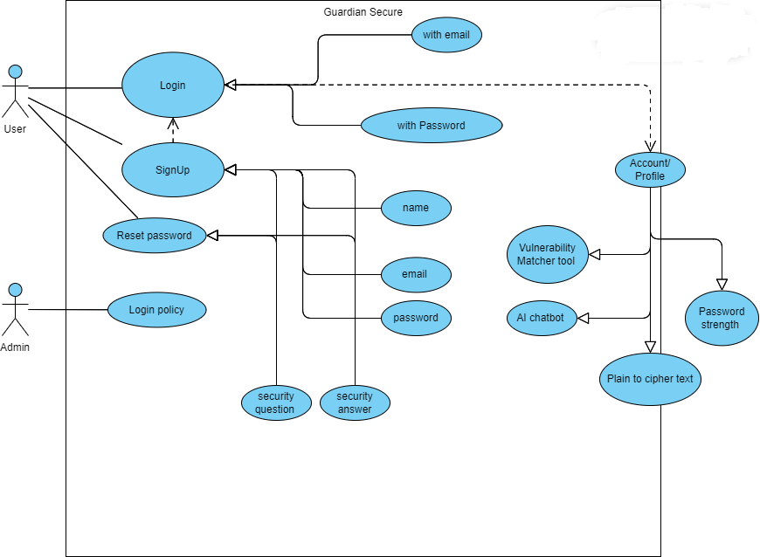
Use Case Diagram
7

Slide 9
THANK YOU

