Slide 1

Guardian Secure: Elevate Your Online Security with User- Friendly Solutions

Slide 2

Introduction
Guardian Secure is a robust web application focused on enhancing user security and privacy through a suite of cybersecurity tools and features. Built with Flask, it provides secure user authentication, account management, and a range of security tools to safeguard user data.

Slide 3

Feature
Landing page with Login, Signup, and Password reset functionalities.
Cybersecurity Services includes Password checker, Vulnerability matcher, etc.
Flask-Login for User authentication& accessing services.
MySQL database for storing user information
Password Reset using security questions.
AI Chatbot

Slide 4
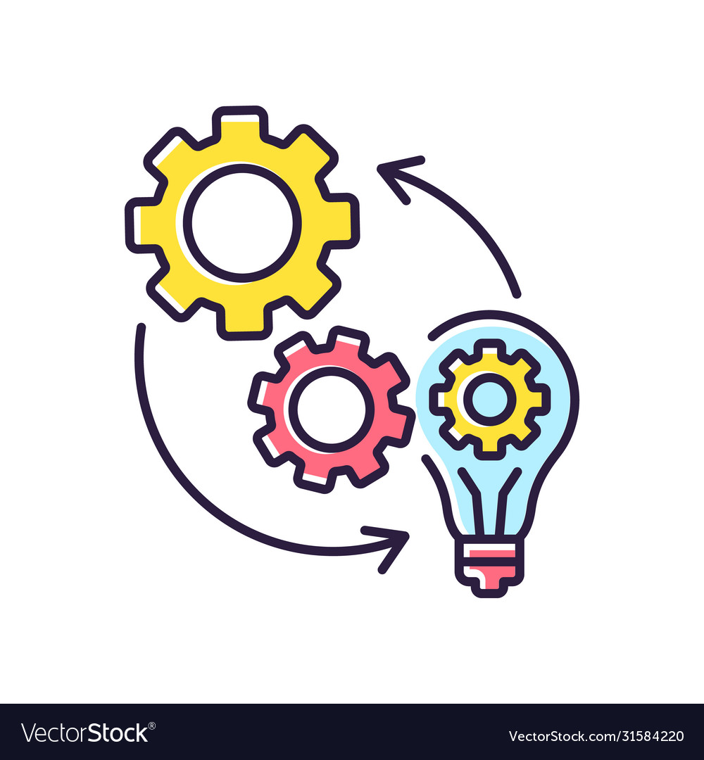
Implementation
Flask App Structure: Organized folder structure with routes for authentication and tools. Base template and inheritance for consistent UI across pages.
Flask-Login Integration: Implemented @login_required decorator for secure access. Ensured authentication with user session management.
Database Schema: Designed user table schema (email, password, security question, etc.).Utilized SQL Alchemy for ORM with Flask app.

Slide 5
Implementation cotd…
Password Reset Mechanism: Implemented OTP-based password reset mechanism.
Included security question Verification: for additional security.
Enhancing user experience with seamless password recovery.
Vulnerability Matcher Tool: Utilizing Python zapv2 module and OWASP Zap Proxy for vulnerability assessment.
Spidering process for web app scanning.
Options for Active and Passive scanning.
Additional Tools: Password strength checker to ensure robust passwords.
Cipher text conversion using SHA256 and MD5 for data security.

Slide 6

Progress
Successfully developed landing page with authentication feature. Implemented Flask-Login for secure access to services.
Database setup implemented for storing user data securely.
Partial implementation of password reset mechanism.
Password checker tool enacted.
Vulnerability matcher tool is successfully implemented to find vulnerabilities.

Slide 7

Future Plans
Flask-Mail integration utilizing Flask-Mail for sending OTP emails to users for password reset.
Integration and development of AI chatbot for cyber security queries.
Integration of Vulnerability Matcher Tool: for finding vulnerabilities and generating reports.
Deploying the web app on a cloud service provider, such as Heroku or Render.com, to ensure scalability, reliability, and accessibility.

Slide 8
Thanks!

