Slide 1
Amazon Beauty Products Recommendation Engine
Varsha Tripathi
Capstone Project
Springboard Data Science
Jan, 2020

Slide 2
Recommender Systems
Very commonly used, especially in the digital domain and e-commerce world.
According to McKinsey, 35% of Amazon.com's revenue is generated by it's recommendation engine.
Provide relevant suggestions to online users to make better decisions about their purchases.
Amazon, Netflix, YouTube and Yelp use intelligent recommender systems to help customers take their brand experiences into their hands and make informed decisions about which products to buy or which movies to watch or which restaurants to eat at.
Strong and smart recommender systems can have positive effects on user experience.
Result into higher customer satisfaction and retention, and in turn boost revenues.

Slide 3
The Approach
Data collection
json raw data files -> pandas dataframe -> csv files
Data wrangling
Clean the data
Fix the missing values and duplicates
Feature Engineering
Extract related count
Sentiment analysis of review texts
EDA
Plot and explore the data
Check for imbalances and outliers
Recommendation systems
1. Popularity-based
2. Content-based
3. Collaborative filtering
4. Hybrid methods
Evaluation of Model Accuracy and Performance

Slide 4
Process Flowchart
Data Collection
Data Wrangling
Feature Engineering
Recommender Engines
Evaluation
EDA

Slide 5
The Client
The recommendation system will be useful for Amazon.com as well as it’s customers.
Amazon.com:
can use this to make personalized recommendations to it’s customers
using the product attributes and reviews from other customers
Amazon.com customers:
will receive personalized recommendations
based on their ratings for products they have already used and
based on their similarity with other customers
smart recommendations will enrich their shopping experience
The models can be used by any businesses such as Yelp, LinkedIn, Netflix, YouTube, Pandora to create a delightful user experience while driving incremental revenue.

Slide 6
The Dataset
Publicly provided by Julian McAuley of UCSD
Link: http://jmcauley.ucsd.edu/data/amazon/links.html
Reviews timeline: May 1996 – Jul 2014
Raw Data
2 json files:
reviews.json and meta.json
2,023,070 reviews
259,204 products
File size
Reviews file 1111 MB
Meta file 320 MB

Slide 7
Data Wrangling
Loaded the 2 raw json compressed files into pandas dataframes
Loaded the data from pandas dataframes to csv files
Data Cleaning
No duplicates were found in meta file
Dropped imUrl from meta file
Dropped reviewerName from reviews file

Slide 8
Feature Engineering
Meta file:
More than 50% products missing brand information. Merged “brand” and “title” into “brand_title”
Extracted “beauty” and “health_personal_care” columns from “salesRank” column (nested dictionary)
Extracted “related_count” from “related” column (nested dictionary)
Reviews file:
More than 50% products missing brand information. Merged “brand” and “title” into “brand_title”
Extracted “beauty” and “health_personal_care” columns from “salesRank” column (nested dictionary)
Combined “reviewText” and “summary” into “review” column
Extracted “related_count” from “related” column (nested dictionary)
Extracted “upvotes” and “downvotes” from “helpful” column (list)
Performed sentiment analysis on “review” column and created new feature called “polarity”
Extracted “main_cat” and “sub_cat” columns from “categories” (list)

Slide 9
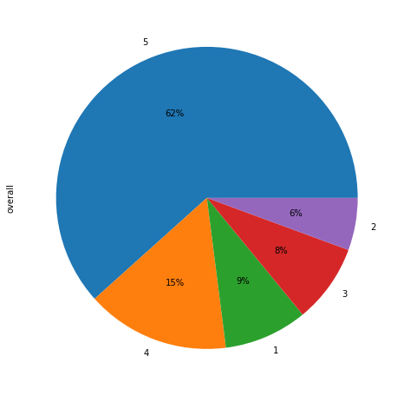
EDA - % of different overall values

Slide 10
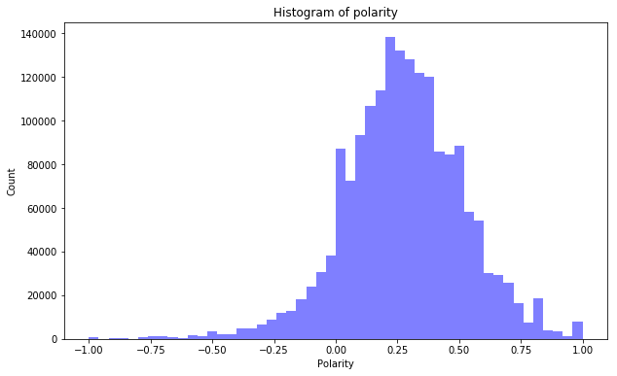
EDA – Histogram of polarity

Slide 11
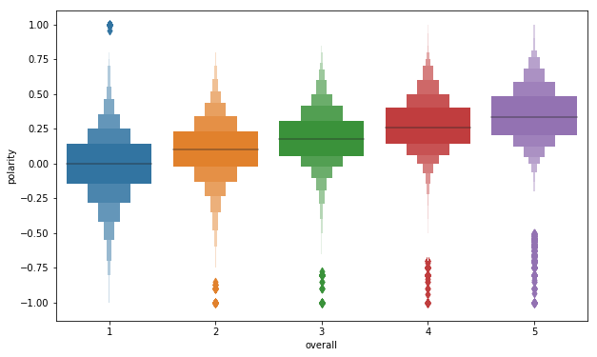
EDA – Polarity by overall score

Slide 12
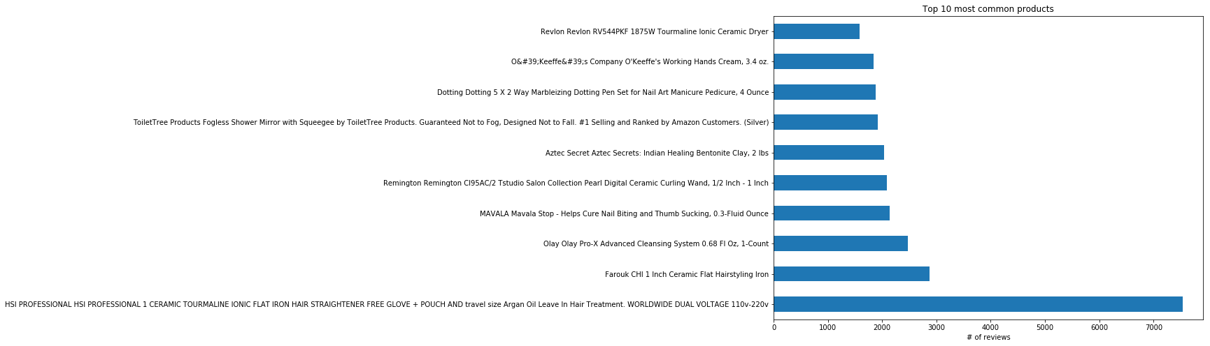
EDA – Top 10 reviewed products

Slide 13
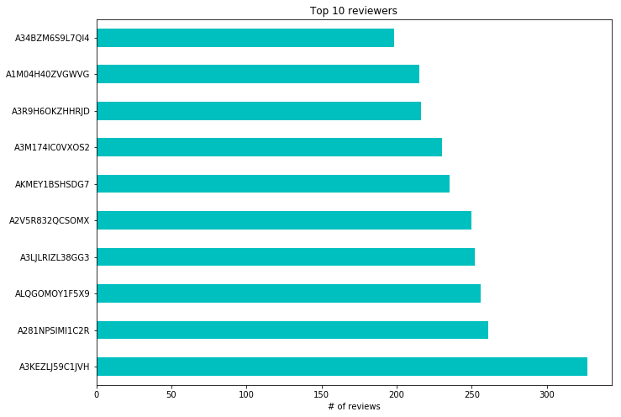
EDA – Top 10 reviewers

Slide 14
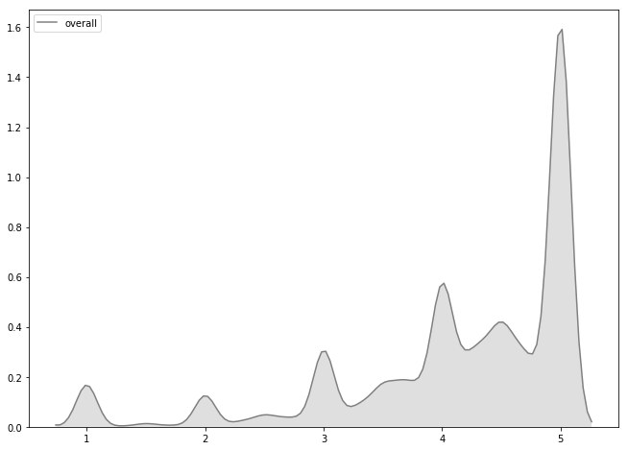
EDA – Mean rating KDE distribution

Slide 15
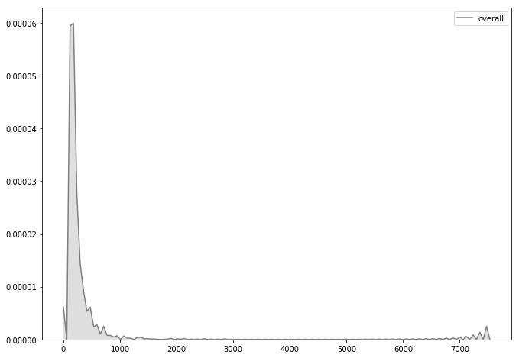
EDA – No. of ratings per product KDE distribution

Slide 16
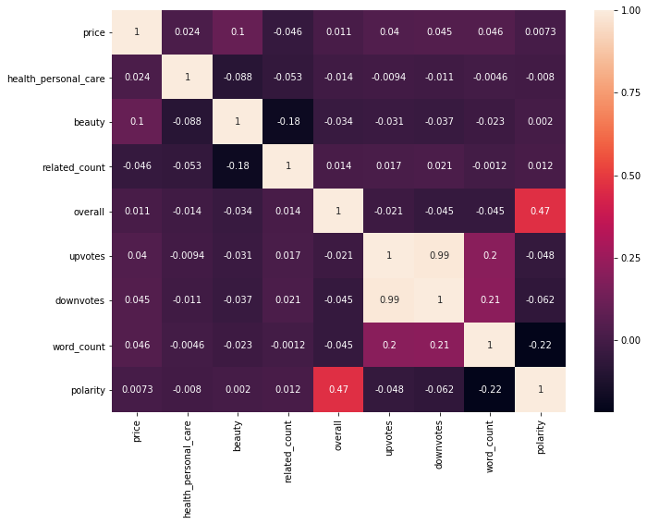
EDA – Correlation Matrix

Slide 17
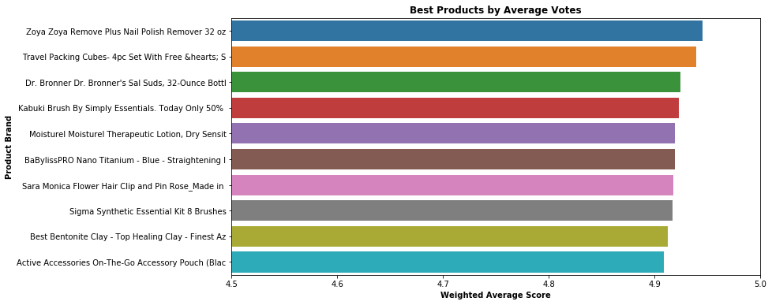
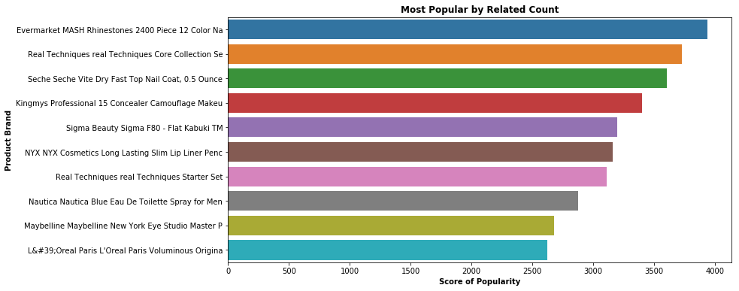
Recommender: Popularity-based
Non personalized and recommends the same top-N products to everyone
Simplest type of recommender, but not very useful or effective
Popularity can be determined by:
Most rated item (based on rating count)
Average overall rating
Sales rank based on category
Weighted average for each item’s
average rating
Combination of best rated and most
popular items

Slide 18
Recommender: Content-based
Compute item vectors using attributes from the meta dataset
Vectors created using TfIdf and CountVectorizer
Recommends an item based on its features and how similar they are to features of other items in the data set
Similarity of item attributes can be determined using cosine similarity or Euclidean distance or nearest-neighbor algorithms
Independent of interaction history of other users and captures specific interests of a user
Tends to over-specialize and will recommend only items similar to those that the user has previously used and rated.
Evaluation metrics:
RMSE
R-squared

Slide 19
Recommender: Collaborative
Ignores user and item attributes and instead focuses on User-Item interactions
Determines similarities between 2 users or 2 items, using the historical ratings given to items by various users and makes recommendations on the basis of that
Sparse utility matrix is built using customer rating for items
Types:
Memory-based
User-user collaborative filtering
Item-item collaborative filtering
Model-based: Perform matrix factorization to compress the sparse matrix to improve accuracy and performance
Cold start problem: New items cannot be rated until they have been rated by someone

Slide 20
Recommender: Hybrid
Combine the strengths of 2 or more filtering methods
Incorporate content-based techniques into a collaborative approach
Incorporate collaborative techniques into a content-based approach
Improves recommender performance and overcomes cold-start problems
7 ways to apply hybrid technique:
Weighted
Feature combination
Switching method
Mixed
Feature Augmentation
Cascade
Meta-level

Slide 21
Potential Improvements
Use more features from the 2 datasets to build the personalized recommender
Apply NLP techniques on item description and review text for a richer and more accurate recommender
Improve computation using cloud distributed systems and Spark
Use the entire data set (without dropping any rows)
Build a user interface screen to input an item or a user, that will output a blend of top-N non-personalized and personalized recommendations on the same screen
Improve the rating metric by adjusting overall score using review time and age relevance of the rating
Improvise using Deep Learning methods

Slide 22
Acknowledgement
Max Sop (mentorship)
Julian McAuley of UCSD (free dataset)
Springboard team (curriculum and administrative support)
Recommender Systems specialization course from Coursera
Building a Recommendation System with Python Machine Learning & AI
Machine Learning and AI Foundations: Recommendations

Slide 23
Reference
Project Final Report: https://github.com/venustrip/Amazon-Recommendation-Engine/blob/master/final_report.ipynb
Data Wrangling: https://github.com/venustrip/Amazon-Recommendation-Engine/blob/master/clean_meta.ipynb
EDA: https://github.com/venustrip/Amazon-Recommendation-Engine/blob/master/milestone_report.ipynb
Popularity-based recommender: https://github.com/venustrip/Amazon-Recommendation-Engine/blob/master/recommender_popular.ipynb
Personalized content-based recommender: https://github.com/venustrip/Amazon-Recommendation-Engine/blob/master/recommender_content.ipynb
Personalized collaborative recommender: https://github.com/venustrip/Amazon-Recommendation-Engine/blob/master/recommender_collab.ipynb
Hybrid recommender: https://github.com/venustrip/Amazon-Recommendation-Engine/blob/master/recommender_hybrid.ipynb

