Slide 1
SecureVision – Multimodal DeepFake Detection
Audio + Image Deepfake Detection | Architecture & Flow

Slide 2
Overview
SecureVision is a multimodal deepfake detection system for audio and imagesUses SpecRNet-Lite for audio deepfake detectionUses SigLIP (Hugging Face) for image deepfake detectionCombines both modalities using late score-level fusionSupports CLI, Web UI, and batch evaluationDesigned to be lightweight, configurable, and deployment-ready

Slide 3
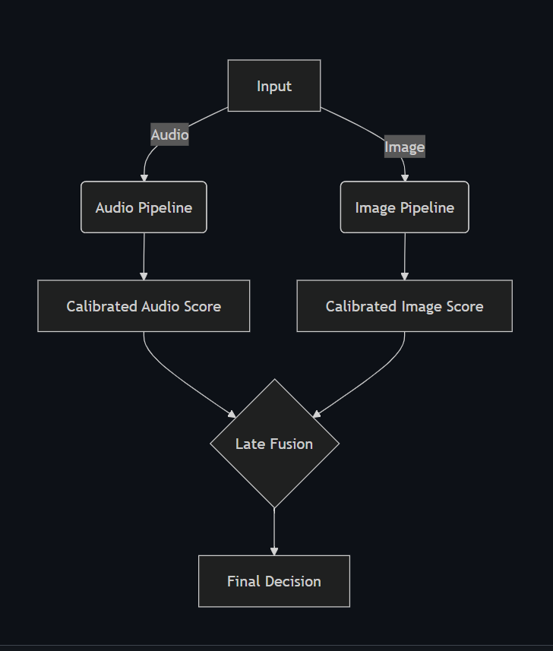
Architecture Diagram

Slide 4
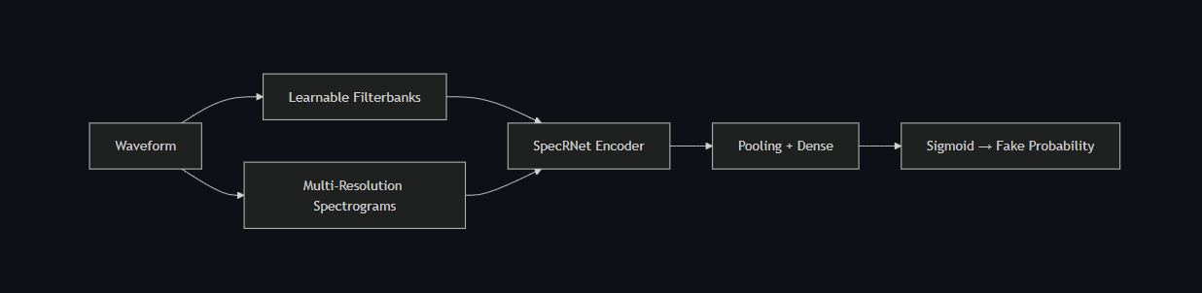
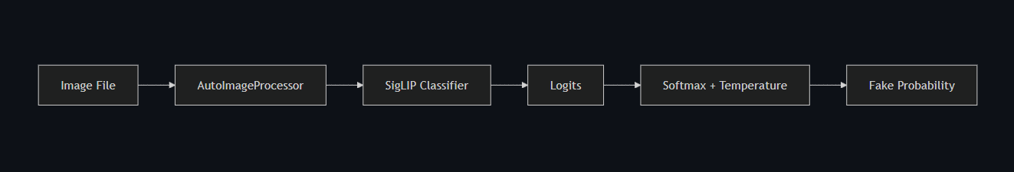
Audio & Image Inference Flow

Slide 5
Audio Model – SpecRNet-Lite
• Lightweight audio deepfake detection model (SpecRNet-Lite)
• Architecture: 3× Conv + BatchNorm + SiLU blocks
• Temporal downsampling to capture long-range artifacts
• Adaptive Average Pooling followed by bi-directional GRU
• MLP classification head with sigmoid fake probability output
• Supports multi-resolution spectrogram branches (FFT: 256 / 512 / 1024)
Speaker Notes:
• CNN channels: [16, 32, 64]
• GRU hidden size: 128
• Dropout: 0.2
• Optimized for low-latency inference

Slide 6
Image Model – SigLIP (Hugging Face)
• Image deepfake detection using SigLIP classifier
• Input preprocessing via AutoImageProcessor
• Model: SiglipForImageClassification (Hugging Face)
• Outputs logits for 2 classes (REAL / FAKE)
• Softmax applied with optional temperature scaling
• Class index 1 corresponds to FAKE
• Default decision threshold: 0.30
Speaker Notes:
• Model cached locally under checkpoints/pretrained_hf/
• Temperature scaling improves probability calibration
• timm CNNs used as fallback when HF is unavailable

Slide 7
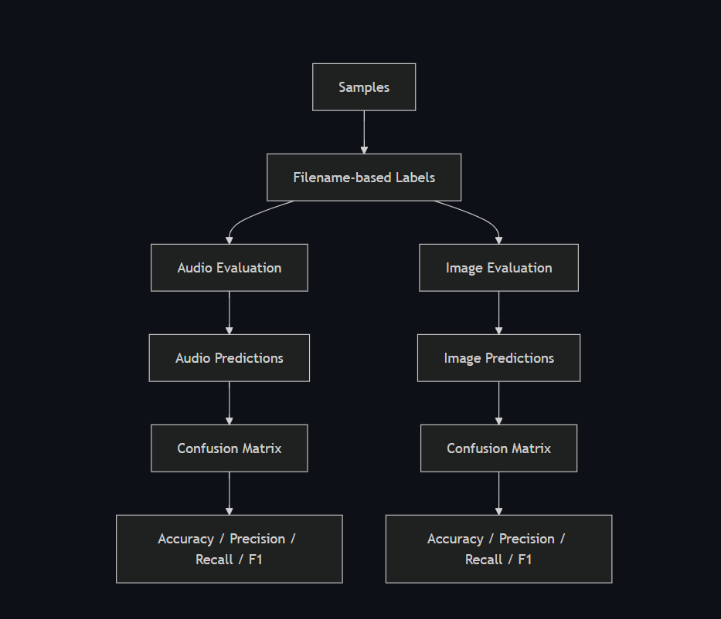
Evaluation & Metrics Pipeline

Slide 8
How to Run
Web App: python web/app.py → http://localhost:8000
CLI Audio: python detect.py --audio file.wav
CLI Image: python detect.py --image file.jpg
Multimodal: python detect.py --audio ... --image ...

Slide 9
Reported Performance
Audio accuracy: 94–96%, EER: 4–6%
Image accuracy: 91–93%, EER: 7–9%
Thresholds configurable via YAML

