Slide 1
LINUX
M.Vinod ( 296)

Slide 2
LINUX
Open Source
Multi–User & Multi–Tasking System
Shell
Security
Portable

Slide 3
UNIX File System
Ordinary files
Directories
Devices
Links

Slide 4
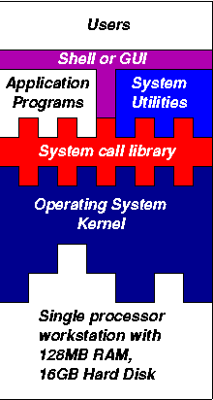
Architecture of Linux
Kernel
Shell or GUI
System Utilities
Application Programs

Slide 5
Command - uname
- To know about System Information

Slide 6
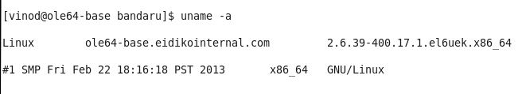
Command - uname
Kernel
Node Host name
Kernel Release
Kernel Version
Operating System
Processor ( or )
Hardware platform

Slide 7
LINUX Commands
Ex: mkdir –p dir/sub1/sub2
General format of linux command
Command -options targets

Slide 8
LINUX Commands
Login passwd pwd cd ls mkdir rmdir cp mv rm echo tail head sort uniq less more chgrp chown su locate which man chmod cat touch info bc wc alias diff shutdown who File umask cal date id sed vi find grep tar gzip usermod awk

Slide 9
Standard input, output and errors(0, 1 and 2)
Redirection (> ,< , >> , << , | )
Specifying multiple filenames
C , C++ compilers ( cc , CC)
Super user
Cron jobs
Searching multiple words with grep
Copy a file to multiple directories at a time
Midnight commander (mc)

Slide 10
Network Related commands
ssh scp write mail netstat
ping traceroute wget
top ps jobs kill du df free
Foreground and Background processes
LINUX PROCESSES

Slide 11
THANK YOU

