Slide 1

Title: The Market Place For Human Wisdom
Student Name: D. Venya Sri
Student ID: 2520030531
Cluster:1
Section: 4
Under the Guidance
of
Supervisor Name: Jayaram Boga
Assistant Professor
Department of CSE

Slide 2
Abstract
The Marketplace of Human Wisdom proposes a paradigm shift in knowledge acquisition by establishing a decentralized, peer-to-peer platform dedicated to the exchange of lived experience rather than static information. Envisioned as a global "Living Library," the project connects individuals for live, one-on-one interactions, operating on the foundational belief that every individual possesses unique mastery—from technical skills to life transitions—that constitutes valuable intellectual capital. Distinct from traditional learning management systems, this platform utilizes a time-banking economy where users trade time equitably through "Wisdom Coins," thereby democratizing access to mentorship across socioeconomic divides. By prioritizing authentic human connection over algorithmic content generation, the project seeks to preserve and propagate the nuance of human wisdom, creating visible lineages of knowledge transfer that demonstrate that, even in the age of Artificial Intelligence, human perspective remains the world's most valuable asset.

Slide 3
Existing System
Learning mainly through online courses and tutorials
Limited personal interaction with experienced mentors
Knowledge mainly theoretical and information-based
Mentorship platforms are often expensive
No structured system for exchanging real life experiences

Slide 4
Proposed System
A decentralized platform for exchanging human wisdom
Users act as both mentors and learners
Live interaction enables practical knowledge sharing
Wisdom Coins used for time-based knowledge exchange
Builds a community driven learning ecosystem

Slide 5
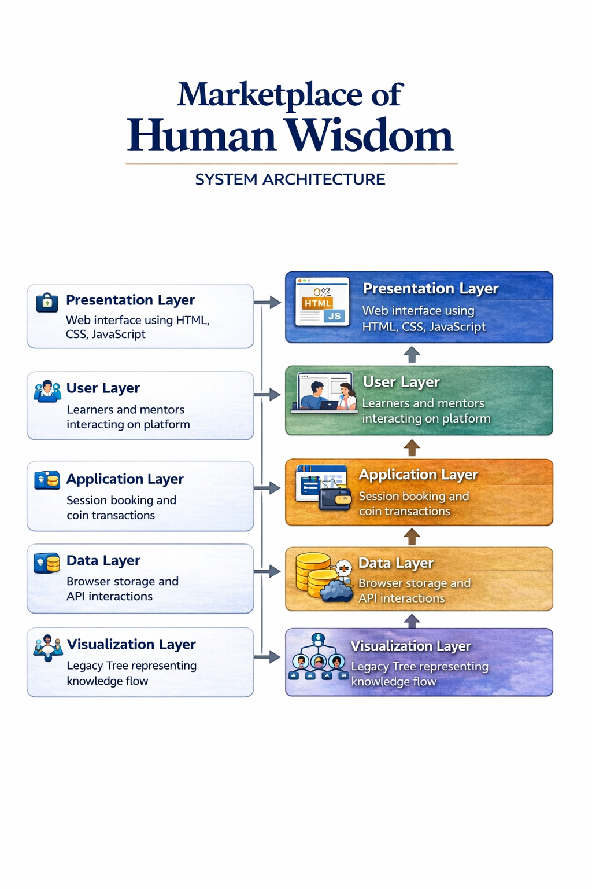

System Architecture

Slide 6
Project Modules
User Authentication Module – Login and profile management
Human Library Module – List of mentors and expertise
Session Booking Module – Borrow experience using coins
Wisdom Coin Wallet Module – Tracks knowledge exchange
Legacy Tree Module – Visualizes knowledge sharing network
Community Interaction Module – Connects users globally

Slide 7
Objectives
Develop a platform for exchanging human experiences
Promote peer-to-peer learning and mentorship
Provide accessible knowledge sharing globally
Implement modern web development concepts
Integrate data structures and algorithms concepts

Slide 8
Co’s Attainments - FWD
1. CO1 • Implemented HTML document structure • Used CSS styling and layout techniques
2. CO2 • Developed forms and input validation • Implemented responsive layouts
3. CO3 • Applied JavaScript fundamentals and functions • Used arrays, objects and control structures
4. CO4 • Implemented DOM manipulation • Used event handling for interactive features

Slide 9
Co’s Attainments - DSA
1. CO1 • Applied algorithm analysis concepts • Used searching and sorting logic
2. CO2 • Implemented linked list concepts for structured data
3. CO3 • Used stack and queue data structures
4. CO4 • Applied hashing techniques for efficient data lookup

Slide 10
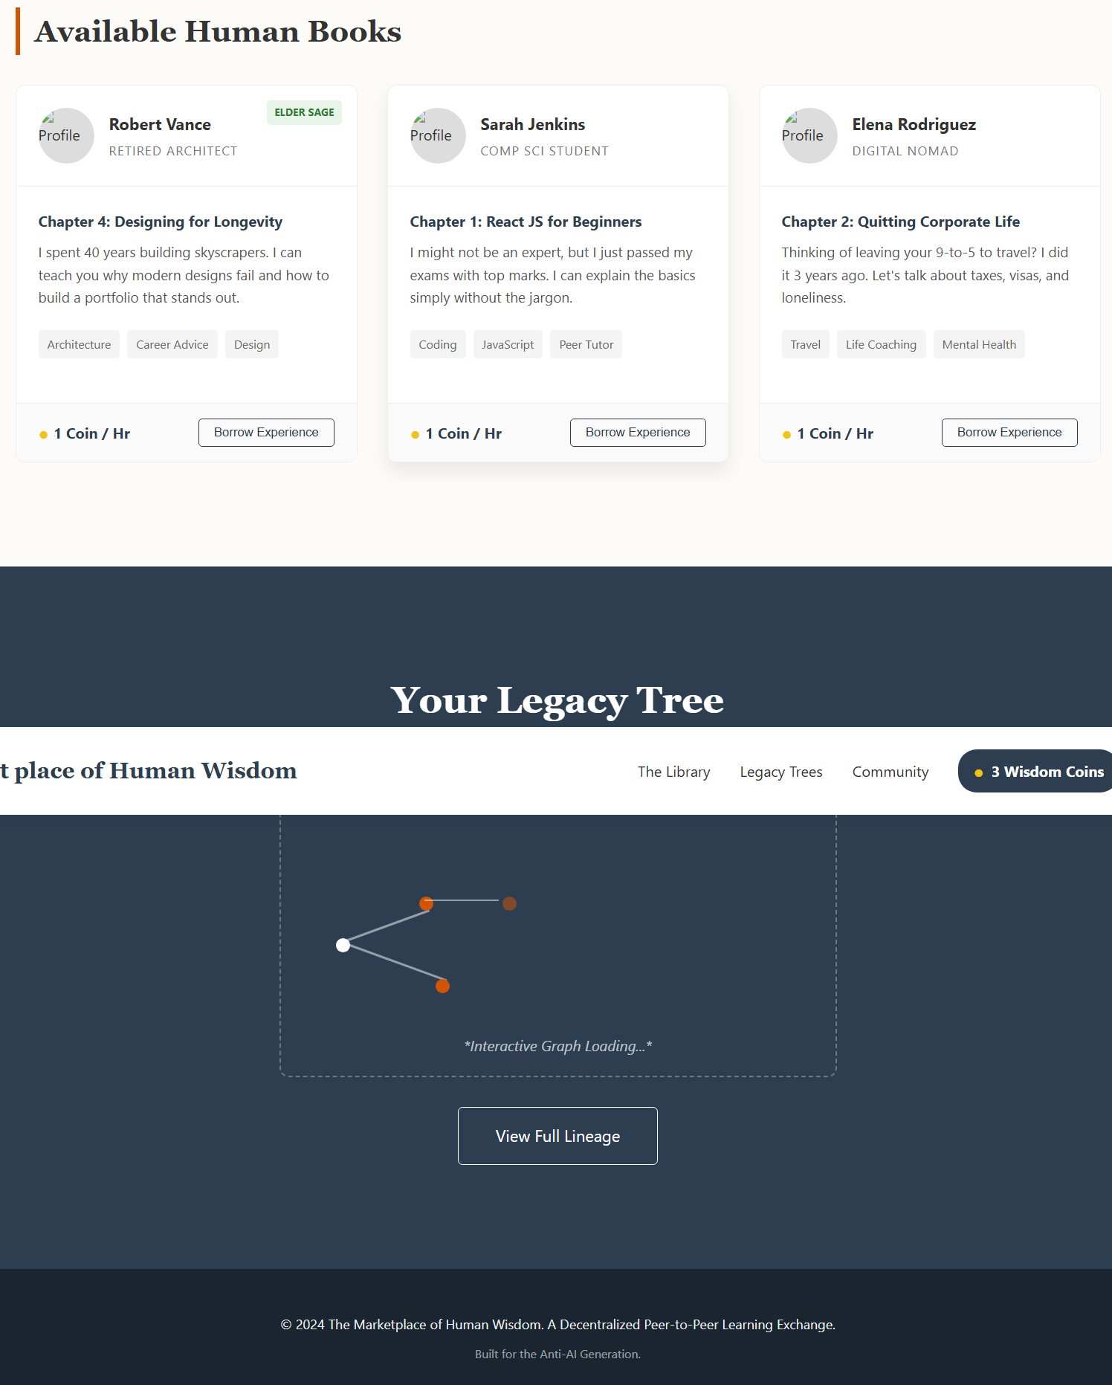
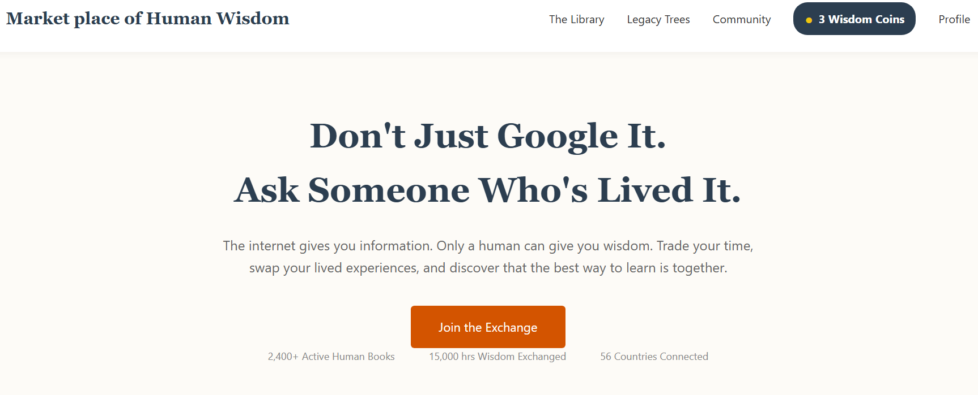
Screenshots for FWD & DSA

Slide 11
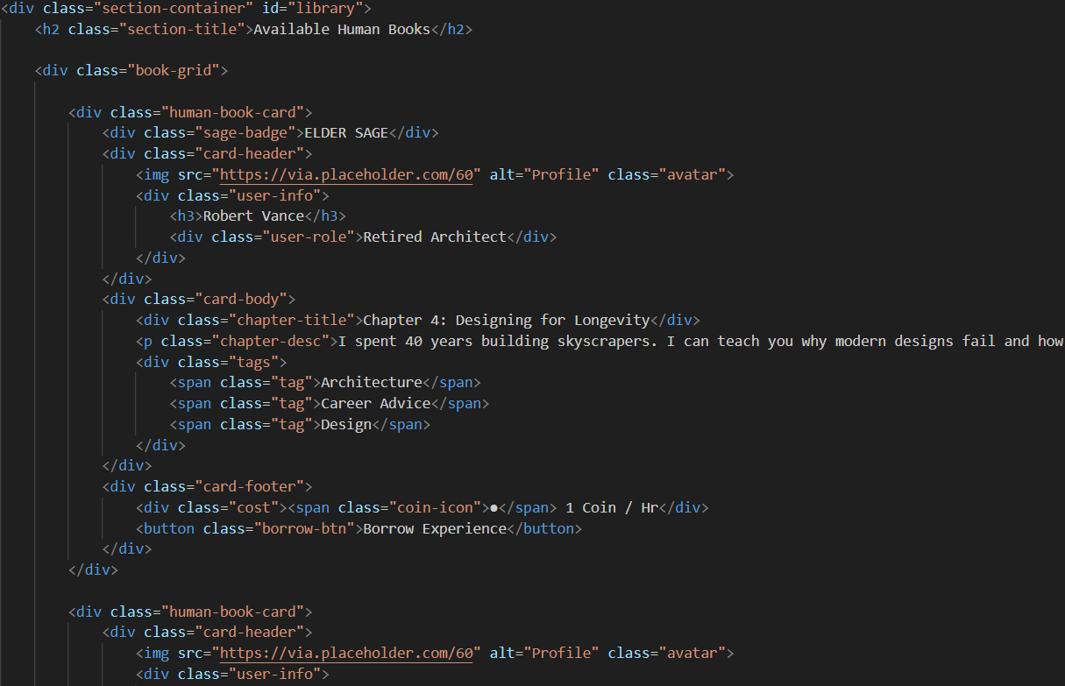
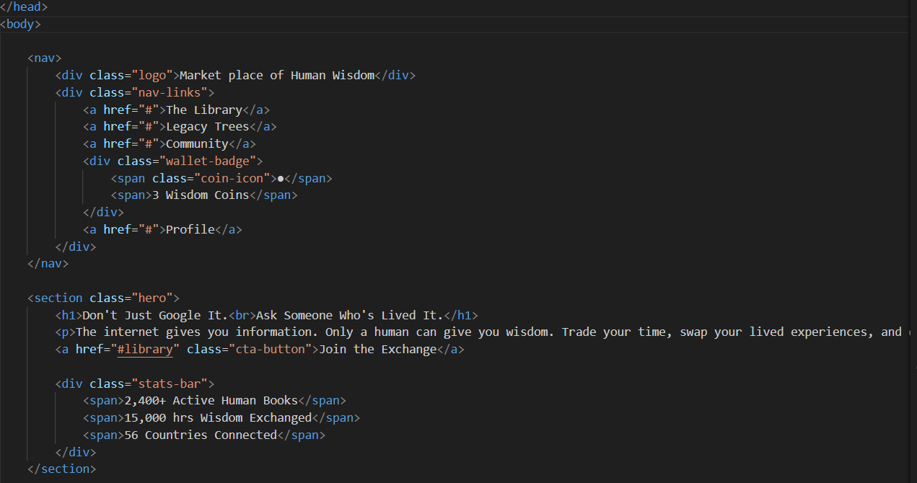
Screenshots for FWD

Slide 12
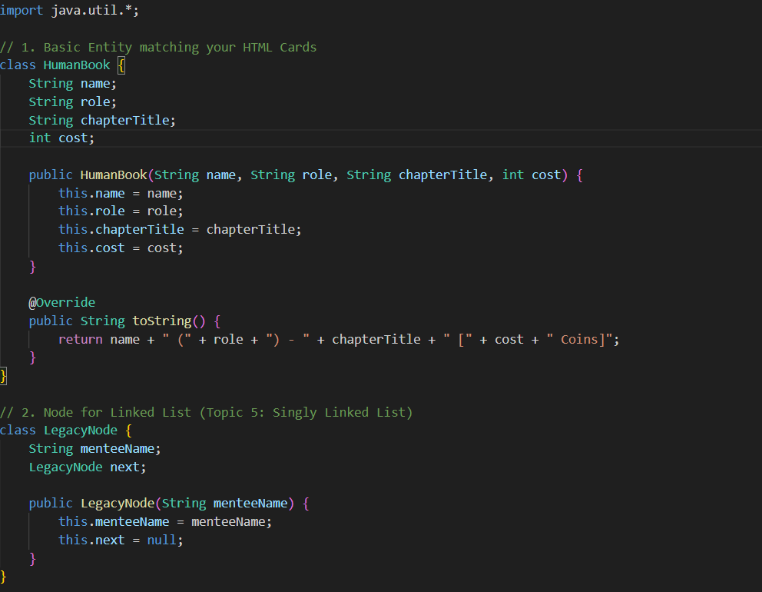
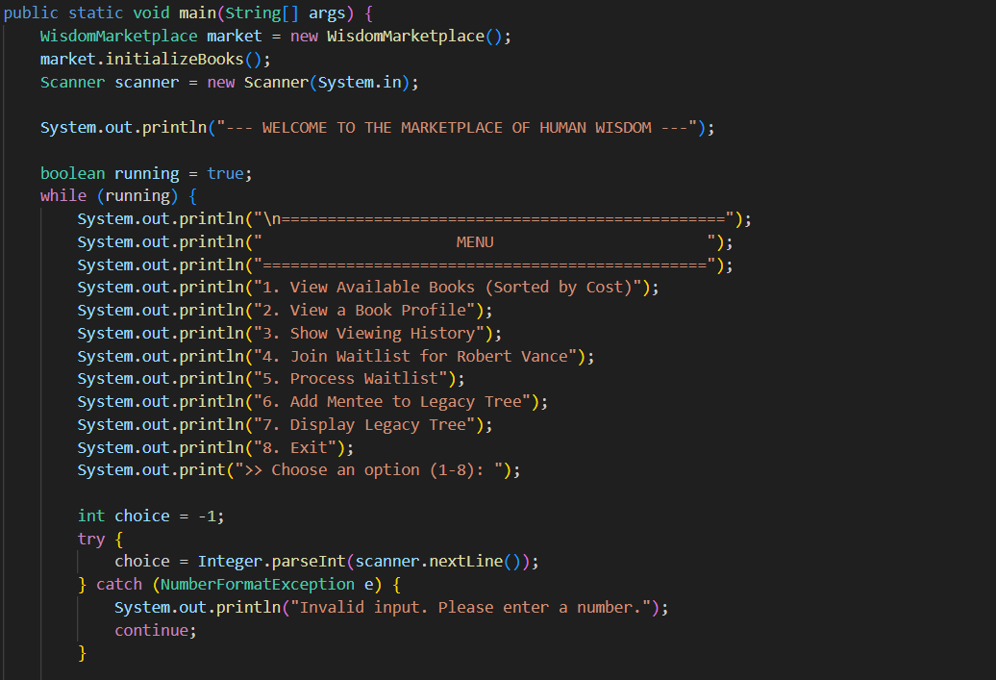
Screenshots for DSA

Slide 13
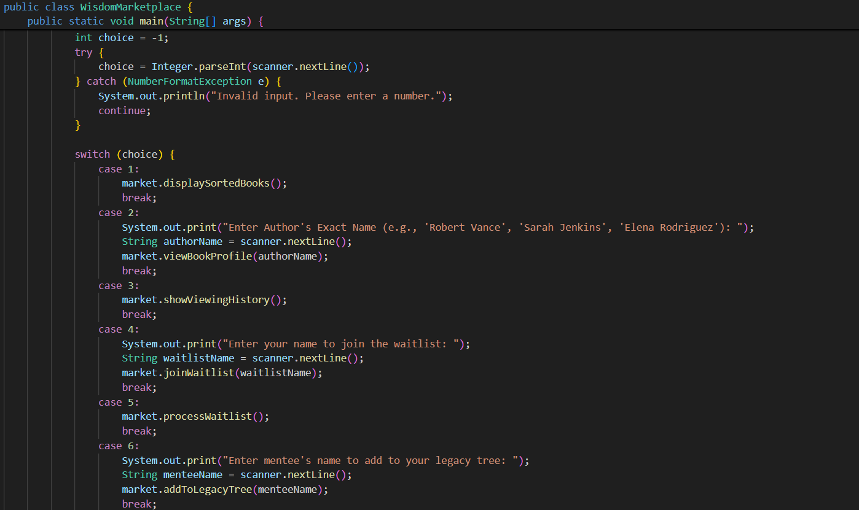
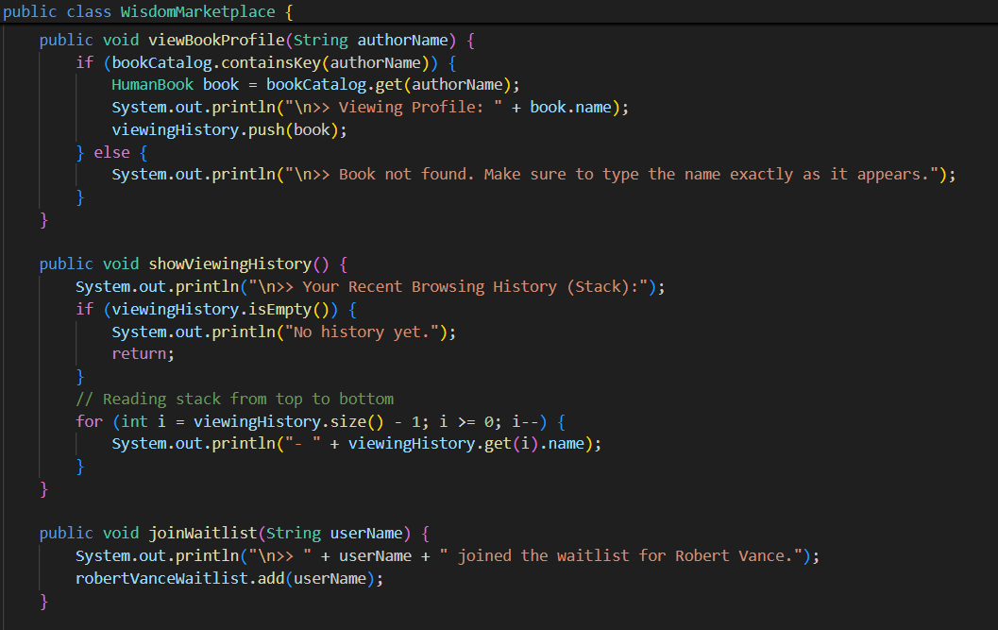
Screenshots for DSA

Slide 14
Conclusion
• Marketplace of Human Wisdom enables real experience sharing • Provides a decentralized learning environment • Encourages mentorship and collaboration • Integrates Web Development and DSA concepts • Demonstrates practical implementation of programming skills

Slide 15
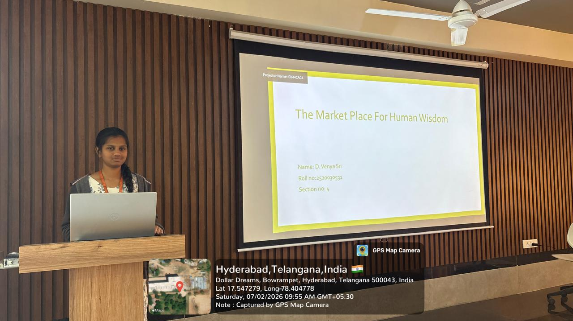
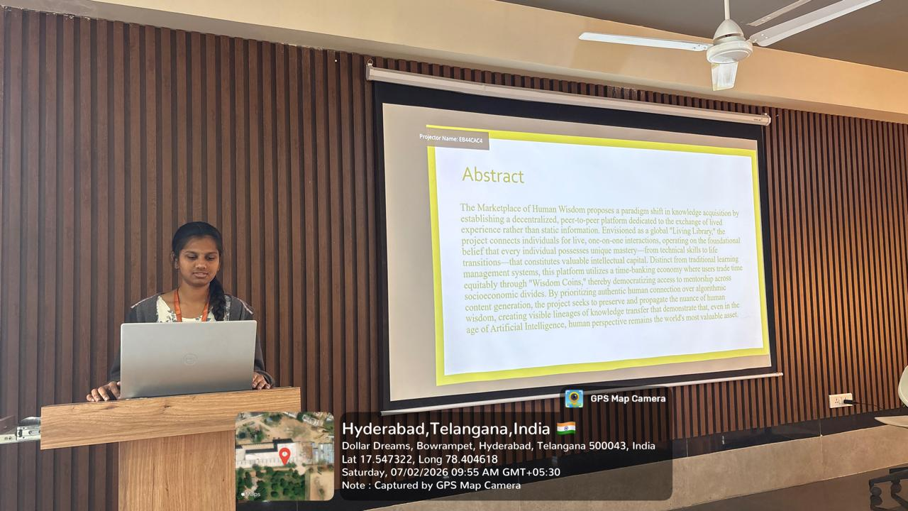
Geo- Tag Photos

Slide 16
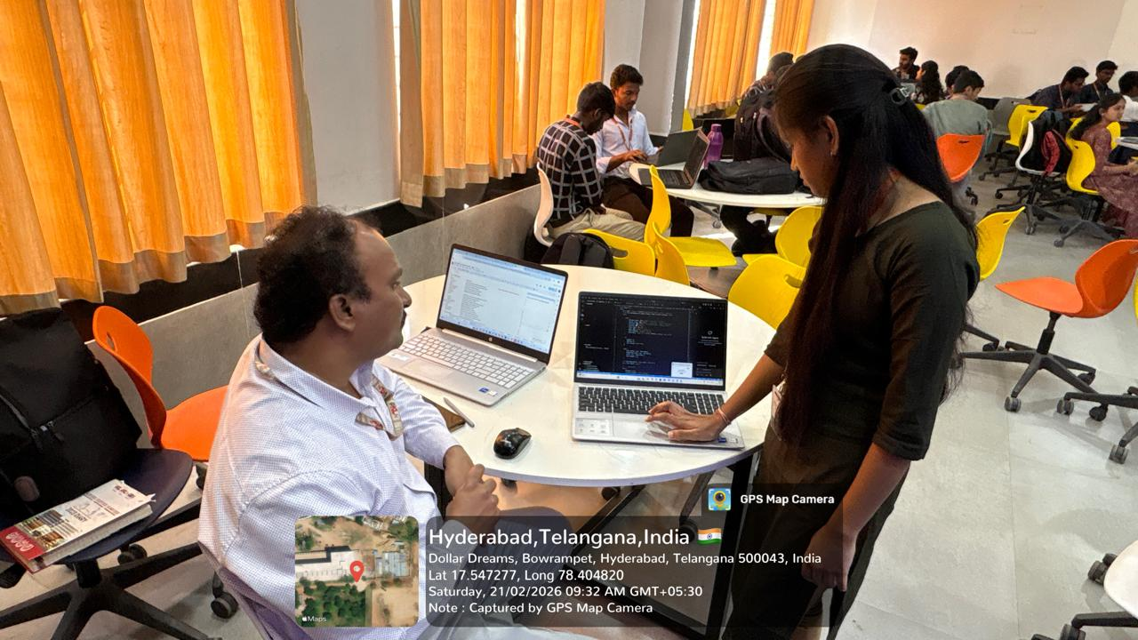
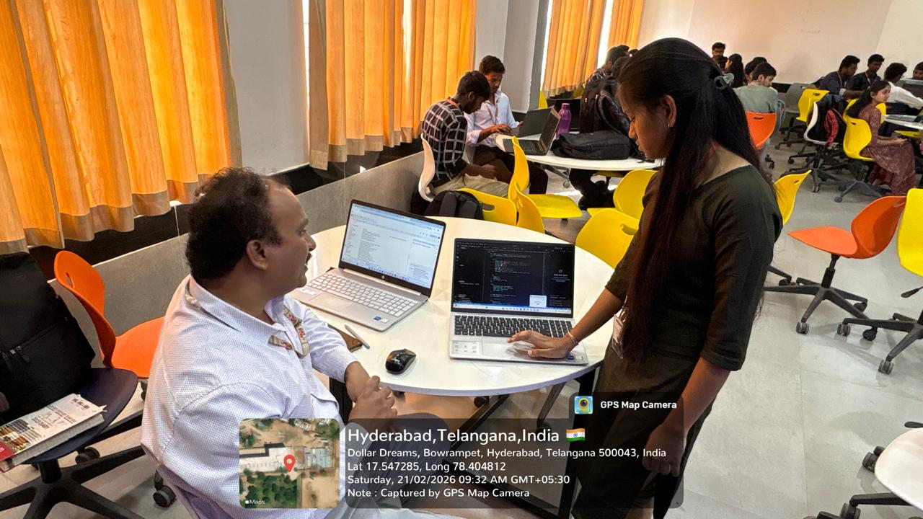
Geo- Tag Photos

Slide 17
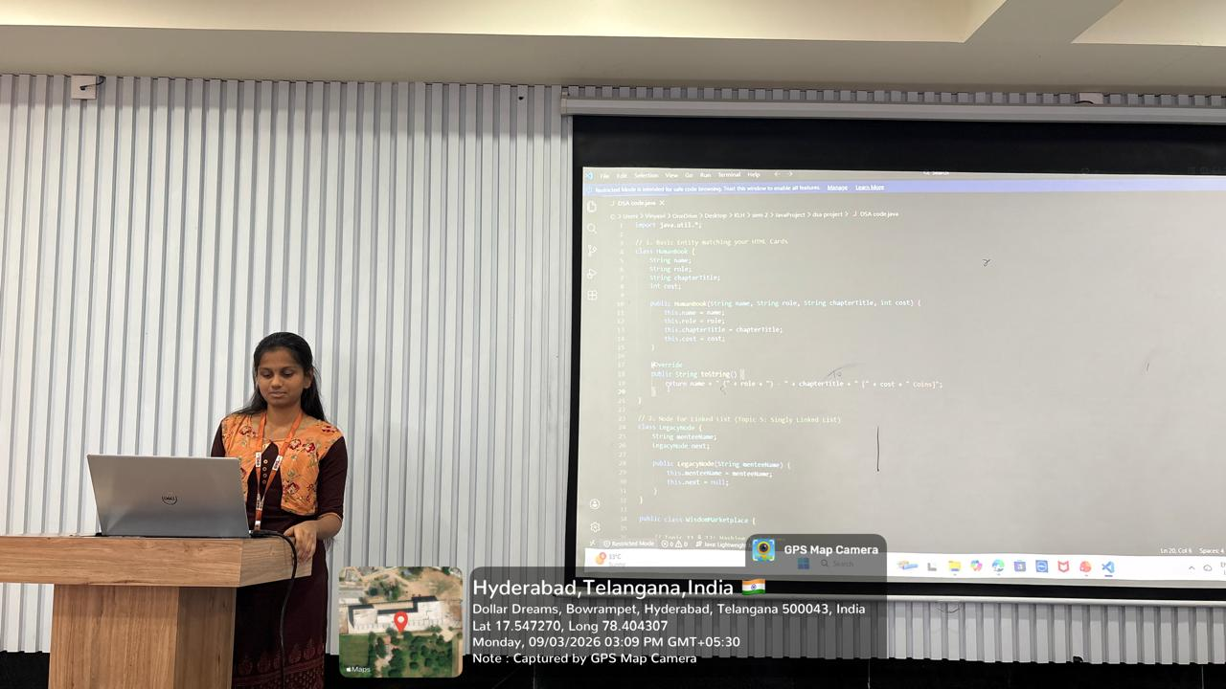
Geo- Tag Photos

Slide 18
THANK YOU

