Slide 1
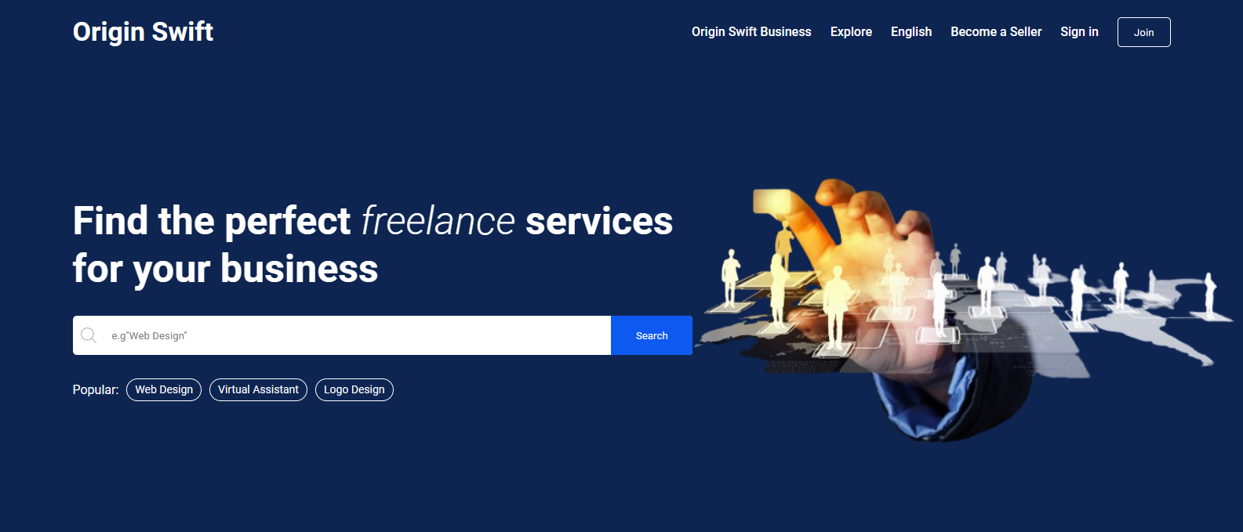
ORIGIN SWIFT
Kevin D. Membreve

Slide 2
ORIGIN SWIFT
ORIGIN SWIFT is a platform that allows freelancers to become sellers by showcasing their work samples, descriptions, and pricing. This provides an opportunity for business owners and hiring managers, who are buyers on the platform, to easily find and hire the right freelancer for their project. Additionally, ORIGIN SWIFT offers a simple and efficient way to connect with skilled professionals without having to sift through piles of resumes or conduct countless interviews.

Slide 3
The FREELANCE COMPANY PROJECT is a platform designed for freelancers who are actively seeking new projects, as well as business owners and hiring managers who are looking for suitable professional freelancers. Freelancers can create a profile and list themselves as "sellers" to showcase their work samples, descriptions, and pricing. Business owners and hiring managers can create a profile as "buyers" and search for talented freelancers for their projects. Our platform provides an easy-to-use interface for both sellers and buyers to connect and collaborate.

Slide 4
OBJECTIVES
The main objectives of our FREELANCE COMPANY PROJECT are:
To provide a platform for freelancers to showcase their work and connect with potential clients and increase their exposure and visibility in the market.
To make it easy for business owners and hiring managers to find talented freelancers for their projects.
To promote diversity and inclusivity by catering to freelancers from different industries and backgrounds.

Slide 5
To provide a secure platform for freelancers and buyers to collaborate and complete projects.
To provide a user-friendly interface for both sellers and buyers.
To continuously improve the platform based on user feedback and market trends.
Our objective is to empower freelancers and help business owners find the right freelancers for their needs. We provide a user-friendly platform that promotes diversity and inclusivity, allows freelancers to showcase their work and set their own pricing, and facilitates seamless communication and collaboration between freelancers and buyers. We continuously improve the platform based on user feedback and market trends.

Slide 6
GOAL
Our project goal for the FREELANCE COMPANY PROJECT is to create a comprehensive platform for freelancers, hiring managers, and business owners to find and collaborate on suitable project opportunities. We aim to connect talented freelancers with potential clients and provide a user-friendly interface for both sellers and buyers to communicate and collaborate. Freelancers can create profiles, showcase their work, set their own pricing, and receive notifications when someone purchases their services. Hiring managers and business owners can easily search and filter freelancers based on their budget and sort freelancers based on best selling, newest, and popular. Our project is focused on empowering freelancers and simplifying the process of finding and completing projects for both freelancers and buyers.

Slide 7
PROJECT TIMELINE
Conduct Research – 1-3 days
Write Content – 1-5 days
Design Pages – 1week and 4days
Review Design – 5 days
Coding – 1-2 weeks
Review – 1 week

Slide 8
HOMEPAGE
LOGO
HOME
NAVIGATION TABS
Search Bar
MORE CONTENTS
FOOTER

