Slide 1


Sentiment Analysis on Beauty Products’ Review

Slide 2



Problem Definition
2005-2014
Sentiment Analysis

Slide 3
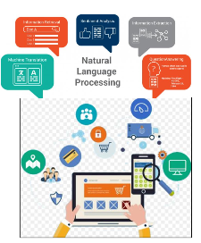

Problem Definition

Slide 4


Data
Classification Model
NLP Sentiment Analysis

Slide 5



Data Retrieval
Data Location
Original Data
Format
csv file
Format

Slide 6
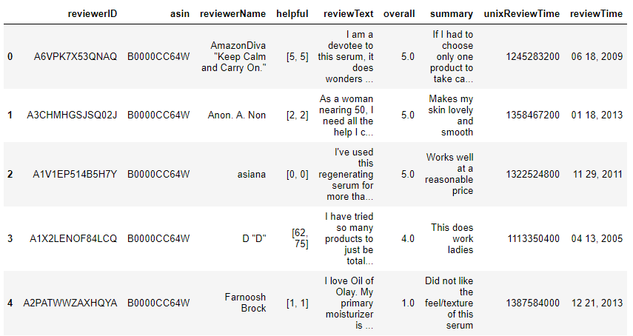
Data Information
28798 Rows(Reviews), 9 Columns(Variables)

Slide 7
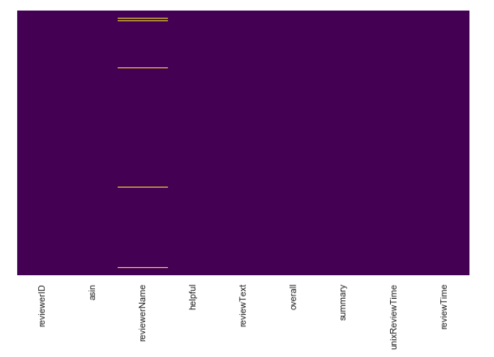

Data Wrangling – Missing & Duplicate Values
NO

Slide 8
Data Wrangling
Concatenate the texts
Drop ‘helpful’ feature
Rearrange ‘Overall’ feature
Rearrange ‘reviewerID’ and ‘reviewerName’
Rearrange ‘unixReviewTime’ and ‘reviewTime’

Slide 9

Data Wrangling – Rename Features
Sample
reviewerID : "customer"
asin : "product"
reviewText: This will be concatenated with "summary" and renamed as "review_text"
overall: "rating_class“
reviewTime: "year"

Slide 10

Descriptive Statistics
Bad Ratings
2084
Good Ratings
22425
Imbalanced Dataset

Slide 11

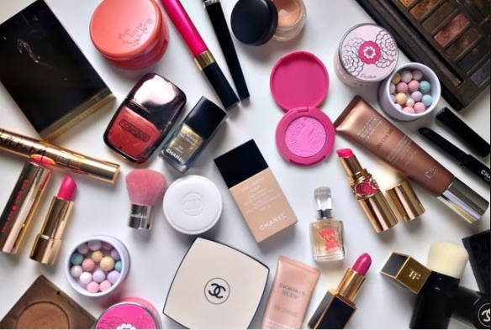
Descriptive Statistics
1340
Unique Customers
733
Unique Beauty Products
18 Reviews for Products
34 Reviews for Each Product

Slide 12

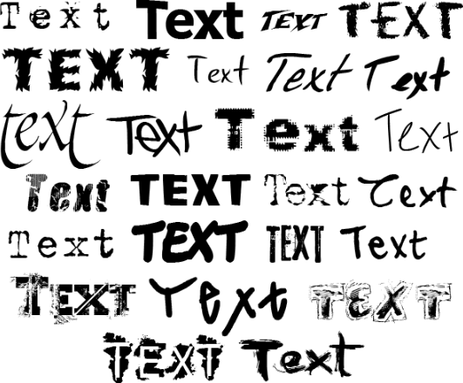
Preprocessing Text

Slide 13
Preprocessing Text
Remove tags
Remove accented characters
Expand contractions
Remove special characters
Lemmatisation versus Stemming
Removing stopwords
Tokenization
Remove extra white space and digits
Spelling corrections
Grammatical Corrections
Remove repeated characters
Lower the text

Slide 14
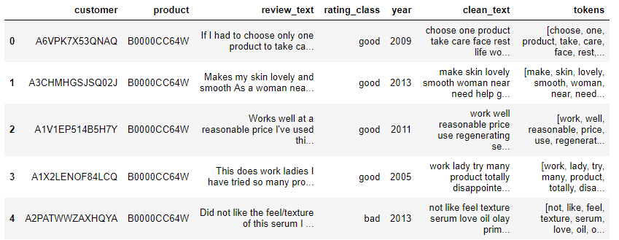
Preprocessing Text

Slide 15
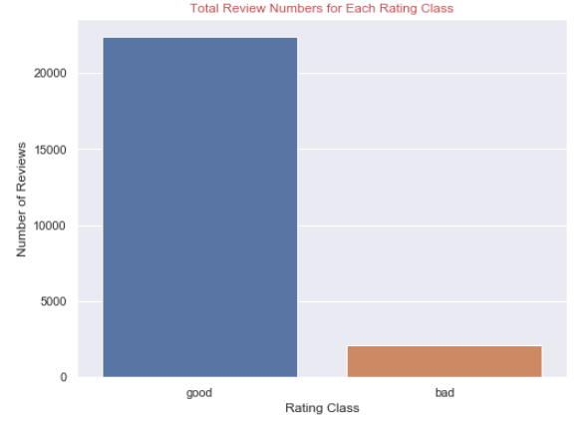
Exploratory Data Analysis – Target Variable
91.5%
8.5%

Slide 16
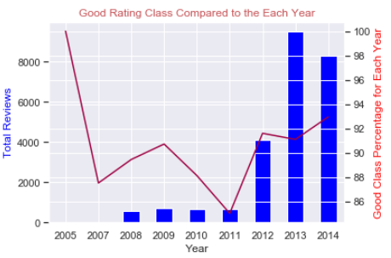
Exploratory Data Analysis – ‘Year’ Feature

Slide 17
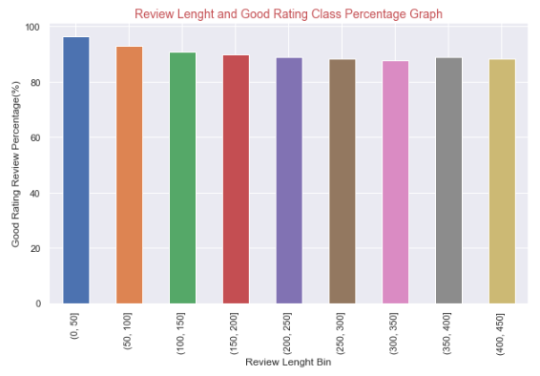
Exploratory Data Analysis – ‘Review Length’ Feature

Slide 18
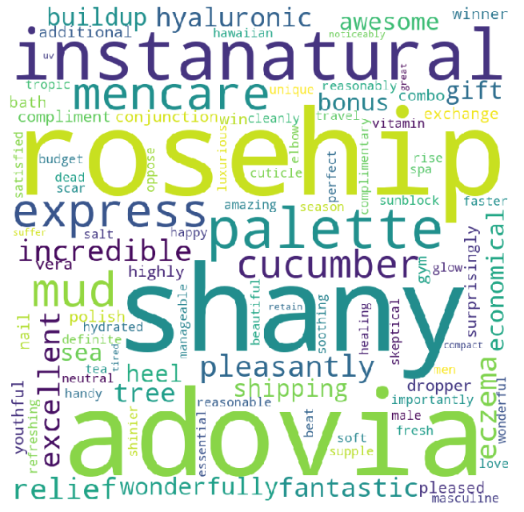
Exploratory Data Analysis – ‘Text Review’ Feature
Good Rating Words

Slide 19
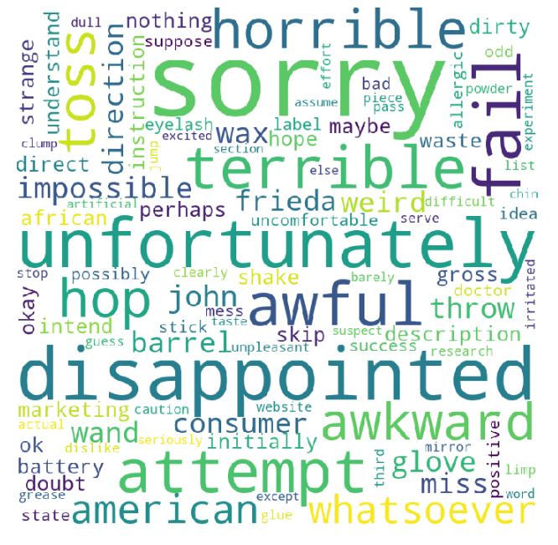
Exploratory Data Analysis – ‘Text Review’ Feature
Bad Rating Words

Slide 20



Feature Selection

Slide 21
Modeling – Data Preprocessing
Separating Response Variable and Feature
X = df2['clean_text']
y = df2['rating_class']
Splitting Dataset into Training and Test Set
Test Size = 25%
Stratified Sampling
Train Set Shape : (18381,)
Test Set Shape : (6128,)

Slide 22
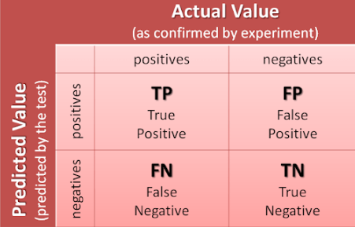

Modeling – Selecting the Right Evaluation Metric

Slide 23
Modeling – Apply vectorizing
CountVectorizer
Turning a collection of text documents into numerical feature vectors.
TF-IDF
Hashing Vectorizer

Slide 24
Modeling – Models
Logistic Regression
Random Forest
Supervised
Machine Learning
Classification
Models
Naïve Bayes
XGBoost
CatBoost

Slide 25

Dummy Classifier
f1 score: 0.84

Slide 26
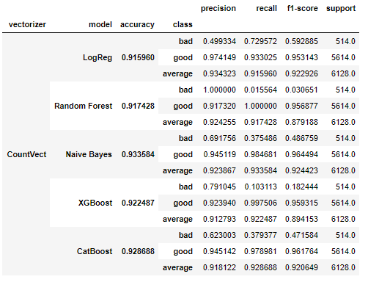
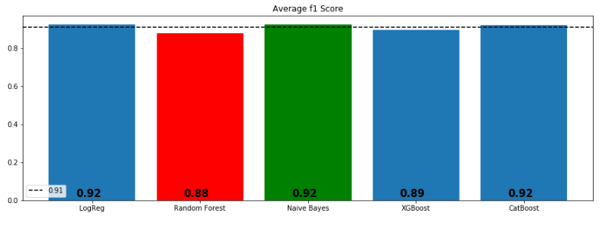
Count-Vectorizing and Algorithms

Slide 27
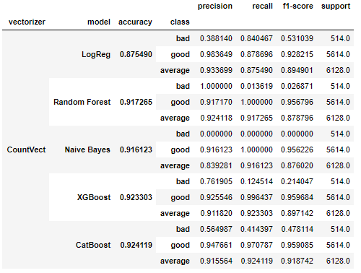
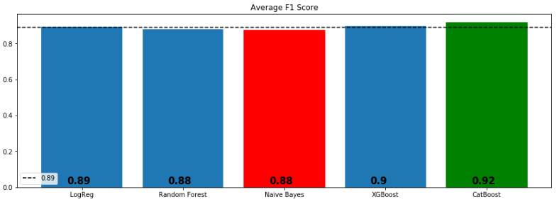
TF-IDF and Algorithms

Slide 28
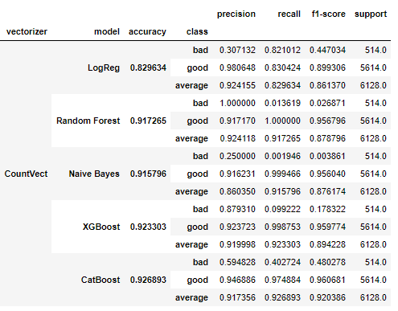
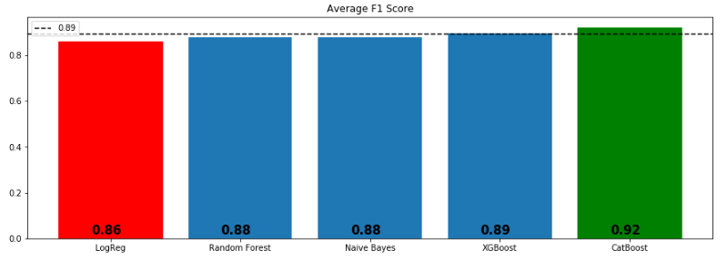
Hashing Vectorizing and Algorithms

Slide 29
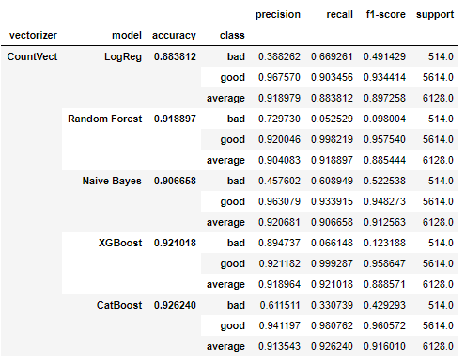
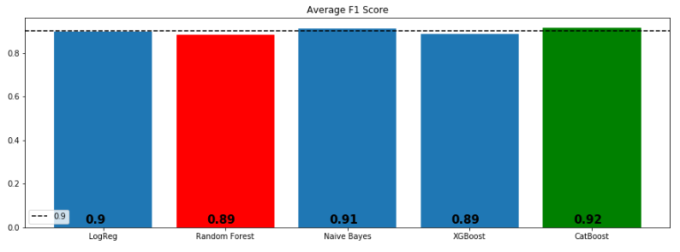
Count-Vectorizing and Algorithms Adding Most and Least Common Words to Stopwords List

Slide 30
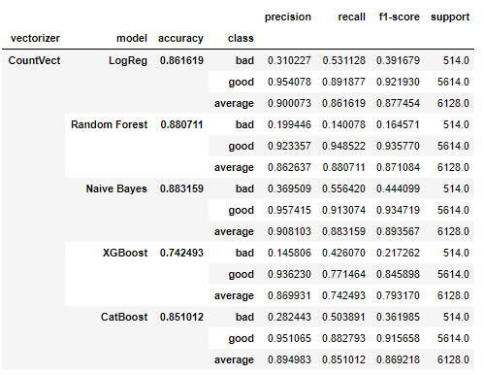
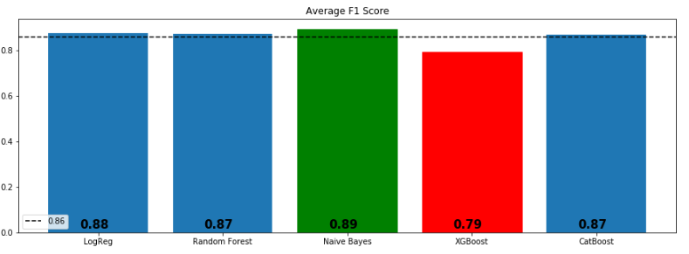
Count-Vectorizing and Algorithms Synthetic Minority Oversampling Technique (SMOTE)

Slide 31
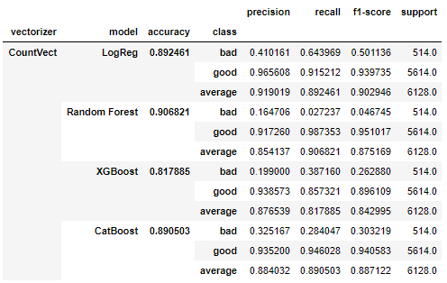
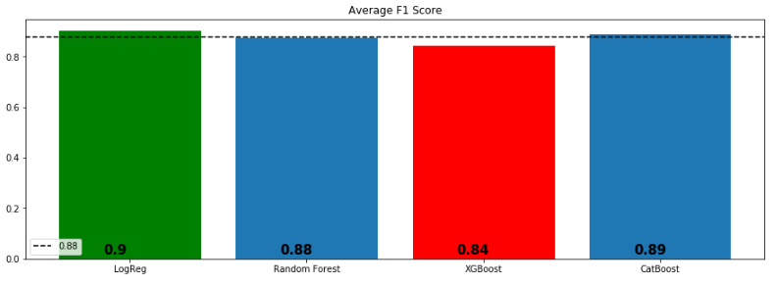
Count-Vectorizing and Algorithms PCA + SMOTE

Slide 32
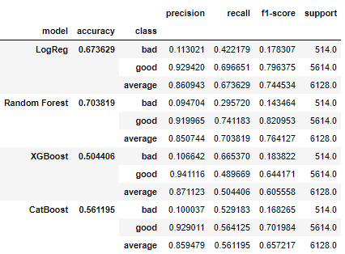
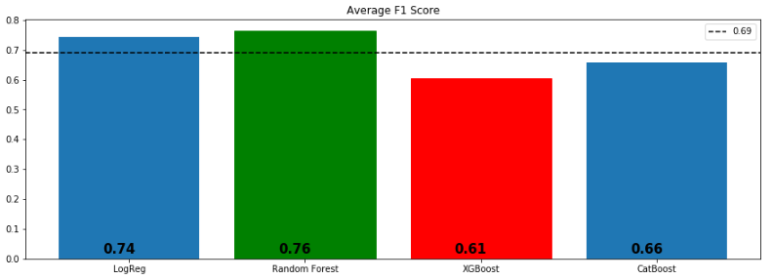
Count-Vectorizing and Algorithms Truncated SVD + SMOTE

Slide 33
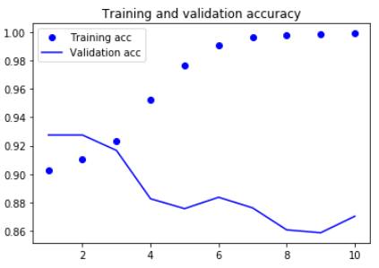
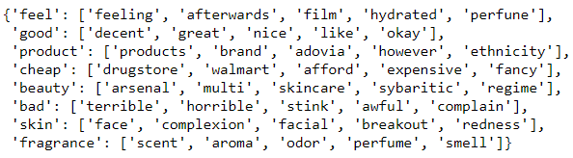
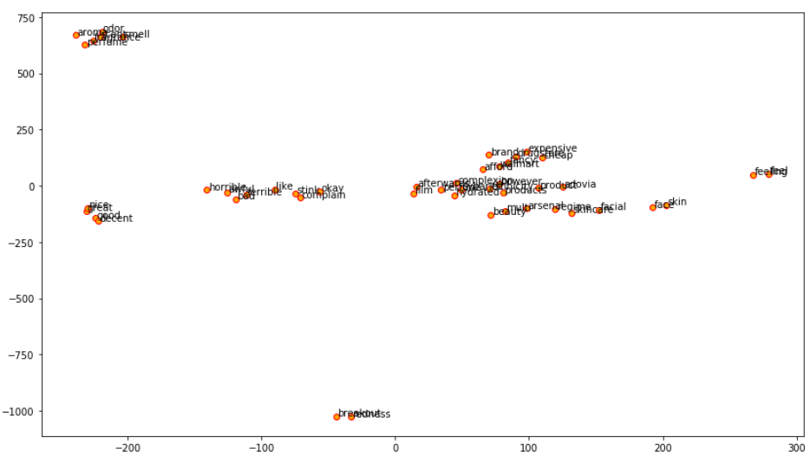
Word2Vec and Simple Neural Network
Visualization of the words of interest and their similar words using their embedding vectors after reducing their dimensions to a 2-D space with t-SNE
f1 score: 0.9235

Slide 34
Conclusion
* In this project, I tried to predict the good and bad words based on the reviews left by the e-customers.
* We applied;
- Count Vector, TF-IDF, Hashing Vector, Word2Vec
- Classification Models and Simple Neural Network
- Adding most and lest common words to CountVect,
- SMOTE,
- PCA + SMOTE
- Truncated SVD + SMOTE

Slide 35
Conclusion
*nBoosting algorithms were the winners almost each combinations.
*nI will go with Naïve Bayes with Count Vectorizing in deploying section (f1 score is 0.924423).
*nAdding most and least common words to the stopword list didn’t have impact on models’ performance.
*nSMOTE and Linear Dimensionality Reduction techniques decreased the f-1 scores.

Slide 36
Recommendations
* We recommend the client to use the model as it is and give us some time to develop neural network algorithms to get better scores. By the way, prediction time and the size of the data set are also important and need to be considered. Especially neural network algorithms may not be outperforming with the low size data sets.

Slide 37
Recommendations
* Provide a system that user can write their reviews/feedbacks without grammatical mistakes such as not accepting the review if it does not satisfy the word/grammar correctness.
* Encourage users to reflect their experience with products via giving incentives.
* Use the reviews as a feedback mechanism, take actions towards them, and let the customers know about the conclusion.
Helps to Provide Steady Training Dataset

Slide 38
Future Study
*nImplementation of Dask library for parallel processing to decrease run time.
*nAfter decreasing run time, focusing on hyperparameter tuning more.
*nImplementation of Deep Learning with different neural network types and different layer combinations to get better results.

