Slide 1
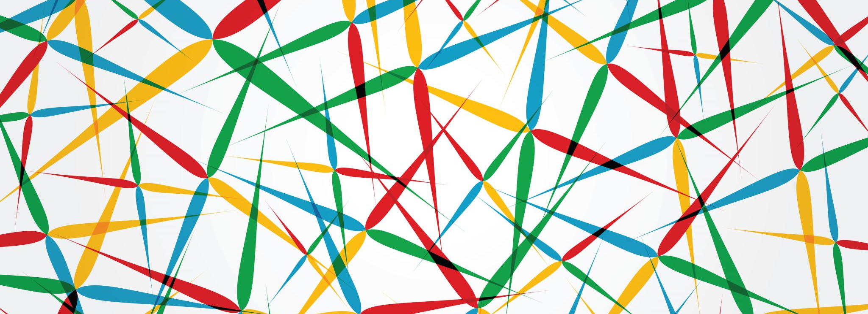
IoT Analytics
Visualization and analysis of energy data

Slide 2
Seasonal pattern (Total enegry)

Slide 3
Monthly pattern (Mean energy)

Slide 4
Weekly pattern (Mean energy)

