Slide 1


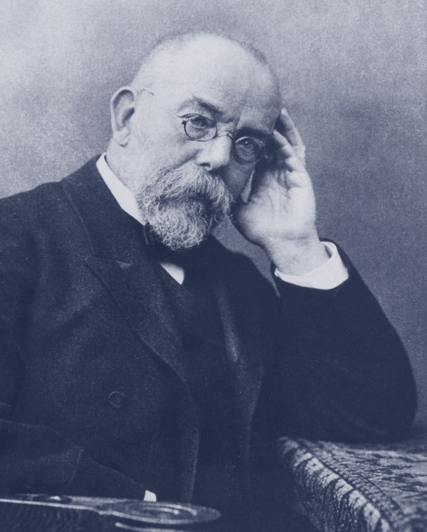
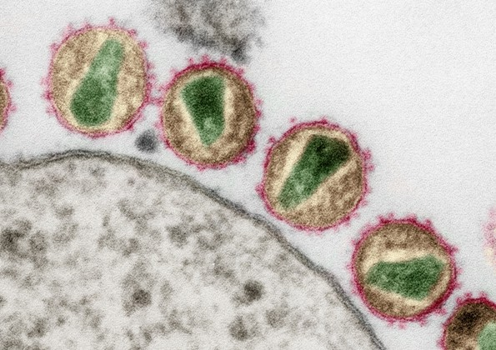
Next generation sequencing and the bioinformatics workflow for variant detection
Britta Altmann
Virologisches Seminar
20.03.2017

Slide 2
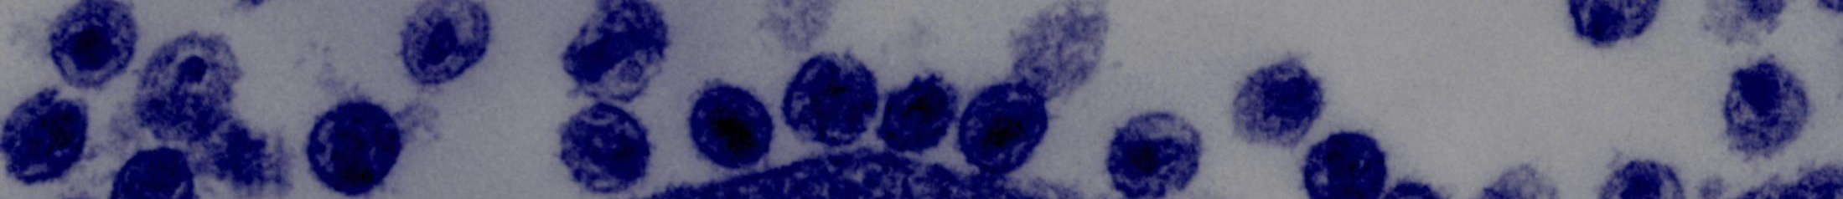
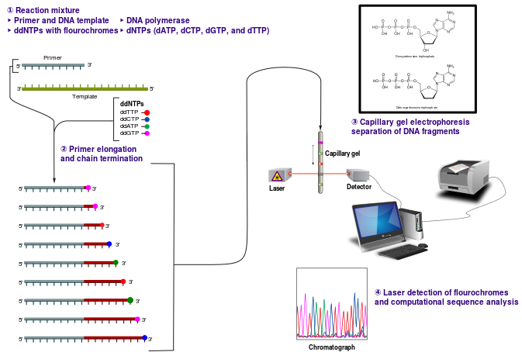
1st Gen – Sanger-Sequencing
① Reaction mixture: Primer and DNA template + DNA polymerase + ddNTPs with flourochromes + dNTPs
③ Capillary gel electrophoresis separation of DNA fragments
② Primer elongation and chain termination
④ Laser detection of flourochromes and computational sequence analysis

Slide 3
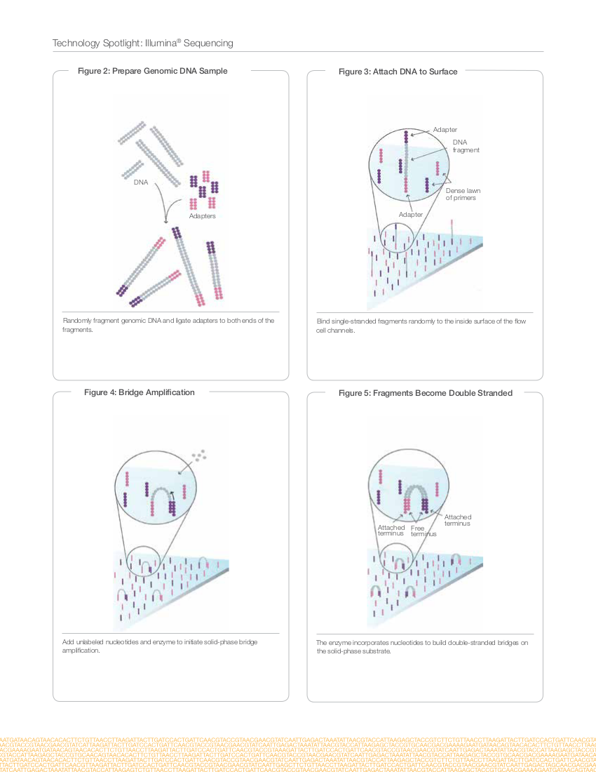
2nd Gen – Illumina (sequencing by synthesis)
Prepare Genomic DNA Sample
Attach DNA to Surface
Bridge Amplification
Fragments Become Double Stranded
Denature the Double-Stranded Molecules
Complete Amplification
Determine First Base
Image First Base
Determine Second Base
Image Second Chemistry Cycle
Sequencing Over Multiple Chemistry Cycles

Slide 4
2nd Gen – Illumina (sequencing by synthesis)
Prepare Genomic DNA Sample
Attach DNA to Surface
Bridge Amplification
Fragments Become Double Stranded
Denature the Double-Stranded Molecules
Complete Amplification
Determine First Base
Image First Base
Determine Second Base
Image Second Chemistry Cycle
Sequencing Over Multiple Chemistry Cycles
fixed / isolated samples

Slide 5
2nd Gen – Illumina (sequencing by synthesis)
Prepare Genomic DNA Sample
Attach DNA to Surface
Bridge Amplification
Fragments Become Double Stranded
Denature the Double-Stranded Molecules
Complete Amplification
Determine First Base
Image First Base
Determine Second Base
Image Second Chemistry Cycle
Sequencing Over Multiple Chemistry Cycles

Slide 6
2nd Gen – Illumina (sequencing by synthesis)
Prepare Genomic DNA Sample
Attach DNA to Surface
Bridge Amplification
Fragments Become Double Stranded
Denature the Double-Stranded Molecules
Complete Amplification
Determine First Base
Image First Base
Determine Second Base
Image Second Chemistry Cycle
Sequencing Over Multiple Chemistry Cycles

Slide 7
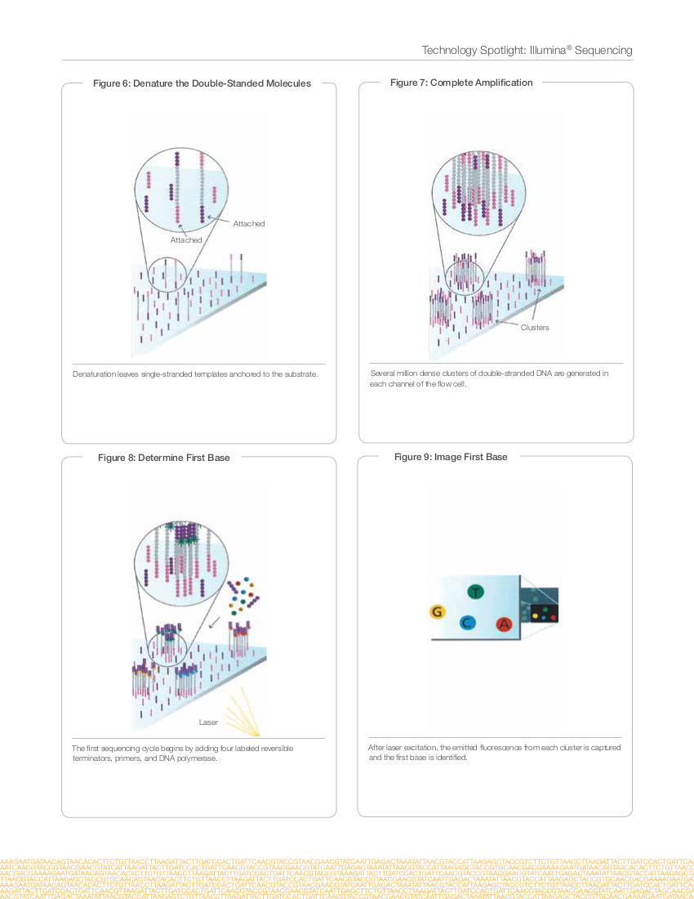
2nd Gen – Illumina (sequencing by synthesis)
Prepare Genomic DNA Sample
Attach DNA to Surface
Bridge Amplification
Fragments Become Double Stranded
Denature the Double-Stranded Molecules
Complete Amplification
Determine First Base
Image First Base
Determine Second Base
Image Second Chemistry Cycle
Sequencing Over Multiple Chemistry Cycles

Slide 8
2nd Gen – Illumina (sequencing by synthesis)
Prepare Genomic DNA Sample
Attach DNA to Surface
Bridge Amplification
Fragments Become Double Stranded
Denature the Double-Stranded Molecules
Complete Amplification
Determine First Base
Image First Base
Determine Second Base
Image Second Chemistry Cycle
Sequencing Over Multiple Chemistry Cycles
≈1'000 copies/cluster

Slide 9
2nd Gen – Illumina (sequencing by synthesis)
Prepare Genomic DNA Sample
Attach DNA to Surface
Bridge Amplification
Fragments Become Double Stranded
Denature the Double-Stranded Molecules
Complete Amplification
Determine First Base
Image First Base
Determine Second Base
Image Second Chemistry Cycle
Sequencing Over Multiple Chemistry Cycles

Slide 10
2nd Gen – Illumina (sequencing by synthesis)
Prepare Genomic DNA Sample
Attach DNA to Surface
Bridge Amplification
Fragments Become Double Stranded
Denature the Double-Stranded Molecules
Complete Amplification
Determine First Base
Image First Base
Determine Second Base
Image Second Chemistry Cycle
Sequencing Over Multiple Chemistry Cycles

Slide 11
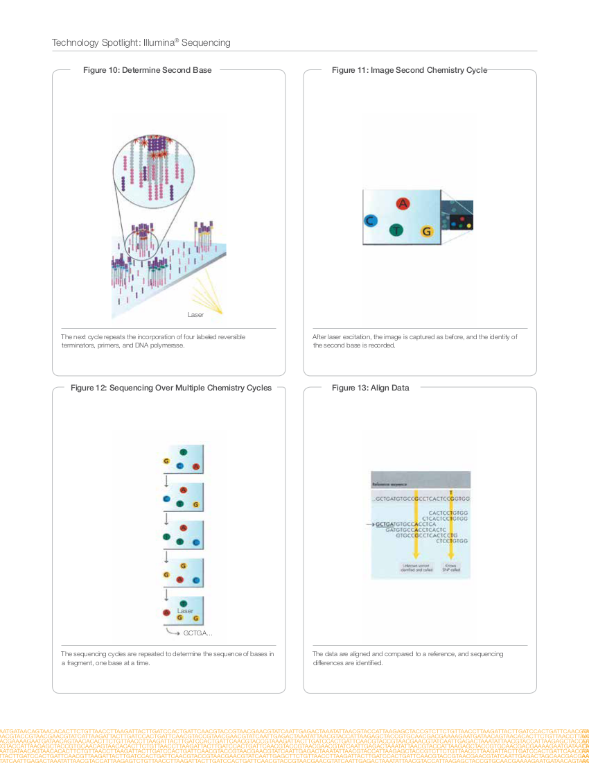
2nd Gen – Illumina (sequencing by synthesis)
Prepare Genomic DNA Sample
Attach DNA to Surface
Bridge Amplification
Fragments Become Double Stranded
Denature the Double-Stranded Molecules
Complete Amplification
Determine First Base
Image First Base
Determine Second Base
Image Second Chemistry Cycle
Sequencing Over Multiple Chemistry Cycles

Slide 12
2nd Gen – Illumina (sequencing by synthesis)
Prepare Genomic DNA Sample
Attach DNA to Surface
Bridge Amplification
Fragments Become Double Stranded
Denature the Double-Stranded Molecules
Complete Amplification
Determine First Base
Image First Base
Determine Second Base
Image Second Chemistry Cycle
Sequencing Over Multiple Chemistry Cycles

Slide 13
2nd Gen – Illumina (sequencing by synthesis)
Prepare Genomic DNA Sample
Attach DNA to Surface
Bridge Amplification
Fragments Become Double Stranded
Denature the Double-Stranded Molecules
Complete Amplification
Determine First Base
Image First Base
Determine Second Base
Image Second Chemistry Cycle
Sequencing Over Multiple Chemistry Cycles

Slide 14
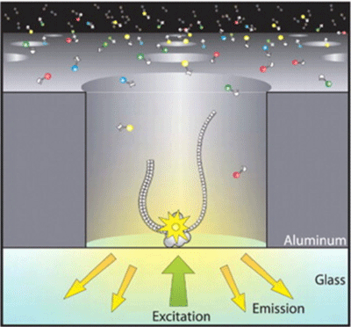
3rd Generation Sequencing
Pacific Biosciences (single-molecule sequencing) - basic principle
fixed DNA polymerase

Slide 15
NGS - application spectrum
NGS technologies can help to answer questions of
Genomics
Transcriptomics
Epigenomics
Metagenomics

Slide 16
NGS - application spectrum
DNA-Sequencing
*Whole-Genome Sequencing (re-sequencing of known species, de novo of unknown)
*Targeted Resequencing (only a subset of genes/regions of interest were analysed)
ChIP Sequencing (identify DNA-binding sites)
RNA-Sequencing
*mRNA Sequencing (detect features in the coding transcriptome)
**total RNA Sequencing (detect features in the coding and noncoding RNA)
*targeted RNA Sequencing (measure gene, differential and allele-specific expression)
*small RNA Sequencing
*Ribosome Profiling
**RNA Exome Capture Sequencing
**Ultra-Low-Input and Single-Cell RNA-Seq
Methylation-Sequencing
**can provide insight into methylation patterns at a single nucleotide level
** possibly realizable on Illumina MiSeq System, available at RKI
** possibly realizable on Illumina HiSeq2500 System, available at RKI

Slide 17
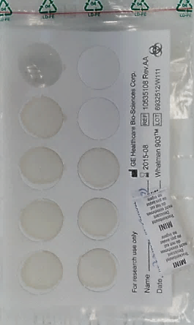
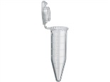
Project: Molecular surveillance of HIV-1
Aim:
Monitoring of resistant HIV-1 and HIV-1 subtypes in newly infected HIV-patients in Germany
one-step RT-PCR
Dried serum spots
of ≈ 60% of all new
HIV diagnoses
Protease
Reverse
Transcriptase
Integrase
Envelope
Nextera XT® Library Preparation
HIV-1 RNA isolation

Slide 18
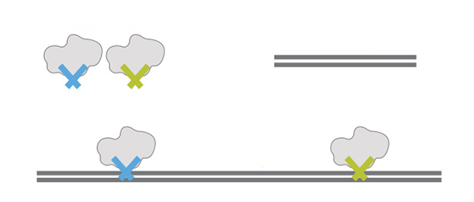
Nextera XT® Library Preparation
Transposomes
Genomic DNA
~ 300 bp
Tagmentation
(fragmentation + adapter tagging)

Slide 19

Nextera XT® Library Preparation
Reduced-cycle PCR amplification
(add indices and flow cell binding adapters)
P5
Read 1 Sequencing Primer
Index 2
Index 1
Read 2 Sequencing Primer
P7
sequencing-ready fragment
pool libraries
add to flow cell
clusterbuilding /
bridge-amplification
Sequencing by synthesis

Slide 20
Project: Molecular surveillance of HIV-1
Challenges for the data analysis workflow:
sample material arise from a virus population (quasispecies) -> high heterogeneity within one sample
often poor sample quality / -quantity (dried serum spots)
several PCR-fragments are pooled and sequenced simultaneously
two of these PCR-fragments overlap each other
NGS-results must be comparable with previous Sanger-results
handle structural mutations as insertions and deletions (InDels)
automatisation for high throughput (96 samples per run, at least 12 runs per year)
pipeline should be robust, flexible and upgradeable
and last but not least: easy to handle

Slide 21
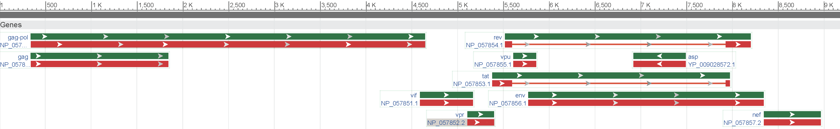
Project: Molecular surveillance of HIV-1
the material:
PCR-products of genomic regions of interest:
HIV-1
PR
L=575 bp
INT
ENV
RT
L=915 bp
L=599 bp
L=718 bp
Targeted DNA-ReSequencing
with a shotgun-like library preparation

Slide 22
Project: Molecular surveillance of HIV-1
In the past 3 years:
23 MiSeq-Runs were performed
96 samples per run
raw-reads : ≈ 800 million in total, in mean 374'000 per sample
trimmed reads: ≈ 650 million in total, in mean 297'000 per sample
sequenced bases : ≈ 117 Giga in total, in mean 54 Mega per sample

Slide 23
Workflow – concept
automatisation:
Part I:
pre-process (prepare raw reads for mapping)
main-process (iterative mapping against customized reference to generate "best" alignment)
Part II:
analyze alignment (generate consensus sequence and detect variants)
Part III:
validate results
Part IV:
purify consensus sequence (primer trimming, PR-RT-fusion)
Part V:
use sequences and results: e.g. determine subtype and drug-resistance, upload results into HIV-database
completed
completed
maximized
completed
partly possible

Slide 24
Workflow - rawdata
Illumina MiSeq (V3 / paired end → 2x 300 cyles):
kind of readpaires
Targeted PCR-product (amplicon)
no technical sequence, no overlap
300 bases forward
300 bases reverse
no technical sequence, with overlap
300 bases forward
300 bases reverse
some technical sequence, complete overlap
300 bases forward
300 bases reverse
high quality
low quality

Slide 25
Workflow I - Preprocess
Preprocessing step 1: adapterclipping
some technical sequence, complete overlap

Slide 26
Workflow I - Preprocess
Preprocessing step 2: read-merging
no technical sequence, with overlap
removed technical sequence, complete overlap

Slide 27
Workflow I - Preprocess
Preprocessing step 3: base-quality trim
high quality
low quality
no technical sequence, no overlap
no technical sequence, merged / elongated
removed technical sequence, merged / elongated

Slide 28
Workflow I – Mainprocess (overview)
standard consensus (HXB2)
map
customized consensus
map
improve consensus, consider deletions
trimmed reads
map
improve consensus, consider insertions
map
improve consensus, consider deletions
map
final alignment

Slide 29
Workflow I – Mainprocess cycle 1
standard reference | C | C | C | C | T | C | G | T | C | A | C | A | A | T | A | A | A | G | A | T | Num of Hits | Num of Errors | Score (Hits - Errors)
read_01 | C | C | C | C | T | C | G | T | C | A | C | A | A | T | A | A | A | G | A | T | 20 | 0 | 20
read_02 | C | C | A | A | T | A | G | T | C | A | C | G | A | C | T | A | A | G | A | T | 14 | 6 | 8
read_03 | C | C | A | A | T | A | G | T | C | A | C | G | A | C | T | A | A | G | A | T | 14 | 6 | 8
read_04 | C | C | C | C | T | C | G | T | C | A | C | A | A | T | A | A | A | G | A | T | 20 | 0 | 20
read_05 | C | C | C | C | T | C | G | T | C | A | C | A | A | T | A | A | A | G | A | T | 20 | 0 | 20
read_06 | C | C | A | A | T | A | G | T | C | A | C | G | A | C | T | A | A | G | A | T | 14 | 6 | 8
read_07 | C | C | A | A | T | A | G | T | C | A | C | G | A | C | T | A | A | G | A | T | 14 | 6 | 8
read_08 | C | C | A | A | T | A | G | T | C | A | C | G | A | C | T | A | A | G | A | T | 14 | 6 | 8
read_09 | C | C | C | C | T | C | G | T | C | A | C | A | A | T | A | A | A | G | A | T | 20 | 0 | 20
read_10 | C | C | A | A | T | A | G | T | C | A | C | G | A | C | T | A | A | G | A | T | 14 | 6 | 8
read_11 | unmapped - too much errors?
read_12 | unmapped - too much errors?
read_13 | unmapped - too much errors?
read_14 | unmapped - too much errors?
read_15 | unmapped - too much errors?
15 reads of many thousands
20 positions of many hundreds
map against standard reference, generate consensus 1
A | 0 | 0 | 6 | 6 | 0 | 6 | 0 | 0 | 0 | 10 | 0 | 4 | 10 | 0 | 4 | 10 | 10 | 0 | 10 | 0 | ∑=164 | ∑=36 | ∑=128
G | 0 | 0 | 0 | 0 | 0 | 0 | 10 | 0 | 0 | 0 | 0 | 6 | 0 | 0 | 0 | 0 | 0 | 10 | 0 | 0
T | 0 | 0 | 0 | 0 | 10 | 0 | 0 | 10 | 0 | 0 | 0 | 0 | 0 | 4 | 6 | 0 | 0 | 0 | 0 | 10
C | 10 | 10 | 4 | 4 | 0 | 4 | 0 | 0 | 10 | 0 | 10 | 0 | 0 | 6 | 0 | 0 | 0 | 0 | 0 | 0
consensus1 | C | C | A | A | T | A | G | T | C | A | C | G | A | C | T | A | A | G | A | T
generating consensus1 base by base using the most frequent base, ignoring insertions and deletions

Slide 30
Workflow I – Mainprocess cycle 2
consensus1 | C | C | A | A | T | A | G | T | C | A | C | G | A | C | T | A | A | G | A | T | Num of Hits | Num of Errors | Score (Hits - Errors)
read_01 | C | C | C | C | T | C | G | T | C | A | C | A | A | T | A | A | A | G | A | T | 14 | 6 | 8
read_02 | C | C | A | A | T | A | G | T | C | A | C | G | A | C | T | A | A | G | A | T | 20 | 0 | 20
read_03 | C | C | A | A | T | A | G | T | C | A | C | G | A | C | T | A | A | G | A | T | 20 | 0 | 20
read_04 | C | C | C | C | T | C | G | T | C | A | C | A | A | T | A | A | A | G | A | T | 14 | 6 | 8
read_05 | C | C | C | C | T | C | G | T | C | A | C | A | A | T | A | A | A | G | A | T | 14 | 6 | 8
read_06 | C | C | A | A | T | A | G | T | C | A | C | G | A | C | T | A | A | G | A | T | 20 | 0 | 20
read_07 | C | C | A | A | T | A | G | T | C | A | C | G | A | C | T | A | A | G | A | T | 20 | 0 | 20
read_08 | C | C | A | A | T | A | G | T | C | A | C | G | A | C | T | A | A | G | A | T | 20 | 0 | 20
read_09 | C | C | C | C | T | C | G | T | C | A | C | A | A | T | A | A | A | G | A | T | 14 | 6 | 8
read_10 | C | C | A | A | T | A | G | T | C | A | C | G | A | C | T | A | A | G | A | T | 20 | 0 | 20
read_11 | C | C | A | A | T | A | G | T | C | A | C | G | G | C | T | A | A | G | A | T | 19 | 1 | 18
read_12 | C | C | A | A | T | A | G | T | C | A | C | G | G | C | T | A | A | G | A | T | 19 | 1 | 18
read_13 | C | C | A | A | T | A | G | T | C | A | C | G | G | C | T | A | A | G | A | T | 19 | 1 | 18
read_14 | C | C | A | A | T | A | G | T | C | A | C | G | G | C | T | A | A | G | A | T | 19 | 1 | 18
read_15 | C | C | A | A | T | A | G | T | C | A | C | G | G | C | T | A | A | G | A | T | 19 | 1 | 18
map against consensus 1, generate consensus 2
A | 0 | 0 | 11 | 11 | 0 | 11 | 0 | 0 | 0 | 15 | 0 | 4 | 10 | 0 | 4 | 15 | 15 | 0 | 15 | 0 | ∑=271 | ∑=29 | ∑=242
G | 0 | 0 | 0 | 0 | 0 | 0 | 15 | 0 | 0 | 0 | 0 | 11 | 5 | 0 | 0 | 0 | 0 | 15 | 0 | 0 | previous values:
T | 0 | 0 | 0 | 0 | 15 | 0 | 0 | 15 | 0 | 0 | 0 | 0 | 0 | 4 | 11 | 0 | 0 | 0 | 0 | 15 | ∑=164 | ∑=36 | ∑=128
C | 15 | 15 | 4 | 4 | 0 | 4 | 0 | 0 | 15 | 0 | 15 | 0 | 0 | 11 | 0 | 0 | 0 | 0 | 0 | 0
temp. consensus2 | C | C | A | A | T | A | G | T | C | A | C | G | A | C | T | A | A | G | A | T
generating consensus2 base by base using the most frequent base, ignoring deletions

Slide 31
Workflow I – Mainprocess cycle 2
temp. consensus2 | C | A | G | T | A | C | T | G | G | A | T | G | T | G | G | G | T | G | A | T | Num of Hits | Num of Errors | Score (Hits - Errors)
read_101 | C | A | G | T | A | C | T | G | G | A | * | * | * | G | G | G | T | G | A | T | 17 | 3 | 14
read_102 | C | A | G | T | A | C | T | G | G | A | * | * | * | G | G | G | T | G | A | T | 17 | 3 | 14
read_103 | C | A | G | T | A | C | T | G | G | A | * | * | * | G | G | G | T | G | A | T | 17 | 3 | 14
read_104 | C | A | G | T | A | C | T | G | G | A | * | * | * | G | G | G | T | G | A | T | 17 | 3 | 14
read_105 | C | A | G | T | A | C | T | G | G | A | T | G | T | G | G | G | T | G | A | T | 20 | 0 | 17
read_106 | C | A | G | T | A | C | T | G | G | A | T | G | T | G | G | G | T | G | A | T | 20 | 0 | 17
read_107 | C | A | G | T | A | C | T | G | G | A | * | * | * | G | G | G | T | G | A | T | 17 | 3 | 14
read_108 | C | A | G | T | A | C | T | G | G | A | T | G | T | G | G | G | T | G | A | T | 20 | 0 | 17
read_109 | C | A | G | T | A | C | T | G | G | A | T | G | T | G | G | G | T | G | A | T | 20 | 0 | 17
read_110 | C | A | G | T | A | C | T | G | G | A | * | * | * | G | G | G | T | G | A | T | 17 | 3 | 14
read_111 | C | A | G | T | A | C | T | G | G | A | * | * | * | G | G | G | T | G | A | T | 17 | 3 | 14
read_112 | C | A | G | T | A | C | T | G | G | A | * | * | * | G | G | G | T | G | A | T | 17 | 3 | 14
read_113 | C | A | G | T | A | C | T | G | G | A | * | * | * | G | G | G | T | G | A | T | 17 | 3 | 14
read_114 | C | A | G | T | A | C | T | G | G | A | * | * | * | G | G | G | T | G | A | T | 17 | 3 | 14
read_115 | C | A | G | T | A | C | T | G | G | A | * | * | * | G | G | G | T | G | A | T | 17 | 3 | 14
remove deletions in consensus 2
A | 0 | 15 | 0 | 0 | 15 | 0 | 0 | 0 | 0 | 15 | 0 | 0 | 0 | 0 | 0 | 0 | 0 | 0 | 15 | 0 | ∑=267 | ∑=33 | ∑=222
G | 0 | 0 | 15 | 0 | 0 | 0 | 0 | 15 | 15 | 0 | 0 | 4 | 0 | 15 | 15 | 15 | 0 | 15 | 0 | 0
T | 0 | 0 | 0 | 15 | 0 | 0 | 15 | 0 | 0 | 0 | 4 | 0 | 4 | 0 | 0 | 0 | 15 | 0 | 0 | 15
C | 15 | 0 | 0 | 0 | 0 | 15 | 0 | 0 | 0 | 0 | 0 | 0 | 0 | 0 | 0 | 0 | 0 | 0 | 0 | 0
consensus2 | C | C | A | A | T | A | G | T | C | A | (remove) | C | T | A | A | G | A | T
editing consensus2 by removing deletions, ignoring insertions

Slide 32
Workflow I – Mainprocess cycle 2
consensus2 | C | A | G | T | A | C | T | G | G | A | (removed) | G | G | G | T | G | A | T | Num of Hits | Num of Errors | Score (Hits - Errors)
read_101 | C | A | G | T | A | C | T | G | G | A |  |  |  | G | G | G | T | G | A | T | 17 | 0 | 17
read_102 | C | A | G | T | A | C | T | G | G | A |  |  |  | G | G | G | T | G | A | T | 17 | 0 | 17
read_103 | C | A | G | T | A | C | T | G | G | A |  |  |  | G | G | G | T | G | A | T | 17 | 0 | 17
read_104 | C | A | G | T | A | C | T | G | G | A |  |  |  | G | G | G | T | G | A | T | 17 | 0 | 17
read_105 | C | A | G | T | A | C | T | G | G | A | T | G | T | G | G | G | T | G | A | T | 17 | 3 | 14
read_106 | C | A | G | T | A | C | T | G | G | A | T | G | T | G | G | G | T | G | A | T | 17 | 3 | 14
read_107 | C | A | G | T | A | C | T | G | G | A |  |  |  | G | G | G | T | G | A | T | 17 | 0 | 17
read_108 | C | A | G | T | A | C | T | G | G | A | T | G | T | G | G | G | T | G | A | T | 17 | 3 | 14
read_109 | C | A | G | T | A | C | T | G | G | A | T | G | T | G | G | G | T | G | A | T | 17 | 3 | 14
read_110 | C | A | G | T | A | C | T | G | G | A |  |  |  | G | G | G | T | G | A | T | 17 | 0 | 17
read_111 | C | A | G | T | A | C | T | G | G | A |  |  |  | G | G | G | T | G | A | T | 17 | 0 | 17
read_112 | C | A | G | T | A | C | T | G | G | A |  |  |  | G | G | G | T | G | A | T | 17 | 0 | 17
read_113 | C | A | G | T | A | C | T | G | G | A |  |  |  | G | G | G | T | G | A | T | 17 | 0 | 17
read_114 | C | A | G | T | A | C | T | G | G | A |  |  |  | G | G | G | T | G | A | T | 17 | 0 | 17
read_115 | C | A | G | T | A | C | T | G | G | A |  |  |  | G | G | G | T | G | A | T | 17 | 0 | 17
map against consensus 2, generate consensus 3
A | 0 | 15 | 0 | 0 | 15 | 0 | 0 | 0 | 0 | 15 |  |  |  | 0 | 0 | 0 | 0 | 0 | 15 | 0 | ∑=255 | ∑=12 | ∑=243
G | 0 | 0 | 15 | 0 | 0 | 0 | 0 | 15 | 15 | 0 |  |  |  | 15 | 15 | 15 | 0 | 15 | 0 | 0 | previous values:
T | 0 | 0 | 0 | 15 | 0 | 0 | 15 | 0 | 0 | 0 |  |  |  | 0 | 0 | 0 | 15 | 0 | 0 | 15 | ∑=267 | ∑=33 | ∑=222
C | 15 | 0 | 0 | 0 | 0 | 15 | 0 | 0 | 0 | 0 |  |  |  | 0 | 0 | 0 | 0 | 0 | 0 | 0
temp. consensus3 | C | C | A | A | T | A | G | T | C | A | (removed) | C | T | A | A | G | A | T
generating consensus3 base by base using the most frequent base, ignoring insertions

Slide 33
Workflow I – Mainprocess cycle 3
temp. consensus3 | C | A | G | T | T | A | C | G | (insert) | T | A | G | A | T | T | G | A | T | Num of Hits | Num of Errors | Score (Hits - Errors)
read_1101 | C | A | G | T | T | A | C | G |  |  |  | T | A | G | A | T | T | G | A | T | 17 | 0 | 17
read_1102 | C | A | G | T | T | A | C | G |  |  |  | T | A | G | A | T | T | G | A | T | 17 | 0 | 17
read_1103 | C | A | G | T | T | A | C | G | G | A | G | T | A | G | A | T | T | G | A | T | 17 | 3 | 14
read_1104 | C | A | G | T | T | A | C | G | G | A | G | T | A | G | A | T | T | G | A | T | 17 | 3 | 14
read_1105 | C | A | G | T | T | A | C | G | G | A | G | T | A | G | A | T | T | G | A | T | 17 | 3 | 14
read_1106 | C | A | G | T | T | A | C | G | G | A | G | T | A | G | A | T | T | G | A | T | 17 | 3 | 14
read_1107 | C | A | G | T | T | A | C | G |  |  |  | T | A | G | A | T | T | G | A | T | 17 | 0 | 17
read_1108 | C | A | G | T | T | A | C | G | G | A | G | T | A | G | A | T | T | G | A | T | 17 | 3 | 14
read_1109 | C | A | G | T | T | A | C | G | G | A | G | T | A | G | A | T | T | G | A | T | 17 | 3 | 14
read_1110 | C | A | G | T | T | A | C | G | G | A | G | T | A | G | A | T | T | G | A | T | 17 | 3 | 14
read_1111 | C | A | G | T | T | A | C | G | G | A | G | T | A | G | A | T | T | G | A | T | 17 | 3 | 14
read_1112 | C | A | G | T | T | A | C | G | G | A | G | T | A | G | A | T | T | G | A | T | 17 | 3 | 14
read_1113 | C | A | G | T | T | A | C | G | G | A | G | T | A | G | A | T | T | G | A | T | 17 | 3 | 14
read_1114 | C | A | G | T | T | A | C | G |  |  |  | T | A | G | A | T | T | G | A | T | 17 | 0 | 17
read_1115 | C | A | G | T | T | A | C | G | G | A | G | T | A | G | A | T | T | G | A | T | 17 | 3 | 14
add insertions to consensus3
A | 0 | 15 | 0 | 0 | 0 | 15 | 0 | 0 |  |  |  | 0 | 15 | 0 | 15 | 0 | 0 | 0 | 15 | 0 | ∑=255 | ∑=33 | ∑=222
G | 0 | 0 | 15 | 0 | 0 | 0 | 0 | 15 |  |  |  | 0 | 0 | 15 | 0 | 0 | 0 | 15 | 0 | 0
T | 0 | 0 | 0 | 15 | 15 | 0 | 0 | 0 |  |  |  | 15 | 0 | 0 | 0 | 15 | 15 | 0 | 0 | 15
C | 15 | 0 | 0 | 0 | 0 | 0 | 15 | 0 |  |  |  | 0 | 0 | 0 | 0 | 0 | 0 | 0 | 0 | 0
consensus3 | C | A | G | T | T | A | C | G | G | A | G | T | A | G | A | T | T | G | A | T
editing consensus3 by adding insertions, ignoring deletions

Slide 34
Workflow I – Mainprocess cycle 4
consensus3 | C | A | G | T | T | A | C | G | G | A | G | T | A | G | A | T | T | G | A | T | Num of Hits | Num of Errors | Score (Hits - Errors)
read_1101 | C | A | G | T | T | A | C | G | * | * | * | T | A | G | A | T | T | G | A | T | 17 | 3 | 14
read_1102 | C | A | G | T | T | A | C | G | * | * | * | T | A | G | A | T | T | G | A | T | 17 | 3 | 14
read_1103 | C | A | G | T | T | A | C | G | G | A | G | T | A | G | A | T | T | G | A | T | 20 | 0 | 20
read_1104 | C | A | G | T | T | A | C | G | G | A | G | T | A | G | A | T | T | G | A | T | 20 | 0 | 20
read_1105 | C | A | G | T | T | A | C | G | G | A | G | T | A | G | A | T | T | G | A | T | 20 | 0 | 20
read_1106 | C | A | G | T | T | A | C | G | G | A | G | T | A | G | A | T | T | G | A | T | 20 | 0 | 20
read_1107 | C | A | G | T | T | A | C | G | * | * | * | T | A | G | A | T | T | G | A | T | 17 | 3 | 14
read_1108 | C | A | G | T | T | A | C | G | G | A | G | T | A | G | A | T | T | G | A | T | 20 | 0 | 20
read_1109 | C | A | G | T | T | A | C | G | G | A | G | T | A | G | A | T | T | G | A | T | 20 | 0 | 20
read_1110 | C | A | G | T | T | A | C | G | G | A | G | T | A | G | A | T | T | G | A | T | 20 | 0 | 20
read_1111 | C | A | G | T | T | A | C | G | G | A | G | T | A | G | A | T | T | G | A | T | 20 | 0 | 20
read_1112 | C | A | G | T | T | A | C | G | G | A | G | T | A | G | A | T | T | G | A | T | 20 | 0 | 20
read_1113 | C | A | G | T | T | A | C | G | G | A | G | T | A | G | A | T | T | G | A | T | 20 | 0 | 20
read_1114 | C | A | G | T | T | A | C | G | * | * | * | T | A | G | A | T | T | G | A | T | 17 | 3 | 14
read_1115 | C | A | G | T | T | A | C | G | G | A | G | T | A | G | A | T | T | G | A | T | 20 | 0 | 20
map against consensus 3, generate consensus 4
A | 0 | 15 | 0 | 0 | 0 | 15 | 0 | 0 | 0 | 11 | 0 | 0 | 15 | 0 | 15 | 0 | 0 | 0 | 15 | 0 | ∑=288 | ∑=12 | ∑=276
G | 0 | 0 | 15 | 0 | 0 | 0 | 0 | 15 | 11 | 0 | 11 | 0 | 0 | 15 | 0 | 0 | 0 | 15 | 0 | 0 | previous values:
T | 0 | 0 | 0 | 15 | 15 | 0 | 0 | 0 | 0 | 0 | 0 | 15 | 0 | 0 | 0 | 15 | 15 | 0 | 0 | 15 | ∑=255 | ∑=33 | ∑=222
C | 15 | 0 | 0 | 0 | 0 | 0 | 15 | 0 | 0 | 0 | 0 | 0 | 0 | 0 | 0 | 0 | 0 | 0 | 0 | 0
temp. consensus4 | C | A | G | T | T | A | C | G | G | A | G | T | A | G | A | T | T | G | A | T

Slide 35
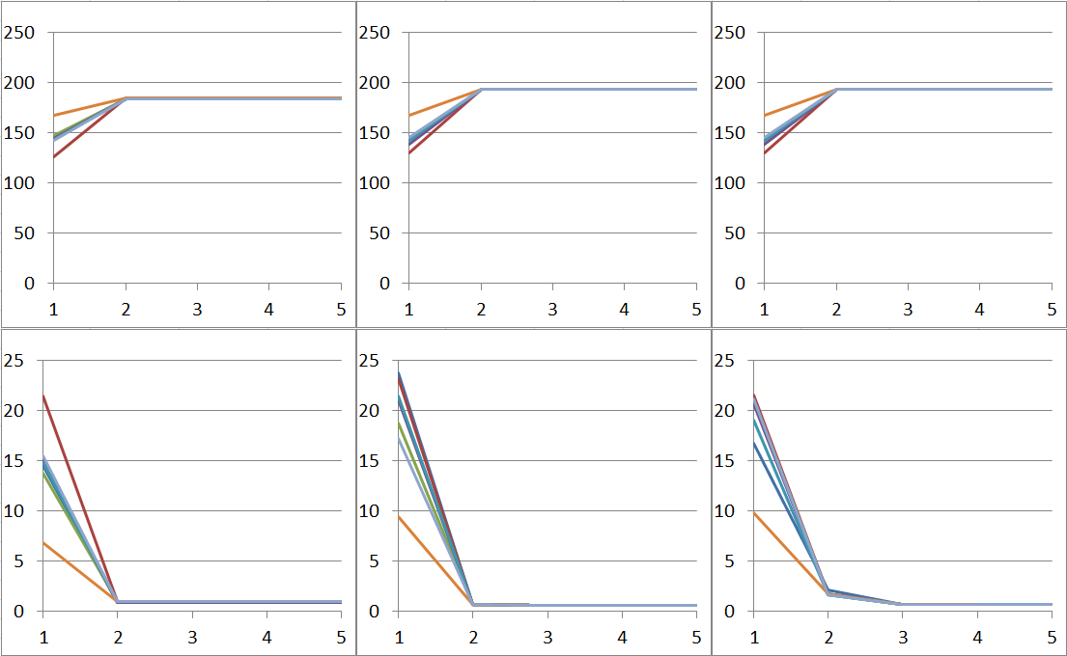
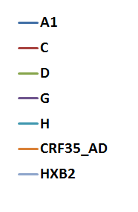
Workflow I - Mainprocess
Mainprocess: the reference sequence
Question: does the chosen start-reference affect the resulting alignment?
Answer: No! Mapping against 7 different start-references leads to identical results for a single sample.
PR-fragment
RT-fragment
INT-fragment
alignment-score
(mean)
editing distance
(mean)
mapping cycles

Slide 36
Workflow I – Mainprocess (overview)
standard consensus (HXB2)
map
editing distance
num. of unmapps
customized consensus
map
improve consensus, consider deletions
trimmed reads
map
improve consensus, consider insertions
map
alignment precision
alignment score
improve consensus, consider deletions
map
final alignment
→ ready for analysis

Slide 37
Workflow II – codon-based analysis
most NGS-tools detect variants on nucleotide level:
Codon Position | 193 |  |  | 194 |  |  | 195
Base Position | 577 | 578 | 579 | 580 | 581 | 582 | 583 | 584 | 585
read1 | T | T | T | A | C | C | A | C | A
read2 | T | T | T | A | C | C | A | C | A
read3 | T | T | T | A | C | C | A | C | A
read4 | T | T | T | A | C | C | A | C | A
read5 | T | T | T | A | C | C | A | C | A
read6 | T | T | T | A | C | C | A | C | A
read7 | T | T | T | A | C | C | A | C | A
read8 | T | T | T | A | C | C | A | C | A
read9 | T | T | T | T | A | C | A | C | A
read10 | T | T | T | T | A | C | A | C | A
A | 0 | 0 | 0 | 8 | 2 | 0 | 10 | 0 | 10
G | 0 | 0 | 0 | 0 | 0 | 0 | 0 | 0 | 0
T | 10 | 10 | 10 | 2 | 0 | 0 | 0 | 0 | 0
C | 0 | 0 | 0 | 0 | 8 | 10 | 0 | 10 | 0
WMC | ACC | T
 | TAC | Y
 | AAC | N
 | TCC | S
Consensus | T | T | T | W | M | C | A | C | A
variant report | nt: 580 | A: 80% | T: 20%
 | nt: 581 | A: 20% | C: 80%
 | nt: 582 | C: 100%

Slide 38
Workflow II – codon-based analysis
our tool detects variants on codon level:
Codon Position | 193 |  |  | 194 |  |  | 195
Base Position | 577 | 578 | 579 | 580 | 581 | 582 | 583 | 584 | 585
read1 | T | T | T | A | C | C | A | C | A
read2 | T | T | T | A | C | C | A | C | A
read3 | T | T | T | A | C | C | A | C | A
read4 | T | T | T | A | C | C | A | C | A
read5 | T | T | T | A | C | C | A | C | A
read6 | T | T | T | A | C | C | A | C | A
read7 | T | T | T | A | C | C | A | C | A
read8 | T | T | T | A | C | C | A | C | A
read9 | T | T | T | T | A | C | A | C | A
read10 | T | T | T | T | A | C | A | C | A
additional benefits of codon-based analysis:
reduced probability of randomly accumulated errors
increased sensitivity
 |  | TTT |  |  | ACC |  |  | ACA
 |  | 10 |  |  | 8 |  |  | 10
 |  |  |  |  | TAC
 |  |  |  |  | 2
WMC | ACC | T
 | TAC | Y
 | AAC | N
 | TCC | S
Consensus | T | T | T | W | M | C | A | C | A
variant report
 | codon: 194 | ACC: 80% | TAC: 20%
Same as formerly
new

Slide 39
Workflow II – codon-based analysis
CodonAnalyser – Sample Output (resistance mutations)
MedClass | FragNum | MutName | Codon | percentage | MedClass | FragNum | MutName | Codon | percentage
PI | 1 | L10I | (ATT) | 54.69% | PI | 1 | L10V | (GTT) | 44.40%
PI | 1 | G16E | (GAA) | 80.92%
PI | 1 | K20I | (ATA) | 22.51%
PI | 1 | M36I | (ATA) | 99.72%
PI | 1 | H69K | (AAA) | 98.68%
PI | 1 | L89M | (ATG) | 99.64%
NRTI | 2 | A62V | (GTT) | 98.91%
NNRTI | 2 | V90I | (ATT) | 98.85%
NNRTI | 2 | K103N | (AAT) | 98.95%
NNRTI | 2 | P225H | (CAC) | 98.74%
INI | 3 | L74M | (ATG) | 99.51%

Slide 40
Workflow II – codon-based analysis
CodonAnalyser – Sample Output ("details")
frag | Codon Position | Valid coverage | meanCodon Quality | Main Codon | percentage | Variant Codon | percentage
…
frag_1 | pos_53 | 33'670 | 37.51 | TTT | 99.54%
frag_1 | pos_54 | 34'336 | 37.63 | ATC | 82.08% | CTC | 17.48%
frag_1 | pos_55 | 35'381 | 37.70 | AAA | 99.12%
frag_1 | pos_56 | 36'107 | 37.70 | GTA | 99.62%
frag_1 | pos_57 | 36'088 | 37.67 | AGA | 99.23%
frag_1 | pos_58 | 35'376 | 37.71 | CAG | 79.58% | GAG | 19.78%
frag_1 | pos_59 | 33'907 | 37.68 | TAT | 99.29%
frag_1 | pos_60 | 33'236 | 37.64 | GAT | 99.25%
frag_1 | pos_61 | 35'150 | 37.69 | CAG | 82.57% | CAA | 17.15%
frag_1 | pos_62 | 35'335 | 37.66 | ATA | 82.45% | GTA | 17.20%
frag_1 | pos_63 | 34'402 | 37.62 | CTC | 83.33% | TCC | 16.11%
frag_1 | pos_64 | 36'162 | 37.68 | ATA | 83.37% | ATG | 16.19%
frag_1 | pos_65 | 35'800 | 37.64 | GAA | 99.40%
frag_1 | pos_66 | 35'398 | 37.59 | ATC | 99.59%
frag_1 | pos_67 | 36'215 | 37.61 | TGC | 80.80% | TGT | 18.90%
frag_1 | pos_68 | 34'790 | 37.57 | GGA | 99.37%
…

Slide 41
Workflow III – validating results
each fragment must to be validated separately
to presume "true" results we request:
mean coverage > 5'000
minimal coverage > 500
maximal coverage > 10'000
a mean codonquality > 35.0
certainly not over the complete fragments,
but without the flanking primerregions!
not very complex for a single sample with 2-4 fragments, but…
… a complete MiSeq-run provides 96 samples

Slide 42
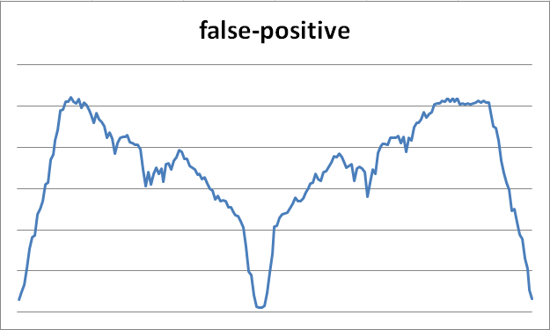
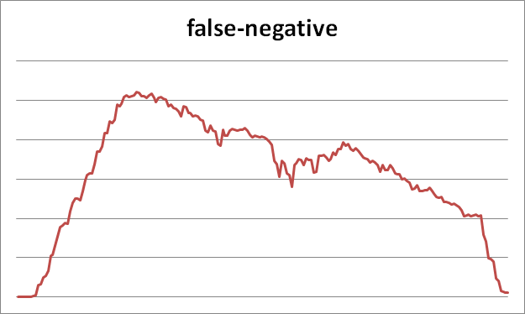
Workflow III – validating results
using a Python script to extract relevant data
using an Excel template sheet to calculate statistics
but this statistics can be unreliable friends:
false-positive:
min, mean, max valid coverage seem satisfactorily,
but the min-value originate from the center of the fragment
false-negative:
mean and max valid coverage seem satisfactorily, min-value << 500
but the insufficient min-value originate from an endstanding position
coverage
position at fragment
coverage
position at fragment

Slide 43
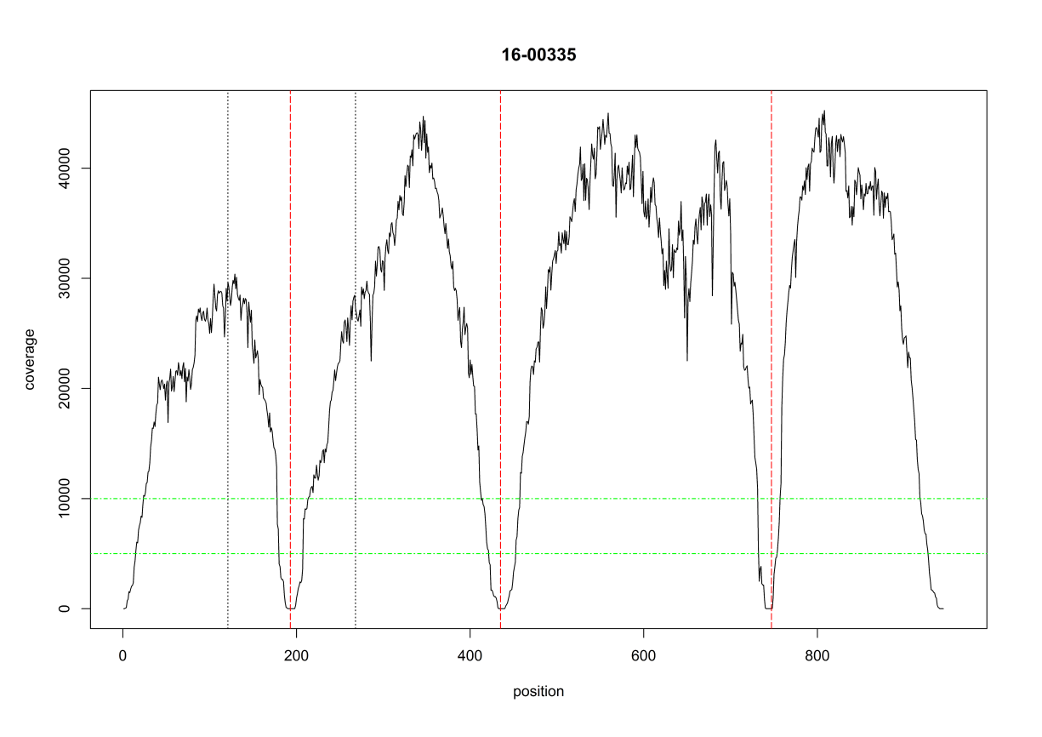
Workflow III – validating results
using a R-script to generate plots
sample name
PR
RT
INT
ENV
overlap
coverage
10'000 for max
5'000 for mean
position at fragments

Slide 44
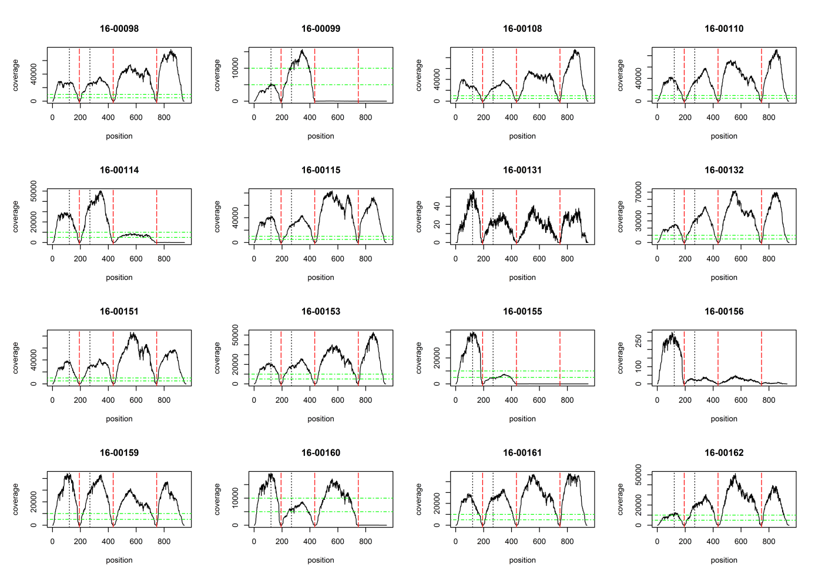
Workflow III – validating results
... many plots

Slide 45
Workflow IV – adjust sample consensus
remove flanking primer
PR
RT
INT
ENV

Slide 46
Workflow IV – adjust sample consensus
merge PR and RT consensus to single PRRT-Sequence
PR
PRRT
RT
INT
ENV

Slide 47
Workflow V - completion
use webtools for subtyping
generate file(s) for parallel sequence-upload to HIV-DB
generate file(s) for parallel variant-upload to HIV-DB
generate file for parallel subtype-upload to HIV-DB
remove invalid parts of results

Slide 48
Project: Molecular surveillance
In the past 3 years:
23 MiSeq-Runs were performed
96 samples per run
raw-reads : ≈ 800 million in total, in mean 374'000 per sample
trimmed reads: ≈ 650 million in total, in mean 297'000 per sample
sequenced bases : ≈ 117 Giga in total, in mean 54 Mega per sample
…
≈1'500 PRRT sequences were generated
≈ 900 INT sequences were generated
≈ 400 ENV sequences were generated

Slide 49
Outlook
aside from executing this routine, we should:
find the lowest trustable coverage → generate valid results from suboptimal runs / samples
identify non-HIV-reads (unmapped reads) → improve lab-settings to suspend such "contaminations"
find correlations between viral load / amount of PCR-product and the chance of successful sequencing → exclude samples with very low chance for a valid sequence
test / adapt the pipeline / workflow for additional fragments (HCV) → potential problem: crossmapping between HIV- and HCV-reads
test / adapt the pipeline / workflow for full-length amplicons → potential problem: more and complexer structural variants (InDels)
always test, bugfix, upgrade the pipeline and ease the workflow

Slide 50
Thank you for attention

