Slide 1


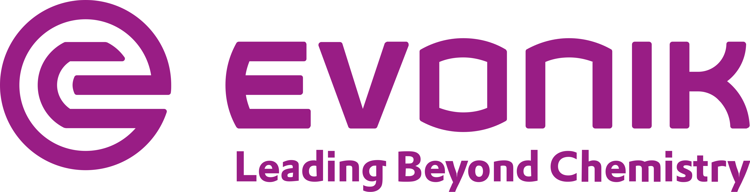
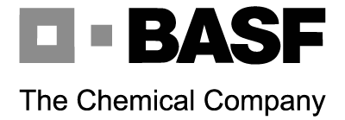

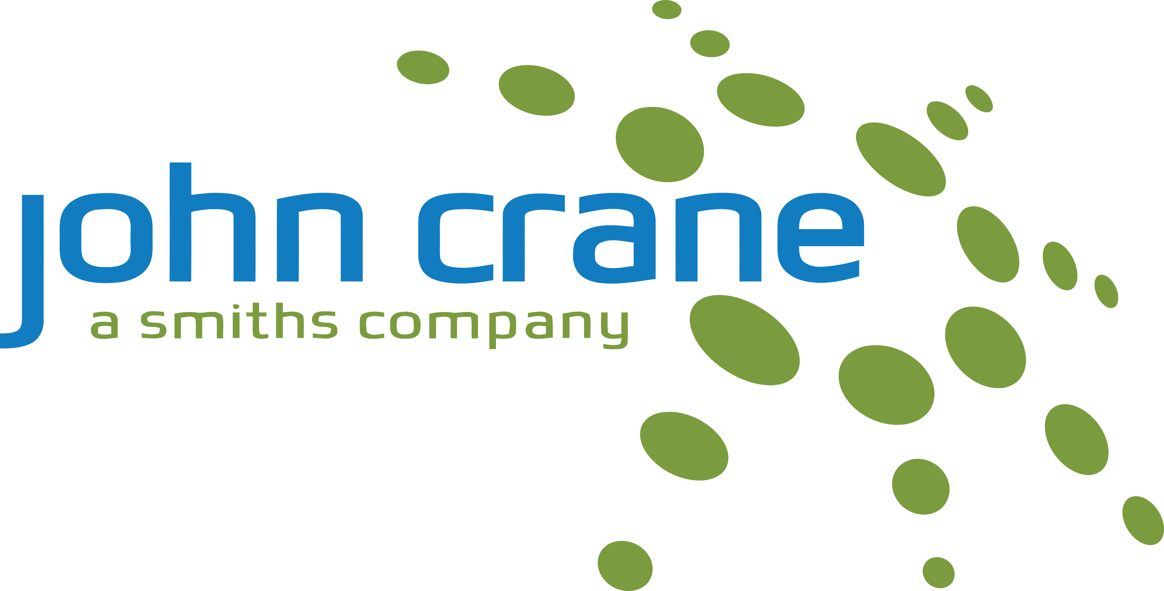

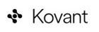
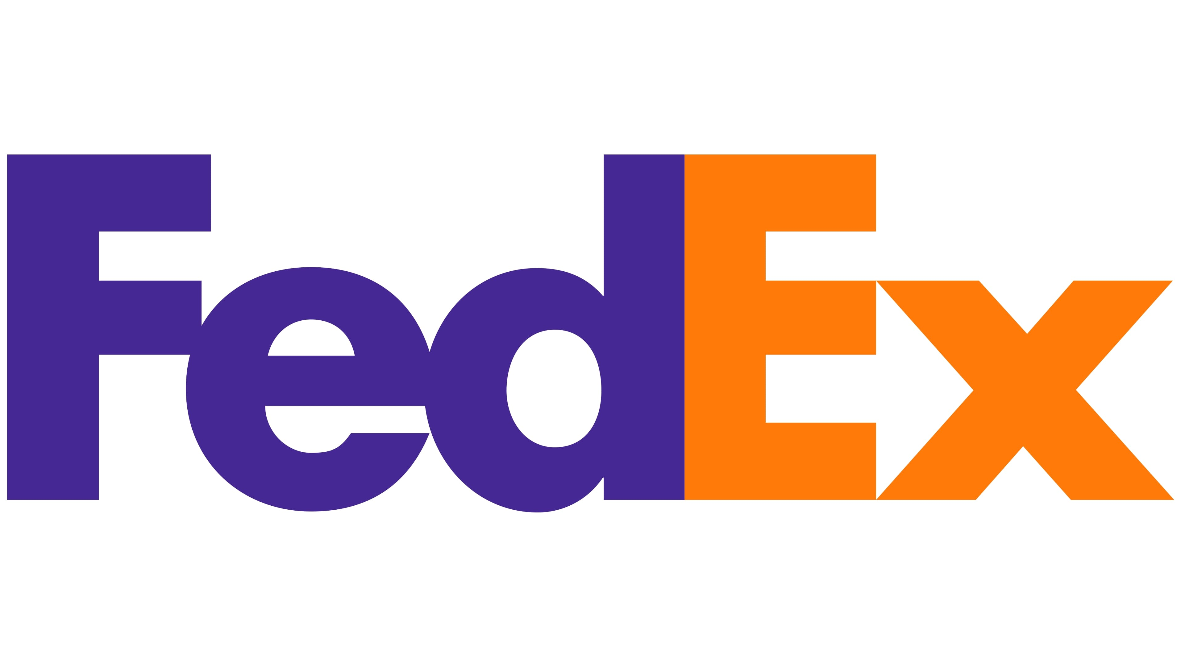



WHO WAS THERE
MUNICH, GERMANY · MAY 2026
Amazon
APM Terminals
Operational Excellence &
Process Transformation Summit
ASML
BASF
Bilfinger
Bizagi
FEATURED PARTICIPANTS
BTA Food & Services
CCC Group
› 3-day international summit
Process transformation, continuous improvement, and operational excellence in the AI era.
› BMW Museum opening visit
Day 1 at the BMW Museum — a live case study in precision and innovation culture.
› 2 full days of sessions
Workshops, keynotes, and peer-led success stories from global organizations.
› 27 organizations in the room
Across industry, logistics, chemicals, tech, manufacturing, and beyond.
Columbia Sportswear
European XFEL
Evonik
exceedium
FedEx
HelloFresh
John Crane
Kaizen Institute
Kovant
Linde
MediaMarktSaturn
NORMA Group
Pandatron
PPG
Shell
Six Sigma Inst.
Sixt
Solidelectron
Specialized
Sportradar
1

Slide 2
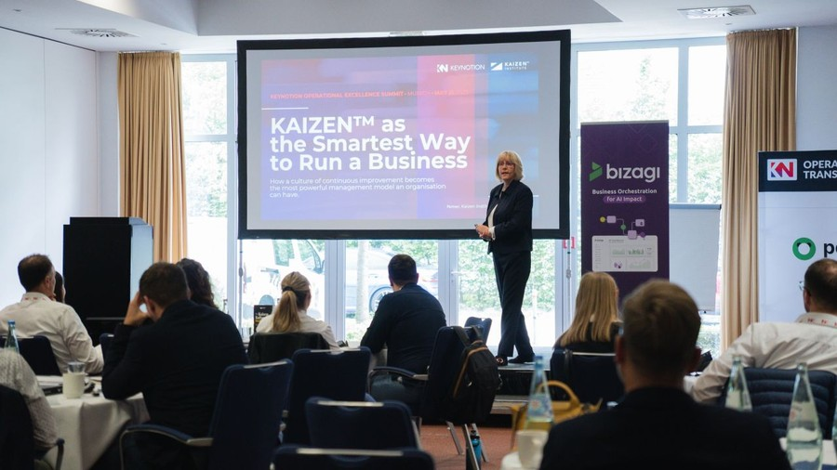
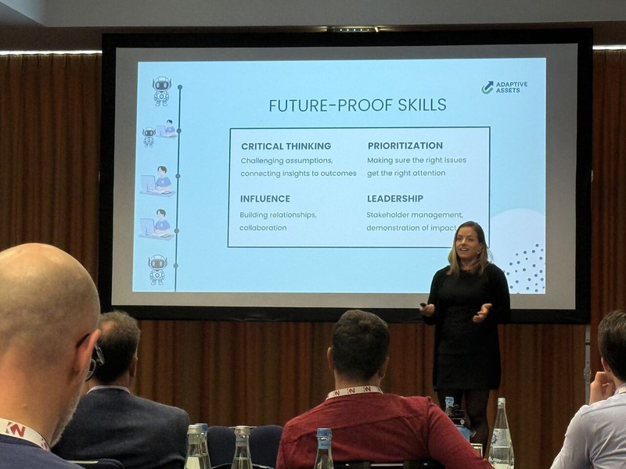
OPEX 2026 · KEY LEARNINGS
What I Brought Back
1
OutSystems visibility
Only a few attendees had heard of OutSystems — a reminder of how much brand reach still matters outside the tech bubble.
2
Agents as team members
"Agents are your new team members" — Somil Gupta (Kovant). Multiple speakers confirmed agents running as process operators with human oversight is where the industry is heading.
3
AI trust gap
A general feeling of lack of trust in AI persisted. Only a handful of presentations showed AI making a measurable difference in their organizations.
4
We are ahead on enablement
Compared with non-tech organizations, our AI enablement level is already above average. We have a head start — the question is whether we use it.
5
ASML x Kaizen hypergrowth
ASML leveraged Kaizen as their hypergrowth strategy from day one. A powerful proof point: continuous improvement frameworks scale from startup to global leader.
2

Slide 3
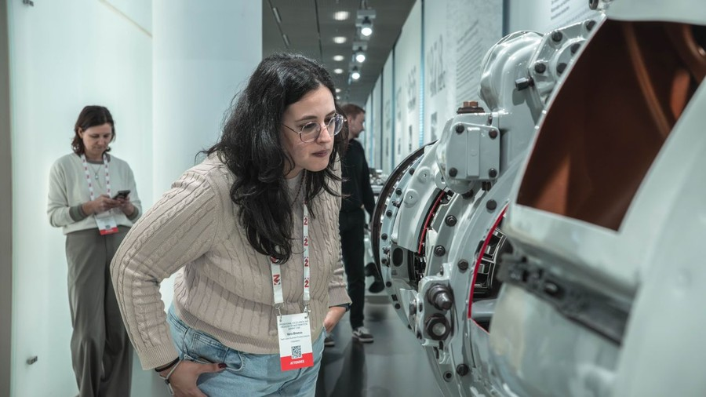
OPEX 2026 · IMPLICATIONS
What This Means for Process Engineering & Engineering Ops
Validate the direction
We are leading
The 'agents as process operators' framing aligns exactly with Method 1 (AI Transformation).
OPEX 2026 confirms we are building toward the right future.
OutSystems is ahead on AI change management — not just PE, the whole company. When we explained how we enable AI across the org, the room noticed.
This is a competitive advantage worth protecting.
Kaizen as a cultural foundation
Outcomes earn credibility
ASML's story only works because Kaizen was never a side project — it was embedded in how they operate from day one. OPEX made it clear: you cannot build a continuous improvement culture on the margins.
It needs dedicated ownership, time, and investment. We don't have solid foundations yet. That's the work.
The AI trust gap is real — most organizations in the room hadn't seen AI deliver. The answer isn't more tools or more talking points. It's visible results tied to real problems. Every win PE delivers is a proof point.
3

