Slide 1
Coupon-System Analysis
Antavo Challenge 2022

Slide 2
TABLE OF CONTENTS
Dataset pre-processing
Analytics
Results
Specific utilities
Data handler scripts
Plotting
Predicting
Processing scripts
Evaluation
Suggestions

Slide 3
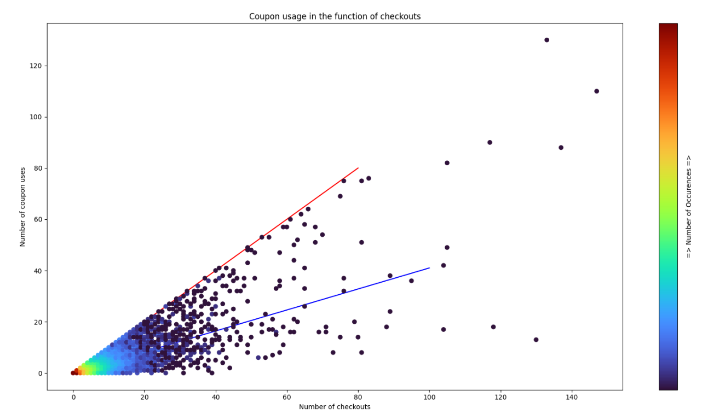
Customer statistics – Coupon usage

Slide 4
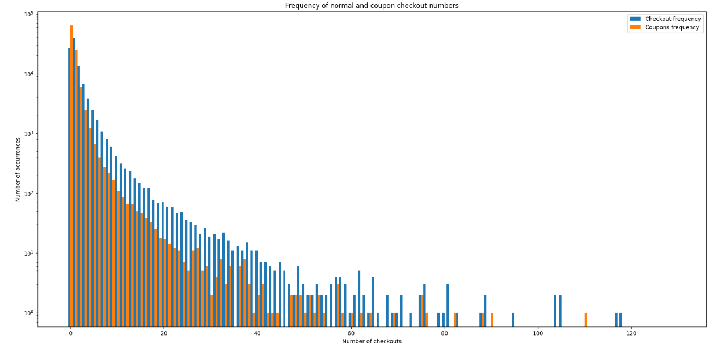
Customer statistics – Frequency of coupon usage

Slide 5
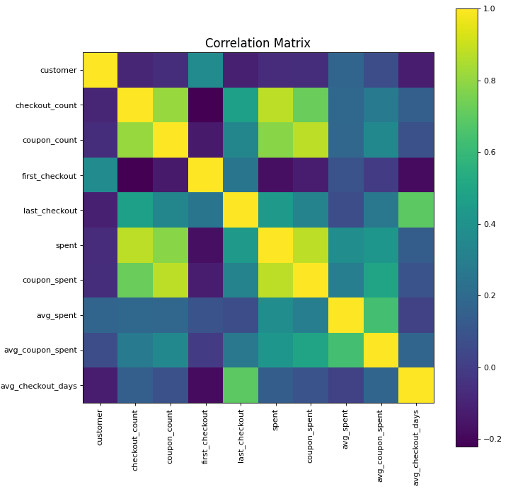
Customer statistics – Correlation matrix

Slide 6
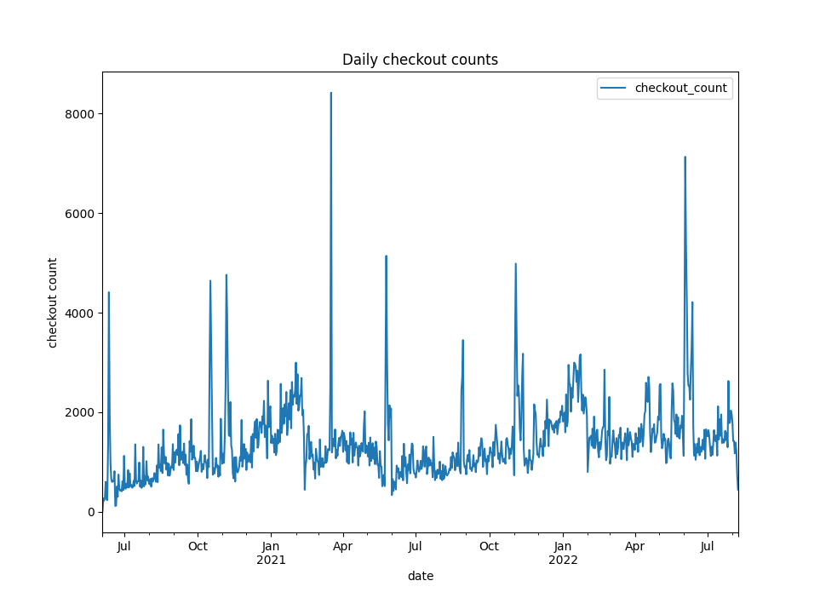
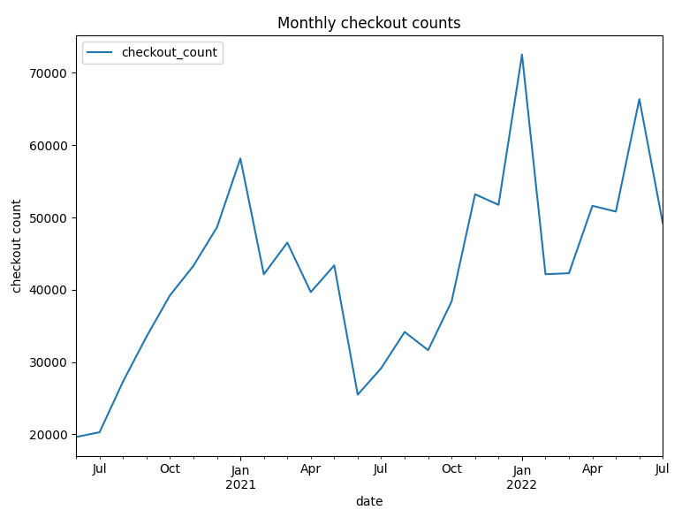
Daily/Monthly statistics –Checkout counts

Slide 7
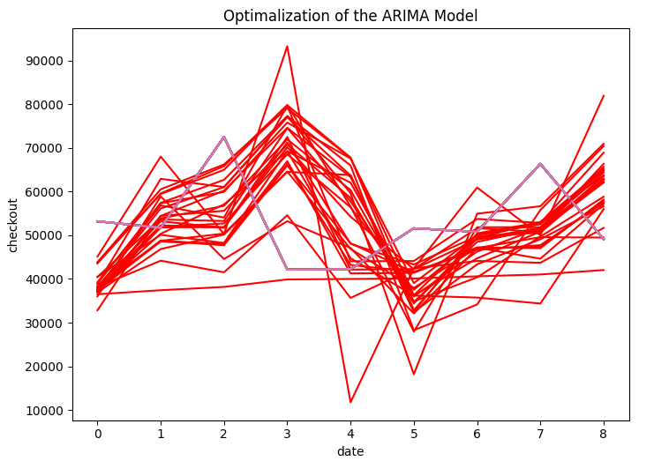
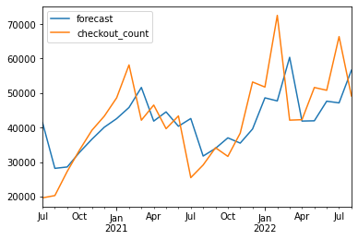
ARIMA model – Prediction

Slide 8
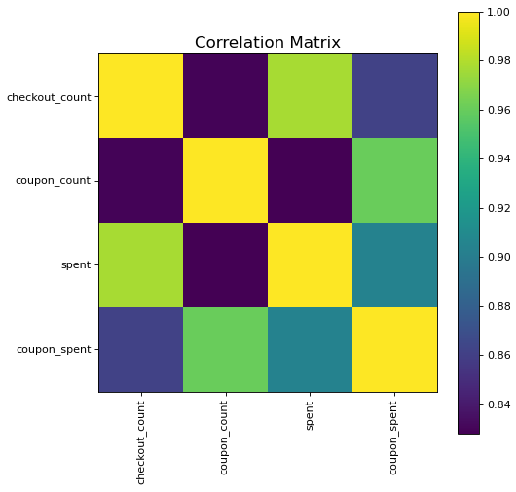
Correlation Matrix

Slide 9
Improvements
For new customers:
Less coupons and discounts
More possibilities for other benefits for e.g.: memebership promotions
For old customers:
More coupons and discounts
More advertisement about coupons and discounts

Slide 10
Thank you for your attention!

