Slide 1
Elasticsearch
By Vera Kalinichenko

Slide 2
Buzz WordS.
Open Source
JSON
Rest
Http
Lucene
Distributed Data Store
Very good for Searching and Analyzing Data

Slide 3
Search engine. Lucene.
Lucene was first release in 2000 by SourceForge
Java-based indexing and search technology
Sorl is a high performance search server built using Lucene Core, with XML/HTTP and JSON/Python/Ruby APIs, hit highlighting, facets search, caching, replication, and a web admin interface.

Slide 4

Structured vs. unstructure
Organized Information
Schema
Examples: Database – structured, how about Emails?

Slide 5
Features
Endless Plugins in Elasticsearch
Nice Graphical Interface
Community Support

Slide 6
How it works…
Protocol | Advantages | Disadvantages | Type
HTTP | More often use. Api safe. Compatible with different ES versions. Suggested JSON . | Overhead | Text
Native | Programmatic. Massive indexing, fast. | Api changes break application | Binary
Thrift | As Http |  | Binary

Slide 7
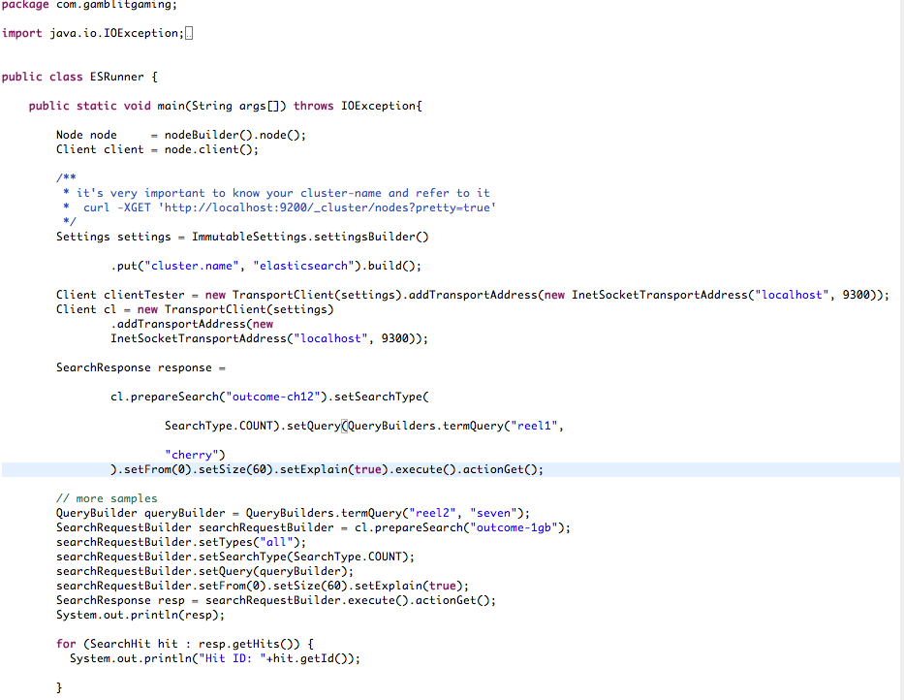
How to do it? Native Example

Slide 8
How to do it? Logstash
Edit log4j.properties file
Create logstash configuration file (shipper.conf)
Download logstash jar
Run the following
java –jar logstash-1.3.3-flatjar.jar agent –f shipper.conf

Slide 9
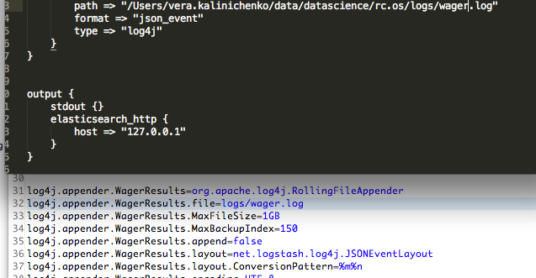
Logstash Configuration and log4j.properties

Slide 10
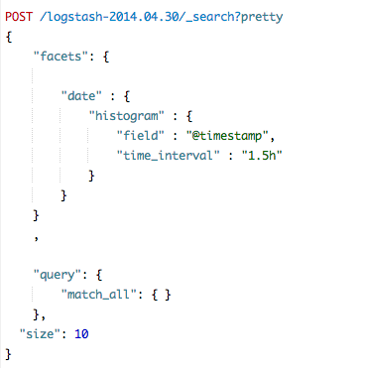
Facets - Aggregations

Slide 11
What are Facets? Why? How?
Facets – ability to find subcategories within your data.
Improve results
Faceting is an additional step in the query processing
They allow to execute
Histogram
Counting
Statistics
Geo distance aggregation
The main usage of facets is to provide additional data to the search results to improve the results quality.

Slide 12
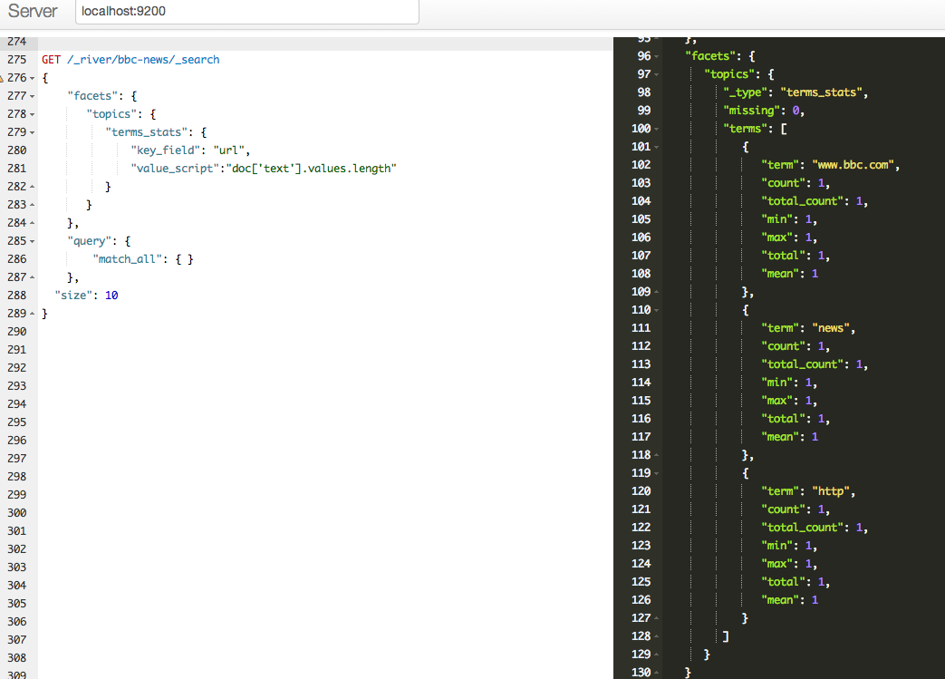
Facets. Examples. BBC Crawled -Data

Slide 13
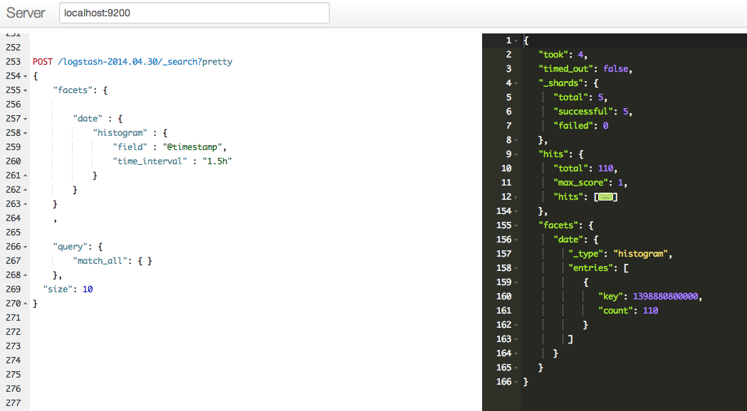
Facets. Examples. Logstash out the box

Slide 14
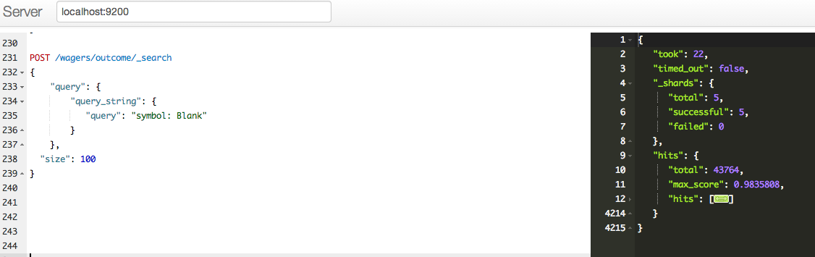
More Examples.

Slide 15
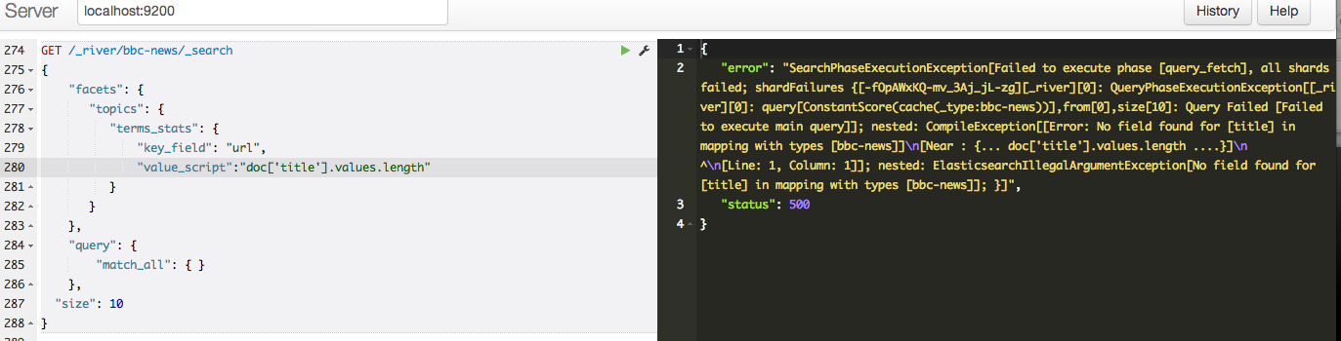
Executing and Debugging.

Slide 16
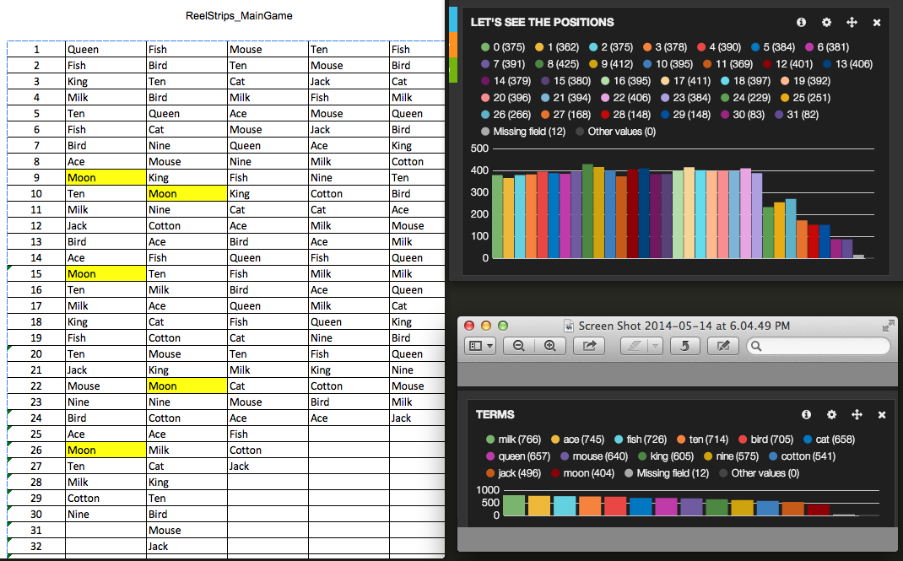
Reels. Position Aggregation and The theoretical reel.

Slide 17
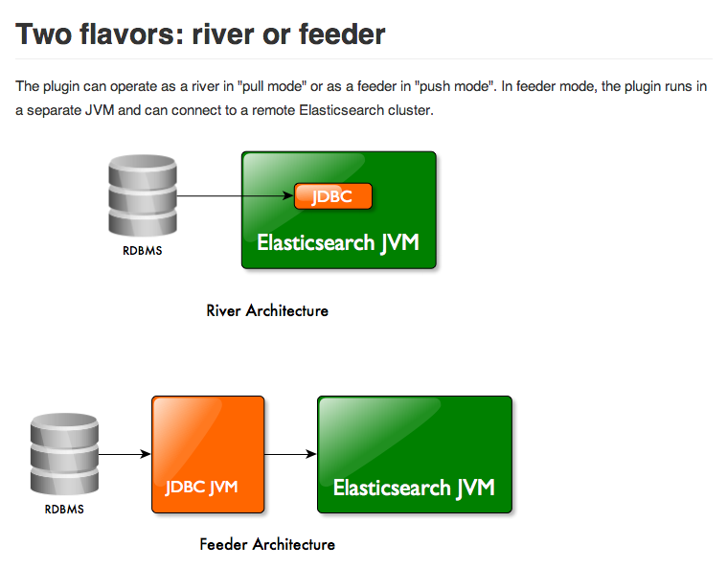
JDBC River Plugin. How and WHY?

Slide 18
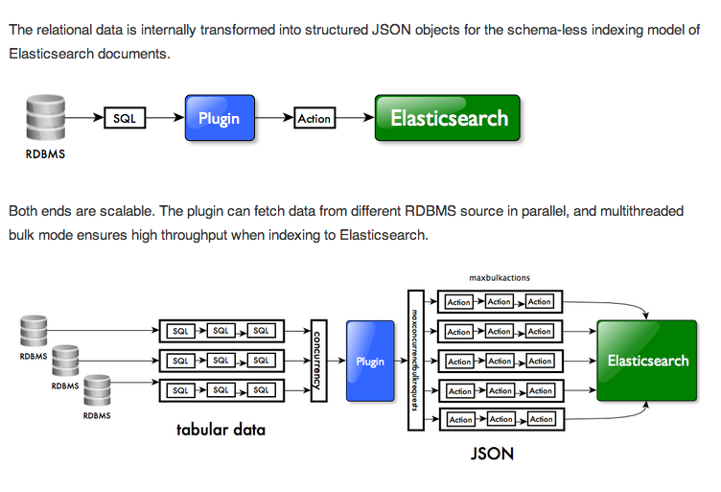
JDBC River plugin. Architecture.

Slide 19
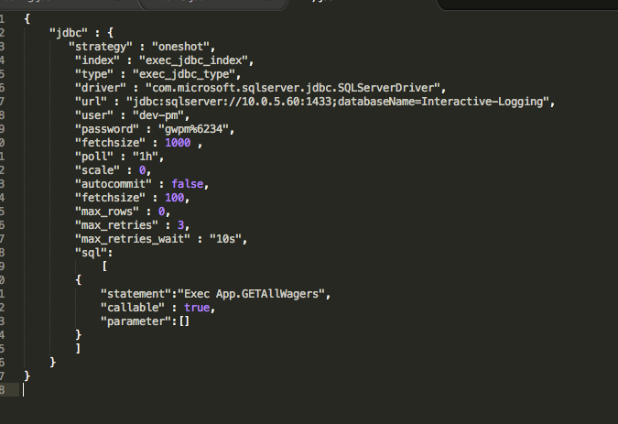
Developer perspectives.
Install jdbc-plugin
Put your JDBC driver jar in your plugin folder
Index with specific shell script
$
curl -XPUT ’localhost:9200/_river/my_jdbc_river/_meta' –d @sample.json

Slide 20
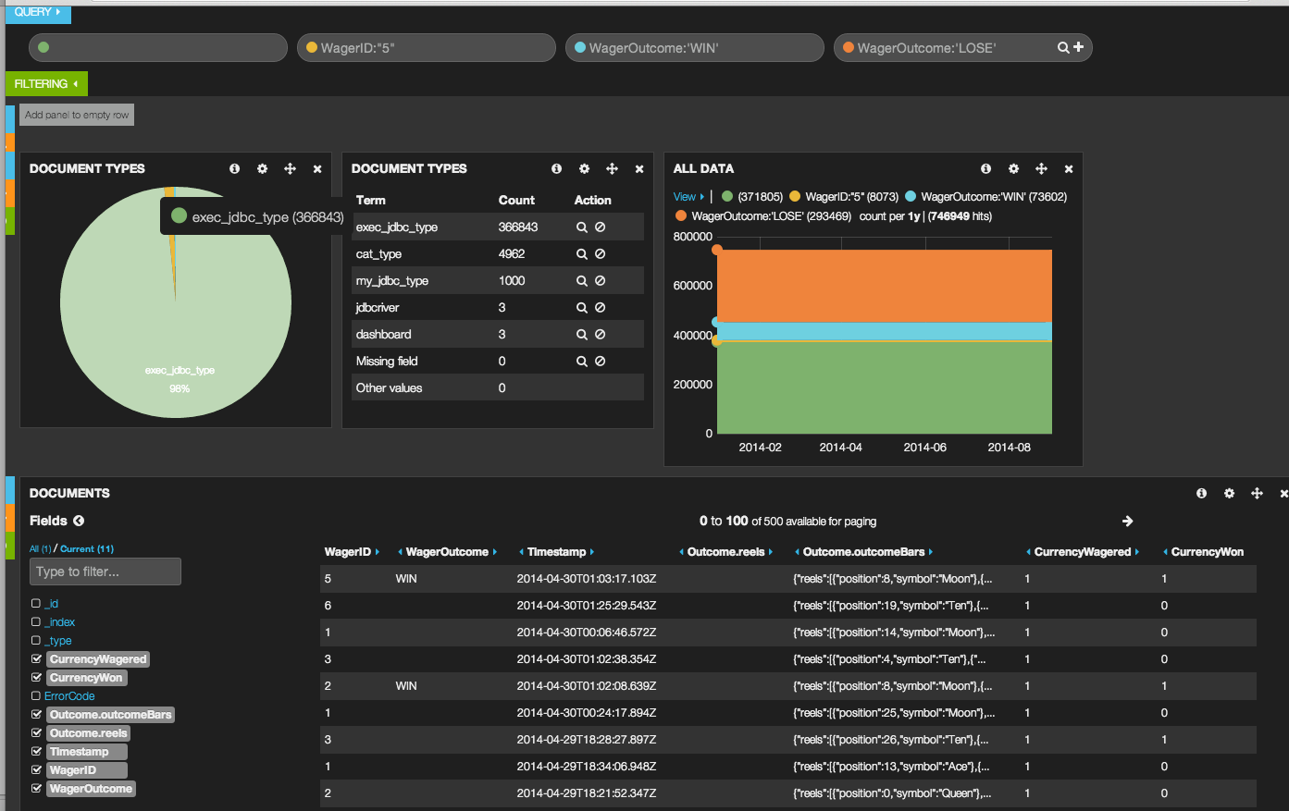
Kibana Data view

Slide 21
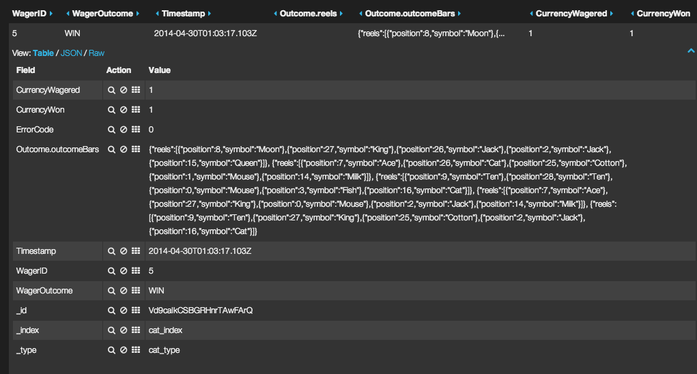
Reels View

Slide 22
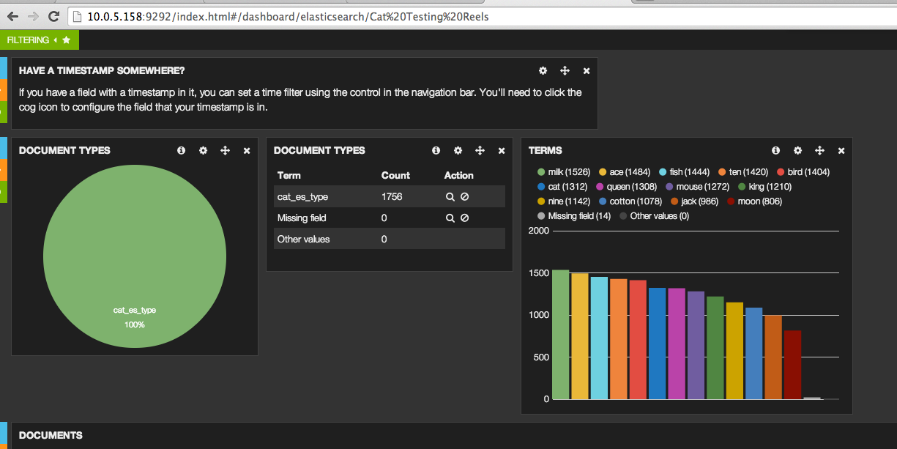
Quick check on symbols.

Slide 23
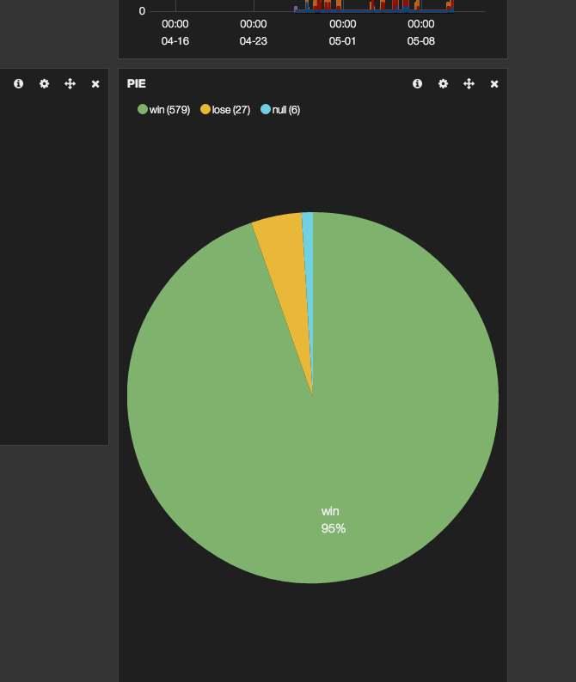
Quick RTP

Slide 24
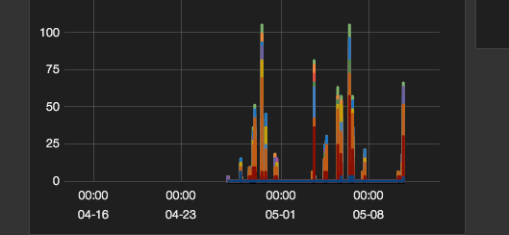
Symbols Distribution over Time

Slide 25
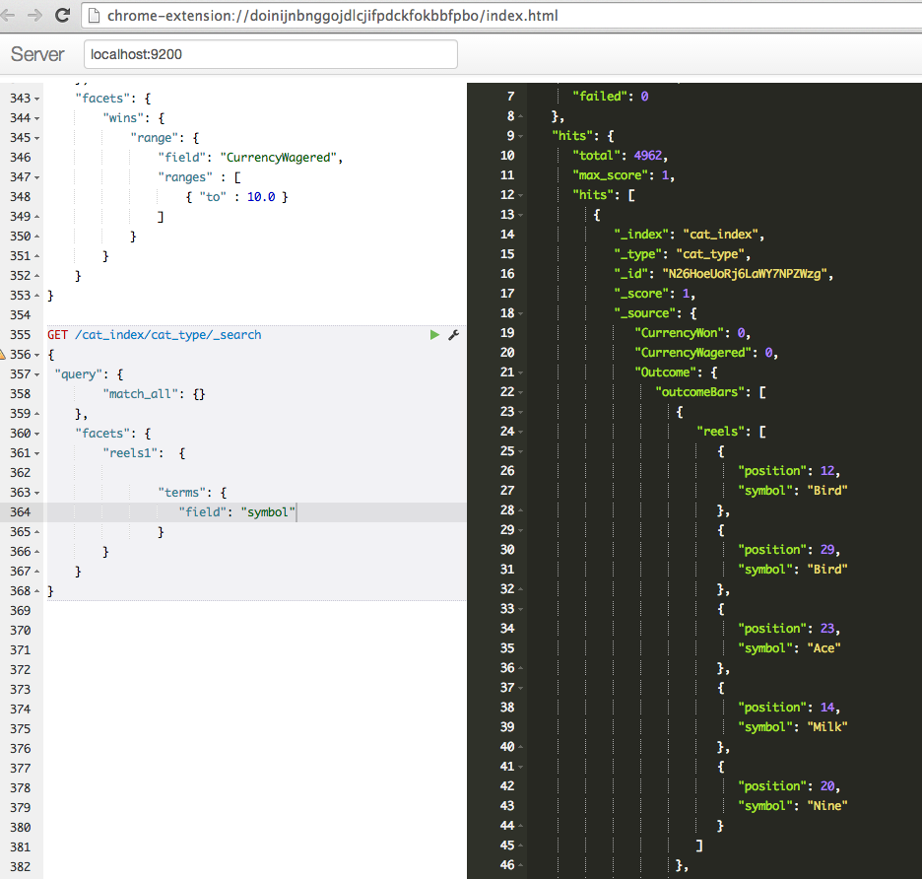
Sense. Chrome Plugin for json.

Slide 26
Elasticsearch alternatives?
Solr
Custom Lucene

Slide 27
BigDesk and it’s usage
Elasticsearch Plugin
Monitors systems

Slide 28
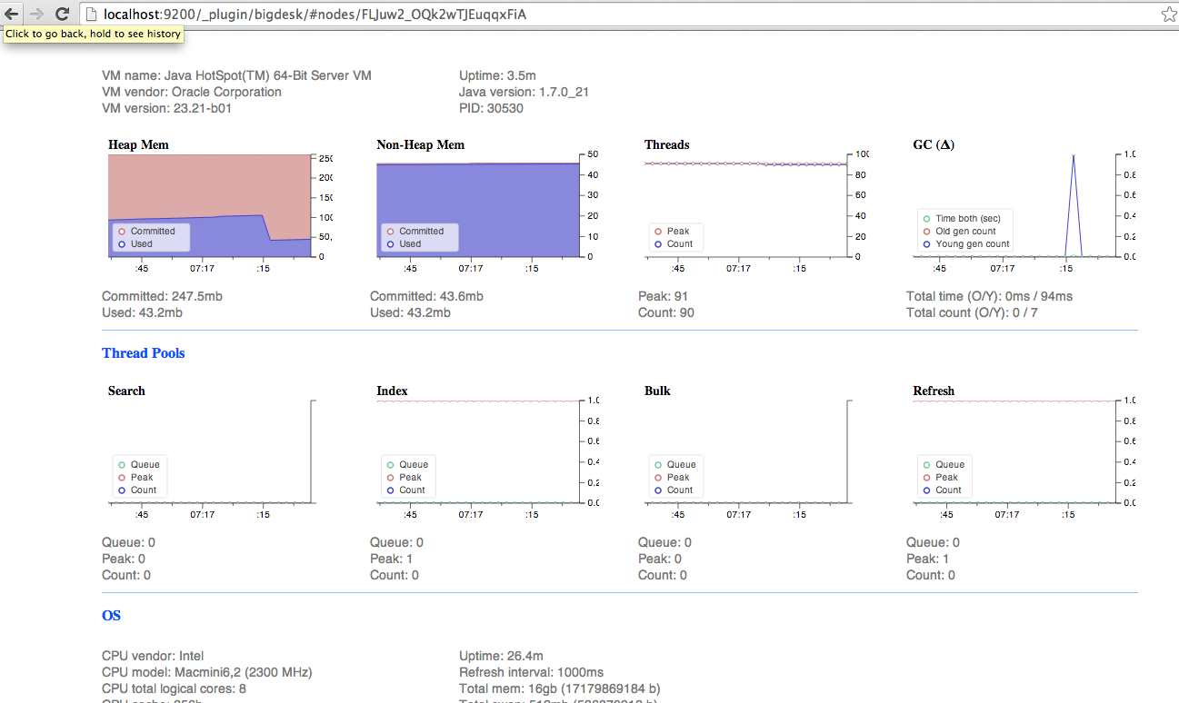
How we can leverage it?
Tons of nice things.. And more

Slide 29
setup
wget elasticsearch.tar.gz
tar xzvf elasticsearch.tar.gz
bin/elasticsearch
curl localhost:9200

Slide 30
the data in. Documents in.
curl –XPUT localhost:9200/game/name/lucky_words –d `{“some” : json }`
curl –XGET localhost:9200/game/name/lucky_words
curl –XDELETE localhost:9200/game/name/lucky_words

Slide 31
Search
curl –XGET localhost:9200/_search?q=best_game
curl –XGET localhost:9200/_search –d `{
“query”: {
“query_string”: {
“query”: “lucky_words AND rtp:95”
}
}
}`

Slide 32
Query your data
Query format – JSON
Build in filters
Queries vs Filters

Slide 33
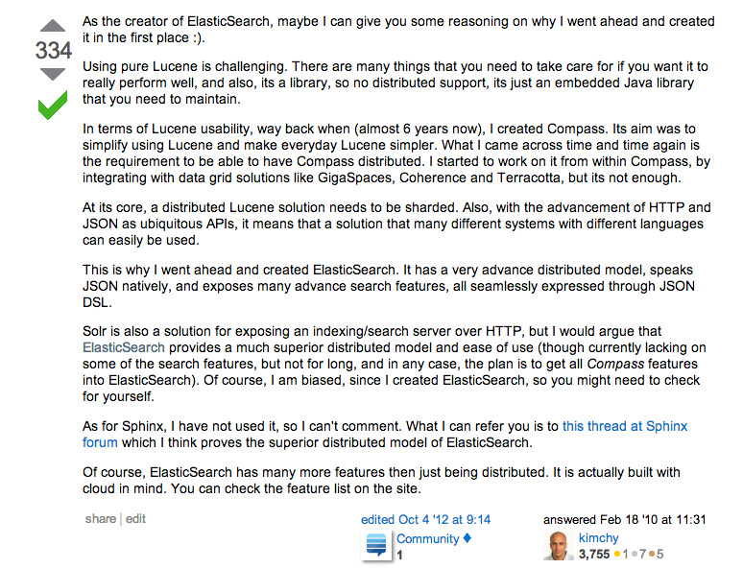
ES

Slide 34
Sorl vs Elasticsearch

