Slide 1
Elasticsearch
By Vera Kalinichenko

Slide 2
Buzz WordS.
Open Source
JSON
Rest
Http
Lucene
Distributed Data Store
Very good for Searching and Analyzing Data

Slide 3
Search engine. Lucene.
Java-based indexing and search technology.
Sorl is a high performance search server built using Lucene Core, with XML/HTTP and JSON/Python/Ruby APIs, hit highlighting, facets search, caching, replication, and a web admin interface.
Lucene. Open Source APIs design to search.

Slide 4
Structured vs. unstructure

Slide 5
Lucene

Slide 6
Features
Endless Plugins in Elasticsearch
Nice Graphical Interface
Community Support

Slide 7
How it works…
Protocol | Advantages | Disadvantages | Type
HTTP | More often use. Api safe. Compatible with different ES versions. Suggested JSON . | Overhead | Text
Native | Programmatic. Massive indexing, fast. | Api changes break application | Binary
Thrift | As Http |  | Binary

Slide 8
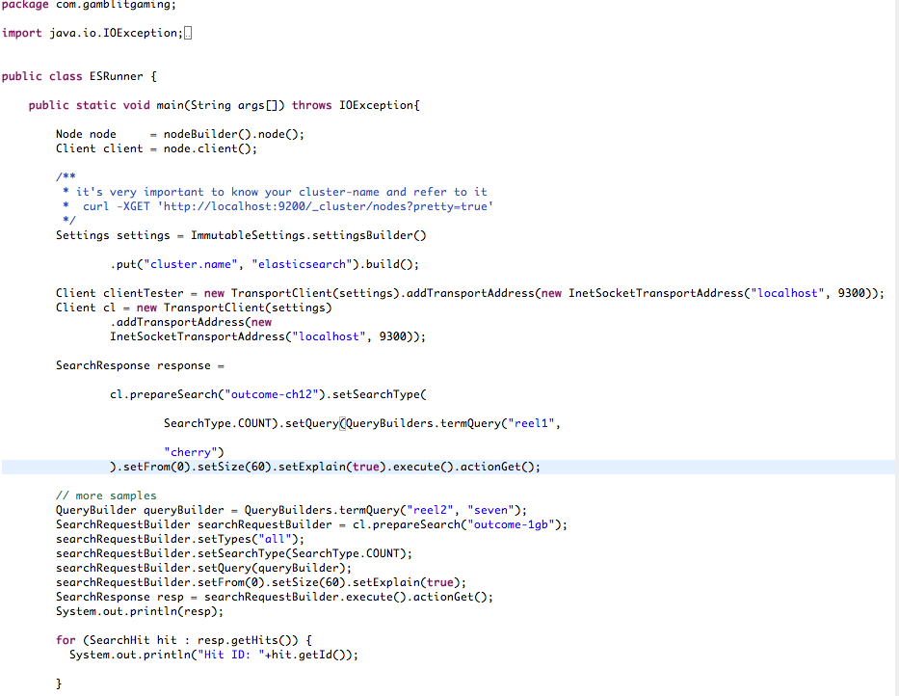
How to do it? Native Example

Slide 9
How to do it? Logstash
Edit log4j.properties file
Create logstash configuration file (shipper.conf)
Download logstash jar
Run the following
java –jar logstash-1.3.3-flatjar.jar agent –f shipper.conf

Slide 10
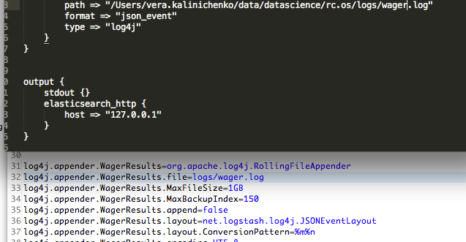
Logstash Configuration and log4j.properties

Slide 11
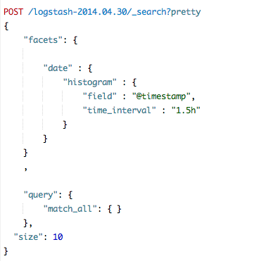
Facets - Aggregations

Slide 12
What are Facets, Filters and others terms..
Facets – aggregators, designed to narrow down your search category.

Slide 13
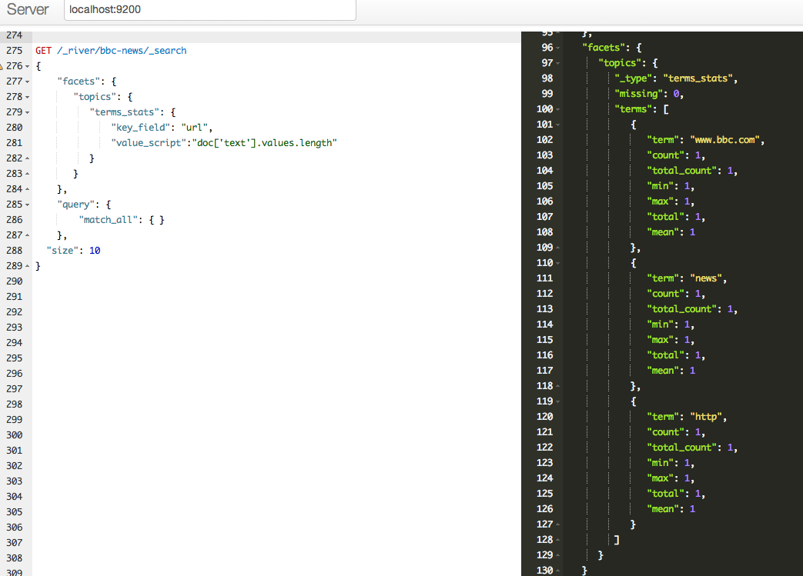
Facets. Examples. BBC Crawled -Data

Slide 14
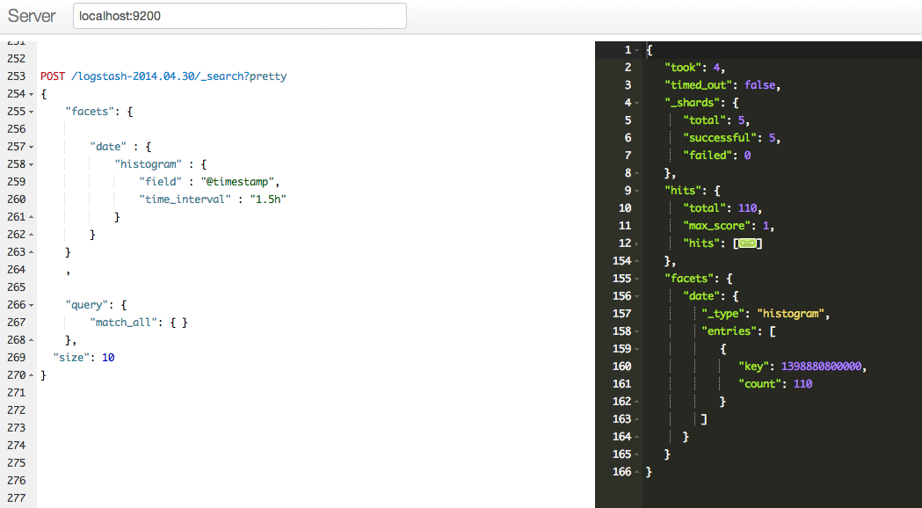
Facets. Examples. Logstash out the box

Slide 15
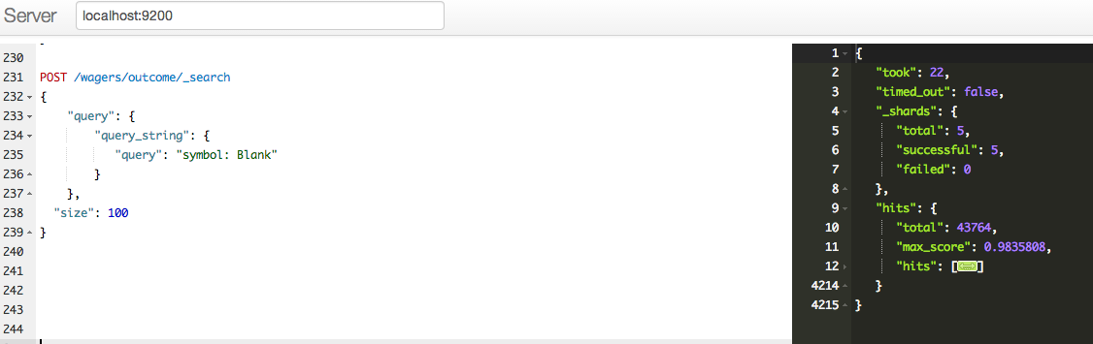
More Examples.

Slide 16
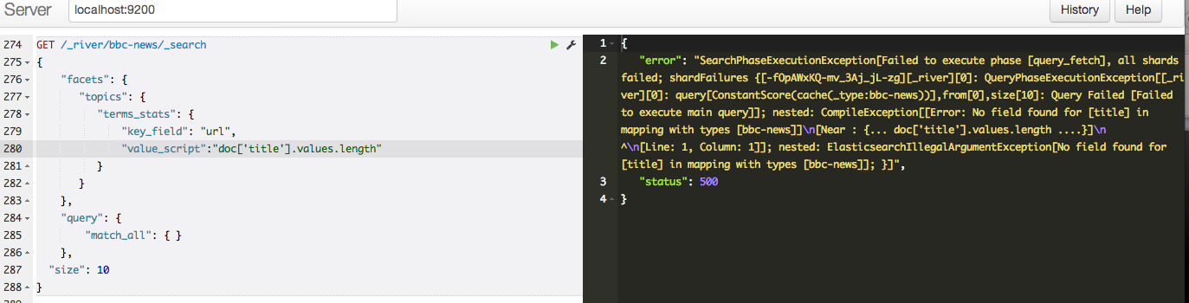
Executing and Debugging.

Slide 17
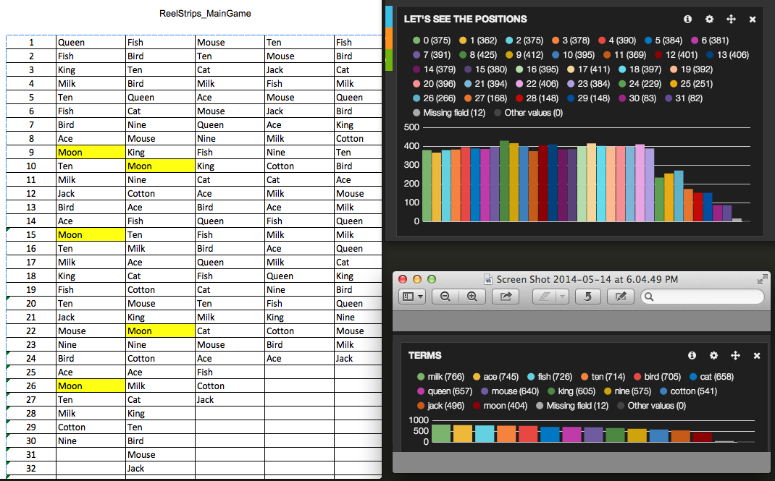
Reels. Position Aggregation and The theoretical reel.

Slide 18
Lucene Query. Syntax.

Slide 19
BigDesk and it’s usage

Slide 20
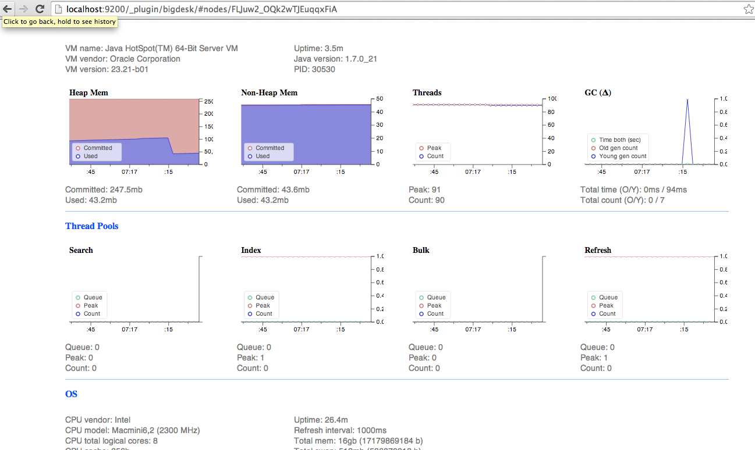
How we can leverage it?
Tons of nice things.. And more

Slide 21
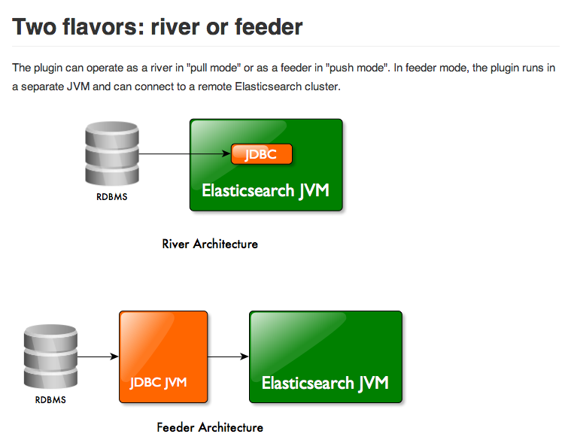
JDBC River Plugin. How and WHY?

Slide 22
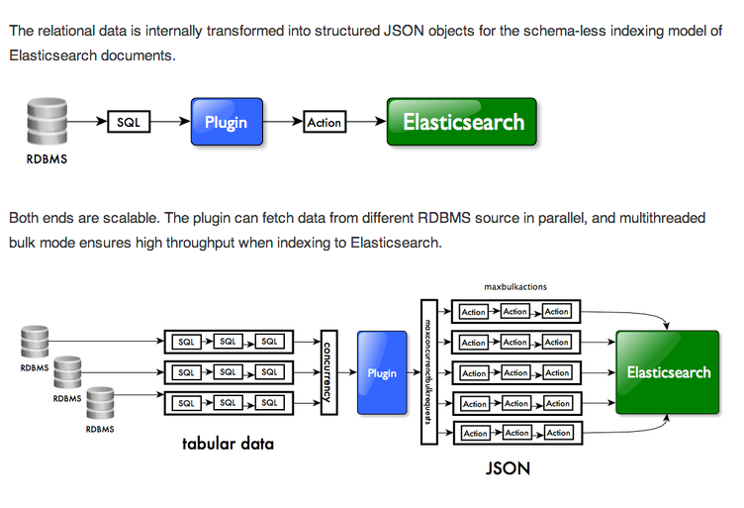
JDBC River plugin. Architecture.

Slide 23
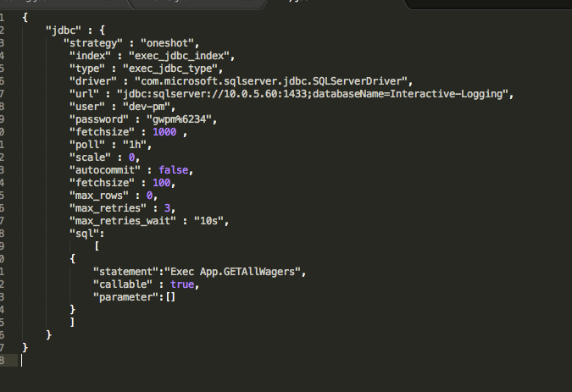
Developer perspectives.
Install jdbc-plugin
Put your JDBC driver jar in your plugin folder
Index with specific shell script
$
curl -XPUT ’localhost:9200/_river/my_jdbc_river/_meta' –d @sample.json

Slide 24
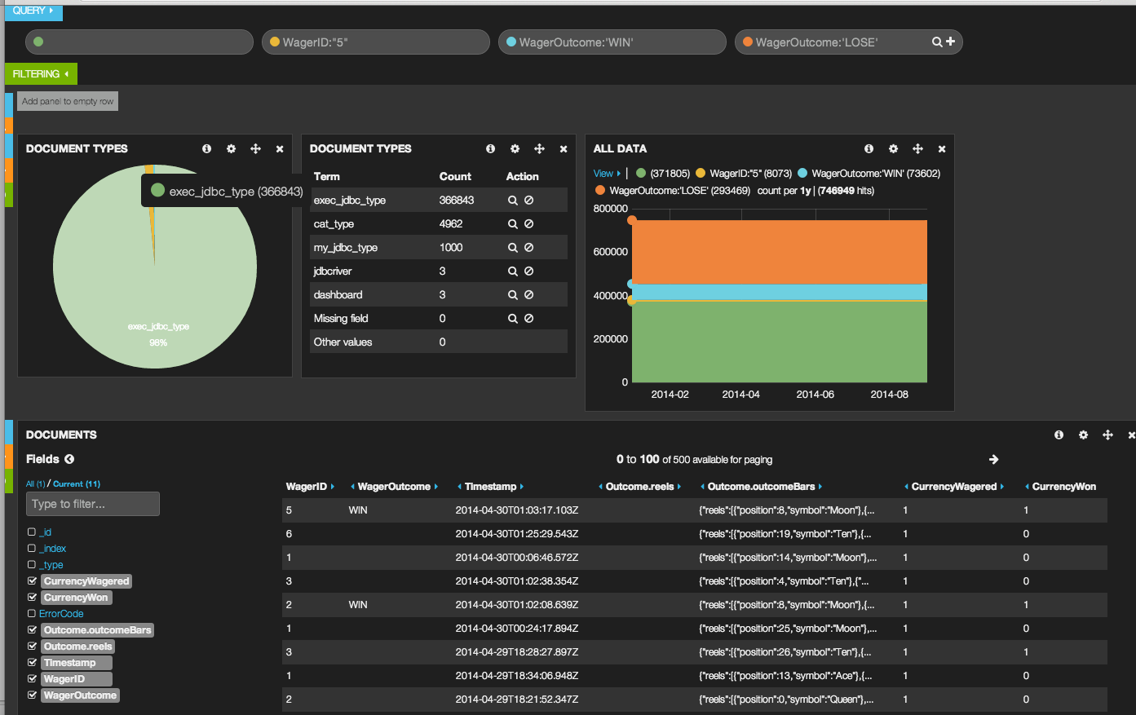
Kibana Data view

Slide 25
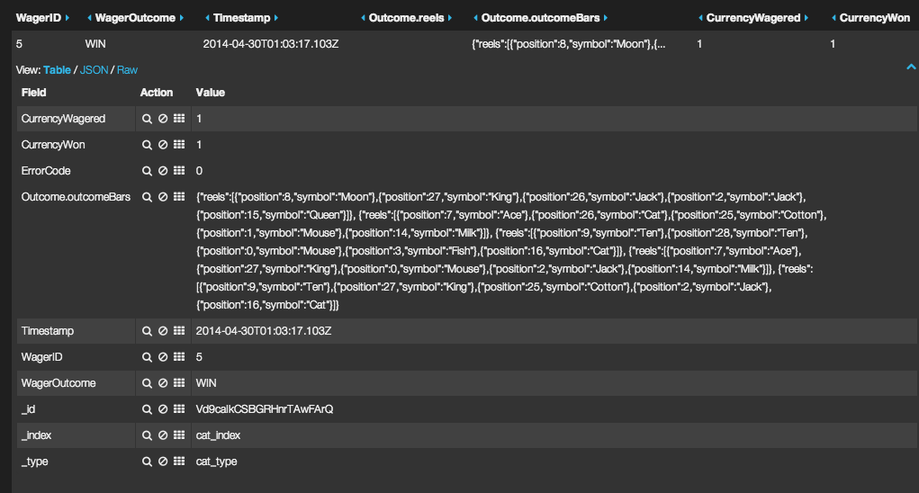
Reels View

Slide 26
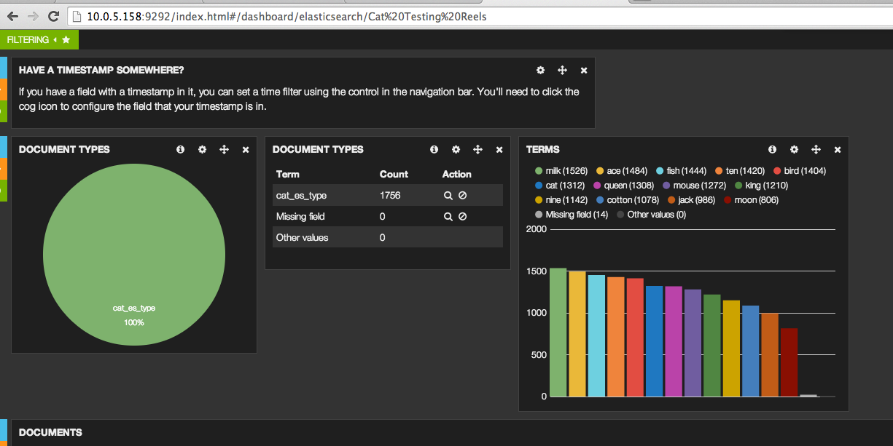
Quick check on symbols.

Slide 27
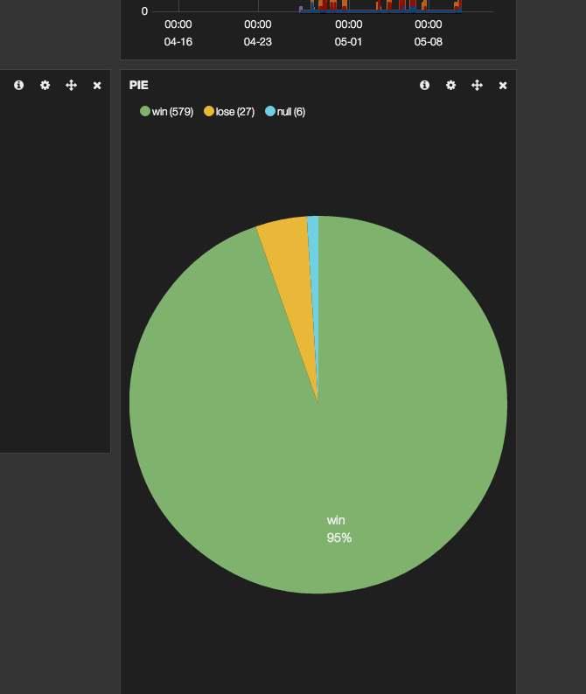
Quick RTP

Slide 28
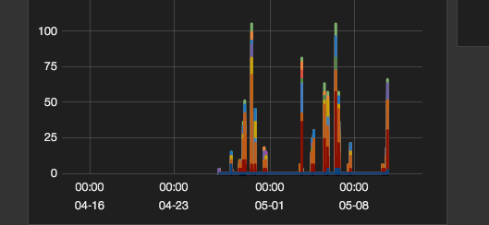
Symbols Distribution over Time

Slide 29
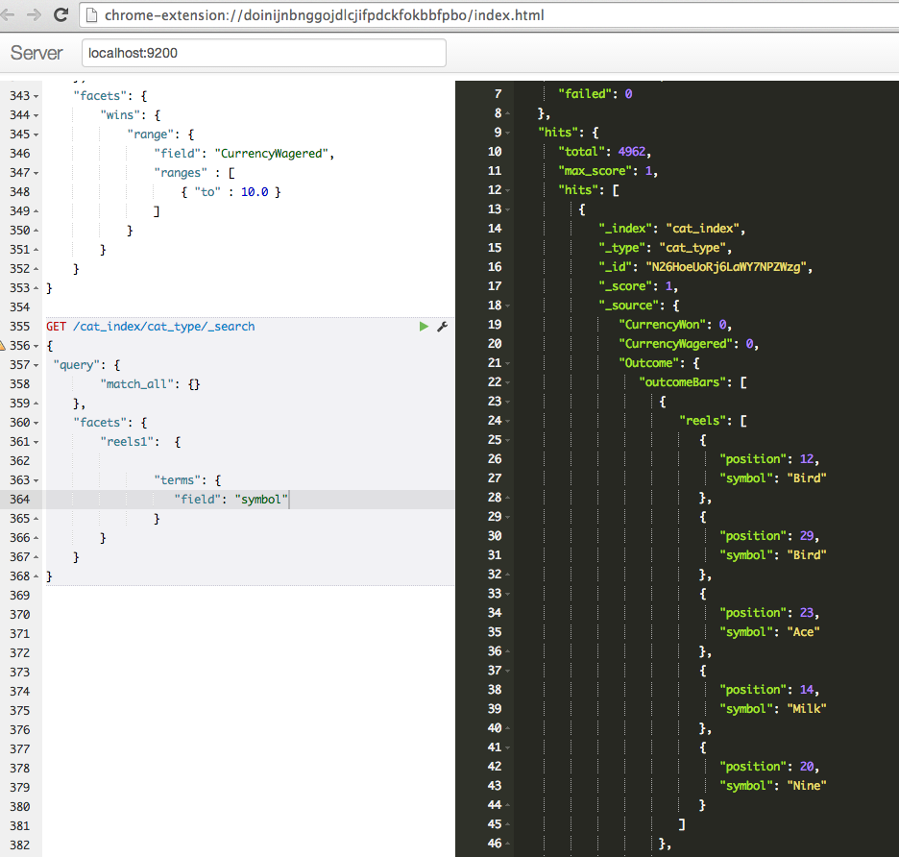
Sense. Chrome Plugin for json.

Slide 30
Elasticsearch alternatives?
Solr

Slide 31
setup
wget elasticsearch.tar.gz
tar xzvf elasticsearch.tar.gz
bin/elasticsearch
curl localhost:9200

Slide 32
the data in. Documents in.
curl –XPUT localhost:9200/game/name/lucky_words –d `{“some” : json }`
curl –XGET localhost:9200/game/name/lucky_words
curl –XDELETE localhost:9200/game/name/lucky_words

Slide 33
Search
curl –XGET localhost:9200/_search?q=best_game
curl –XGET localhost:9200/_search –d `{
“query”: {
“query_string”: {
“query”: “lucky_words AND rtp:95”
}
}
}`

Slide 34
Query your data
Query format – JSON
Build in filters
Queries vs Filters

Slide 35
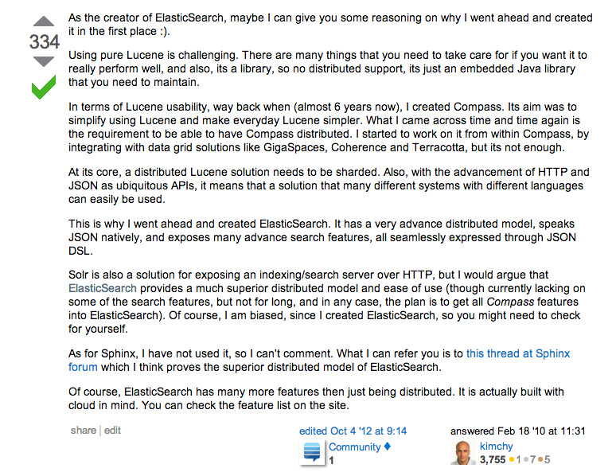
ES

Slide 36
Sorl vs Elasticsearch

