Slide 1
Elasticsearch
By Vera Kalinichenko

Slide 2
Outline
What is Elasticsearch?
Advantages
Examples
More Details
Walk thru Examples

Slide 3
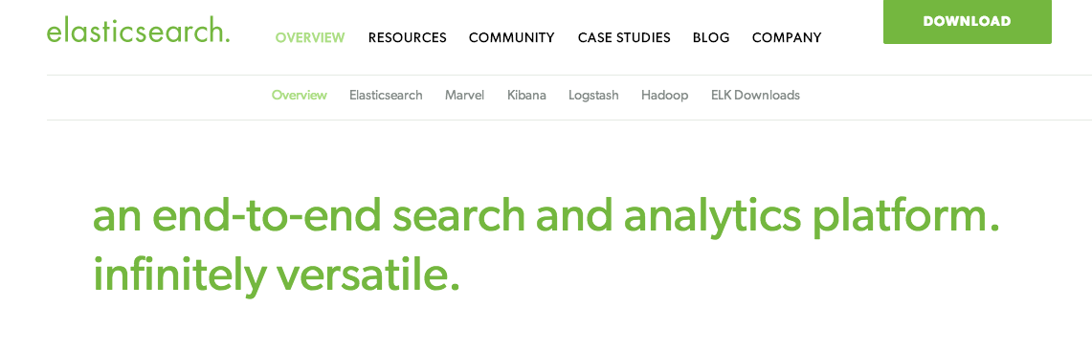
Elasticsearch

Slide 4
Buzz WordS.
Open Source
JSON
Rest
Http
Lucene
Distributed Data Store
Very good for Searching and Analyzing Data

Slide 5
Search engine. Lucene.
Lucene was first release in 2000 on SourceForge
Java-based indexing and search technology
Sorl is a high performance search server built using Lucene Core, with XML/HTTP and JSON/Python/Ruby APIs, hit highlighting, facets search, caching, replication, and a web admin interface.

Slide 6

Structured vs. unstructureD
Organized Information
Schema
Examples: Database – structured, how about Emails?

Slide 7
Features
Endless Plugins in Elasticsearch
Nice Graphical Interface
Community Support

Slide 8
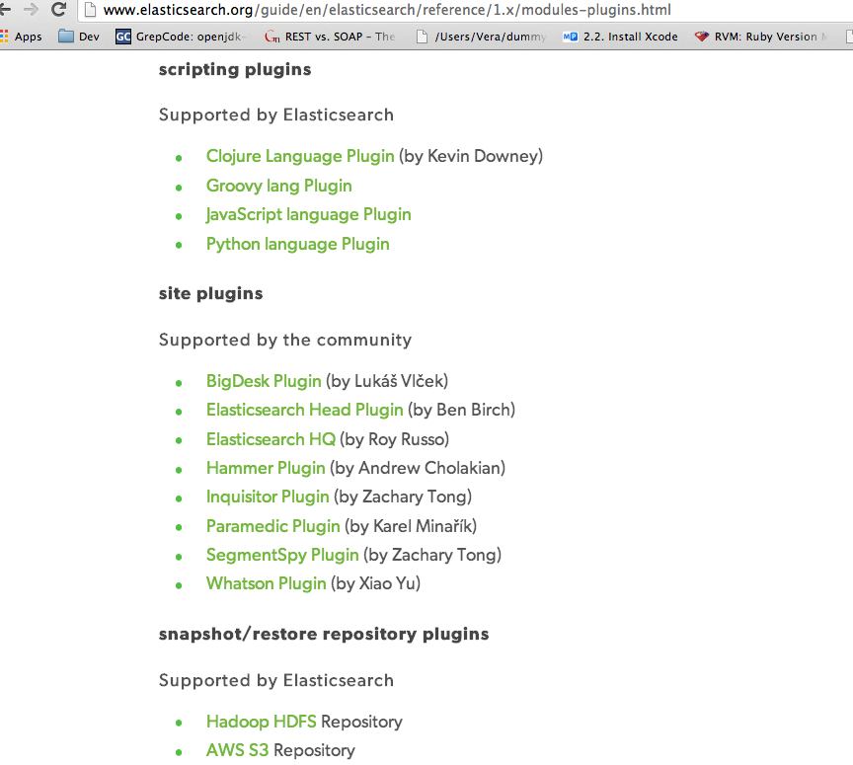
List of SuPported plugin by community

Slide 9
How it works…
Protocol | Advantages | Disadvantages | Type
HTTP | More often use. Api safe. Compatible with different ES versions. Suggested JSON . | Overhead | Text
Native | Programmatic. Massive indexing, fast. | Api changes break application | Binary
Thrift | As Http |  | Binary

Slide 10
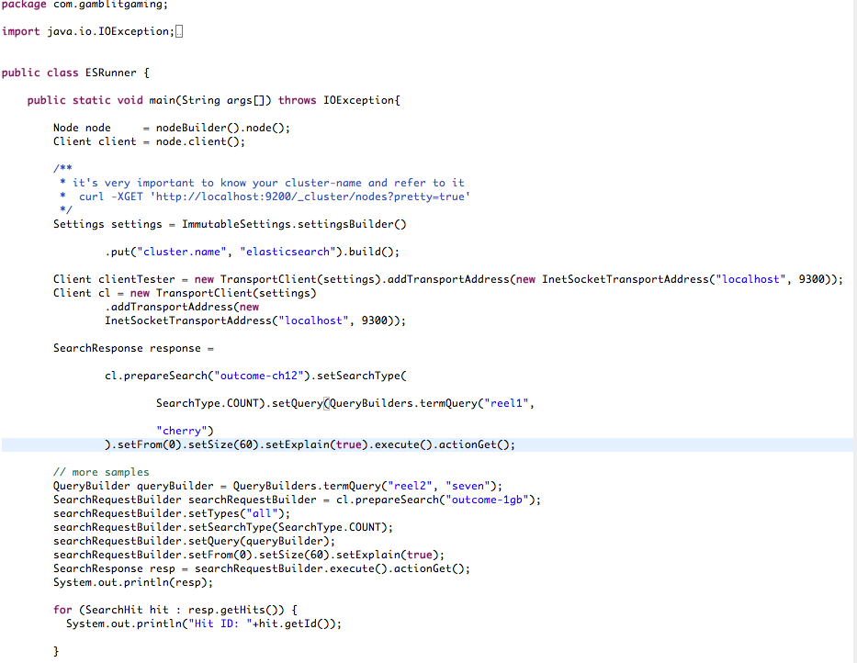
How to do it? Native Example

Slide 11
How to do it? Logstash
Edit log4j.properties file
Create logstash configuration file (shipper.conf)
Download logstash jar
Run the following
java –jar logstash-1.3.3-flatjar.jar agent –f shipper.conf

Slide 12
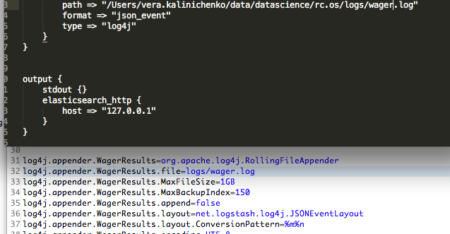
Logstash Configuration and log4j.properties

Slide 13
What are Facets? Why? How?
Facets – ability to find subcategories within your data.
Improve results
Faceting is an additional step in the query processing
They allow to execute
Histogram
Counting
Statistics
Geo distance aggregation
The main usage of facets is to provide additional data to the search results to improve the results quality.

Slide 14
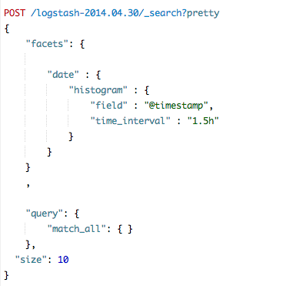
Facets - Aggregations

Slide 15
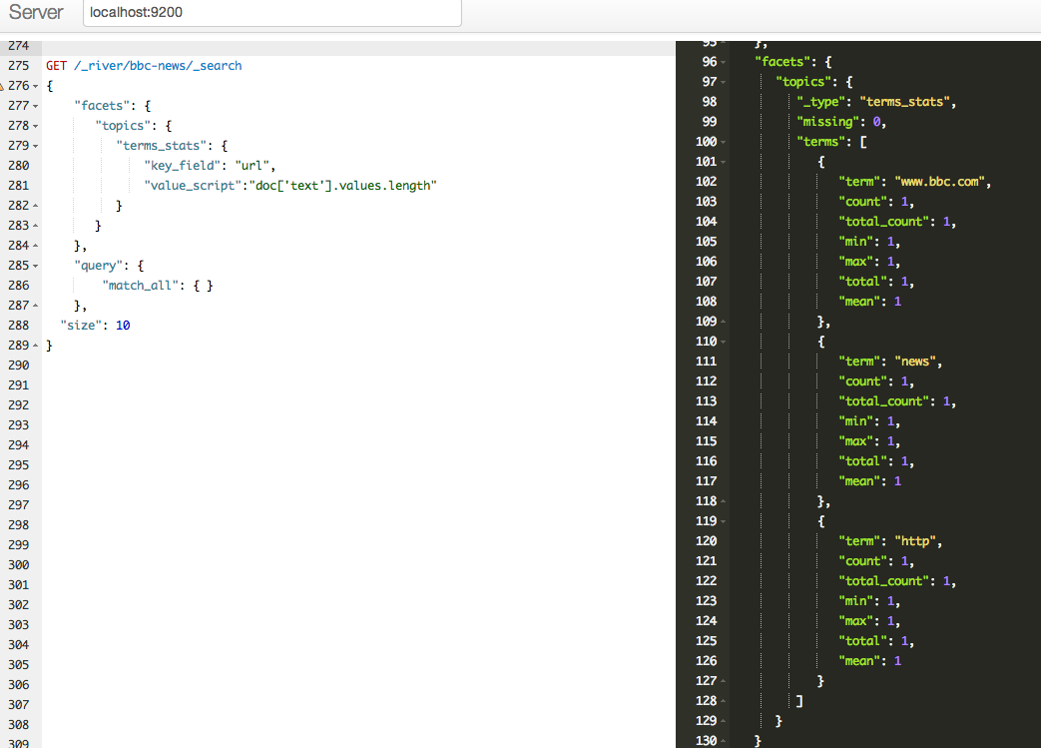
Facets. Examples. BBC Crawled -Data

Slide 16
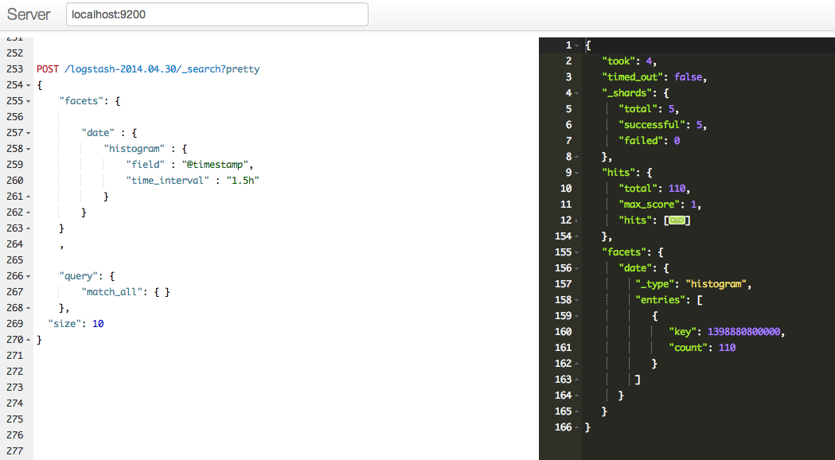
Facets. Examples. Logstash out the box

Slide 17
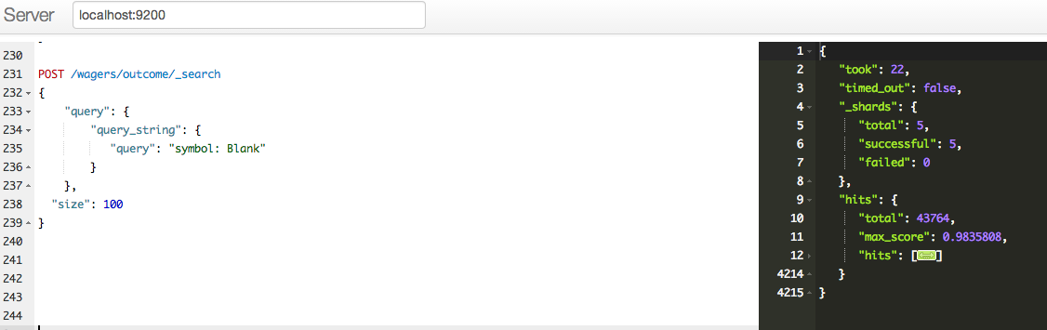
More Examples.

Slide 18
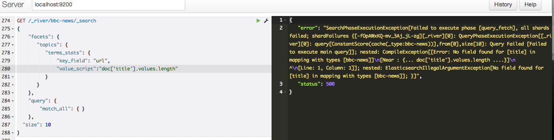
Executing and Debugging.

Slide 19
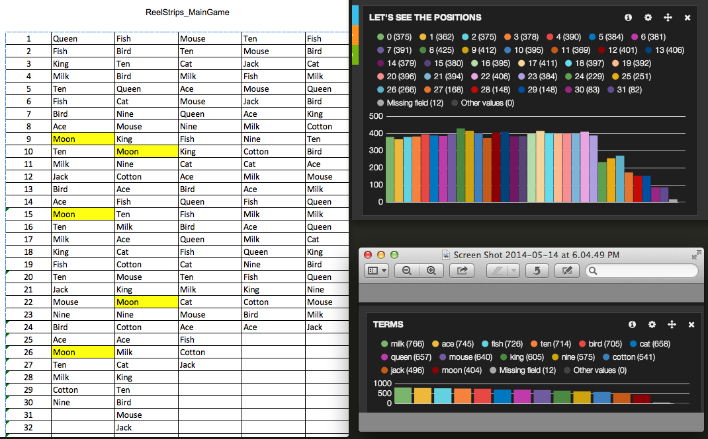
Reels. Position Aggregation and The theoretical reel.

Slide 20
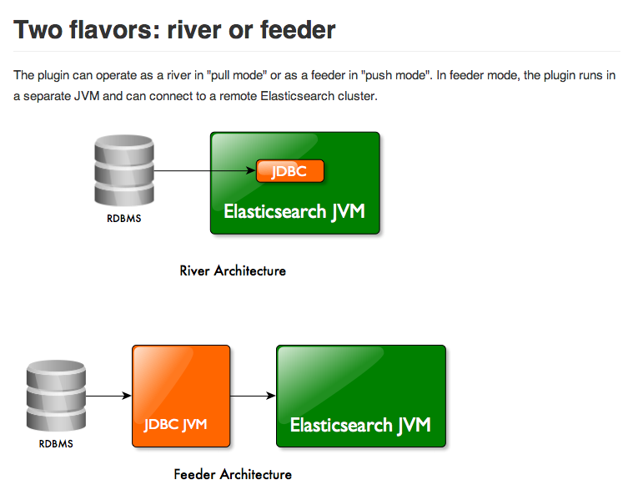
JDBC River Plugin. WHY and how?

Slide 21
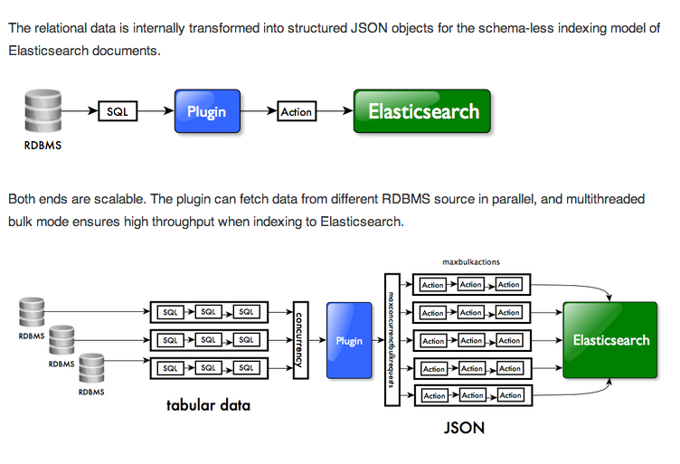
JDBC River plugin. Architecture.

Slide 22
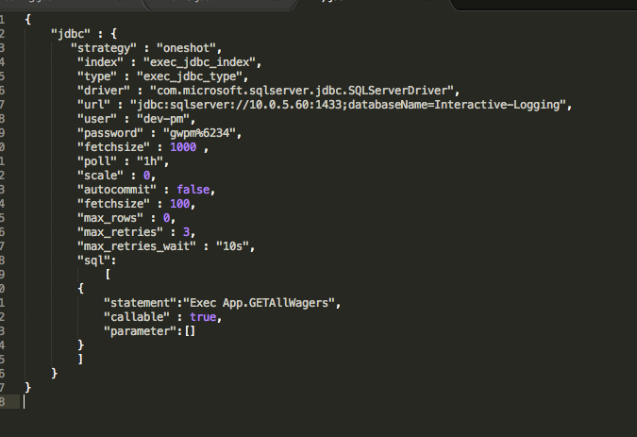
Developer perspectives.
Install jdbc-plugin
Put your JDBC driver jar in your plugin folder
Index with specific shell script
$
curl -XPUT ’localhost:9200/_river/my_jdbc_river/_meta' –d @sample.json

Slide 23
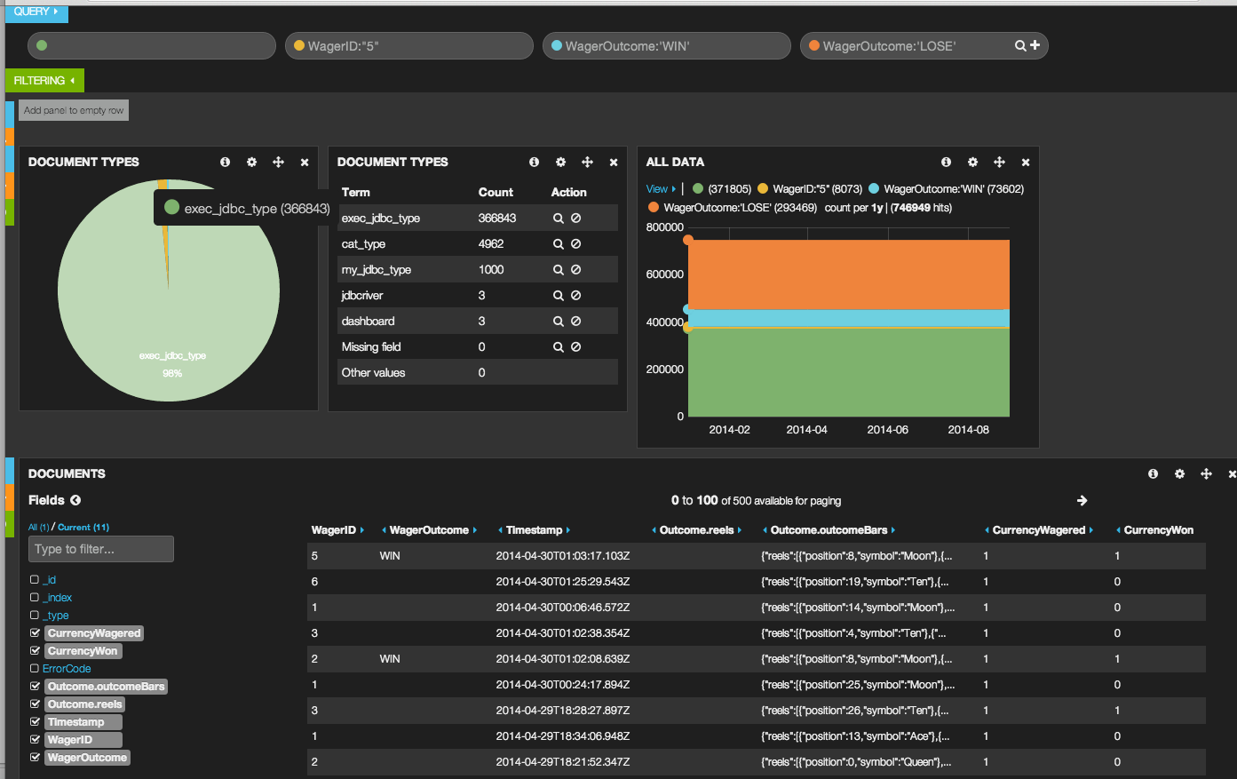
Kibana Data view

Slide 24
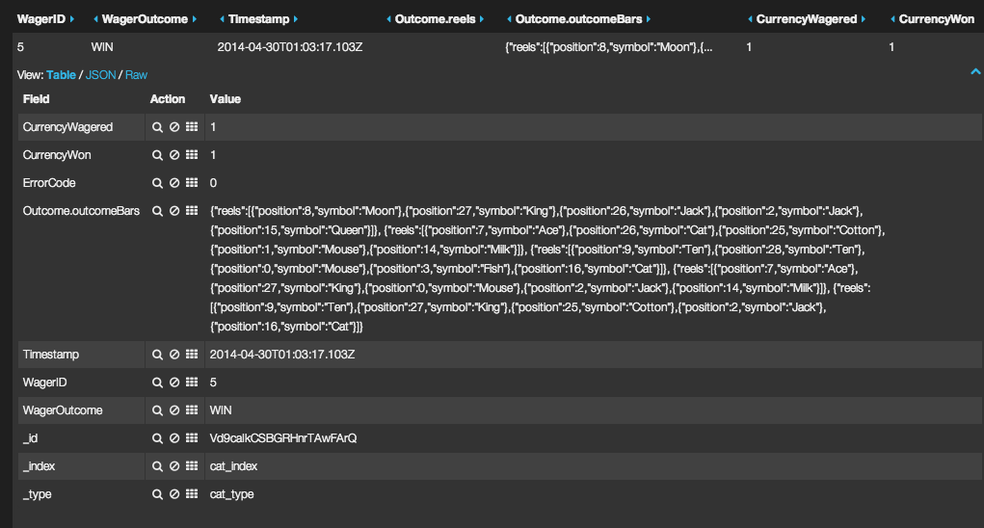
Reels View

Slide 25
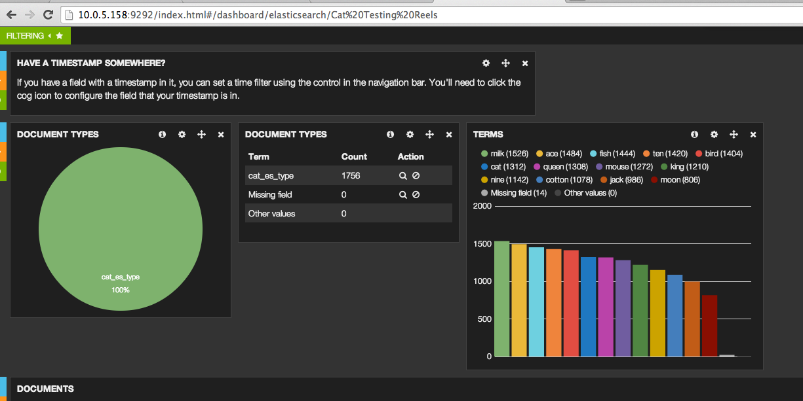
Quick check on symbols.

Slide 26
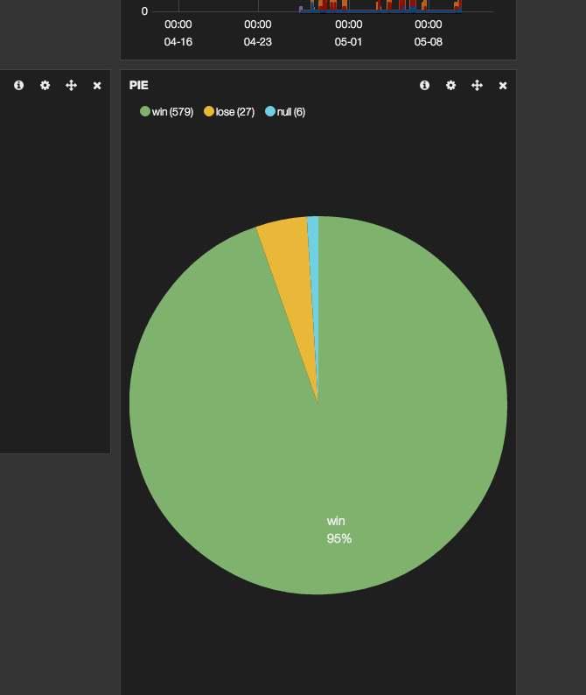
Quick RTP

Slide 27
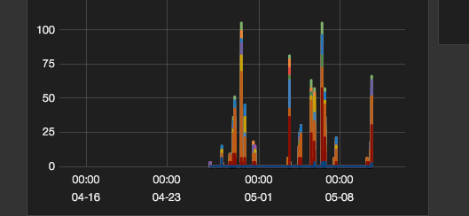
Symbols Distribution over Time

Slide 28
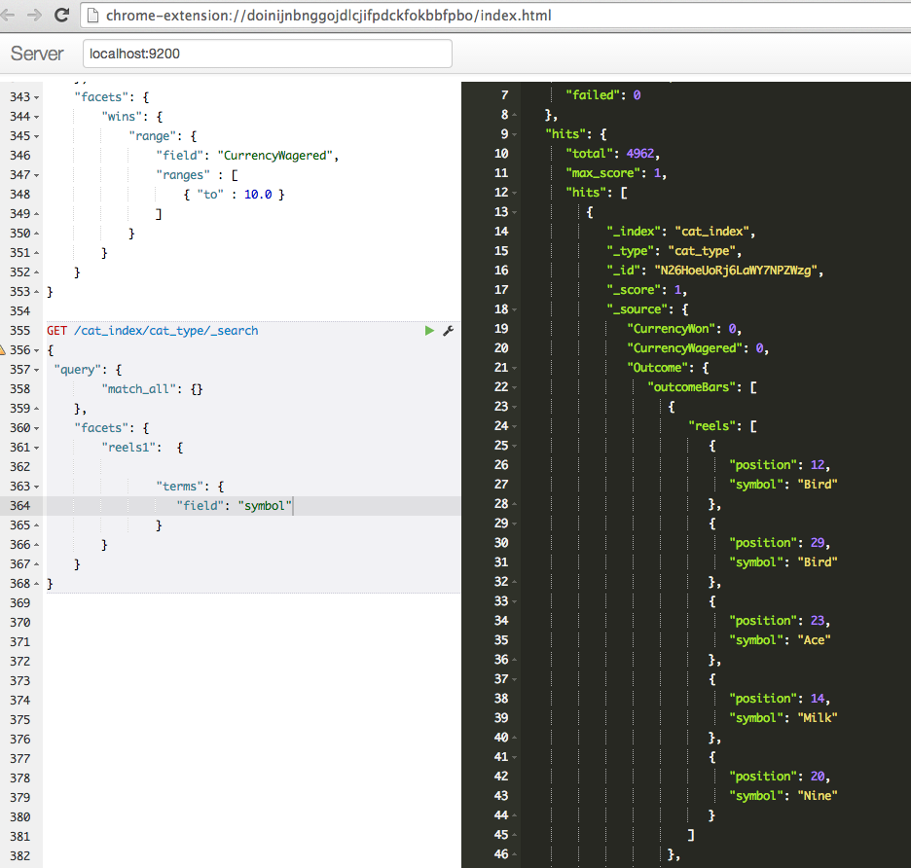
Sense. Chrome Plugin for json.

Slide 29
Elasticsearch alternatives?
Solr
Custom Lucene

Slide 30
BigDesk and it’s usage
Elasticsearch Plugin
Monitors systems

Slide 31
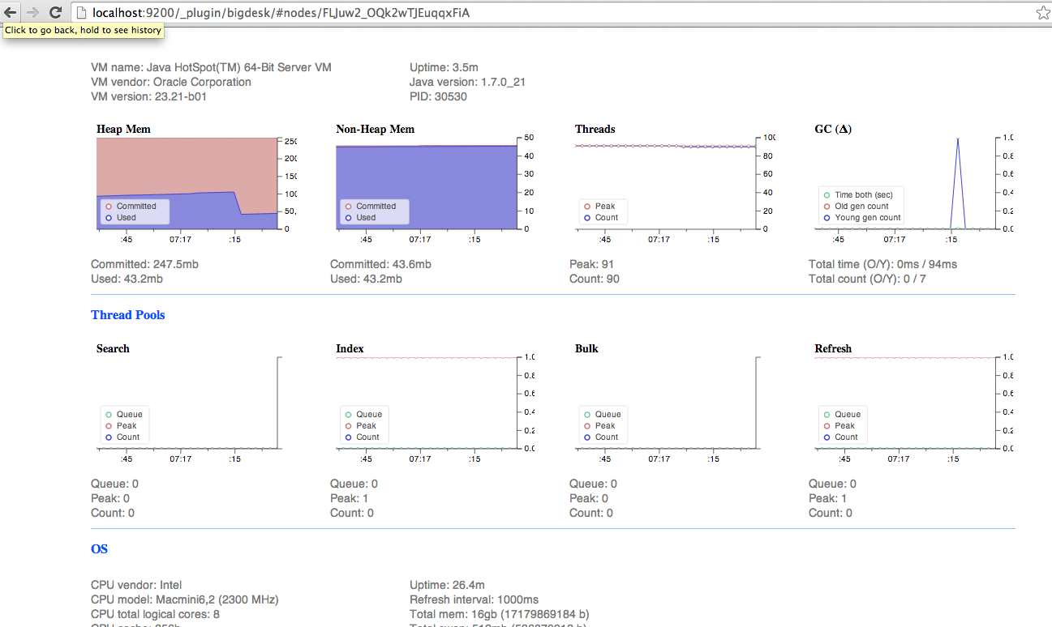
How we can leverage it?
Tons of nice things.. And more

Slide 32
setup
wget elasticsearch.tar.gz
tar xzvf elasticsearch.tar.gz
bin/elasticsearch
curl localhost:9200

Slide 33
the data in. Documents in.
curl –XPUT localhost:9200/game/name/lucky_words –d `{“some” : json }`
curl –XGET localhost:9200/game/name/lucky_words
curl –XDELETE localhost:9200/game/name/lucky_words

Slide 34
Search
curl –XGET localhost:9200/_search?q=best_game
curl –XGET localhost:9200/_search –d `{
“query”: {
“query_string”: {
“query”: “lucky_words AND rtp:95”
}
}
}`

Slide 35
Query your data
Query format – JSON
Build in filters
Queries vs Filters

Slide 36
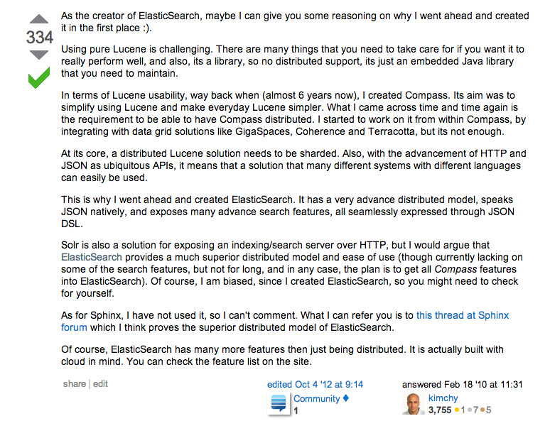
ES

