Slide 1
Game Theory and R

Slide 2
Theory of Games
Chess
Number of Arrangements
Birthday problem. Randomness
Cards
And so on

Slide 3
Why is it important?
Fun
Fun
And more Fun

Slide 4
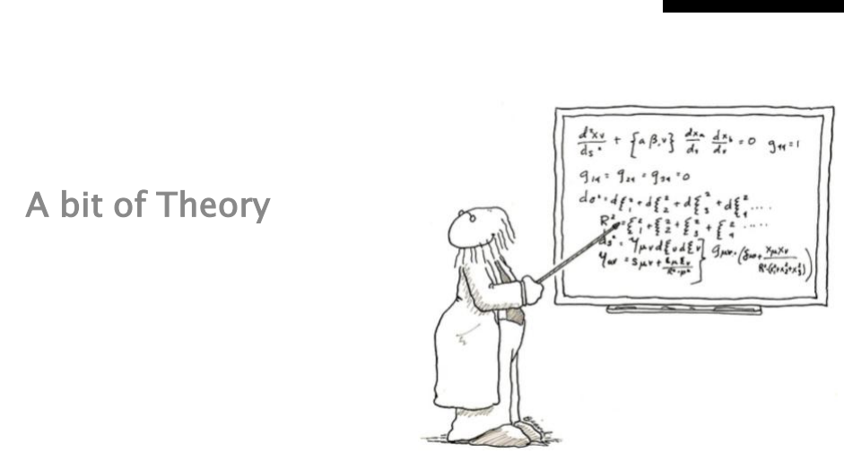
Theory.

Slide 5
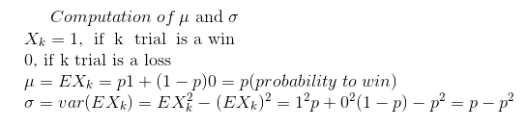
What is expectation, variance in paying slots?

Slide 6
Question
A chess player is considering endgames in which White has a king, no pawns, no rooks and exactly three other pieces. What combinations of white pieces are possible? No promotions have occurred.

Slide 7
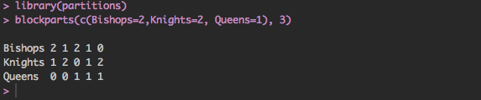
Answer
This is an urn problem with a pool of 7 objects, in this case non-king chess pieces. An
enumeration of the size-3 draws is required, which is given by new function blockparts().
This function enumerates the distinct solutions to equation 1 in columns which appear in
lexicographical order:
> blockparts(c(Bishops=2,Knights=2,Queens=1),3)

Slide 8

Scary binomial. What’s that? Why do we need it?
Some need oxygen, some need math …
It’s fun, I promise.
Helpful in binary analysis
Let’s consider any game, you either win or you lose. So the outcome results are binary.
p – probability to win, q = 1-p probability to lose

Slide 9
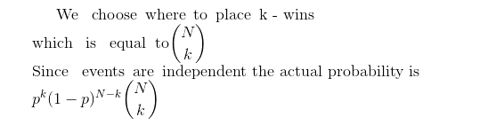
It’s binomial

Slide 10
What’s is the optimal number of games the player has to play attaining the maximum probability to win?

Slide 11
Two terms, A and B, play a series of games. If team A has probability 0.126 of winning each game, is it to its advantage to play the best two out of five games or the best four out of ten? Assume the outcomes of successive games are independent.
N | k | N choose k | Probability to win k times out of N
10 | 1 | 10 | 0.37495007
10 | 2 | 45 | 0.24324564
10 | 3 | 120 | 0.093513198
10 | 4 | 210 | 0.023592289
10 | 5 | 252 | 0.004081412
5 | 1 | 5 | 0.367609122
5 | 2 | 10 | 0.105992562
5 | 3 | 10 | 0.015280392

Slide 12
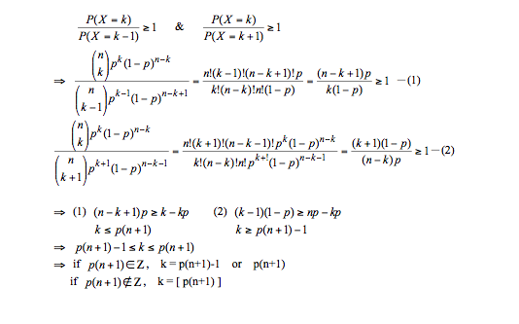
Consider, the player is playing n –turns. Each outcome is either success(win) or a failure (loss). For what value of k (k <=n), P(K) is maximized?

Slide 13
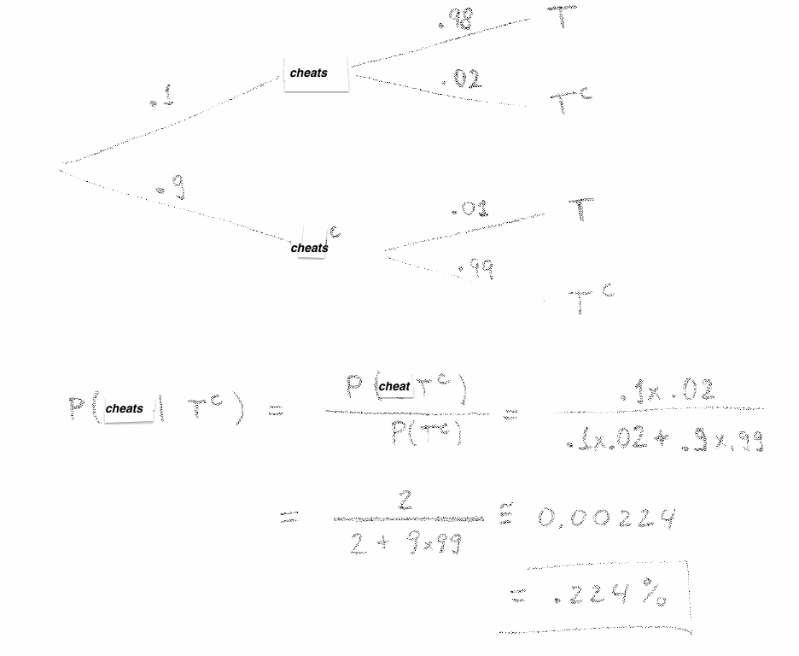
Assume, our cheat model for detecting possible cheaters shows false positive with probability 1% and false negative with probability 2%. In test population 10% of players cheats. Given that someone tested negative for the cheat, what is the probability that he/she is not a fair player?

Slide 14
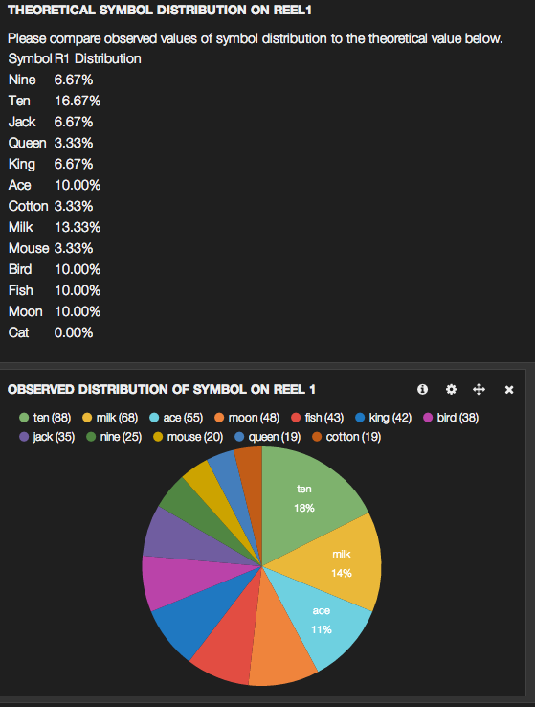
Distributions. Verification. Analysis.

Slide 15
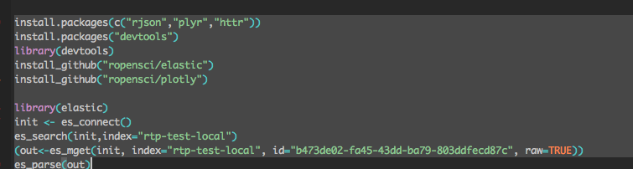
R and ElasticSearch

Slide 16
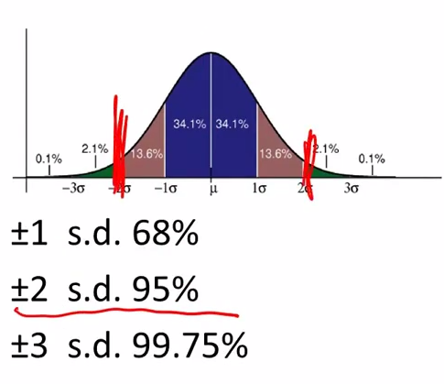
Slots. Probability to win 12.6%.

Slide 17
References
Hankin RKS (2007). “Urn sampling without replacement: enumerative combinatorics in R.”Journal of Statistical Software, Code Snippets, 17(1).

