Slide 1
Classifications
By Vera Kalinichenko

Slide 2
View of the world formulates a model
1. Simply count each video if it was preferred
Group by first column and count the frequency
Find the most frequently picked videos
2. Use transitivity to increase the training space
Construct a model pair based on the prefer list of single preferred videos
Check if the constructed pair in the initial list

Slide 3
Sample data
UID | Text of likes (comma separated)
f13c221af327798ce039afc48d7fc1a5 | "Friend Buzz","Hugh Masekela","Blood In Blood Out","Blood Out”
a9c85f99d918150a711ce8f05535875e | "John Cena - WWE Universe"

Slide 4
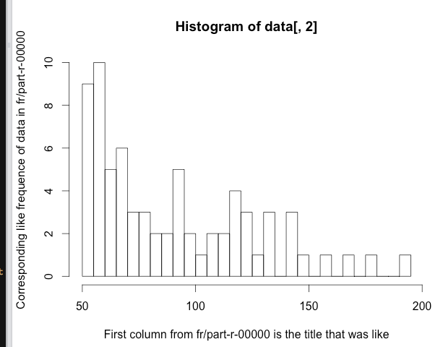
Visualization

Slide 5
Left video id and corresponding count
Title | Count
Eminem | 193
Football | 177
Harry Potter | 170
Family Guy | 159

Slide 6
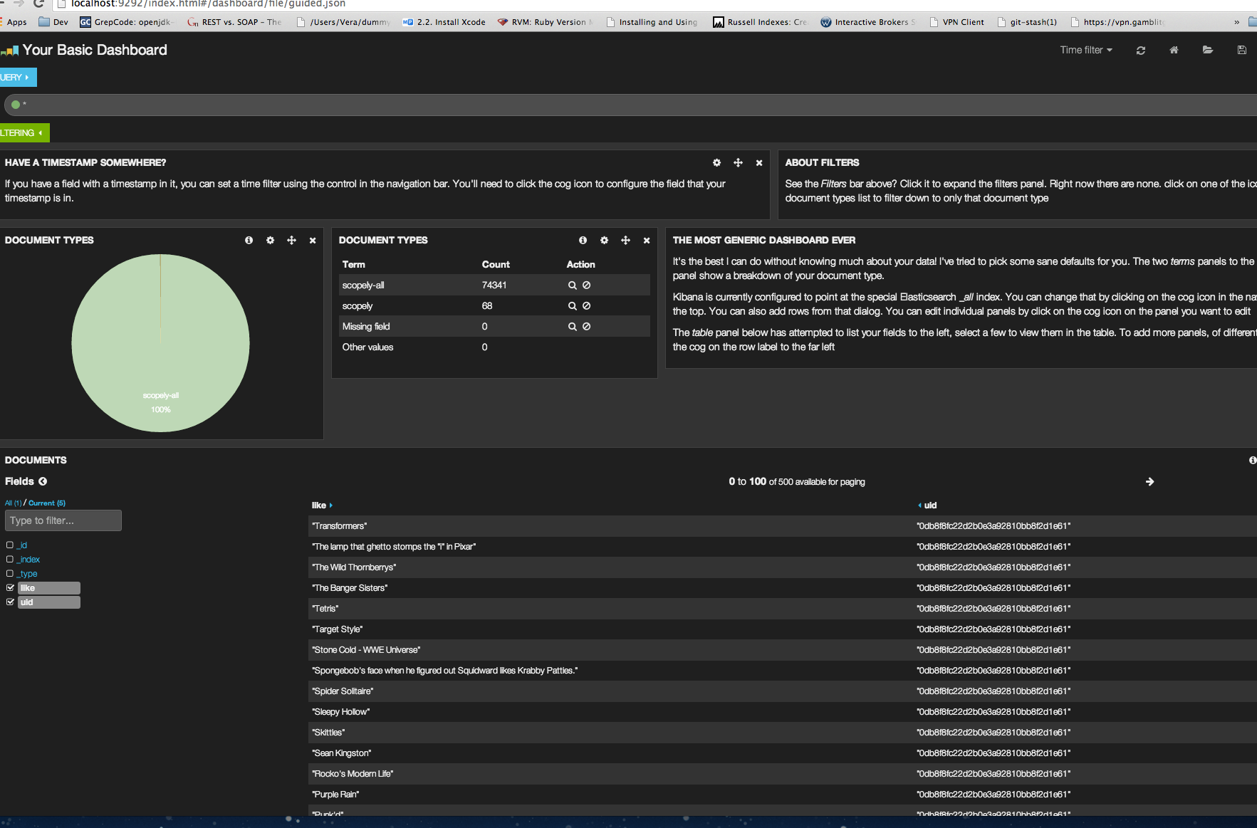
More details via visualization using Elasticsearch and kibana

Slide 7
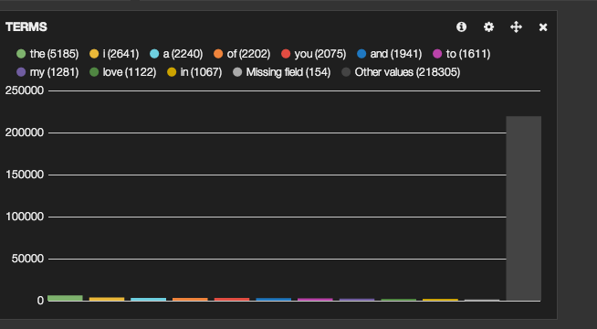
Stop words detection

Slide 8
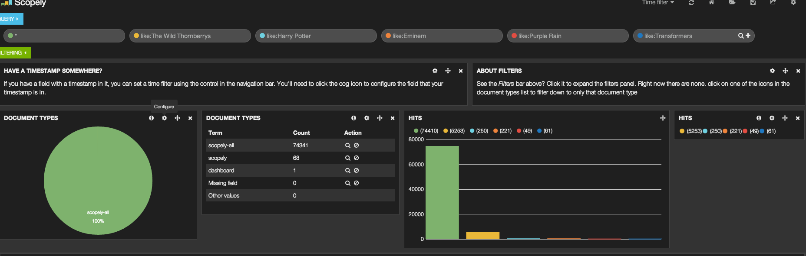
Query Samples and aggegation

Slide 9
Normalize the data
Inspect for duplications and clear the duplicates
Remove any noise

