Slide 1
Classifications

Slide 2
View of the world formulates a model
1. Simply count each video if it was preferred
Construct a model pair based on the prefer list of single preferred videos
Check if the constructed pair in the initial list
2. Use transitivity to increase the training space

Slide 3
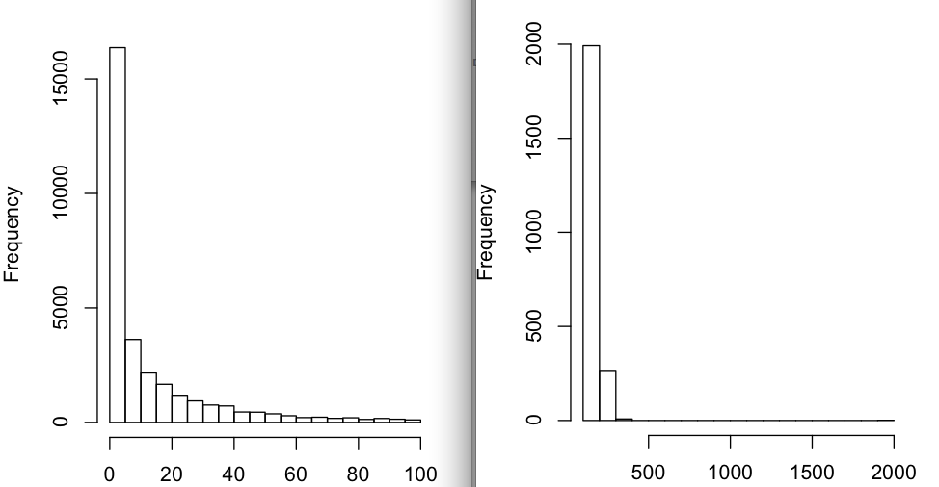
Visualization

Slide 4
Left video id and corresponding count
Video Id | Count
NAME? | 1904
r6NzpVdq1Lk | 383
EHCqz-J51IU | 357
f43-4xlkWxM | 339
oY6tCnu-1Do | 322
qvPugcb7QGE | 299
lrp-FT51zPE | 299
EJJL5dxgVaM | 291
FC5vS8Uju8o | 291
IWuh4qXwuEI | 290

Slide 5
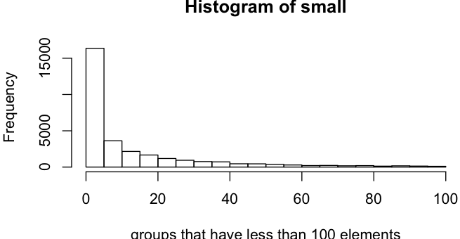
More details via visualization

Slide 6
Duplicates sample
4gDfq2vxyXk | psO6_rNKP6g | right | psO6_rNKP6g | 4gDfq2vxyXk | left
7INfm99741E | zKAW96N-Vms | right | zKAW96N-Vms | 7INfm99741E | left
aAjvqy_L3C8 | kRtbOTXN0FM | left | kRtbOTXN0FM | aAjvqy_L3C8 | right
bdY7Adc1LRM | zKAW96N-Vms | left | zKAW96N-Vms | bdY7Adc1LRM | right
bdY7Adc1LRM | zKAW96N-Vms | right | zKAW96N-Vms | bdY7Adc1LRM | left
kRtbOTXN0FM | aAjvqy_L3C8 | right | aAjvqy_L3C8 | kRtbOTXN0FM | left
psO6_rNKP6g | 4gDfq2vxyXk | left | 4gDfq2vxyXk | psO6_rNKP6g | right
zKAW96N-Vms | 7INfm99741E | left | 7INfm99741E | zKAW96N-Vms | right
zKAW96N-Vms | bdY7Adc1LRM | left | bdY7Adc1LRM | zKAW96N-Vms | right
zKAW96N-Vms | bdY7Adc1LRM | right | bdY7Adc1LRM | zKAW96N-Vms | left

