Slide 1
Classifications

Slide 2
View of the world formulates a model
1. Simply count each video if it was preferred
Group by first column and count the frequency
Find the most frequently picked videos
2. Use transitivity to increase the training space
Construct a model pair based on the prefer list of single preferred videos
Check if the constructed pair in the initial list

Slide 3
Data sample
__NUpIHLt5M | 00JwyUa4MjQ | left
#NAME? | 17OpZsQVbVw | right
__zRZhzf7i8 | QRmV6KWQ8X4 | right
__zRZhzf7i8 | yN0n2L-xhbw | left

Slide 4
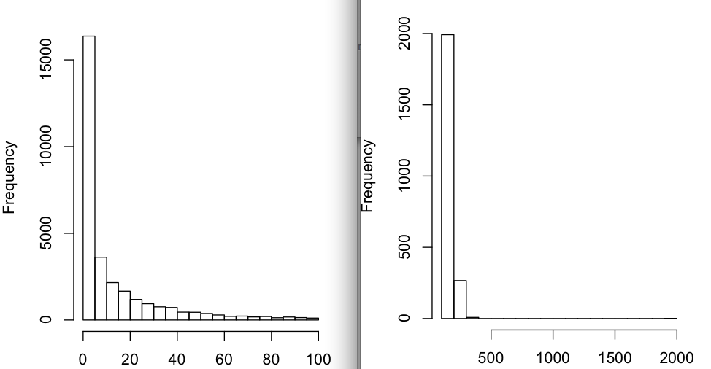
Visualization

Slide 5
Left video id and corresponding count
Video Id | Count
NAME? | 1904
r6NzpVdq1Lk | 383
EHCqz-J51IU | 357
f43-4xlkWxM | 339
oY6tCnu-1Do | 322
qvPugcb7QGE | 299
lrp-FT51zPE | 299
EJJL5dxgVaM | 291
FC5vS8Uju8o | 291
IWuh4qXwuEI | 290

Slide 6
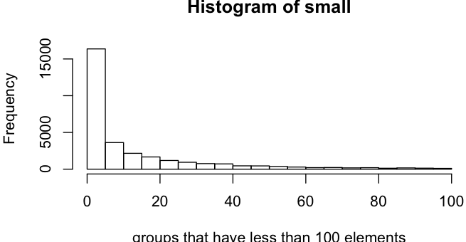
More details via visualization

Slide 7
Normalize the data
Inspect for duplications and clear the duplicates
Remove any noise

Slide 8
Noise sample
#NAME? | 17OpZsQVbVw | right
#NAME? | R94sRLS0QWI | right
#NAME? | 9Cf3XxuM6TU | left
#NAME? | a3HMLgJmy2A | right

Slide 9
Duplicates sample. why?
4gDfq2vxyXk | psO6_rNKP6g | right | psO6_rNKP6g | 4gDfq2vxyXk | left
7INfm99741E | zKAW96N-Vms | right | zKAW96N-Vms | 7INfm99741E | left
aAjvqy_L3C8 | kRtbOTXN0FM | left | kRtbOTXN0FM | aAjvqy_L3C8 | right
bdY7Adc1LRM | zKAW96N-Vms | left | zKAW96N-Vms | bdY7Adc1LRM | right
bdY7Adc1LRM | zKAW96N-Vms | right | zKAW96N-Vms | bdY7Adc1LRM | left
kRtbOTXN0FM | aAjvqy_L3C8 | right | aAjvqy_L3C8 | kRtbOTXN0FM | left
psO6_rNKP6g | 4gDfq2vxyXk | left | 4gDfq2vxyXk | psO6_rNKP6g | right
zKAW96N-Vms | 7INfm99741E | left | 7INfm99741E | zKAW96N-Vms | right
zKAW96N-Vms | bdY7Adc1LRM | left | bdY7Adc1LRM | zKAW96N-Vms | right
zKAW96N-Vms | bdY7Adc1LRM | right | bdY7Adc1LRM | zKAW96N-Vms | left

Slide 10
Transitivity idea
If a<b<c, then a<c
If a>b>c, then a>c
Perform Pig join and use transitivity

