Slide 1
Java Socket Programming and Java RMI
CSE 291
Based on presentation at CMU Qatar

Slide 2

Project 1
Goal: create an RMI (remote method invocation) library.
Three weeks available
Two-Person Project.
Notes:
07/12/11

Slide 3
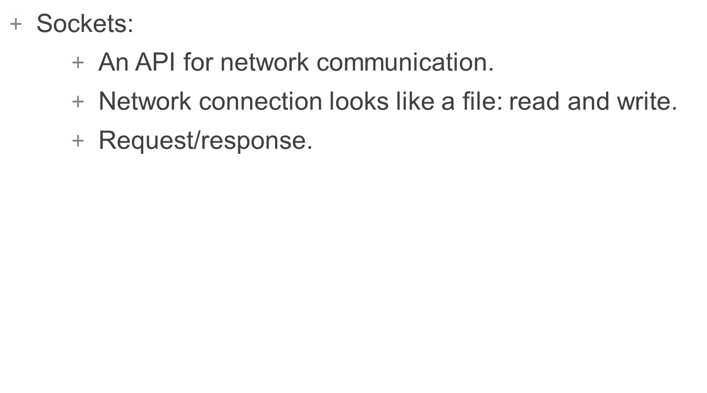
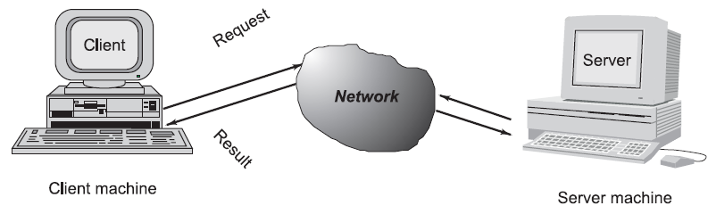
Java Socket Programming
Notes:
07/12/11

Slide 4
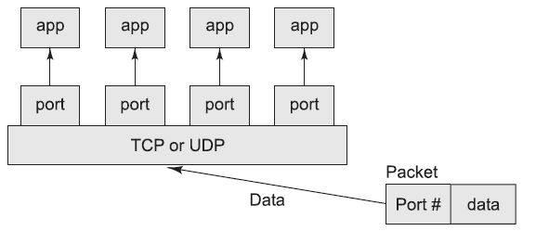

Java Socket Programming
IP Address
  Names a machine/host.
Port
  Port maps to one “channel” on a host.
  For your needs: use ports 49152 through 65535.
Types of Sockets
  UDP (datagram) vs. TCP (connection-oriented).

Slide 5
java.net Package
A package that provides classes and an API for socket programming
  Open/close socket.
  Accept.
  Read/Write.
  Send/Receive.
See the classes:
  ServerSocket – used by server to listen for clients.
  Socket – used by both server and client. Represents a connection.

Slide 6
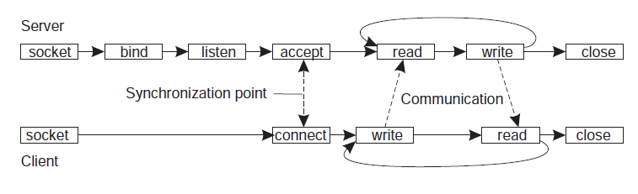
TCP Sockets

Slide 7
java.io Package
Provides many Java input/output APIs.
  In particular, serialization.
  ObjectInputStream/ObjectOutputStream.
  Be careful of stream creation order.
  Serialization requires serializable data.

Slide 8
Putting it Together
Server
Client
ServerSocket listen_socket = new ServerSocket(port);
Socket connection = listen_socket.accept();
ObjectOutputStream out = new ObjectOutputStream(connection.getOutputStream());
out.flush();
ObjectInputStream in = new ObjectInputStream(connection.getInputStream());
Integer i = (Integer)in.readObject();
out.writeObject(some_object);
connection.close();
Socket connection = new Socket(server, port_id);
// Everything else after this point is the same as on the server:
// - Create object output and input streams.
// - Send and receive objects.
// - Close the connection.

Slide 9
Exercise
Write a simple chat server and client using TCP sockets.
  Step 1:
    Client connects to server and sends a message.
    Server forwards all messages that it receives from any clients.
  Step 2:
    One client should not block the server.

Slide 10
Java RMI
What is RMI?
  Methods are executed remotely.
  Mostly looks like regular calls.
What do we need?
  Where is the server?
  Which object/method should I call?
  What if I do not know the server class definition?
  How to communicate?

Slide 11
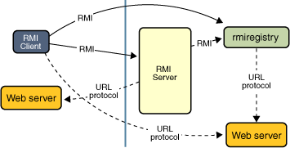
Java RMI
How do we implement?
  Lookup for server/object:
    RMI registry.
  Remote interface:
    Extends RemoteInterface.
    Methods throw RemoteException.
  Make it accessible.
How does the magic happen?
  Stub/skeleton, serialization.
Note: you are implementing a variation on Java RMI!

Slide 12
Your RMI Library
Lacks registry.
  Can be easily built on top of your library – just as Java’s registry is built on top of the rest of Java RMI.
Explicit Skeleton class.
Implementing generic interfaces…
  Use Java reflection!

Slide 13
java.lang.reflect Package
Provides API for examining Java classes at run-time and making method calls.
Interesting classes:
  Class
  Method
  Proxy
  InvocationHandler
Proxy is useful for creating stub objects.

Slide 14
References
http://www.buyya.com/java/Chapter13.pdf
Java API documentation!

