Slide 1
Competitor Landscape Update: Zumilokibart (APG777)
Atopic Dermatitis — APEX Phase 2 Part B 16-Week Data (May 2026)
August 30, 2026 CONFIDENTIAL — For Internal Use Only
Review is required before disclosure.
Notes:
This deck summarizes the zumilokibart (APG777) APEX Phase 2 Part B readout in moderate-to-severe AD from Apogee Therapeutics. Zumilokibart is a next-generation anti-IL-13 mAb designed for extended dosing intervals (Q12W–Q24W). Key question: does it threaten lebrikizumab's positioning as a differentiated IL-13 biologic? The mid dose is the selected Phase 3 dose. Data released May 27, 2026.

Slide 2
Drug Overview: Zumilokibart (APG777)
Profile
• Generic: zumilokibart | Code: APG777 | Sponsor: Apogee Therapeutics
• Modality: Humanized IgG1 monoclonal antibody (engineered Fc for extended half-life)
• Target: IL-13 (high-affinity)
• Route: Subcutaneous injection
• Dosing: Induction Wk 0, 2, 4, 12 (4 dosing days) → Maintenance Q12W (high) or Q24W (mid = planned Ph3 dose)
• Phase: Phase 2 Part B completed; Phase 3 (ADventure) initiation expected 2H 2026
Competitive Positioning
• Same MOA class as lebrikizumab (anti-IL-13) — direct competitor
• Key differentiator: extended dosing (2–4 injections/year vs 26 for Dupixent, 13 for lebrikizumab)
• Numerically highest EASI-75 at Wk16 among all anti-IL-13/IL-4 biologics (cross-trial, Ph2 MCMC-MI)
• Rapid onset: significance by Week 2 for all dose groups
• If confirmed in Phase 3 with NRI, positions as potential best-in-class convenience
Review is required before disclosure.
Notes:
Apogee Therapeutics was founded to develop extended half-life biologics for chronic diseases. Zumilokibart uses engineered Fc to extend half-life, allowing quarterly dosing. The competitive threat is primarily to lebrikizumab (same target) but also to the broader biologic class if convenience drives switching.

Slide 3
Mechanism of Action: Anti-IL-13
Pathway
• IL-13 is a key type 2 cytokine driving AD pathophysiology: barrier disruption, inflammation, pruritus
• Zumilokibart neutralizes IL-13 with high affinity — prevents binding to IL-13Rα1/IL-4Rα receptor complex
• Same target as lebrikizumab and tralokinumab; different from dupilumab (IL-4Rα blocks both IL-4 and IL-13)
Key Differentiators vs Existing IL-13 Therapies
• Engineered IgG1 Fc for extended half-life → enables Q12W–Q24W dosing (vs Q2W–Q4W for lebrikizumab/tralokinumab)
• Higher binding affinity claimed (prevents dissociation during extended dosing interval)
• Same fundamental mechanism — efficacy differentiation likely driven by PK/dosing rather than biology
• Potential risk: longer half-life means slower washout if adverse events occur
Review is required before disclosure.
Notes:
The MOA is essentially identical to lebrikizumab — both selectively block IL-13. The differentiation is entirely PK-driven: engineered Fc extends half-life from ~2 weeks (typical IgG1) to estimated 4-6 weeks, enabling quarterly dosing. If anti-IL-13 monotherapy works, the one requiring fewest injections wins on convenience.

Slide 4
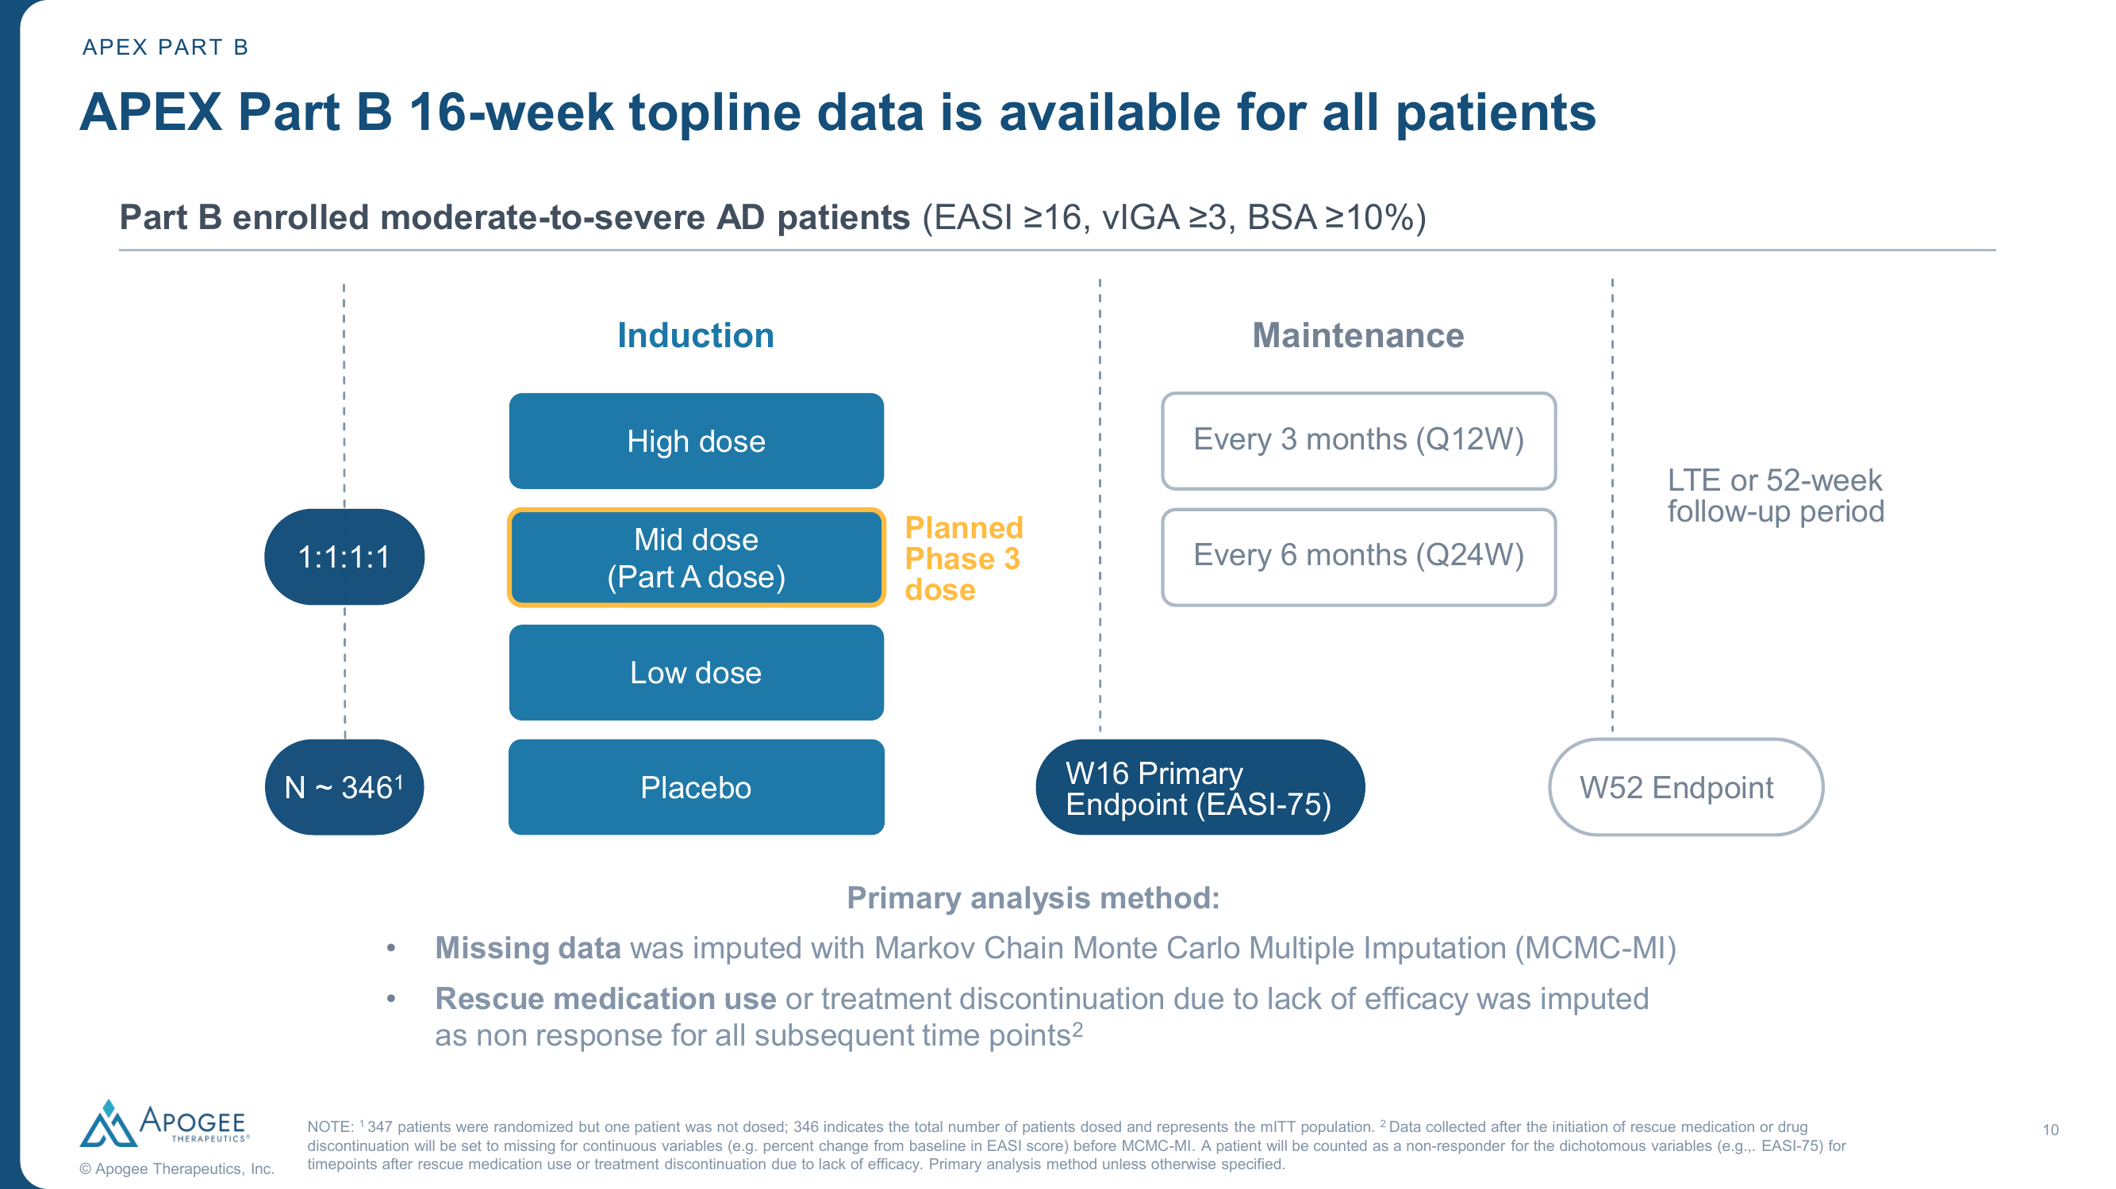
Study Design: APEX Phase 2 Part B
Design
• Phase 2b, randomized, double-blind, placebo-controlled
• N = 346 (mITT); 1:1:1:1 to High/Mid/Low dose + Placebo
• Population: Moderate-to-severe AD (EASI ≥16, vIGA ≥3, BSA ≥10%)
• Monotherapy (no background TCS required)
• Primary endpoint: EASI-75 at Week 16
• Key secondary: IGA 0/1, EASI-90, EASI-100, I-NRS4 at Week 16
• Mid dose = selected Phase 3 dose (N=85 vs N=88 PBO)
• Missing data: MCMC-MI (more lenient than NRI in competitor Ph3s)
Source: Apogee Therapeutics APEX Part B data presentation, May 27, 2026. Review is required before disclosure.
Notes:
APEX Part B enrolled moderate-to-severe AD patients (EASI≥16, vIGA≥3, BSA≥10%). N=346 (mITT) randomized 1:1:1:1. Induction: 4 dosing days (Wk0, 2, 4, 12). Maintenance: High dose Q12W, Mid dose Q24W. Primary endpoint: EASI-75 at Week 16. Rescue medication use/discontinuation = non-response.

Slide 5
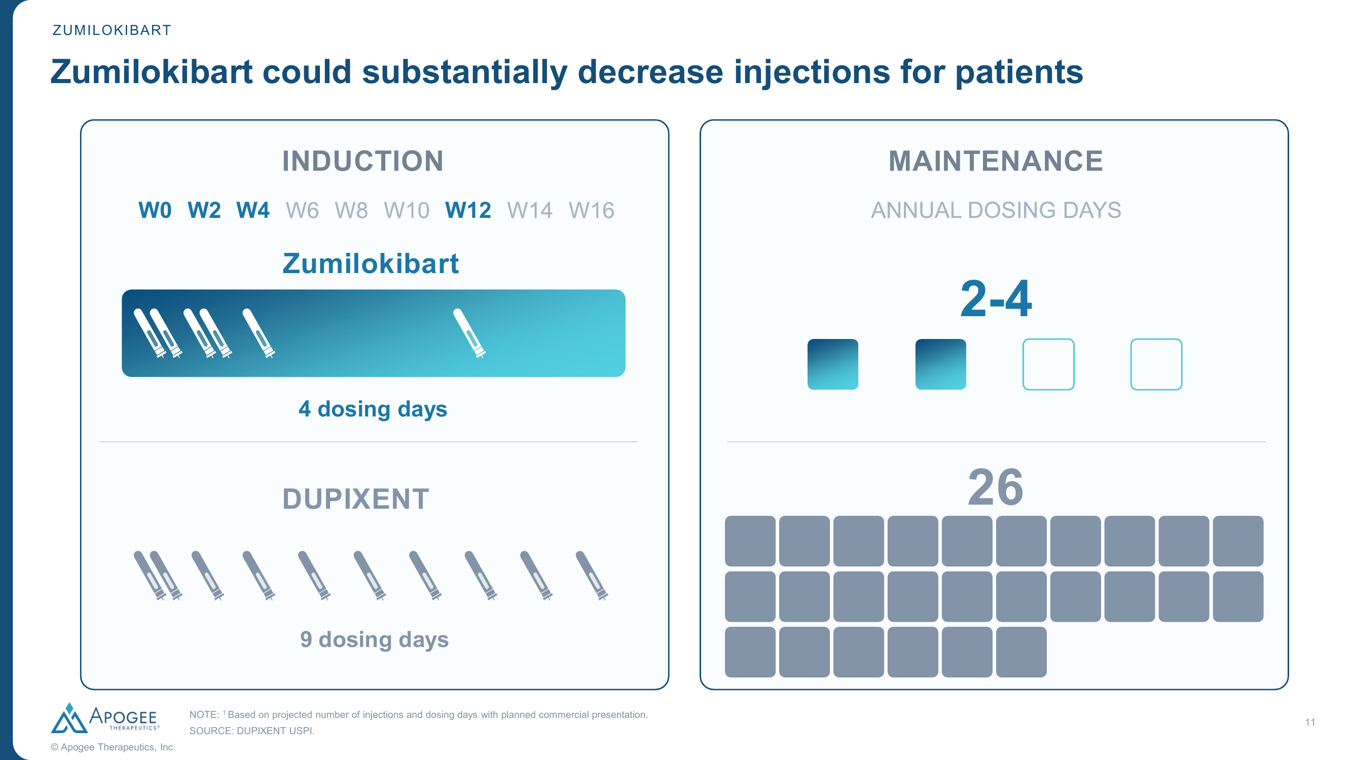
Dosing Convenience: Zumilokibart vs Dupixent
Review is required before disclosure.
Notes:
Key commercial differentiator: Zumilokibart induction requires 4 dosing days (Wk 0, 2, 4, 12) vs 9 for Dupixent. Maintenance: 2–4 annual dosing days for zumilokibart (Q12W–Q24W) vs 26 for Dupixent (Q2W). This is the central competitive narrative. For lebrikizumab: induction Q2W × 16 wks (8 doses), then Q4W maintenance (~13/yr). Zumilokibart's dosing advantage applies vs all current AD biologics.

Slide 6
Key Efficacy Results at Week 16 (Primary Analysis)
Zumilokibart Mid Dose (Planned Phase 3 Dose, N=85) vs Placebo (N=88)
• EASI-75 (primary endpoint): 65.9% vs 23.4% — Δ = 41.9 pp (p<0.001)
• IGA 0/1: 46.0% vs 10.9% — Δ = 34.8 pp (p<0.001)
• EASI-90: 47.4% vs 9.3% — Δ = 37.8 pp (p<0.001)
• I-NRS ≥4pt reduction: 50.5% vs 13.9% — Δ = 36.7 pp (p<0.001)
• EASI-100: 16.5% vs 3.4% — Δ = 12.9 pp (p<0.01)
• EASI % change from BL (LS mean): −70.6% vs −34.9% (p<0.001)
Dose-Response at Week 16
• Mid and high doses showed similar clinical activity across all endpoints
• EASI-75: High 61.6%, Mid 65.9%, Low 50.5%
• IGA 0/1: High 33.4%, Mid 46.0%, Low 27.6%
• EASI-90: High 35.8%, Mid 47.4%, Low 28.2%
• I-NRS4: High 43.4%, Mid 50.5%, Low 35.7%
• Mid dose selected for Phase 3 based on compelling benefit-risk profile
• ⚠ MCMC-MI imputation — expect 5–10% lower rates with NRI in Phase 3
Review is required before disclosure.
Notes:
All primary and key secondary endpoints were met with high statistical significance. Mid and high doses showed similar activity, while low dose was expectedly lower. IMPORTANT: This is MCMC-MI analysis. In Phase 3 competitor trials using NRI, placebo rates are typically 10-15% for EASI-75 — the 23.4% here likely reflects the more lenient imputation. If the same data were analyzed with NRI, both active and placebo rates would likely be lower.

Slide 7
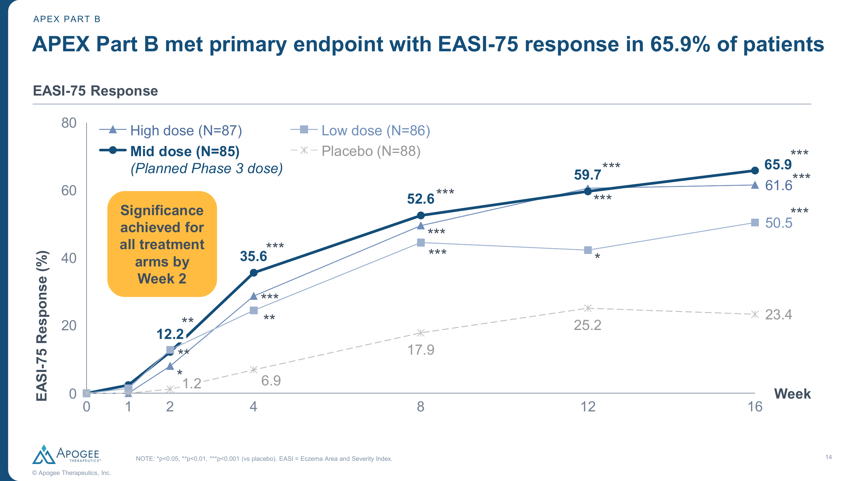
Primary Endpoint: EASI-75 Response Over Time
Source: Apogee Therapeutics. Review is required before disclosure.
Notes:
EASI-75 time course shows clear dose-response with separation from placebo by Week 2 for all arms. Mid dose (N=85): Wk2 12.2%, Wk4 35.6%, Wk8 52.6%, Wk12 59.7%, Wk16 65.9%. High dose (N=87): 61.6% at Wk16. Low dose (N=86): 50.5% at Wk16. Placebo (N=88): 23.4% at Wk16. All active arms achieved p<0.001 vs placebo. Significance achieved for all treatment arms by Week 2.

Slide 8
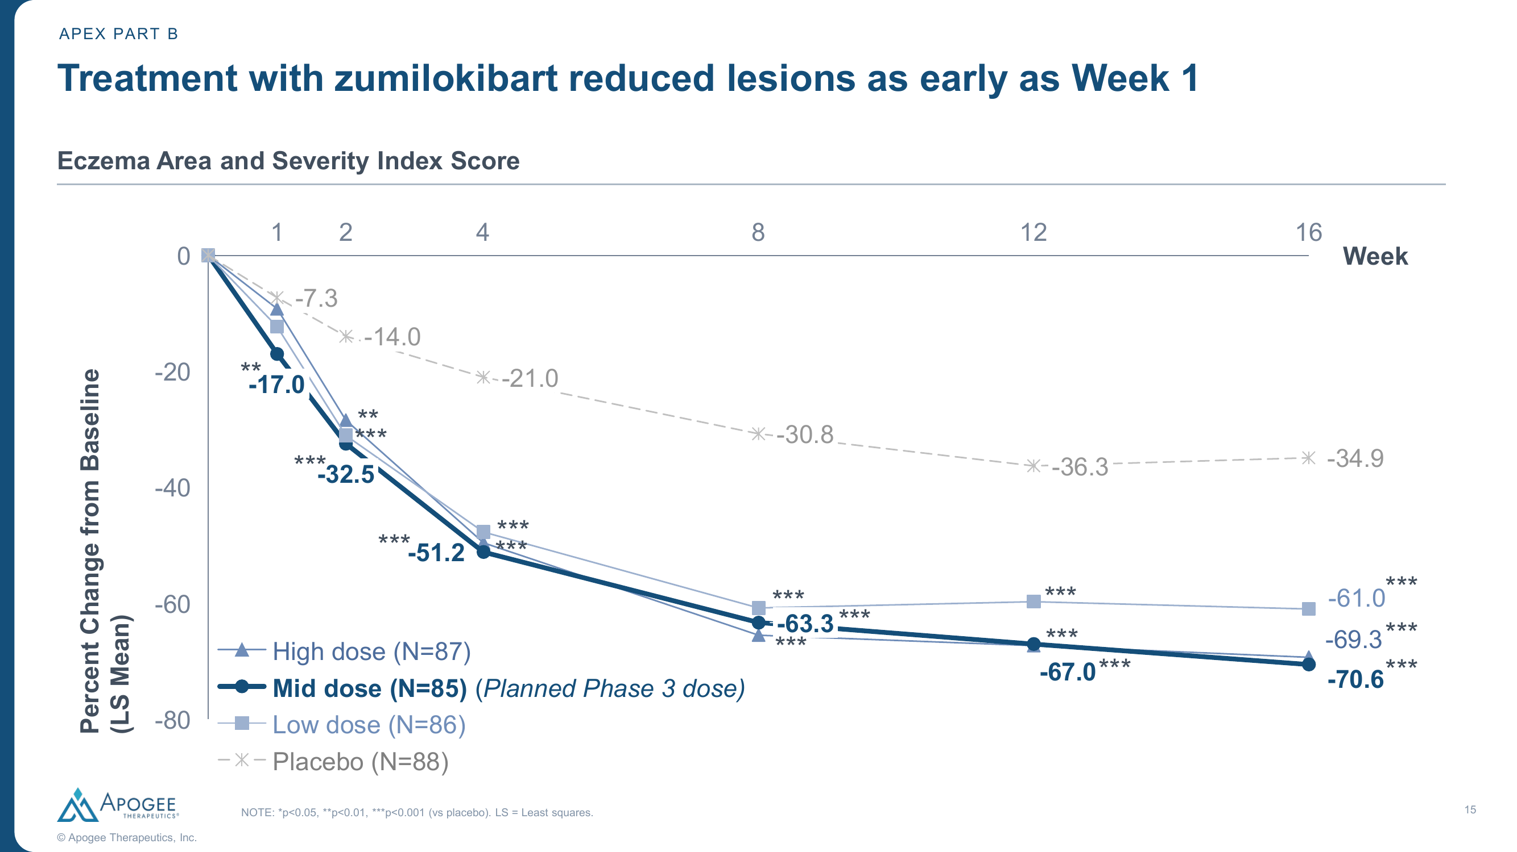
EASI Change from Baseline (Continuous Endpoint)
Source: Apogee Therapeutics. Review is required before disclosure.
Notes:
Percent change in EASI score from baseline (LS mean). Mid dose at Wk16: −70.6% (vs −34.9% PBO). Week 1: −17.0% vs −7.3% (p<0.01) — significant itch and lesion reduction from the very first week. Continuous improvement seen through Week 16 — plateau not yet reached, suggesting further gains at later timepoints. This continuous measure confirms the categorical EASI-75 findings.

Slide 9
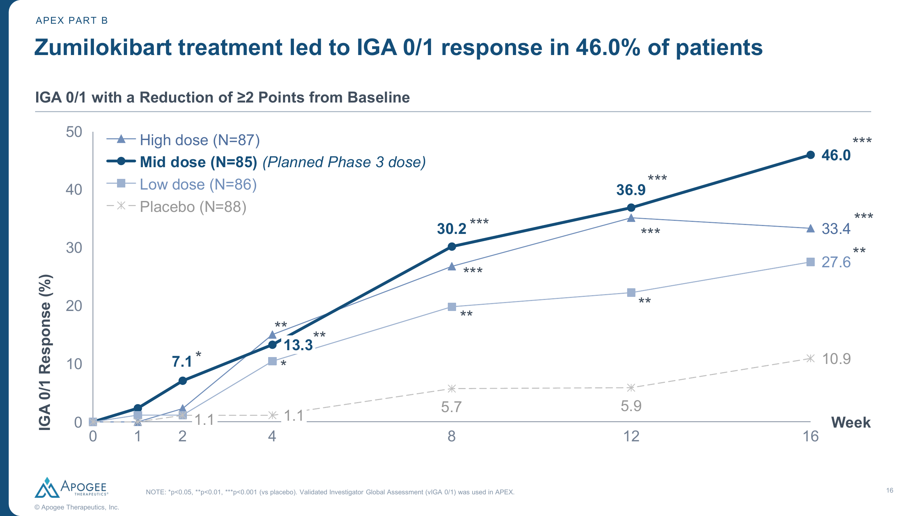
IGA 0/1 Response Over Time
Source: Apogee Therapeutics. Review is required before disclosure.
Notes:
IGA 0/1 with ≥2 point reduction time course. Mid dose at Wk16: 46.0% (vs 10.9% PBO, p<0.001). High dose: 33.4%. Low dose: 27.6%. Clear separation by Week 2 (mid dose 7.1% vs PBO ~0%). Note: Zumilokibart assessed vIGA 0/1 (validated IGA) while competitor trials used IGA 0/1. The validated scale is considered slightly more stringent but generally comparable.

Slide 10
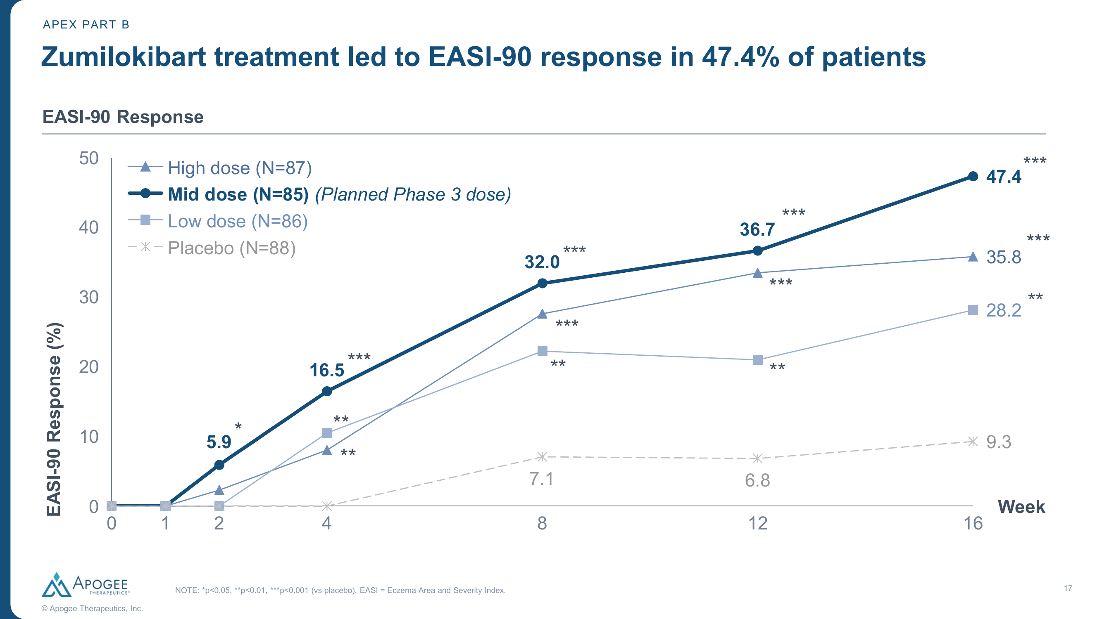
EASI-90 Response Over Time
Source: Apogee Therapeutics. Review is required before disclosure.
Notes:
EASI-90 time course. Mid dose at Wk16: 47.4% (vs 9.3% PBO, p<0.001). High dose: 35.8%. Low dose: 28.2%. Near-complete clearance showing strong response. Significance by Week 2 for mid dose (5.9%, p<0.05).

Slide 11
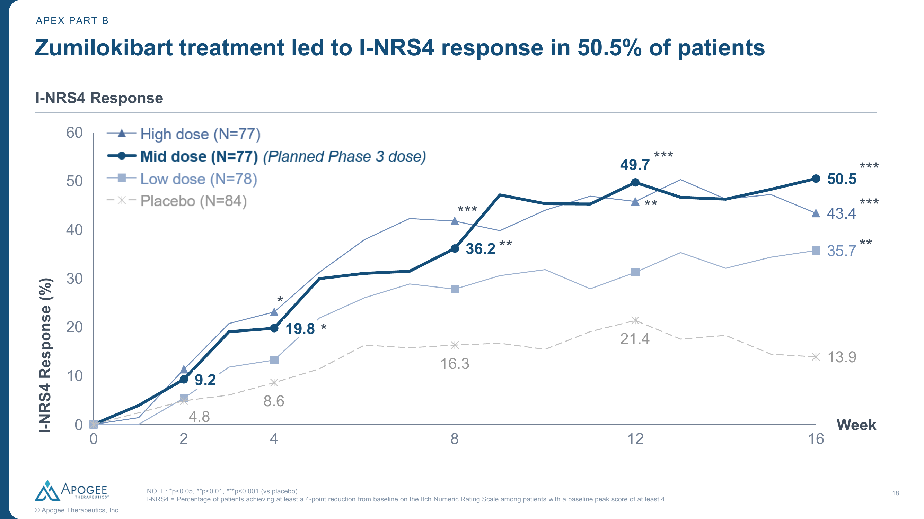
I-NRS ≥4-Point Improvement (Itch Response) Over Time
Source: Apogee Therapeutics. Review is required before disclosure.
Notes:
I-NRS4 (itch reduction ≥4 points from baseline peak ≥4). Mid dose (N=77): Wk2 9.2%, Wk4 19.8%, Wk8 36.2%, Wk12 49.7%, Wk16 50.5%. Placebo (N=84): 13.9% at Wk16. Note: itch significance achieved later than skin endpoints — Wk4 for I-NRS4 vs Wk2 for EASI-75. This is consistent with other anti-IL-13 agents where skin improvement precedes itch relief.

Slide 12
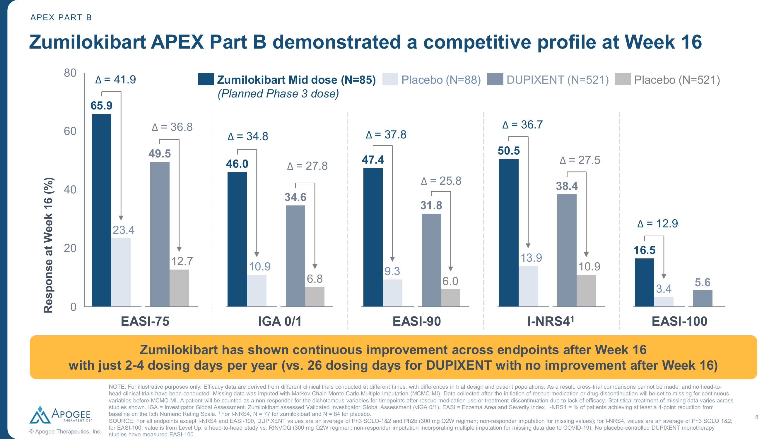
Competitive Comparison: Zumilokibart vs Dupixent Across Endpoints
Cross-trial comparison for illustrative purposes only. Review is required before disclosure.
Notes:
Apogee's own cross-trial comparison: zumilokibart mid dose vs Dupixent across 5 endpoints at Wk16. EASI-75: 65.9% vs 49.5% (Δ from PBO: 41.9 vs 36.8). IGA 0/1: 46.0% vs 34.6% (Δ: 34.8 vs 27.8). EASI-90: 47.4% vs 31.8% (Δ: 37.8 vs 25.8). I-NRS4: 50.5% vs 38.4% (Δ: 36.7 vs 27.5). EASI-100: 16.5% vs 5.6%. CAVEATS: Different trials, different populations, different imputation methods (MCMC-MI vs NRI). PBO rates vary (23.4% vs 12.7%).

Slide 13
Broader Competitor Landscape: EASI-75 at Week 16
Drug | Sponsor | Target | Route/Freq | Phase | EASI-75 | Δ vs PBO | Notes
Zumilokibart (mid) | Apogee | IL-13 | SC Q12W | Ph2b | 65.9% | 41.9 | Phase 3 dose; monotherapy
Dupilumab 300mg | Sanofi/Regen | IL-4/IL-13 | SC Q2W | Approved | 49.5% | 36.8 | SOLO 1&2 avg; monotherapy
Lebrikizumab 250mg | Lilly | IL-13 | SC Q4W | Approved | 53.0% | 37.7 | ADVOCATE 1&2 avg; monotherapy
Nemolizumab+TCS | Galderma | IL-31 | SC Q4W | Approved | 42.8% | 13.2 | ARCADIA 1&2 avg; +TCS
Adbry 300mg | LEO | IL-13 | SC Q2W | Approved | 29.1% | 17.0 | ECZTRA 1&2 avg; monotherapy
Upadacitinib 15mg | AbbVie | JAK1 | PO QD | Approved | ~70% | ~43 | Measure Up 1&2; monotherapy
Abrocitinib 100mg | Pfizer | JAK1 | PO QD | Approved | ~44% | ~29 | JADE MONO-1; Wk12
Cross-trial comparison for illustrative purposes only. Differences in trial design, populations, and endpoints preclude direct comparison. Review is required before disclosure.
Notes:
Cross-trial landscape for EASI-75 at Week 16 across approved and late-stage competitors. Zumilokibart shows numerically highest response among biologics but caveat: Phase 2 MCMC-MI analysis vs Phase 3 NRI for competitors. JAK inhibitors (oral) show higher rates but carry boxed warning. Nemolizumab+TCS is combo therapy — lower Δ reflects high PBO+TCS rate (29.6%).

Slide 14
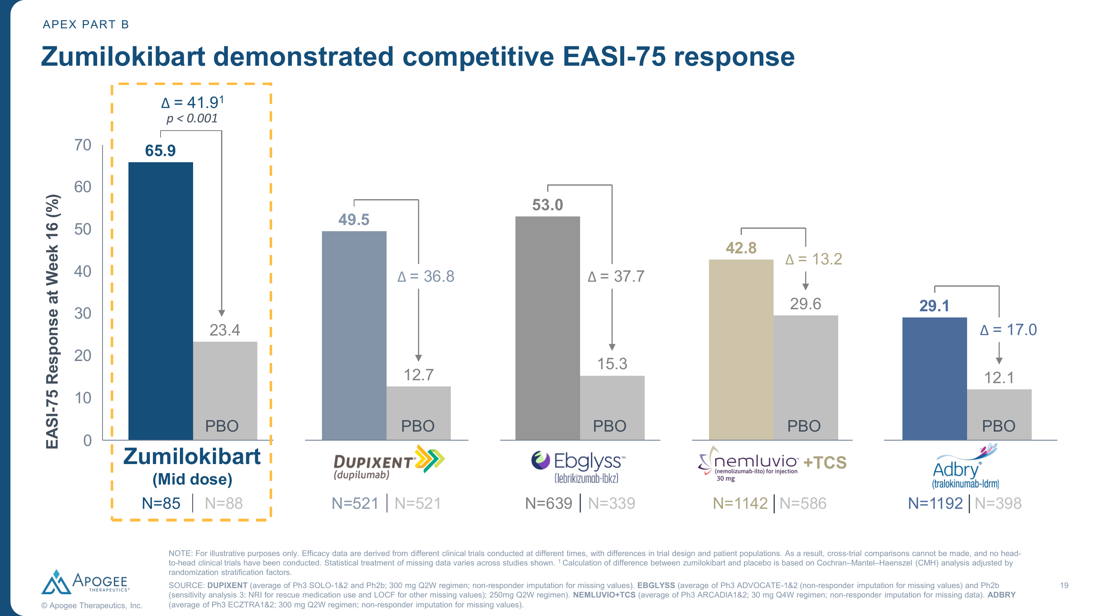
Competitive EASI-75 Bar Chart (Sponsor Data)
Cross-trial comparison for illustrative purposes only. Review is required before disclosure.
Notes:
EASI-75 cross-trial comparison against 4 approved biologics. Zumilokibart 65.9% (N=85, PBO 23.4%). Dupixent 49.5% (N=521, PBO 12.7%, Δ=36.8). Ebglyss/lebrikizumab 53.0% (N=639, PBO 15.3%, Δ=37.7). Nemluvio+TCS (nemolizumab) 42.8% (N=1142, PBO 29.6%, Δ=13.2 — note: combo with TCS). Adbry/tralokinumab 29.1% (N=1192, PBO 12.1%, Δ=17.0). Higher PBO rate for zumilokibart inflates both active and delta.

Slide 15
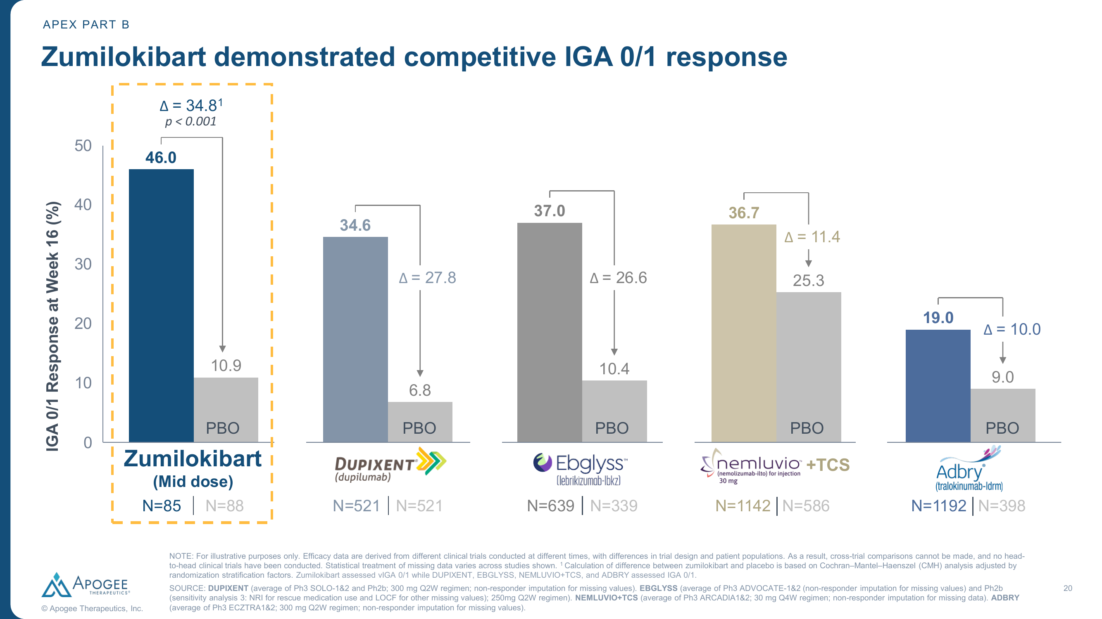
Broader Competitive Landscape: IGA 0/1 at Week 16
Cross-trial comparison for illustrative purposes only. Review is required before disclosure.
Notes:
IGA 0/1 cross-trial. Zumilokibart 46.0% (PBO 10.9%, Δ=34.8). Dupixent 34.6% (PBO 6.8%, Δ=27.8). Ebglyss 37.0% (PBO 10.4%, Δ=26.6). Nemluvio+TCS 36.7% (PBO 25.3%, Δ=11.4). Adbry 19.0% (PBO 9.0%, Δ=10.0). Zumilokibart assessed vIGA 0/1 vs IGA 0/1 in competitor trials — slightly different scales.

Slide 16
Safety Summary Through Week 16
Safety Event, n (%) | Low (N=86) | Mid (N=85) | High (N=87) | PBO (N=88)
≥1 TEAE | 65 (75.6%) | 51 (60.0%) | 59 (67.8%) | 59 (67.0%)
≥1 Serious TEAE | 2 (2.3%) | 1 (1.2%) | 3 (3.4%) | 2 (2.3%)
Disc. due to TEAE | 1 (1.2%) | 2 (2.4%) | 3 (3.4%) | 2 (2.3%)
Nasopharyngitis | 22 (25.6%) | 12 (14.1%) | 10 (11.5%) | 19 (21.6%)
Headache | 7 (8.1%) | 6 (7.1%) | 6 (6.9%) | 3 (3.4%)
Noninfective conjunctivitis | 4 (4.7%) | 5 (5.9%) | 10 (11.5%) | 0 (0%)
URTI | 5 (5.8%) | 6 (7.1%) | 5 (5.7%) | 3 (3.4%)
Conjunctivitis (pooled, all PTs) | 13 (15.1%) | 9 (10.6%) | 18 (20.7%) | 0 (0%)
Source: Apogee Therapeutics APEX Part B. Review is required before disclosure.
Notes:
Safety profile appears manageable but limited data. Conjunctivitis is the key signal: dose-dependent (10.6% to 20.7%), all in active arms vs 0% PBO. This is higher than lebrikizumab (~7-8% in ADVOCATE). Higher conjunctivitis could become a differentiator favoring lebrikizumab if it persists in Ph3. Overall TEAE rate for mid dose (60%) was lower than placebo (67%), which is reassuring. No effect of ADAs on PK, clinical activity, or safety.

Slide 17
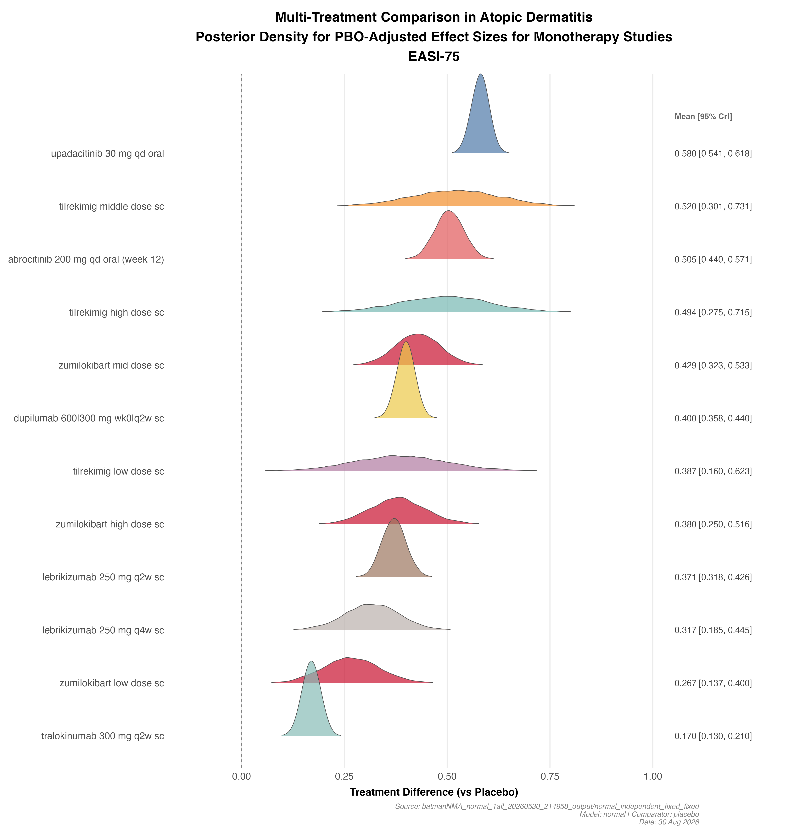
BNMA: EASI-75 — Treatment Effects vs Placebo
Key Findings
• Zumilokibart mid dose ranks competitively — posterior mean 0.429 [0.323, 0.533], overlapping with dupilumab (0.400) and lebrikizumab Q2W (0.371)
• Upadacitinib 30mg leads (0.580); tilrekimig and abrocitinib 200mg also competitive but with wider CrI
• All zumilokibart doses show significant effects vs placebo (CrI excludes 0)
• Formal indirect comparison does NOT support clear superiority over established biologics — cross-trial bar charts overstate the difference
Random-effects BNMA; indirect comparison only. Review is required before disclosure.
Notes:
BNMA normal-model with 79 treatments from Ph2/Ph3 AD trials on the EASI-75 responder rate difference scale. Zumilokibart mid dose posterior mean of 0.429 overlaps substantially with dupilumab (0.400) and lebrikizumab (0.371). The key insight: once between-study heterogeneity is accounted for, zumilokibart is competitive but NOT clearly superior. Tilrekimig (another IL-13 next-gen from Roche) also ranks high with wide CrI reflecting early-phase data.

Slide 18
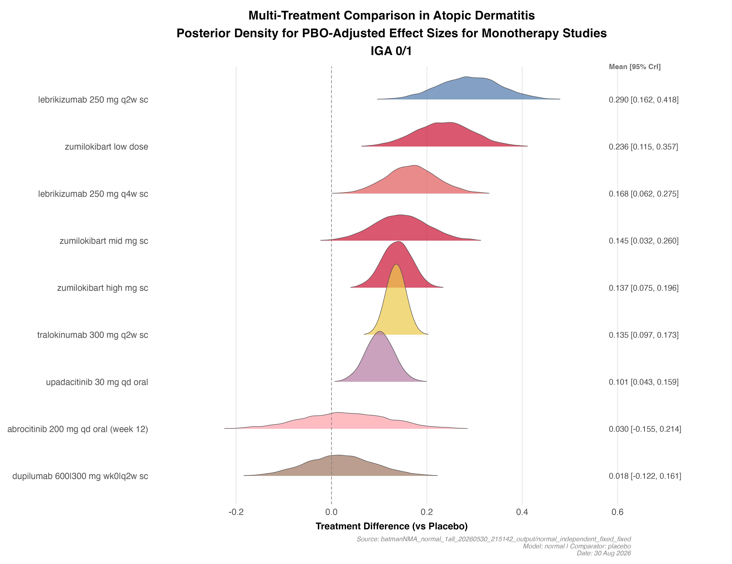
BNMA: IGA 0/1 — Treatment Effects vs Placebo
Key Findings
• Lebrikizumab 250mg Q2W has highest posterior mean (0.290) — ranks #1 for IGA 0/1
• Zumilokibart low dose ranks #2 (0.236); mid dose ranks #4 (0.145)
• Dupilumab and abrocitinib CrI cross 0 — not significantly different from placebo in this IGA 0/1 network
• Lilly can use this to counter the 'best-in-class' narrative on IGA 0/1
Random-effects BNMA; indirect comparison only. Review is required before disclosure.
Notes:
IGA 0/1 BNMA from 78-treatment network. Important contrast with cross-trial comparison: lebrikizumab actually ranks #1 for IGA 0/1, despite the press release showing zumilokibart with higher point estimate. This reflects the BNMA's ability to account for heterogeneity in placebo rates. Zumilokibart is competitive but lebrikizumab has a stronger IGA 0/1 signal in the formal network.

Slide 19
Head-to-Head vs Lebrikizumab (Lilly)
Similarities
• Same target: IL-13 neutralization
• Same patient population: moderate-to-severe AD
• Same endpoint framework (EASI-75, IGA 0/1)
• Both SC injection
• Both show rapid onset (separation by Wk 2)
Differences
• Dosing: Q24W (zumi) vs Q2W→Q4W (lebri): 2–4 vs 13 injections/yr
• Efficacy (cross-trial): EASI-75 65.9% vs 53.0% — MCMC-MI vs NRI caveat
• BNMA: overlapping posteriors; no significant separation
• Phase: Ph2 Part B (zumi) vs Ph3 + approved (lebri)
• Conjunctivitis: 10.6% (zumi mid) vs ~7–8% (lebri Ph3)
• Safety database: N=85 (zumi) vs >1000 (lebri)
• Label: none (zumi) vs broad AD label (lebri)
Review is required before disclosure.
Notes:
Zumilokibart wins on convenience (dosing interval) and numerically on efficacy in cross-trial bars. Lebrikizumab wins on evidence maturity: approved, Phase 3 data with standard NRI, growing real-world evidence. The BNMA shows overlapping posteriors. Key uncertainty: will Ph3 with NRI confirm Ph2 MCMC-MI numbers?

Slide 20
Key Takeaways & Implications for Lilly
• Zumilokibart achieved numerically best EASI-75 (65.9%) and IGA 0/1 (46.0%) at Wk16 — but Ph2 with MCMC-MI imputation • Extended dosing (Q24W maintenance, 2–4 injections/year) is a powerful commercial differentiator vs all AD biologics • BNMA shows competitive but overlapping efficacy with lebrikizumab — no clear statistical separation • Conjunctivitis rate 10.6–20.7% (dose-dependent) is higher than lebrikizumab (~7–8%) — potential Lilly advantage • Timeline: ADventure Phase 3 initiation 2H 2026 → readout ~2028 → regulatory filing ~2029 earliest
Recommended Actions
• Monitor ADventure Phase 3 design: NRI vs MCMC-MI, sample size, comparator arm • Leverage BNMA indirect comparison to counter cross-trial bar chart narrative (show overlapping CrIs) • Strengthen lebrikizumab positioning on safety (lower conjunctivitis), real-world evidence, and label breadth • Prepare materials comparing dosing convenience vs certainty of efficacy (Phase 3 data vs Phase 2) • Assess BNMA update once Phase 3 data available
Notes:
Bottom line: zumilokibart is the most credible emerging threat to lebrikizumab in the anti-IL-13 space. The convenience story is powerful. However, Lilly has a 2-3 year head start, approved label, robust Ph3 data, and possibly a lower conjunctivitis rate. The BNMA does not support clear superiority. Key question: will Ph3 NRI confirm Ph2 numbers? Monitor closely.

