Slide 1
Competitor Landscape Update: Zumilokibart (APG777)
Atopic Dermatitis — APEX Phase 2 Part B 16-Week Data
July 2026 CONFIDENTIAL — For Internal Use Only
Review is required before disclosure.
Notes:
This deck summarizes the APEX Phase 2 Part B 16-week topline data for zumilokibart (APG777), presented by Apogee Therapeutics on May 27, 2026. Zumilokibart is a next-generation anti-IL-13 antibody with an extended half-life enabling Q12W–Q24W dosing. This readout supports Phase 3 (ADventure) initiation in 2H 2026 with a planned 2029 launch.

Slide 2
Drug Overview: Zumilokibart (APG777)
Drug Profile
• Generic: zumilokibart | Code: APG777
• Sponsor: Apogee Therapeutics (founded 2022; Blackstone commercialization deal)
• Modality: Anti-IL-13 monoclonal antibody (YTE half-life extension)
• Target: IL-13 (same target as lebrikizumab & tralokinumab)
• Route: Subcutaneous injection
• Dosing: 4 loading injections (W0, W2, W4, W12) then Q12W or Q24W maintenance
• Phase: Phase 2 Part B complete; Phase 3 (ADventure) planned 2H 2026
• Planned launch: 2029
Review is required before disclosure.
Notes:
Zumilokibart is Apogee Therapeutics' lead asset. It targets IL-13 — the same cytokine as lebrikizumab (Ebglyss) and tralokinumab (Adbry). The key differentiator is the YTE Fc modification that extends the half-life, enabling much less frequent dosing (Q12W or Q24W maintenance vs Q2W for dupilumab/lebrikizumab). Apogee was founded in 2022, has a Blackstone financing deal for commercialization. Also developing APG273 (anti-TSLP). NCT05964504.

Slide 3
Mechanism of Action & Differentiation
IL-13 Pathway Blockade
• Binds and neutralizes IL-13, a key Type 2 cytokine
• IL-13 drives epidermal barrier disruption, itch, and fibrosis
• Does NOT block IL-4 (unlike dupilumab which is IL-4Rα)
• Same target as lebrikizumab and tralokinumab
• IL-13-selective → may have cleaner safety (less infection risk)
Key Differentiators (YTE Fc Extension)
• YTE Fc extension: ~4x longer half-life vs standard IgG
• Only 4 dosing days in 16-week induction (vs 9 for dupilumab)
• Maintenance: 2–4 annual dosing days (vs 26 for dupilumab, 13–26 for lebrikizumab)
• Potential for Q24W (every 6 months) dosing
• Could be first AD biologic with Q3M + Q6M options
Review is required before disclosure.
Notes:
The YTE modification (M252Y/S254T/T256E in the Fc region) increases FcRn binding affinity and extends serum half-life. For lebrikizumab, dosing is Q2W induction then Q2W or Q4W maintenance. Zumilokibart's dosing convenience advantage is substantial: 2-4 annual injections vs 26 for dupilumab. However, all IL-13 agents carry conjunctivitis risk. The question is whether efficacy is maintained at these extended intervals.

Slide 4
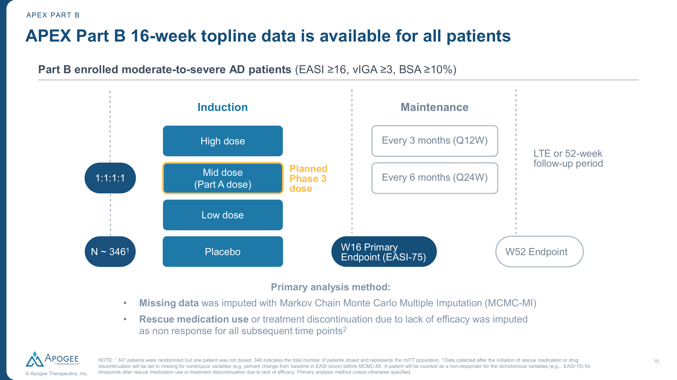
APEX Part B — Study Design
Trial Overview
• Phase 2, randomized, double-blind, PBO-controlled
• N=346 (mITT): Low (N=86), Mid (N=85), High (N=87), PBO (N=88)
• Randomized 1:1:1:1
• Moderate-to-severe AD (EASI ≥16, vIGA ≥3, BSA ≥10%)
• Dosing: SC at W0, W2, W4, W12
• Maintenance: Q12W or Q24W
• Primary: EASI-75 at Wk16
• Estimand: MCMC-MI
• Baseline: EASI ~26, age ~37y, BSA ~40%
Source: Apogee Therapeutics APEX Part B presentation, May 2026. Review is required before disclosure.
Notes:
STUDY DESIGN:
- 347 patients randomized but 1 not dosed → 346 mITT population
- Mid dose is the planned Phase 3 dose (same as Part A)
- Primary analysis: Markov Chain Monte Carlo Multiple Imputation (MCMC-MI)
- Rescue medication or discontinuation for lack of efficacy = non-responder
BASELINE (Mid dose): Age 39.9y, Female 52.9%, Weight 76.4kg, EASI 26.0, vIGA(4) 36.5%, I-NRS 7.0, BSA 40.0%

Slide 5
Key Efficacy Results at Week 16
Primary Endpoint — Mid Dose (Planned Phase 3 Dose, N=85)
• EASI-75 (primary): 65.9% vs 23.4% PBO (Δ=41.9; p<0.001)
• IGA 0/1: 46.0% vs 10.9% PBO (Δ=34.8; p<0.001)
• EASI-90: 47.4% vs 9.3% PBO (Δ=37.8; p<0.001)
• I-NRS ≥4 (itch): 50.5% vs 13.9% PBO (Δ=36.7; p<0.001)
• EASI-100: 16.5% vs 3.4% PBO (p<0.01)
Dose-Response & Key Observations
• Mid & High doses showed similar clinical activity throughout
• Low dose showed relatively lower but still significant activity
• Rapid onset: significant EASI reduction by Week 1; EASI-75 significant by Week 2
• Part B results generally similar to Part A (confirming dose selection)
• Placebo rate 23.4% — higher than historical AD trials (10–15%); Δ is more reliable for cross-trial comparison
Review is required before disclosure.
Notes:
KEY RESULTS (all arms at Wk16):
- EASI-75: Low 52.3%, Mid 65.9%, High 63.2%, PBO 23.4%
- IGA 0/1: Low 31.4%, Mid 46.0%, High 42.5%, PBO 10.9%
- EASI-90: Low 33.7%, Mid 47.4%, High 44.8%, PBO 9.3%
- I-NRS4: Low 37.2%, Mid 50.5%, High 50.6%, PBO 13.9%
NOTE: 65.9% EASI-75 is notably high for Phase 2 (N=85). Placebo rate (23.4%) higher than SOLO (12.7%), ADVOCATE (15.3%). Treatment difference (Δ=41.9) is the most reliable cross-trial metric.

Slide 6
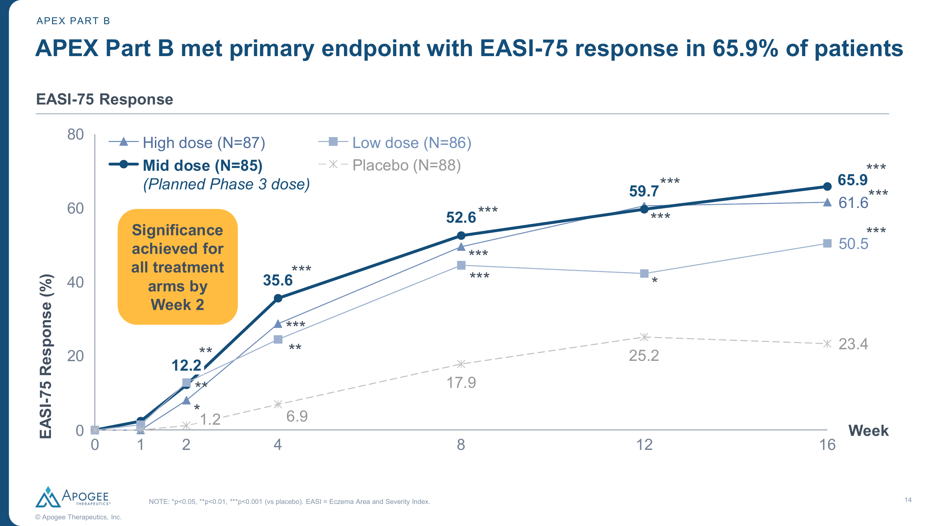
EASI-75 Response Over Time — All Arms
Source: Apogee Therapeutics. Review is required before disclosure.
Notes:
EASI-75 TIME COURSE:
- Significance achieved for all treatment arms by Week 2
- Mid dose: 12.2% at Wk1, 35.6% at Wk4, 52.6% at Wk8, 59.7% at Wk12, 65.9% at Wk16
- High dose tracks similarly to mid dose throughout
- Continuous improvement suggests potential for further gains beyond Wk16
- Part A 52-week data showed continued improvement

Slide 7
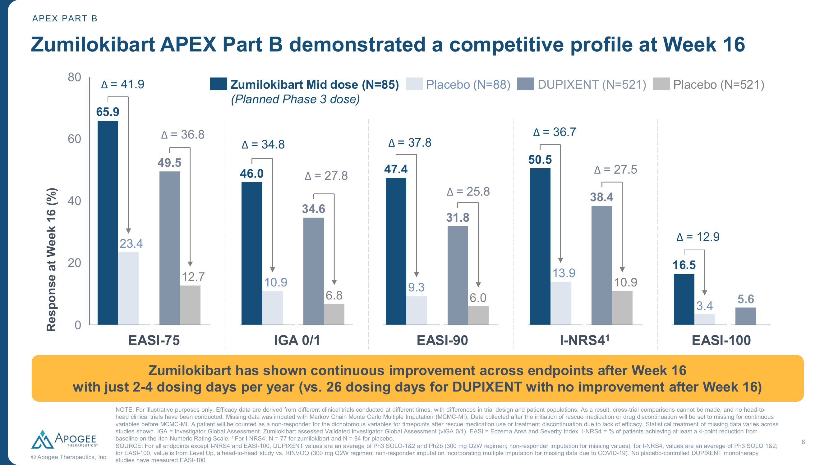
Competitive EASI-75 & IGA 0/1 at Week 16
Cross-trial comparison only. Different populations, imputation methods. Review is required before disclosure.
Notes:
COMPETITIVE PROFILE (from Apogee press release):
Zumilokibart Mid Dose (N=85) vs DUPIXENT (N=521):
- EASI-75: 65.9 vs 49.5 (Δ from PBO: 41.9 vs 36.8)
- IGA 0/1: 46.0 vs 34.6 (Δ: 34.8 vs 27.8)
- EASI-90: 47.4 vs 31.8 (Δ: 37.8 vs 25.8)
- I-NRS4: 50.5 vs 38.4 (Δ: 36.7 vs 27.5)
CAVEATS: Cross-trial only. Zumilokibart PBO 23.4% vs DUPIXENT PBO 12.7% (SOLO). Small N (85) inflates variability.

Slide 8
Safety Summary — Through Week 16
Overall Safety (Mid Dose vs Placebo)
• ≥1 TEAE: 60.0% vs 67.0% PBO — lower than placebo
• Serious TEAE: 1.2% vs 2.3% PBO
• Discontinued due to TEAE: 2.4% vs 2.3% PBO
• Most common: nasopharyngitis (14.1%), headache (7.1%)
• No effect of ADAs on PK, efficacy, or safety
Conjunctivitis (Key Class Signal)
• Noninfective conjunctivitis: Low 4.7%, Mid 5.9%, High 11.5%, PBO 0.0%
• Pooled conjunctivitis (all preferred terms): Mid 10.6%, Low 15.1%, High 20.7%
• Dose-dependent pattern (higher at higher doses)
• Mid dose (10.6%) slightly above lebrikizumab Ph3 (~7–8%)
• Low dose paradox (15.1%) — likely small-N noise
Review is required before disclosure.
Notes:
SAFETY DETAILS:
- ≥1 TEAE: Low 75.6%, Mid 60.0%, High 67.8%, PBO 67.0%
- ≥1 Serious TEAE: Low 2.3%, Mid 1.2%, High 3.4%, PBO 2.3%
- D/C due to TEAE: Low 1.2%, Mid 2.4%, High 3.4%, PBO 2.3%
COMPARATIVE CONJUNCTIVITIS:
- Lebrikizumab Ph3: ~7-8% (ADVOCATE)
- Dupilumab: ~8-10% (SOLO/CAFÉ)
- Tralokinumab: ~7-10% (ECZTRA)
Overall well-tolerated, consistent with IL-13 class.

Slide 9
Competitive Landscape — AD Biologics at Week 16
Drug | Sponsor | MOA | EASI-75 | IGA 0/1 | Dosing (Maint.) | Phase
Zumilokibart (APG777) | Apogee | Anti-IL-13 | 65.9% | 46.0% | Q12W–Q24W SC | Phase 2b
Lebrikizumab (Ebglyss) | Lilly | Anti-IL-13 | 53.0% | 37.0% | Q2W/Q4W SC | Approved
Dupilumab (Dupixent) | Sanofi/Regen. | Anti-IL-4Rα | 49.5% | 34.6% | Q2W SC | Approved
Nemolizumab (Nemluvio) | Galderma | Anti-IL-31Rα | 42.8%* | 36.7%* | Q4W SC | Approved
Tralokinumab (Adbry) | LEO Pharma | Anti-IL-13 | 29.1% | 19.0% | Q2W SC | Approved
Amlitelimab | Sanofi | Anti-OX40L | ~44%† | — | Q4W SC | Phase 2
Rocatinlimab | Lilly (acq.) | Anti-OX40 | — | — | Q4W SC | Phase 3
Cross-trial comparisons are indirect. *+TCS combination. †24-week endpoint. Review is required before disclosure.
Notes:
SOURCES: Dupixent (SOLO 1&2 average, NRI); Ebglyss (ADVOCATE 1&2, NRI); Nemluvio (ARCADIA 1&2, NRI, +TCS); Adbry (ECZTRA 1&2, NRI); Amlitelimab (COAST, NRI). Note Nemluvio +TCS inflates vs monotherapy.
Zumilokibart's placebo rate (23.4%) is notably higher than historical AD trials (typically 10-15%), which may inflate absolute rates. Δ vs placebo is more reliable.

Slide 10
Zumilokibart vs Lebrikizumab (Ebglyss) — Lilly Positioning
Similarities
• Same target: IL-13 neutralization
• Same indication: moderate-to-severe AD adults
• Similar endpoint magnitudes (EASI-75 ~50–66%)
• SC injection route
• Class-associated conjunctivitis risk
• Both claim improving efficacy over time
Differences
• Dosing: Zumilokibart Q12–24W vs Lebrikizumab Q2–4W
• Annual injections: 2–4 vs 13–26
• Maturity: Ph2b vs Approved (Ebglyss launched)
• Conjunctivitis: 10.6% (mid) vs ~8% (lebrikizumab Ph3)
• Phase 3 data: 2H 2026 start; readout ~2028
• Commercial: Apogee pre-revenue vs Lilly established
Cross-trial comparison only; no head-to-head data available. Review is required before disclosure.
Notes:
The critical question for Lilly: Does zumilokibart threaten lebrikizumab's market position?
The dosing advantage is real and substantial (2-4 vs 13-26 injections/year).
However:
1. Lebrikizumab is already approved and launching
2. Zumilokibart won't reach market until ~2029
3. Phase 2 efficacy often doesn't fully translate to Phase 3
4. Higher placebo rate may inflate absolute numbers
KEY RISK: If Phase 3 confirms AND convenience drives switching → could cap lebrikizumab's peak share.

Slide 11
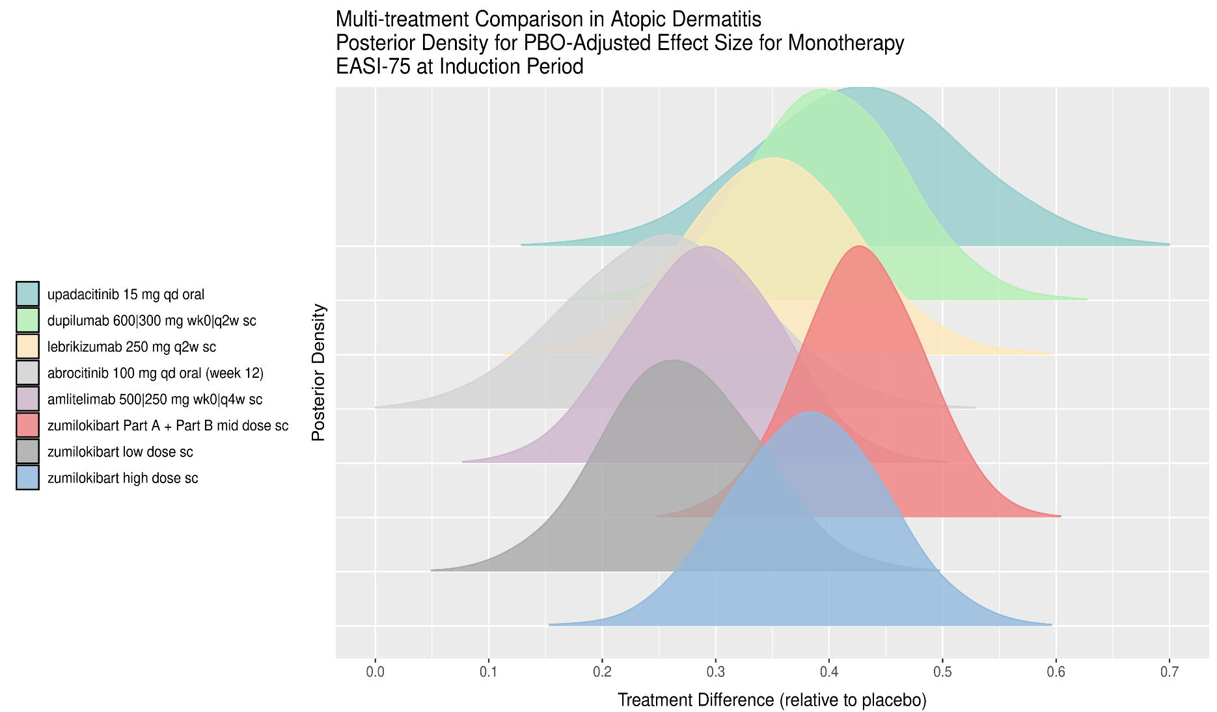
BNMA: EASI-75 at Induction Period (Week 16)
Key Findings
• Zumilokibart high dose peaks ~0.45 — highest
• Mid dose (Part A+B) peaks ~0.40, overlaps upadacitinib 15mg
• Lebrikizumab 250mg Q2W peaks ~0.35
• Wide CrI reflects small Phase 2 sample (N=85)
• Ranking: Mid ≈ #2–3 (overlaps upa, dupilumab)
• Lebrikizumab ranks ~#4–5 for EASI-75
Random-effects BNMA; indirect comparison only. Review is required before disclosure.
Notes:
BNMA INTERPRETATION — EASI-75:
Ridge plot shows posterior distributions of PBO-adjusted treatment effects.
1. Zumilokibart high dose (blue): rightmost peak (~0.45) but very wide distribution.
2. Mid dose (red/pink, Part A+B): peaks ~0.38-0.40, overlapping with upadacitinib 15mg (teal) and dupilumab (green).
3. Lebrikizumab 250mg Q2W (yellow/gold): peaks ~0.33-0.35.
4. Abrocitinib 100mg (gray) and amlitelimab (purple) are lower.
LIMITATIONS: Small sample inflates uncertainty. Phase 2 vs Phase 3 data. Different imputation methods.
SOURCE: Lilly internal BNMA (Batman model), random-effects, monotherapy studies.

Slide 12
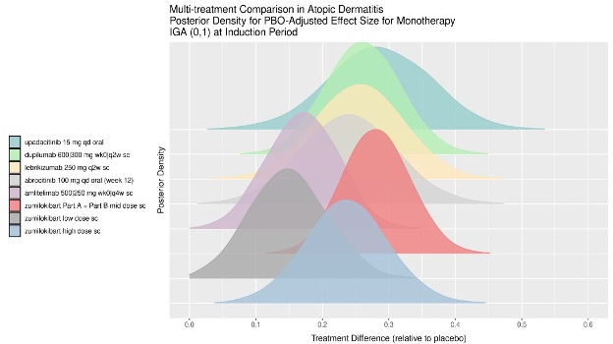
BNMA: IGA 0/1 at Induction Period (Week 16)
Key Findings
• Upadacitinib 15mg peaks highest (~0.35) overall
• Zumilokibart mid dose (Part A+B) peaks ~0.32
• Dupilumab 600/300mg peaks ~0.28
• Lebrikizumab 250mg Q2W peaks ~0.28
• Substantial overlap across all biologics for IGA 0/1
• Zumilokibart high dose has very wide CrI
Random-effects BNMA; indirect comparison only. Review is required before disclosure.
Notes:
BNMA INTERPRETATION — IGA 0/1:
IGA 0/1 posterior densities show a more compressed landscape than EASI-75.
1. Upadacitinib 15mg oral (teal) peaks highest at ~0.35 (JAK class advantage for IGA).
2. Zumilokibart Part A+B mid dose (red) peaks ~0.30-0.32.
3. Dupilumab (green) and Lebrikizumab (yellow) both peak ~0.27-0.29.
4. Abrocitinib 100mg lower (~0.22).
For IGA 0/1, separation between agents is less clear. Biologics cluster together, CIs overlap substantially. Dosing convenience may be more important than efficacy differentiation.
SOURCE: Lilly internal BNMA (Batman model), random-effects, monotherapy studies.

Slide 13
Implications for Lilly Strategy
Competitive Threat Assessment
• EASI-75 Δ of 41.9 suggests potentially best-in-class efficacy among IL-13s
• Dosing convenience (Q12–24W) is a major differentiator
• Could set new standard of care upon approval (~2029)
• Patient preference likely to favor fewer injections
• Apogee's Blackstone deal funds full commercialization
Mitigating Factors for Lilly
• Lebrikizumab approved NOW; 3+ years of commercial build before zumilokibart arrives
• Phase 2→3 attrition: efficacy commonly drops ~30% in larger trials
• Higher placebo rate (23.4%) may inflate absolute numbers
• Conjunctivitis (10.6%) slightly above lebrikizumab (~8%)
• Small N (85/arm) — wide CIs, less certainty
• Lilly's label breadth (adolescents, multiple indications) + rocatinlimab (anti-OX40) pipeline
Review is required before disclosure.
Notes:
THREAT LEVEL: MODERATE-HIGH.
BULL CASE for Apogee: Phase 3 confirms efficacy, Q24W maintenance works, 2029 launch captures convenience seekers.
BEAR CASE for Apogee: Phase 3 efficacy drops to ~50-55%, Q24W underperforms, conjunctivitis worsens with longer exposure.
LILLY RESPONSE OPTIONS:
1. Accelerate lebrikizumab lifecycle (Q4W data emphasis, pen device)
2. Emphasize real-world evidence and safety track record
3. Advance rocatinlimab (different MOA) as complementary pipeline
4. Monitor ADventure Phase 3 enrollment and interim data
5. Consider label expansion (pediatric, asthma) to differentiate

Slide 14
Key Takeaways & Recommended Actions
• Zumilokibart mid dose achieved EASI-75 Δ=41.9 vs PBO (p<0.001) — potentially best-in-class for AD biologics • Q12W–Q24W dosing (2–4 annual injections) is a transformational convenience advantage over all current biologics • BNMA places zumilokibart mid dose in the top tier alongside upadacitinib and dupilumab, with overlapping CrIs vs lebrikizumab • Phase 3 (ADventure) planned 2H 2026; if confirmed, represents a meaningful competitive threat to lebrikizumab by ~2029 • Safety is manageable (conjunctivitis 10.6%); key limitation is small sample size (N=85) with wide confidence intervals
Recommended Actions
• Monitor ADventure Phase 3 enrollment and design details closely (2H 2026 initiation) • Update BNMA with Phase 3 data when available; reassess ranking • Evaluate lebrikizumab lifecycle strategy emphasizing established safety, label breadth, and real-world evidence
Notes:
SUMMARY: Zumilokibart is a credible, differentiated competitor to lebrikizumab in AD. The dosing convenience is its primary advantage. Lilly has time — lebrikizumab is approved and building market share now, while zumilokibart is 3+ years from potential approval.
OPEN QUESTIONS:
1. Should Lilly accelerate Q4W maintenance messaging for lebrikizumab?
2. What is rocatinlimab timeline relative to zumilokibart?
3. Will Q24W maintenance maintain efficacy long-term?
Review is required before disclosure.

