Slide 1
Summary
Compound Overview & Development Timeline
• Zumilokibart (APG777): Apogee Therapeutics, anti-IL-13 mAb (Monotherapy AtD study)
• Part B (dose-finding) induction results disclosed; Mid Dose in Part B is same dose as used in Part A
• APEX Part A (proof-of-concept): Wk16 induction (July 2025); Wk52 maintenance (March 2026)
• Ph3 AtD studies: 2 Monotherapy + 1 TCS Combination (ADventure) to start 2H 2026; possible approval in 2029
• Other indications: Asthma (Ph2b start 1H2027); Eosinophilic Esophagitis (Ph2 start 2H2026)
Phase 2 APEX AtD Part B Induction Results (Dosing at Week 0, 2, 4, and 12); N=346
• Mid Dose Zum vs Pbo Wk 16: EASI-75 (65.9% vs 23.4%, Δ=42.5%); IGA0-1 (46% vs 10.9%, Δ=35.1%); Itch NRS (50.5% vs 13.9%, Δ=36.6%)
• High Dose Zum efficacy results similar to Mid Dose Zum; Low dose Zum numerically lower than both other doses
• Part B results generally similar to Part A; Mid-Dose Zum to be used in Ph3 AtD
• Baseline severity in mid-dose Zum appears less severe than Dupi Ph2b (300mg Q2W) and comparable to Lebri Ph2b (250mg Q2W), but less severe than both Lebri and Dupi Ph3, respectively
• Safety: Pooled conjunctivitis rate (across all Pref Terms) was 10.6% and 20.7% for mid dose Zum and high dose Zum, respectively
Key Takeaways
• Wk16 EASI-75 and IGA 0-1 results are slightly better than comparable Ph2 Mono studies — vs Dupi (<5%) on both endpoints, vs Lebri ~8% (EASI-75) and <5% (IGA 0-1); similar to Upa
• BNMA: mid dose ranks #2–3 for EASI-75 (overlaps upadacitinib 15mg; above lebrikizumab)
• Probability of study success is very high (>98%) for both Ph3 studies meeting both co-primary endpoints
• Dosing advantage (Q12W–Q24W = 2–4 injections/year) is a major differentiator vs all current AD biologics
Cross-trial comparisons are indirect. Review is required before disclosure.
Notes:
CONTEXT: Apogee Therapeutics presented APEX Phase 2 Part B 16-week topline data on May 27, 2026. Zumilokibart (APG777) is a next-generation anti-IL-13 mAb with YTE half-life extension enabling Q12W–Q24W dosing.
KEY NUMBERS (Mid Dose, N=85):
- EASI-75 (primary): 65.9% vs 23.4% PBO (Δ=41.9; p<0.001)
- IGA 0/1: 46.0% vs 10.9% PBO (Δ=34.8; p<0.001)
- EASI-90: 47.4% vs 9.3% PBO (Δ=37.8; p<0.001)
- I-NRS4: 50.5% vs 13.9% PBO (Δ=36.7; p<0.001)
- EASI-100: 16.5% vs 3.4% PBO (p<0.01)
DOSING:
- Induction: SC at W0, W2, W4, W12 (4 injections total)
- Maintenance: Q12W or Q24W (2–4/year vs 26 for dupilumab)
BASELINE: mean EASI ~26, age ~37y, ~70% White, AD duration ~26y
CAVEATS: Ph2 (N=85/arm), placebo rate (23.4%) higher than historical (~12–15%), MCMC-MI estimand. Treatment difference (Δ) is the most reliable cross-trial comparison metric.
SOURCE: Apogee Therapeutics investor presentation, May 27, 2026.

Slide 2
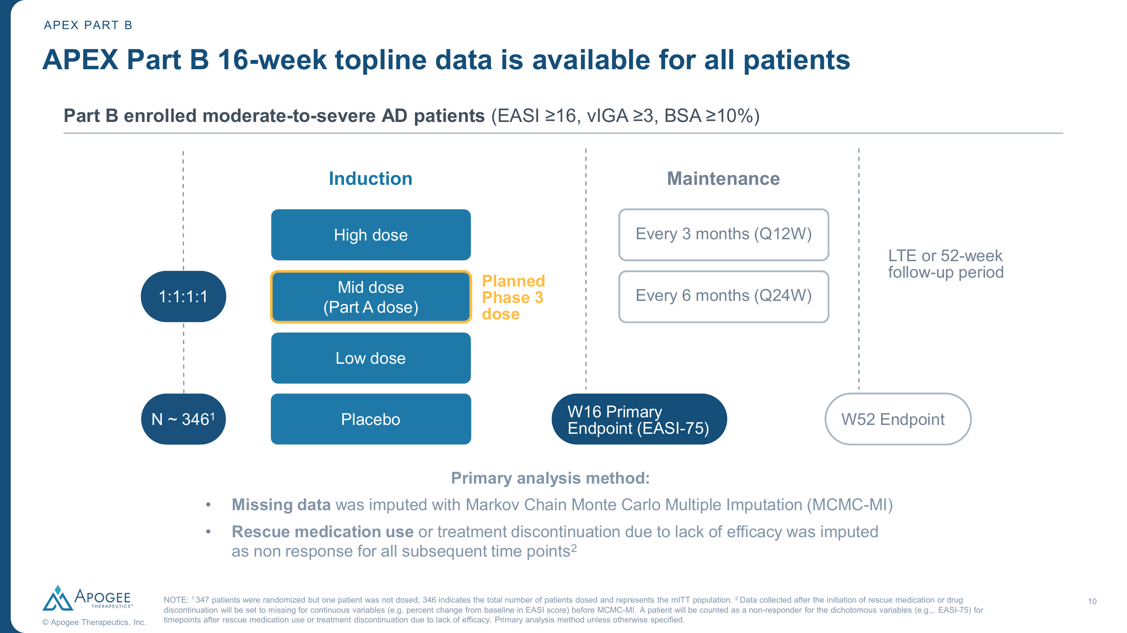
Study Design — APEX Phase 2 Part B
Trial Overview
• Phase 2, randomized, double-blind, PBO-controlled
• N=346 (mITT): Low (N=86), Mid (N=85), High (N=87), PBO (N=88) — 1:1:1:1
• Moderate-to-severe AD (EASI ≥16, vIGA ≥3, BSA ≥10%)
• Dosing: SC at W0, W2, W4, W12 (4 injections induction)
• Maintenance: Q12W or Q24W
• Primary: EASI-75 at Wk16
• Key secondaries: IGA 0/1, EASI-90, I-NRS ≥4, EASI-100
• Estimand: MCMC-MI (rescue/d/c = non-responder)
• Baseline: EASI ~26, age ~37y, BSA ~40%
Source: Apogee Therapeutics APEX Part B presentation, May 2026. Review is required before disclosure.
Notes:
STUDY DESIGN (figure directly from Apogee press release):
- 347 patients randomized but 1 not dosed → 346 mITT population
- Arms: Low dose (N=86), Mid dose (N=85), High dose (N=87), Placebo (N=88)
- Randomized 1:1:1:1
- Mid dose is the planned Phase 3 dose (same as Part A)
- SC injection at W0, W2, W4, W12 during induction
- Maintenance: Q12W (every 3 months) or Q24W (every 6 months)
- Primary endpoint: EASI-75 at Week 16
- Primary analysis: MCMC Multiple Imputation
- Rescue medication or discontinuation for lack of efficacy = non-responder
- Population: Moderate-to-severe AD (EASI ≥16, vIGA ≥3, BSA ≥10%)
BASELINE CHARACTERISTICS (Mid dose):
- Age: 39.9y, Female 52.9%, Weight 76.4kg
- EASI: 26.0, vIGA(4): 36.5%, I-NRS: 7.0, BSA: 40.0%
- Comparable across all arms

Slide 3
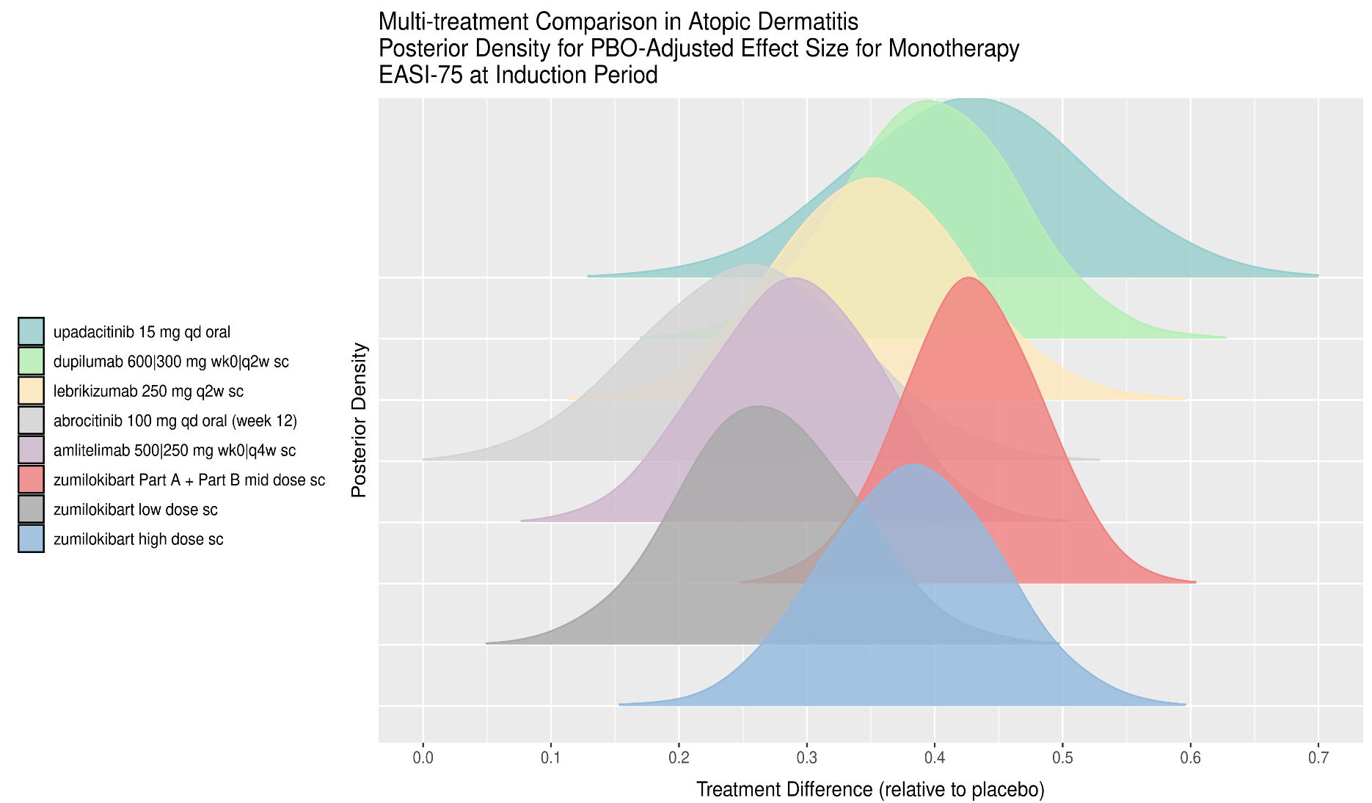
Efficacy & BNMA Context — EASI-75 at Week 16
Key Findings
• Zumilokibart mid dose peaks ~0.40 (PBO-adjusted effect)
• Overlaps upadacitinib 15mg (~0.40) and dupilumab (~0.35)
• Above lebrikizumab 250mg Q2W (~0.35)
• Wide CrI due to Phase 2 sample (N=85)
• Cannot definitively separate from dupilumab or lebrikizumab yet
• Phase 3 data will narrow credible intervals
Random-effects BNMA; indirect comparison only. Review is required before disclosure.
Notes:
BNMA INTERPRETATION — EASI-75:
Ridge plot shows posterior distributions of PBO-adjusted treatment effects from Bayesian NMA (monotherapy, induction period).
RANKINGS (by peak posterior density):
1. Zumilokibart high dose (~0.45) — widest distribution
2. Upadacitinib 15mg (~0.40)
3. Zumilokibart mid dose Part A+B (~0.38-0.40)
4. Dupilumab 600/300mg (~0.35)
5. Lebrikizumab 250mg Q2W (~0.33-0.35)
6. Abrocitinib 100mg (~0.28)
7. Amlitelimab (~0.25)
CROSS-TRIAL CONTEXT (from press release):
- Zumilokibart: 65.9% (Δ=41.9 from PBO)
- Dupixent: 49.5% (Δ=36.8)
- Ebglyss: 53.0% (Δ=37.7)
- Nemluvio+TCS: 42.8% (Δ=13.2)
- Adbry: 29.1% (Δ=17.0)
KEY: Substantial overlap between agents. Phase 3 will tighten distribution.
SOURCE: Lilly internal BNMA (random-effects model), monotherapy studies.

Slide 4
Safety Profile & Competitive Positioning
Safety (Mid Dose, Week 16)
• ≥1 TEAE: 60.0% (vs 67.0% PBO) — lower than placebo; Serious TEAE: 1.2% (vs 2.3% PBO)
• Discontinued due to TEAE: 2.4% (vs 2.3% PBO)
• Conjunctivitis (pooled): 10.6% (dose-dependent; High dose 20.7%)
• Most common AEs: nasopharyngitis (14.1%), headache (7.1%)
• No effect of ADAs on PK, efficacy, or safety; no new safety signals vs IL-13 class
Competitive Differentiation
• Dosing: 2–4 annual injections vs 26 (dupilumab), 13–26 (lebrikizumab)
• Highest EASI-75 Δ among IL-13s (41.9 vs 37.7 lebrikizumab, 17.0 tralokinumab)
• Rapid onset: significant EASI reduction by Week 1–2
• First biologic with Q3M + Q6M maintenance options
• Conjunctivitis (10.6%) slightly above lebrikizumab (~7–8%)
• Small Ph2 sample (N=85) — awaiting Phase 3 confirmation
• Potential 2029 launch — 3+ years for Lilly to build lebrikizumab share
Cross-trial comparison for illustrative purposes only. Review is required before disclosure.
Notes:
SAFETY DETAILS (from Apogee presentation):
- ≥1 TEAE: Low 75.6%, Mid 60.0%, High 67.8%, PBO 67.0%
- ≥1 Serious TEAE: Low 2.3%, Mid 1.2%, High 3.4%, PBO 2.3%
- D/C due to TEAE: Low 1.2%, Mid 2.4%, High 3.4%, PBO 2.3%
- Noninfective conjunctivitis by arm: Low 4.7%, Mid 5.9%, High 11.5%, PBO 0.0%
- Pooled conjunctivitis (all preferred terms): Mid 10.6%, Low 15.1%, High 20.7%
COMPETITIVE CONTEXT:
- Lebrikizumab Ph3 conjunctivitis: ~7-8% (ADVOCATE)
- Dupilumab conjunctivitis: ~8-10% (SOLO/CAFÉ)
- Tralokinumab conjunctivitis: ~7-10% (ECZTRA)
Mid dose conjunctivitis is slightly higher but manageable. Dose-dependent (higher at higher doses).

Slide 5
Key Takeaways & Recommended Actions
• Zumilokibart achieved potentially best-in-class EASI-75 Δ (41.9 vs PBO) with only 4 dosing days in induction • BNMA ranks mid dose in the top tier (overlapping upadacitinib/dupilumab) — above lebrikizumab for EASI-75 • Q12W–Q24W dosing (2–4 injections/year) is a transformational convenience advantage vs all current AD biologics • Phase 3 (ADventure) initiation 2H 2026 → potential 2029 launch — Lilly has 3+ year window to build lebrikizumab share • Key uncertainty: Ph2 N=85 with higher placebo rate (23.4%) — efficacy may attenuate in larger Phase 3 trials
Recommended Actions
• Monitor ADventure Phase 3 design and enrollment closely (2H 2026 initiation expected) • Update BNMA with Phase 3 data when available to reassess competitive ranking • Strengthen lebrikizumab lifecycle: emphasize Q4W data, label breadth, real-world evidence, and safety track record
Notes:
STRATEGIC IMPLICATIONS:
THREAT LEVEL: MODERATE-HIGH
- If Phase 3 confirms: meaningful long-term threat to lebrikizumab via dosing convenience
- Mitigant: Lebrikizumab already approved and launching; 3+ years market establishment window
- Phase 2→3 attrition is common (~30% efficacy reduction typical)
TIMELINES:
- ADventure Phase 3 start: 2H 2026
- Phase 3 readout: ~2028 (est.)
- Regulatory filing: ~2028-2029
- Potential launch: 2029
LILLY POSITIONING:
1. Lebrikizumab: established, approved, pediatric expansion, real-world evidence building
2. Rocatinlimab (anti-OX40): differentiated MOA, Phase 3 ongoing
3. Time advantage: build market share and physician loyalty before zumilokibart arrives
OPEN QUESTIONS:
- Will Q24W maintenance maintain efficacy long-term?
- How will conjunctivitis profile evolve with longer exposure?
- Can Apogee execute Phase 3→commercialization as small biotech?
Review is required before disclosure.

