Slide 1
Competitor Landscape Update: IL-4/IL-31 Bispecific Antibodies in AD
BBT001 (Bambusa) Phase 1 Positive Results | JNJ-95475939 (J&J) Phase 2b Terminated
July 30, 2026 CONFIDENTIAL — For Internal Use Only
Review is required before disclosure.
Notes:
This deck covers two IL-4Rα/IL-31 bispecific antibody programs in atopic dermatitis. BBT001 (Bambusa Therapeutics) reported positive Phase 1b/2a proof-of-concept data (data cutoff June 8, 2026), claiming 'best-in-disease' potential with a tetravalent 2+2 bispecific format. Meanwhile, J&J terminated JNJ-95475939 (DUPLEX-AD Phase 2b, which included dupilumab as active comparator) after a prespecified interim analysis showed it did not meet J&J's 'high-bar' efficacy threshold. Key strategic question: Is dual IL-4R + IL-31 blockade a viable improvement over IL-4Rα monotherapy (dupilumab), and what does this mean for Lilly's AD franchise? Sources: CILand articles (Saurabh Kumar, LRL CI team) and Bambusa PRNewswire press release.

Slide 2
Executive Summary: IL-4/IL-31 Bispecific Landscape
Two Programs, Divergent Outcomes
• BBT001 (Bambusa): Phase 1b/2a POSITIVE — PBO-adjusted EASI reduction of -79% at Wk6 (N=17; 12 active, 5 PBO); bio-naïve mod-severe AD
• JNJ-95475939 (J&J/Numab): Phase 2b DUPLEX-AD TERMINATED — prespecified interim analysis did not meet 'high-bar' efficacy vs dupilumab & PBO; no numerical data disclosed
• Both target IL-4/IL-13 + IL-31 pathways, but different molecular formats (BBT001: tetravalent 2+2 with extended t½ vs JNJ: Numab MATCH™ platform)
• BBT001 is now the ONLY IL-4Rα/IL-31 bispecific in active clinical development for AD
Why It Matters for Lilly
• JNJ failure REMOVES a well-funded competitor from this space — reassuring for lebrikizumab's position
• BBT001 Phase 1 data show numerically superior EASI response vs lebrikizumab at matched Wk4/6 timepoints (CILand cross-trial comparison)
• However: N=17, IV only, bio-naïve only, exploratory endpoints — highly preliminary; Phase 2b SC data needed (~2027-2028)
• Too early to claim BBT001 is 'best in disease' — but the signal warrants monitoring through Phase 2b
Review is required before disclosure.
Notes:
Key framing from CILand (Saurabh Kumar): 'It is too early to claim BBT001 is the best in disease based on data from 17 patients. The positive efficacy is encouraging but not surprising given IL-4R and IL-31 are validated targets. However, it is too early to claim BBT001 is the best in disease based on data from 17 patients. A study with dupilumab as active control in the future Phase 2b study like the one of J&J will be imperative to show the true potential of BBT001.' The JNJ DUPLEX-AD study importantly had dupilumab as active comparator — so the failure means JNJ-95475939 could not demonstrate superiority (or even comparable efficacy) against the existing standard of care, not just placebo.

Slide 3
Mechanism of Action: IL-4Rα/IL-13 + IL-31 Dual Pathway Blockade
Scientific Rationale
• IL-4Rα: Shared receptor for IL-4 and IL-13 (Type I & Type II); drives Th2 inflammation, IgE switching, barrier disruption (same target as dupilumab)
• IL-31/IL-31RA: 'Pruritogen cytokine' signaling via IL-31RA/OSMR heterodimer on sensory neurons — mediates itch, neuroinflammation, skin remodeling
• Hypothesis: Simultaneous blockade of inflammation (IL-4/IL-13) AND pruritus (IL-31) in one molecule → dupilumab-level efficacy + superior itch relief
• BBT001 specifically blocks IL-4/IL-13 and IL-31-induced keratinocyte immunopathology, immune cell activation, skin barrier dysfunction, and pruritus
Molecular Format Differences (BBT001 vs JNJ-95475939)
• BBT001: Tetravalent '2+2' bispecific (2 binding sites per target) with Fc modifications for extended half-life → high avidity + long PK
• JNJ-95475939 (NM26-2198): Built on Numab's proprietary MATCH™ multispecific platform → format details less disclosed
• Key question: Did the tetravalent 2+2 format give BBT001 superior target engagement vs JNJ's format? May explain divergent outcomes
• Both prevent IL-4/IL-13 and IL-31-induced pathology but may differ in potency ratio between the two arms
Review is required before disclosure.
Notes:
The mechanism diagram from the JNJ CILand article shows: NM26-2198 (JNJ-95475939) simultaneously blocking IL-4 binding to IL-4Rα (blocking Type I receptor signaling) AND IL-31 binding to IL-31Ra. Downstream effects blocked: decreased anti-microbial barrier, keratinocyte differentiation/filaggrin downregulation (via IL-4Rα blockade) and Th2 differentiation, eosinophil/mast cell production, IgE production (via both), plus sensory nerve activation (via IL-31RA blockade). BBT001's '2+2' tetravalent format means 2 binding sites for each target — this provides higher avidity (functional binding strength) compared to a standard 1+1 bispecific. The Fc modifications extend half-life to support Q3M dosing. The MATCH™ platform from Numab is a modular multispecific technology that may have created a different geometry/avidity profile.

Slide 4
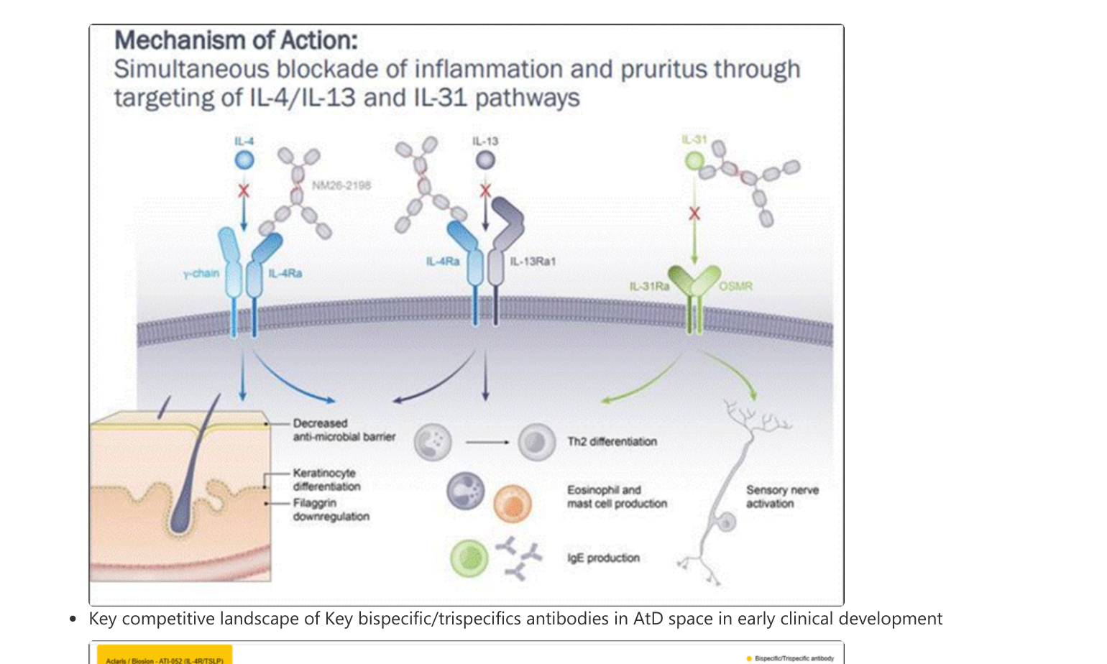
MOA: Simultaneous IL-4/IL-13 + IL-31 Pathway Blockade
Source: CILand (JNJ-95475939 article, 1/7/2026). NM26-2198 shown; BBT001 targets same pathways with tetravalent 2+2 format. Review is required before disclosure.
Notes:
This MOA diagram from the JNJ CILand article illustrates the dual-blockade mechanism. Left panel: NM26-2198 blocks IL-4 binding to IL-4Rα/γ-chain (Type I receptor, used by IL-4 alone). Center panel: The same molecule blocks IL-13 binding to IL-4Rα/IL-13Rα1 (Type II receptor, shared by IL-4 and IL-13). Right panel: Simultaneously blocks IL-31 binding to IL-31Ra/OSMR heterodimer on sensory neurons. Downstream consequences of dual blockade: prevents decreased anti-microbial barrier, keratinocyte differentiation disruption, filaggrin downregulation (skin barrier effects), Th2 differentiation, eosinophil/mast cell production, IgE production (inflammatory effects), AND sensory nerve activation (pruritus/itch). This represents the full disease pathway coverage — combining what dupilumab does (IL-4Rα) with what nemolizumab does (IL-31RA) in a single molecule.

Slide 5
BBT001 (Bambusa): Drug Profile & Phase 1 Design
Drug Profile
• Generic: BBT001 | Sponsor: Bambusa Therapeutics
• Format: Tetravalent '2+2' bispecific antibody
• Targets: IL-4/IL-13 pathway + IL-31 pathway
• Fc modifications: Extended half-life (Q3M potential)
• Route: IV (Phase 1) | SC formulation in development
• Dose: 450 mg IV Q2W × 4 weeks
• Pipeline: BBT002 (IL-4Rα/IL-5, asthma/COPD/CRSwNP, Ph1b/2a)
• BBT003 (GI, preclinical); BBT004 (autoimmune, preclinical)
Phase 1 Design (NCT06808477)
• Global, randomized, double-blind, placebo-controlled
• N = 17 (BBT001 n=12, PBO n=5); 2:1 randomization
• Population: Bio-naïve (no prior IL-4Rα biologics or JAKi)
• Moderate-to-severe AD (sites: New Zealand, United States)
• Treatment: 450mg IV Q2W for 4 weeks
• Primary endpoint: Safety & tolerability
• Exploratory: EASI, PP-NRS, vIGA, TARC, IgE
• Data cutoff: June 8, 2026 | Median f/u: 71 days (33–165)
Source: CILand (7/29/2026) and Bambusa PRNewswire (June 2026). Review is required before disclosure.
Notes:
CILand caveats (critical for presenter): (1) Very small N=17 with only 5 placebo patients; (2) Baseline severity imbalance — active arm entered with higher disease burden (EASI 34.64 vs 29.06; BSA 62.58% vs 47.60%) which could inflate observed treatment effects; (3) 450mg IV Q2W is NOT a commercial-stage dosing regimen — the Q3M maintenance claim is based on PK extrapolation, not clinical demonstration; (4) Bio-naïve only — real-world AD populations increasingly include patients with prior biologic exposure; bio-experienced IV data expected 1H 2027; (5) All efficacy endpoints are exploratory — primary endpoint is safety/tolerability. Not powered for efficacy conclusions. SC PK/efficacy critical for commercial viability — remains to be demonstrated.

Slide 6
BBT001 Phase 1: Efficacy Results (Exploratory)
EASI % Reduction (Placebo-Adjusted, MMRM; p-values from between-group differences)
• Week 1: -35.56% (95% CI: -50.96, -13.59; p=0.0012) — rapid onset from first dose
• Week 2: -61.10% (95% CI: -81.24, -43.87; p<0.0001)
• Week 4: -63.46% (95% CI: -80.75, -43.27; p<0.0001) — end of treatment period
• Week 6: -78.95% (95% CI: -94.62, -57.14; p<0.0001) — response DEEPENING 2 weeks post-last dose
• EASI reduction continued to deepen through follow-up; remained sustained for patients followed
Responder Rates (Placebo-Adjusted, Observed Between-Group Differences)
• EASI-50: Wk1 25% → Wk2 75% → Wk4 91% → Wk6 82%
• EASI-75: Wk1 0% → Wk2 17% → Wk4 45% → Wk6 64%
• PP-NRS % Change: Wk1 -29% → Wk2 -35% → Wk4 -41% → Wk6 -43%
• NRS improvement began as early as Day 1 and was sustained for 8 weeks after the last dose
Baseline Imbalance (Caveat from CILand)
• BBT001 (n=12): EASI 34.64, BSA 62.58%, PP-NRS 7.34, vIGA 3.42 vs PBO (n=5): EASI 29.06, BSA 47.60%, PP-NRS 6.33, vIGA 3.20
• Active arm had HIGHER disease severity at baseline — could inflate observed effects; wide 95% CIs reflect small N
Review is required before disclosure.
Notes:
The headline numbers are striking but require heavy caveating per CILand analysis. The -79% placebo-adjusted EASI change at Week 6 is numerically superior to dupilumab at the same timepoint (~36-40% in SOLO trials). However: (1) only 12 vs 5 patients — a single responder/non-responder shifts the rate by 8-20%; (2) baseline imbalance favors the active arm showing larger absolute improvements; (3) the wide CIs (e.g., -94.62 to -57.14 at Wk6) reflect the uncertainty; (4) MMRM analysis with N=17 is fragile. The deepening response post-treatment (Wk4→Wk6 improvement after dosing stops) is pharmacologically interesting and supports the extended half-life claim — the drug is still working after last dose. The Day 1 itch response supports direct IL-31 neuronal pathway blockade.

Slide 7
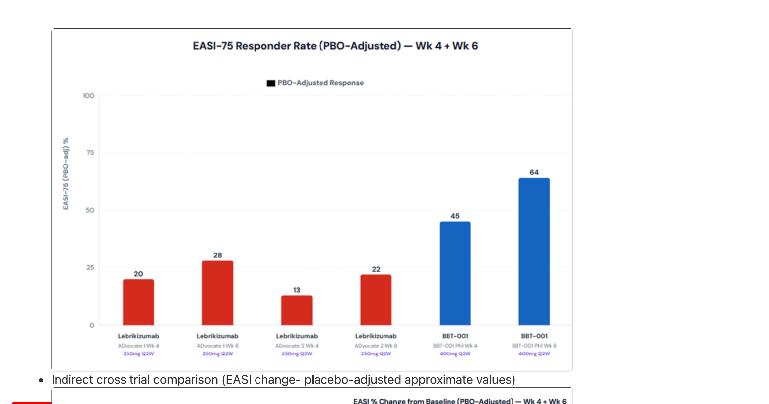
Cross-Trial Comparison: EASI-75 (PBO-Adjusted) — Wk 4 + Wk 6
Source: CILand (7/29/2026). Indirect cross-trial comparison; different study sizes (BBT001 N=12 vs Phase 3 N=300–639), populations, and designs. Review is required before disclosure.
Notes:
This chart from the CILand article shows PBO-adjusted EASI-75 response rates at matched early timepoints. Lebrikizumab ADvocate 1: 20% (Wk4) → 28% (Wk6). Lebrikizumab ADvocate 2: 13% (Wk4) → 22% (Wk6). BBT001 Phase 1: 45% (Wk4) → 64% (Wk6). BBT001 appears to show numerically superior early response vs lebrikizumab at matched timepoints. KEY CAVEATS: (1) N=12 for BBT001 vs N=300-639 for ADvocate — massive difference in statistical reliability; (2) BBT001 used 450mg IV (very high exposure) vs lebrikizumab 250mg SC; (3) BBT001 enrolled bio-naïve only; ADvocate included mixed populations; (4) Error bars not shown for BBT001 — wide CIs from small N would overlap with lebrikizumab. Useful for hypothesis framing but NOT for superiority claims.

Slide 8
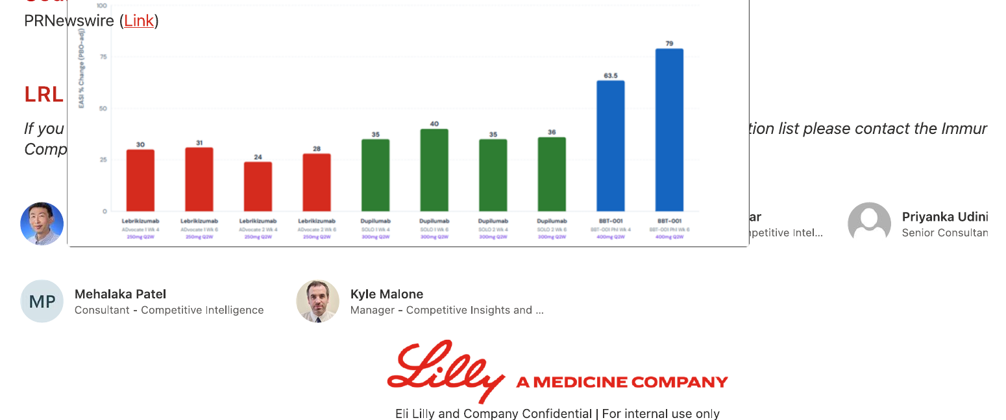
Cross-Trial Comparison: EASI % Change (PBO-Adjusted) — Wk 4 + Wk 6
Source: CILand (7/29/2026). Indirect cross-trial comparison; approximate values. Review is required before disclosure.
Notes:
This second CILand chart shows PBO-adjusted EASI percentage change from baseline at Wk4 and Wk6. Lebrikizumab ADvocate 1: ~30% (Wk4) → ~31% (Wk6). Lebrikizumab ADvocate 2: ~24% (Wk4) → ~29% (Wk6). Dupilumab SOLO 1: ~35% (Wk4) → ~35% (Wk6). Dupilumab SOLO 2: ~40% (Wk4) → ~35% (Wk6). BBT001: ~63.5% (Wk4) → ~79% (Wk6). BBT001 shows approximately double the EASI improvement of dupilumab at Wk6 on this metric. Same caveats apply: N=12 IV bio-naïve vs N=600+ SC broader populations. The continued deepening from Wk4→Wk6 (after treatment ends) is unique to BBT001 and supports the extended half-life claim.

Slide 9
BBT001 Phase 1: Safety, PK, Biomarkers & Upcoming Catalysts
Safety & Immunogenicity
• BBT001 was well tolerated; primary endpoint (safety/tolerability) met
• ZERO conjunctivitis reported — consistent with prior healthy volunteer findings
• Low incidence of treatment-emergent ADA, low titers, no apparent neutralizing activity
• No signal for infections, injection site reactions (IV), or other safety concerns in this small cohort
PK & Biomarkers
• Extended half-life in AD patients confirmed — consistent with healthy volunteer data; supports Q3M maintenance dosing
• Early and substantial reductions in TARC and IgE, sustained ≥8 weeks post-last dose — durable Type 2 pathway suppression
• Biomarker kinetics suggest prolonged target engagement beyond dosing period
Key Upcoming Catalysts (from CILand)
• Full results at upcoming medical conference (TBD — likely late 2026)
• 1H 2027: Topline 12-week IV data in bio-naïve AND bio-experienced AD
• 1H 2027: 14-week IV data in CSU (chronic spontaneous urticaria)
• Phase 2b initiation: Moderate-to-severe AD evaluating SC maintenance dosing (timeline TBD)
• Critical: SC PK/efficacy data will determine commercial viability — IV-only is not a viable commercial regimen
Review is required before disclosure.
Notes:
The zero conjunctivitis finding is interesting but statistically uninformative at N=12 (you'd expect <1 case even with dupilumab's ~9% rate). The extended half-life is the key PK story — if Q3M dosing holds with SC formulation, it positions BBT001 similarly to zumilokibart on convenience. The catalysts to watch: (1) Bio-experienced data in 1H 2027 is critical — if efficacy holds in patients who failed dupilumab, it's a true differentiator; (2) SC formulation Phase 2b will answer whether adequate exposure is achievable subcutaneously; (3) CSU data expands the franchise narrative. CILand notes: 'SC PK/efficacy — critical for commercial viability — remains to be demonstrated.' The IV formulation at 450mg is drug-heavy and expensive to manufacture for a chronic disease.

Slide 10
JNJ-95475939: DUPLEX-AD Failure & Program Background
Study Design: DUPLEX-AD Phase 2b
• Phase 2b, randomized; moderate-to-severe AD
• Arms: JNJ-95475939 vs DUPILUMAB (active) vs PLACEBO
• Had prespecified interim analysis for early termination
• Interim result: Did NOT meet J&J's 'high-bar' efficacy
• Molecule was well-tolerated (no safety signal)
• NO numerical efficacy data disclosed publicly
• Terminated July 2026 based on efficacy futility
Program History
• Originally: NM26-2198 (Yellow Jersey Therapeutics / Numab)
• Platform: Numab MATCH™ multispecific technology
• Targets: IL-4Rα (Type I + Type II receptors) + IL-31
• J&J acquired via Numab definitive agreement (all-cash)
• Yellow Jersey conducted Ph1a/1b (SAD/MAD) in HV + AD
• Phase 1 terminated post-acquisition; minimum objectives met
• J&J advanced DIRECTLY to Phase 2b (Feb 2025) — aggressive timeline to 'stay ahead of competition'
• J&J also acquired Proteologix ($850M): PX128 (IL-13/TSLP) + PX130 (IL-13/IL-22 for AD)
Source: CILand (1/7/2026) and J&J press release. Review is required before disclosure.
Notes:
Critical insight from CILand: The DUPLEX-AD study had dupilumab as an active comparator — this is the gold standard study design. The failure means JNJ-95475939 could not demonstrate clinically meaningful superiority (or even comparability) vs dupilumab at the prespecified interim. This is a much higher bar than just 'beating placebo.' J&J's strategy was aggressive: they acquired the molecule, terminated Phase 1 early (minimum objectives only), and rushed directly to Phase 2b to 'stay ahead of competition.' This aggressive timeline may have resulted in suboptimal dose selection (Phase 1 dose-ranging not fully completed). The acquisition context also shows J&J's commitment to the AD bispecific space — they still have PX130 (IL-13/IL-22) in preclinical and JNJ-7528 in Phase 1.

Slide 11
Why Did JNJ-95475939 Fail? Implications for BBT001
Possible Reasons for JNJ Failure
• Rushed development: Skipped Phase 2a dose-finding; went directly to Ph2b from truncated Ph1
• Suboptimal dose: Without full dose-response, may have selected wrong dose
• Molecular format: MATCH™ platform geometry may yield lower avidity vs BBT001's tetravalent 2+2
• Active comparator bar: Had to beat DUPILUMAB (not just placebo) — very high efficacy hurdle
• Target engagement ratio: May not have adequately blocked both IL-4Rα AND IL-31 simultaneously
• The 'high-bar efficacy' criterion was J&J's own internal standard for advancing — demanding threshold
What BBT001 Must Still Prove
• Efficacy in a powered Phase 2b (N>200) — N=17 is hypothesis-generating only
• SC formulation efficacy — IV 450mg Q2W is not commercially viable
• Performance vs dupilumab active comparator (per CILand: 'imperative')
• Efficacy in bio-experienced patients (prior dupilumab/JAKi failures)
• Long-term maintenance with Q3M dosing (currently PK extrapolation only)
• Dose-response: Only one dose tested so far; need dose optimization
• Phase 2→3 attrition: ~40-50% of AD biologics fail at Phase 3
Speculative analysis. Review is required before disclosure.
Notes:
CILand's key observation: 'A study with dupilumab as active control in the future Phase 2b study like the one of J&J will be imperative to show the true potential of BBT001.' This sets the benchmark clearly — BBT001 must eventually demonstrate superiority vs dupilumab in a powered head-to-head, not just impressive Phase 1 numbers vs placebo. The JNJ failure is instructive: even with a validated target combination, execution matters enormously. J&J's aggressive 'skip Phase 2a' strategy backfired — proper dose-finding might have identified a better regimen. For BBT001, the tetravalent 2+2 format with extended half-life may provide pharmacological advantages, but this hypothesis remains unproven at scale.

Slide 12
CILand Cross-Trial Comparison: EASI-75 (PBO-Adjusted) at Wk4 + Wk6
Drug / Study | Dose | EASI-75 PBO-adj Wk4 (%) | EASI-75 PBO-adj Wk6 (%)
Lebrikizumab — ADvocate 1 | 250mg Q2W | ~20 | ~28
Lebrikizumab — ADvocate 1 | 250mg Q4W | ~25 | ~31
Lebrikizumab — ADvocate 2 | 250mg Q2W | ~13 | ~22
Lebrikizumab — ADvocate 2 | 250mg Q4W | ~24 | ~29
Dupilumab — SOLO 1 | 300mg Q2W | ~35 | ~35
Dupilumab — SOLO 2 Wk4 | 300mg Q2W | ~35 | ~36
Dupilumab — SOLO 2 Wk6 | 300mg Q2W | ~40 | ~36
BBT001 — Ph1 Wk4 | 450mg IV Q2W | 45 | —
BBT001 — Ph1 Wk6 | 450mg IV Q2W | — | 64
Source: CILand article (7/29/2026). Indirect cross-trial comparison; different study sizes, populations, and designs preclude direct comparison. BBT001 N=12 vs N=300-600 for other trials. Review is required before disclosure.
Notes:
This table recreates the CILand cross-trial comparison charts (EASI-75 and EASI % change, PBO-adjusted, at Wk4 and Wk6). BBT001 at Wk4 (45%) and Wk6 (64%) numerically exceeds all comparators at matched timepoints. However, CRITICAL CAVEATS: (1) BBT001 N=12 vs N=300-639 for Phase 3 comparators — wide implicit CIs; (2) BBT001 is bio-naïve only; Phase 3 populations are broader; (3) IV 450mg provides higher drug exposure than SC regimens; (4) Baseline severity imbalance in BBT001 study. CILand also shows EASI % change comparison: Dupilumab SOLO ~35-40% at Wk4/6 vs BBT001 63.5% (Wk4) and 79.0% (Wk6). These data support the hypothesis of rapid, deep response but are NOT confirmatory.

Slide 13
Competitive Landscape: IL-4/IL-31 Bispecifics & Key AD Competitors
Drug | Sponsor | Target(s) | Format | Phase | Key Result | Status
BBT001 | Bambusa | IL-4/IL-13 + IL-31 | Tetravalent 2+2 bsAb | Phase 1 | EASI-75 64% (PBO-adj, Wk6, N=12) | Active — Phase 2b planned
JNJ-95475939 | J&J/Numab | IL-4Rα + IL-31 | MATCH™ platform | Phase 2b | Failed efficacy interim vs dupi+PBO | TERMINATED
Dupilumab | Sanofi/Regen | IL-4Rα | mAb | Approved | EASI-75 ~49% Wk16 (SOLO) | Standard of care
Lebrikizumab | Lilly | IL-13 | mAb | Approved | EASI-75 ~53% Wk16 (ADVOCATE) | Growing commercial
Nemolizumab | Galderma | IL-31RA | mAb | Phase 3 (AD) | EASI-75 ~43% Wk16; strong itch | PN approved (JP)
Zumilokibart | Apogee/JNJ | IL-13 (ext t½) | mAb (Fc YTE) | Phase 2b+ | EASI-75 65.9% Wk16 (N=85) | Ph3 ADventure starting
PX130 | J&J (Proteologix) | IL-13/IL-22 | Bispecific | Preclinical | N/A | JNJ backup for AD
Cross-trial comparison for context only. Different timepoints, N, and populations. Review is required before disclosure.
Notes:
Key landscape context: BBT001 is the ONLY remaining IL-4R/IL-31 bispecific in clinical development. The broader bispecific/trispecific landscape in AD is crowded (CILand shows ~10+ Phase 1 programs), but BBT001 is the most advanced with clinical POC data. Competitive positioning: BBT001 theoretically combines dupilumab-like efficacy (IL-4Rα blockade) with nemolizumab-like itch relief (IL-31 blockade) in one molecule. If Phase 2b confirms, the value proposition is: one injection covering what currently requires two separate biologics. However, the market by 2029+ will have zumilokibart (Q12W convenience), lebrikizumab (established), and potentially several other next-gen agents. The bar keeps rising.

Slide 14
Broader Bispecific/Trispecific Pipeline in AD (Early Stage)
Company | Molecule | Targets | Phase | Notes
Adaris / Biosion | ATI-052 | IL-4R/TSLP | Phase 1
AbbVie | ATTD-3712 | IL-13/IL-31 | Phase 1 | Same pathway as BBT001
Bambusa | BBT001 | IL-4/IL-13 + IL-31 | Phase 1 (POC+) | Leading bispecific with data
Genta | GR-2002 | TSLP | Phase 1
Huaota | HB9055 | IL-11/TSLP | Phase 1
Innovent | BD003 | IL-4Rα/TSLP | Phase 1
J&J | JNJ-7528 | Unknown | Phase 1 | Ph2b planned Feb'26
ABBY / Lulokimab | — | IL-4/IL-16 | Phase 2
Raymed / Selexis | BEL512 | IL-13/TS... | Phase 2
NVS / GHZ-339 | — | IL-13/IL-18 | Phase 2
Pfizer | PF-07264660 | IL-13/IL-33/IL-4 | Phase 2 | Trispecific
Pfizer | PF-07276316 | IL-13/IL-4/TSLP | Phase 2 | Trispecific
UCB - galokimab | — | IL-13/IL-17 | Phase 2
Source: CILand competitive landscape chart (Lilly internal). Company confidential. Review is required before disclosure.
Notes:
This table is derived from the CILand pipeline chart showing bispecific/trispecific antibodies in early AD development. The space is CROWDED — at least 10+ programs in Phase 1-2. Key observations: (1) Multiple IL-13 combinations being tested (IL-13/IL-31, IL-13/TSLP, IL-13/IL-22, IL-13/IL-33); (2) Pfizer has two trispecifics in Phase 2 (3 targets each); (3) AbbVie's ATTD-3712 (IL-13/IL-31) is a direct BBT001 competitor in same target space; (4) Several IL-4R/TSLP combinations in Phase 1. The strategic implication: even if BBT001 succeeds, it will face competition from other multispecific approaches by 2030+. No clear frontrunner has emerged (per CILand commentary). More clinical data on multispecific antibodies expected in coming months.

Slide 15
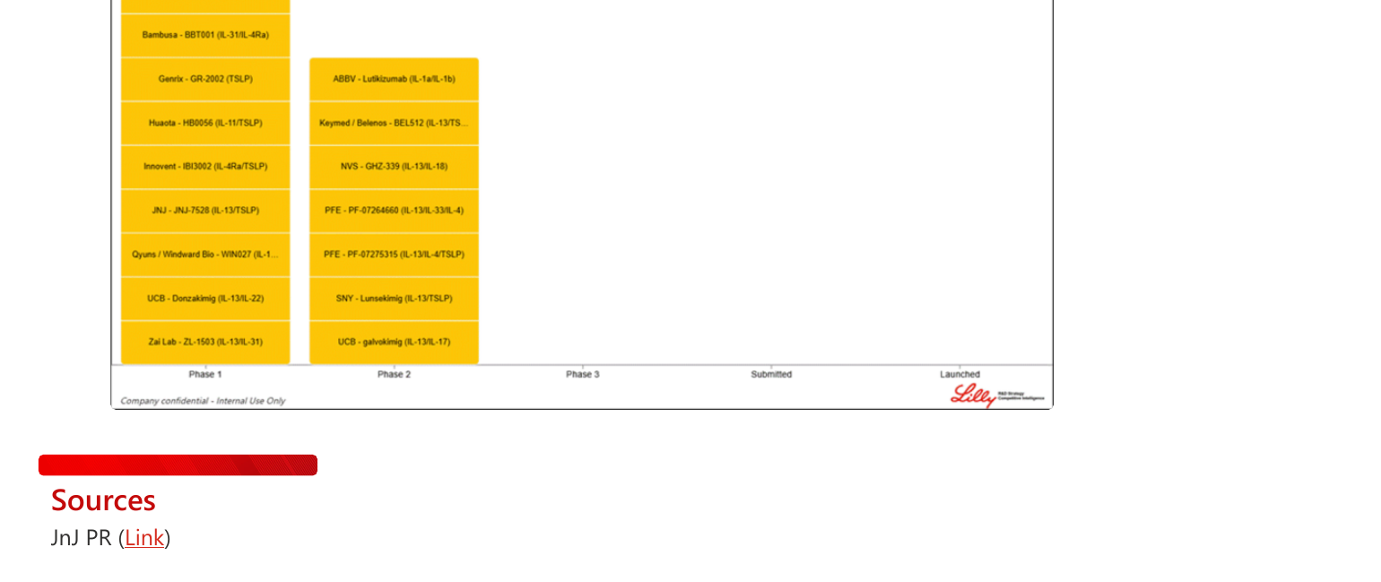
Bispecific/Trispecific AD Pipeline Landscape (CILand)
Source: CILand (1/7/2026). Company confidential — Internal Use Only. Review is required before disclosure.
Notes:
This Lilly CI landscape chart shows all bispecific/trispecific antibodies in clinical development for AD as of early 2026. Phase 1 programs (yellow, left column): Adaris/Biosion ATI-052 (IL-4R/TSLP), AbbVie ATTD-3712 (IL-13/IL-31), Bambusa BBT001 (IL-31/IL-4Rα), Genrix GR-2002 (TSLP), Huaota HB0056 (IL-11/TSLP), Innovent IBI3002 (IL-4Rα/TSLP), J&J JNJ-7528 (IL-13/TSLP), Qyuns/Windward WIN027, UCB Donzakimig (IL-13/IL-22), Zai Lab ZL-1503 (IL-13/IL-31). Phase 2 programs (yellow, right column): ABBV Lutikizumab (IL-1α/IL-1β), Keymed/Belenos BEL512 (IL-13/TS...), NVS GHZ-339 (IL-13/IL-18), Pfizer PF-07264660 (IL-13/IL-33/IL-4), Pfizer PF-07275315 (IL-13/IL-4/TSLP), SNY Lunsekimig (IL-13/TSLP), UCB galvokimig (IL-13/IL-17). No programs in Phase 3 or beyond — the entire bispecific space is early stage. BBT001 with clinical POC is now the most advanced.

Slide 16
Implications for Lilly AD Strategy
Near-Term (0–2 years): Position of Strength
• JNJ-95475939 failure REMOVES a funded bispecific competitor — positive for lebrikizumab
• BBT001 is Phase 1 only (N=17, IV) — no commercial threat until ~2030+ at earliest
• Lebrikizumab market position is SECURE: approved, growing, robust Phase 3 data
• No IL-4/IL-31 bispecific is remotely close to regulatory filing
• Focus: Label expansions, real-world evidence, pediatric data, long-term safety
• Defensive messaging: 'J&J tried this approach and failed — stick with proven IL-13 blockade'
Long-Term Monitoring (3–5+ years)
• KEY TRIPWIRE: BBT001 Phase 2b results with SC formulation (est. 2028)
• If BBT001 shows EASI-75 >50% at Wk16 with SC + Q3M maintenance, it's a real threat
• Must demonstrate superiority vs dupilumab in head-to-head (per CILand requirement)
• Bio-experienced data (1H 2027) will signal whether it can help dupilumab failures
• Watch Bambusa financing — their ability to fund Phase 2/3 determines timeline
• Consider whether Lilly should explore IL-13 + IL-31 bispecific (like AbbVie's ATTD-3712) internally
Review is required before disclosure.
Notes:
Net assessment: Lilly's AD franchise faces NO imminent threat from IL-4/IL-31 bispecifics. The JNJ failure validates that this is a hard problem to solve. BBT001's Phase 1 data are promising but must survive rigorous testing: powered Phase 2b, SC formulation, active comparator, bio-experienced patients. The earliest possible commercial threat is ~2030-2031. Lilly's best strategy: (1) Continue building lebrikizumab franchise (market penetration, RWE, label expansions); (2) Monitor BBT001 milestones as a watching brief; (3) Assess internal BD opportunities in multispecific space if BBT001 Phase 2b confirms. The broader bispecific landscape is crowded — there may be acquisition opportunities if early programs show promise.

Slide 17
Key Takeaways & Recommended Actions
• BBT001 (Bambusa) Phase 1: PBO-adjusted EASI -79% at Wk6, EASI-75 64% (N=12) — impressive signal but extremely preliminary (N=17, IV only, bio-naïve, exploratory) • JNJ-95475939 DUPLEX-AD Phase 2b TERMINATED after prespecified interim analysis — did not meet 'high-bar' efficacy vs dupilumab + placebo; well-tolerated but insufficient efficacy • BBT001 is now the ONLY IL-4Rα/IL-31 bispecific in active AD clinical development; molecular format (tetravalent 2+2) may explain why it succeeded where JNJ's MATCH™ format failed • CILand assessment: 'Too early to claim best-in-disease from 17 patients; dupilumab-controlled Phase 2b imperative to show true potential' • Lilly competitive position UNCHANGED: Lebrikizumab approved and growing; no bispecific threat for 4+ years; JNJ failure removes one funded competitor
Recommended Actions
• Monitor BBT001 bio-experienced IV data (1H 2027) — first signal of utility beyond bio-naïve • Track BBT001 Phase 2b SC initiation and design (active comparator? dose arms? N?) • Watch Bambusa corporate developments: Series C funding, pharma partnerships, conference presentations • No immediate strategic response needed — revisit if Phase 2b SC confirms EASI-75 >50% at Wk16 • Internal R&D assessment: Should Lilly explore IL-13/IL-31 bispecific (parallel to AbbVie's ATTD-3712) as lebrikizumab lifecycle?
Notes:
Final strategic message: The IL-4/IL-31 bispecific class has produced one early positive signal (BBT001) and one definitive mid-stage failure (JNJ-95475939). The divergent outcomes likely reflect differences in molecular execution rather than invalidation of the dual-target hypothesis. For Lilly, this is a WATCHING BRIEF, not an action item. Key dates: 1H 2027 (BBT001 bio-experienced IV data), 2027-2028 (Phase 2b SC initiation). The highest-value intelligence event will be BBT001's Phase 2b design — if they include dupilumab as active comparator (as CILand recommends), it will be the definitive test. If they don't, the data will be less interpretable. Also recommend tracking AbbVie's ATTD-3712 (IL-13/IL-31) as a parallel validation of the itch hypothesis within the IL-13 (not IL-4Rα) framework.

