Slide 1

A PROPOSAL FOR THE MINISTRY OF AGRICULTURE
Agricultural support, from parcel to payment
A connected service for farmers,
field teams and public-service leaders.
P-17 · Maize
P-18
Clear applications. Timely support.
Evidence-led decisions. Visible payment progress.
P-19
HUNGARY · CAP SUPPORT
Napraforgó Farm · an illustrative case
Field & File | Ministry of Agriculture | Case-study proposal
01 / 14
Notes:
The proposed Field & File service brings farmer guidance, seasonal monitoring, field evidence and payment visibility into a connected journey. The Ministry gains programme-level insight, the paying agency gains a coherent case process, and farmers gain understandable actions and a clear view of progress. This presentation follows the business case through the people and service journey into the proposed technology, data and crop-model approach.
Napraforgó Farm and P-17 are illustrative story elements. This is a separate ministry-facing proposal; the existing farmer prototype remains a supporting design reference.
Source references
https://github.com/verboompj/ama/blob/c179b1c2d28298b6b1a135277090672989900913/case/case-study-47.md
https://github.com/verboompj/ama/blob/c179b1c2d28298b6b1a135277090672989900913/docs/Persona/personas-and-use-cases.md
https://github.com/verboompj/ama/blob/c179b1c2d28298b6b1a135277090672989900913/docs/Persona/farm-theme-and-persona-map.md
Field & File is a fictional Hungarian CAP case-study proposal. Figures and target benefits are drawn from the case brief.

Slide 2
THE CASE
A national service with substantial value at stake
Payment performance affects farm liquidity, administrative capacity and the protection of public funds.
160,000
€2 billion
€60 million
farmers served
annual CAP payments
corrections over three years
Farm liquidity
Staff capacity
Public accountability
More predictable support for seasonal costs.
Focus specialist effort on cases that need attention.
Explain decisions and trace the use of public funds.
Field & File | Ministry of Agriculture | Case-study proposal
02 / 14
Notes:
The fictional case concerns a Hungarian paying agency supporting 160,000 farmers and administering €2 billion in annual CAP payments. The case also describes €60 million in financial corrections over three years. Ministry sponsorship connects agricultural policy, paying-agency performance and the experience of beneficiaries. The business ambition is earlier payment, lower inspection cost, fewer errors and stronger farmer satisfaction.
All three figures are planning assumptions from the original case brief. Case targets are ambitions to be assessed through an agreed pilot and subsequent service evaluation.
Source references
https://github.com/verboompj/ama/blob/c179b1c2d28298b6b1a135277090672989900913/case/case-study-47.md
Field & File is a fictional Hungarian CAP case-study proposal. Figures and target benefits are drawn from the case brief.

Slide 3
THE CURRENT PROCESS
Current-process friction extends the time to payment
The case combines complex rules, partial area monitoring and capacity-limited field checks.
1
2
3
4
5
Apply
Check
Clarify
Inspect
Pay
Scheme and parcel details
Administrative + area checks
Farmer response and evidence
Selected on-site controls
Authorised payment process
Farmer effort
Field capacity
Service visibility
Complex requirements and repeated clarification create administrative work.
Limited inspection resources constrain coverage and response time.
Fragmented information complicates case progress and payment explanations.
Field & File | Ministry of Agriculture | Case-study proposal
03 / 14
Notes:
The case describes farmers working through complex eco-scheme rules, a partially implemented area-monitoring system and sample on-the-spot inspections. Persona requirements also identify fragmented case information across claim, parcel, GIS and payment systems. Clarification and evidence collection can therefore extend the path to a completed decision. The proposed service addresses these pain points through timely support and a connected case record.
The process is an illustration of the case and persona requirements. It expresses the business problem for the proposal.
Source references
https://github.com/verboompj/ama/blob/c179b1c2d28298b6b1a135277090672989900913/case/case-study-47.md
https://github.com/verboompj/ama/blob/c179b1c2d28298b6b1a135277090672989900913/docs/Persona/personas-and-use-cases.md
https://github.com/verboompj/ama/blob/c179b1c2d28298b6b1a135277090672989900913/docs/architecture/business-process-flow.md
Field & File is a fictional Hungarian CAP case-study proposal. Figures and target benefits are drawn from the case brief.

Slide 4
THE PROPOSED SOLUTION
One service journey from application to payment
Guidance, seasonal monitoring and case support help the agency resolve issues earlier.
1
2
3
4
5
Guide
Monitor
Resolve
Verify
Pay + explain
Prepare a correct claim
Follow the growing season
Bring context into the case
Focus independent checks
Trace decision and settlement
For farmers
For the paying agency
For the Ministry
Practical actions, accessible help and visible progress.
A shared case history and focused staff work.
Programme insight linked to service outcomes.
Field & File | Ministry of Agriculture | Case-study proposal
04 / 14
Notes:
Field & File proposes guidance before submission, Sentinel monitoring across claimed parcels, timely farmer responses and proportionate field verification. A shared evidence history helps the paying agency establish the amount due and prepare an explained decision. Authorised officials make entitlement and adverse decisions; the existing payment and treasury systems execute and reconcile approved instructions. These responsibilities create a clear service chain for the customer.
The five service capabilities correspond to the maintained guidance, monitoring, resolution, inspection-prioritisation and audit-evidence design.
Source references
https://github.com/verboompj/ama/blob/c179b1c2d28298b6b1a135277090672989900913/case/case-study-47.md
https://github.com/verboompj/ama/blob/c179b1c2d28298b6b1a135277090672989900913/docs/architecture/aks-centered-foundry-architecture.md
https://github.com/verboompj/ama/blob/c179b1c2d28298b6b1a135277090672989900913/docs/architecture/business-process-flow.md
Field & File is a fictional Hungarian CAP case-study proposal. Figures and target benefits are drawn from the case brief.

Slide 5

THE PEOPLE
Three perspectives on the same agricultural case
Each role receives the information and authority needed for its part of the service.
The farmer
The field agent
The Ministry
Prepare the claim.
Explain events in the field.
Follow the payment.
Receive a focused work plan.
Capture independent findings.
Support a timely case decision.
Set policy priorities.
Review programme performance.
Account for public outcomes.
The paying agency manages individual cases and authorised decisions.
Field & File | Ministry of Agriculture | Case-study proposal
05 / 14
Notes:
The farmer needs a clear application and predictable support. The field agent is a paying-agency inspector responsible for independent evidence collection. The Ministry policy official sets programme direction and reviews aggregate results. The paying agency connects these perspectives through day-to-day case management, authorised decisions and payment controls. Ministry oversight is programme-level and privacy-preserving.
The field agent on this slide is a human inspector. The Ministry policy role is distinct from individual case adjudication and treasury execution.
Source references
https://github.com/verboompj/ama/blob/c179b1c2d28298b6b1a135277090672989900913/docs/Persona/personas-and-use-cases.md
https://github.com/verboompj/ama/blob/c179b1c2d28298b6b1a135277090672989900913/docs/Persona/farm-theme-and-persona-map.md
https://github.com/verboompj/ama/blob/c179b1c2d28298b6b1a135277090672989900913/docs/architecture/business-process-flow.md
Field & File is a fictional Hungarian CAP case-study proposal. Figures and target benefits are drawn from the case brief.

Slide 6
THE STORY · NAPRAFORGÓ FARM
One parcel through a growing season
P-17 links the farmer’s experience to the field agent’s work and the agency’s decision.
1
Spring application
P-17 · Maize
P-18
The farmer declares maize and receives a submission receipt.
2
Summer field update
Storm damage and replanting are added to the case.
3
Focused field verification
P-19
The inspector records an independent finding for P-17.
4
Decision and payment
The agency completes controls; the farmer tracks settlement.
Illustrative parcel and events
Field & File | Ministry of Agriculture | Case-study proposal
06 / 14
Notes:
The illustrative story begins with a maize declaration for P-17. Storm damage and replanting create a need for additional context. The farmer records the event and supplies suitable evidence. In this example, a focused field visit helps resolve the remaining uncertainty. The inspector locks an independent finding before model recommendations are shown. Agency staff complete the relevant controls, approve the amount and move the case through payment and reconciliation. The farmer can follow each status.
Farmer evidence is a purposeful capability across the season. Its use follows the applicable scheme or request. Payment timing follows relevant controls, official decisions and the scheme calendar.
Source references
https://github.com/verboompj/ama/blob/c179b1c2d28298b6b1a135277090672989900913/docs/Persona/farm-theme-and-persona-map.md
https://github.com/verboompj/ama/blob/c179b1c2d28298b6b1a135277090672989900913/docs/architecture/business-process-flow.md
https://github.com/verboompj/ama/blob/c179b1c2d28298b6b1a135277090672989900913/docs/research/cap-claim-and-payment-calendar.md
https://github.com/verboompj/ama/blob/c179b1c2d28298b6b1a135277090672989900913/docs/copernicus/crop-classification/drone-survey-validation-process.md
Field & File is a fictional Hungarian CAP case-study proposal. Figures and target benefits are drawn from the case brief.

Slide 7
THE FARMER
A clear application, response and payment experience
The proposed portal brings the farmer’s next actions and case progress into one place.
Napraforgó Farm
Napraforgó Farm
Napraforgó Farm
Your application
and next steps
P-17
Field update
Your payment
progress
Parcels reviewed
Storm damage recorded
Eligible amount approved
Adviser access confirmed
Suitable evidence attached
Treasury instruction sent
Submission receipt
Response receipt
Settlement confirmed
Review application
View case progress
View payment details
Prepare with confidence
Respond with context
Follow the outcome
Field & File | Ministry of Agriculture | Case-study proposal
07 / 14
Notes:
The farmer experience has three connected moments. First, the farmer and authorised adviser prepare the application and confirm its receipt. Second, the farmer can respond to a field update using a practical explanation, correction or suitable evidence. Third, payment progress distinguishes the approved amount, instruction and confirmed settlement. Hungarian language, accessible design, assisted channels and offline drafts support customers with different connectivity and digital confidence.
The screens are illustrative proposed interface states. Evidence requests explain their purpose and response options. Location metadata records provenance; reviewed evidence and applicable rules support eligibility.
Source references
https://github.com/verboompj/ama/blob/c179b1c2d28298b6b1a135277090672989900913/docs/Persona/personas-and-use-cases.md
https://github.com/verboompj/ama/blob/c179b1c2d28298b6b1a135277090672989900913/docs/architecture/business-process-flow.md
https://github.com/verboompj/ama/blob/c179b1c2d28298b6b1a135277090672989900913/docs/Persona/farm-theme-and-persona-map.md
Field & File is a fictional Hungarian CAP case-study proposal. Figures and target benefits are drawn from the case brief.

Slide 8
THE FIELD AGENT
Field teams arrive with a focused work plan
Approved tasks, independent findings and a shared evidence record support efficient field work.
1
Plan the visit
P-17 · Approved task
P-18
Scope, parcel access and evidence method are clear before travel.
2
Capture the facts
Raw observations and capture details join the case evidence record.
P-19
3
Complete the finding
Lock the independent assessment, then review the combined case.
INDEPENDENT FIELD FINDING
An independent probability sample measures service quality across the claim population.
Field & File | Ministry of Agriculture | Case-study proposal
08 / 14
Notes:
The inspector receives an approved task with the parcel, purpose and appropriate ground or authorised drone method. Capture records include raw evidence, time, location and upload integrity. The independent factual finding is locked before the inspector sees model recommendations. A separate independent probability sample checks the wider service, including apparently consistent parcels. Case staff combine the findings with the other evidence, hear the farmer and issue the appropriate decision.
The probability sample is preserved independently from targeted visits and claimant-supplied photos. Responsible owners approve national procedures and drone permissions.
Source references
https://github.com/verboompj/ama/blob/c179b1c2d28298b6b1a135277090672989900913/docs/Persona/personas-and-use-cases.md
https://github.com/verboompj/ama/blob/c179b1c2d28298b6b1a135277090672989900913/docs/copernicus/crop-classification/drone-survey-validation-process.md
https://github.com/verboompj/ama/blob/c179b1c2d28298b6b1a135277090672989900913/docs/architecture/business-process-flow.md
Field & File is a fictional Hungarian CAP case-study proposal. Figures and target benefits are drawn from the case brief.

Slide 9
THE MINISTRY
Ministry oversight linked to service outcomes
Aggregate evidence connects policy intent, paying-agency performance and the farmer experience.
2 months earlier
40% lower
Policy to operations
Payment-timing ambition
Inspection-cost ambition
1
Approved scheme rules
2
Consistent guidance and controls
Lower exposure
Stronger trust
3
Aggregate programme results
Errors and financial corrections
Farmer satisfaction and usability
Pilot measurement establishes the baseline and tests the case ambitions.
Field & File | Ministry of Agriculture | Case-study proposal
09 / 14
Notes:
The Ministry receives aggregate programme views covering payment timeliness, case resolution, regional outcomes, inspection effort and farmer experience. The case brief sets ambitions of payment two months earlier and inspection cost 40% lower. Pilot baselines and agreed measurement rules are needed to assess progress. The Ministry can trace policy versions into guidance and operational rules, while the paying agency remains responsible for individual case outcomes. Auditable evidence supports public and parliamentary accountability.
The target tiles are case ambitions. Pilot participants and business owners agree the cohort, baseline, outcome definitions and evaluation window. Ministry views use privacy-preserving aggregation.
Source references
https://github.com/verboompj/ama/blob/c179b1c2d28298b6b1a135277090672989900913/docs/Persona/personas-and-use-cases.md
https://github.com/verboompj/ama/blob/c179b1c2d28298b6b1a135277090672989900913/case/case-study-47.md
https://github.com/verboompj/ama/blob/c179b1c2d28298b6b1a135277090672989900913/docs/architecture/business-process-flow.md
Field & File is a fictional Hungarian CAP case-study proposal. Figures and target benefits are drawn from the case brief.

Slide 10
TECHNOLOGY
A connected Azure service behind the customer journey
Specialist components provide case workflow, clear explanations and parcel-level crop evidence.
Farmer + adviser
Microsoft Foundry
AKS application runtime
Language + approved-rule search
Guidance and service agents
Case workflow and business rules
Evidence, decisions and status APIs
Azure Machine Learning
Field agent
Crop training + scoring
Agency + Ministry
Copernicus services
Satellite features + time series
Existing registries
and payment systems
Versioned case and evidence records
Controlled identity
and approved EU processing
Field & File | Ministry of Agriculture | Case-study proposal
10 / 14
Notes:
AKS hosts the application services, case workflow and runtime agents. Microsoft Foundry provides managed language-model services for approved-rule explanations, correspondence and evidence summaries, supported by search over approved material. Azure ML trains, tracks and serves the custom crop classifier. Copernicus services perform appropriate raster and time-series processing. Versioned case records, evidence stores and controlled integration connect the platform to existing registries and authorised payment systems. Identity and access follow role-specific responsibilities.
Case and personal model processing uses approved EU Regional or EU Data Zone deployments. Officials decide administrative outcomes; the existing treasury service executes approved payments. This slide presents the maintained proposed architecture.
Source references
https://github.com/verboompj/ama/blob/c179b1c2d28298b6b1a135277090672989900913/docs/architecture/aks-centered-foundry-architecture.md
https://github.com/verboompj/ama/blob/c179b1c2d28298b6b1a135277090672989900913/docs/architecture/business-process-flow.md
https://github.com/verboompj/ama/blob/c179b1c2d28298b6b1a135277090672989900913/docs/copernicus/crop-classification/crop-classifier-training-procedure.md
Field & File is a fictional Hungarian CAP case-study proposal. Figures and target benefits are drawn from the case brief.

Slide 11
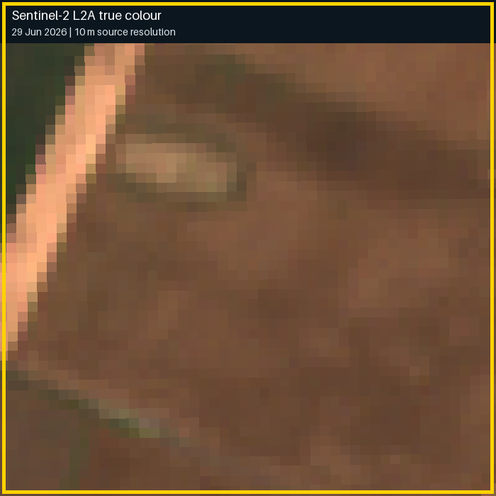
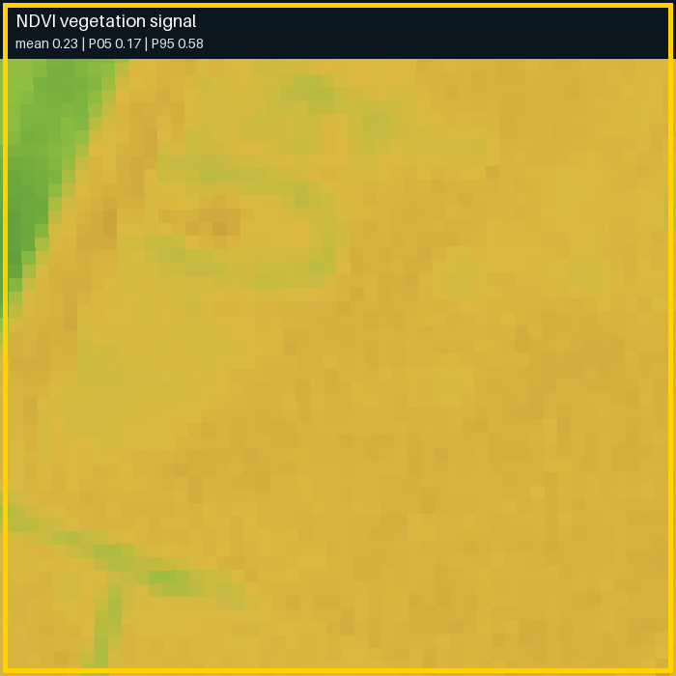
DATA
Connect policy, parcels and field evidence
Each source has a defined role in the proposed service and model-development path.
Agency records
Official parcels, claims, scheme rules and case/payment records.
Public Sentinel-2 sample
Copernicus observations
Sentinel-2 optical and Sentinel-1 radar time series.
Development labels
CLMS crop maps (weak labels) + confidence; EuroCrops for pipeline work.
Field and farmer evidence
Independent inspected crop findings; purposeful farmer event context.
Colour view
Vegetation signal
Illustrative area · 29 June 2026
Agency access and field-label collection are agreed as part of pilot preparation.
Field & File | Ministry of Agriculture | Case-study proposal
11 / 14
Notes:
Official parcel geometries, IACS claims, approved scheme rules and case/payment data are connected through agreed agency access. Sentinel-2 supplies optical observations and vegetation indicators; Sentinel-1 supplies radar observations. The first public-data experiment uses CLMS Crop Types with its confidence layer as weak labels and clearly identified analysis geometries. EuroCrops from nearby countries supports pipeline development. The operational path uses independently validated Hungarian crop labels and authoritative parcel geometry. Farmer field updates provide case context; independently accepted field findings can enter governed label datasets.
CLMS agreement describes experimental prototype performance. Inspection-backed Hungarian evaluation establishes local operational evidence. EuroCrops development data comes from nearby countries. The two illustrations reuse the repository’s 29 June 2026 Sentinel-2 sample through the Earth Search/AWS Open Data mirror.
Source references
https://github.com/verboompj/ama/blob/c179b1c2d28298b6b1a135277090672989900913/docs/copernicus/crop-classification/public-data-crop-prototype-plan.md
https://github.com/verboompj/ama/blob/c179b1c2d28298b6b1a135277090672989900913/docs/copernicus/crop-classification/crop-classifier-training-procedure.md
https://github.com/verboompj/ama/blob/c179b1c2d28298b6b1a135277090672989900913/docs/architecture/aks-centered-foundry-architecture.md
https://github.com/verboompj/ama/blob/c179b1c2d28298b6b1a135277090672989900913/docs/copernicus/crop-classification/sample-data/sentinel-2-hungary-crop-sample.json
Field & File is a fictional Hungarian CAP case-study proposal. Figures and target benefits are drawn from the case brief.

Slide 12
MACHINE LEARNING
Train crop models from seasonal observations
Azure ML manages repeatable experiments and turns parcel time series into crop evidence.
1
2
3
4
5
Prepare
Learn
Calibrate
Evaluate
Register
Parcel-level seasonal features
CPU gradient-boosted baseline
Confidence + review thresholds
Spatial + later-season holdouts
Versioned model + batch scoring
Evidence available by the decision date
Three operational outcomes
Rebuild seasonal features and assess confidence for each supported observation window.
CONSISTENT
REVIEW
UNKNOWN
Results enter the case workflow.
Field & File | Ministry of Agriculture | Case-study proposal
12 / 14
Notes:
Training starts with a defined region, crop taxonomy, seasons, parcel geometries and label provenance. Copernicus processing produces per-parcel optical, radar and quality features. A CPU-friendly gradient-boosted baseline, for example XGBoost or LightGBM, learns seasonal crop patterns in Azure ML. Separate validation data supports model tuning, probability calibration and the review thresholds. Independent spatial and later-season tests measure generalisation. Approved versions are registered and used for asynchronous batch scoring, with online rescoring where justified. The declared crop is compared with the prediction after scoring; predictor inputs contain observation features and approved context.
Each supported decision date uses observations acquired and available by its cutoff. Seasonal features are recomputed for that prefix; every snapshot of a parcel remains in the same split. CLMS target labels and label-confidence metadata are held separately from predictor features. Registered model, features, taxonomy and thresholds are versioned together.
Source references
https://github.com/verboompj/ama/blob/c179b1c2d28298b6b1a135277090672989900913/docs/copernicus/crop-classification/crop-classifier-training-procedure.md
https://github.com/verboompj/ama/blob/c179b1c2d28298b6b1a135277090672989900913/docs/copernicus/crop-classification/public-data-crop-prototype-plan.md
https://github.com/verboompj/ama/blob/c179b1c2d28298b6b1a135277090672989900913/docs/architecture/aks-centered-foundry-architecture.md
Field & File is a fictional Hungarian CAP case-study proposal. Figures and target benefits are drawn from the case brief.

Slide 13
MODEL EVIDENCE
Establish confidence on Hungarian farms
Assess crop performance, seasonal coverage and the workload experienced by farmers and staff.
1
Training set
2
Validation set
3
Locked final test
Fit the crop patterns
Tune and calibrate
Assess the fixed candidate
Crop evidence
Seasonal coverage
Service impact
Precision and recall by crop, region and season.
Confidence and review rates by observation date and parcel size.
False alerts, review workload and case-resolution outcomes.
Public-data experiment → inspected Hungarian evaluation → authorised model release
Field & File | Ministry of Agriculture | Case-study proposal
13 / 14
Notes:
The public-data experiment develops the pipeline and measures agreement with CLMS weak labels. The operational pilot then evaluates on independently checked Hungarian parcels, with approved official geometry and label provenance. Holdings, spatial clusters and parcel versions stay together in their assigned split. A later season and another region test transfer. The final test sample stays locked until the candidate model and thresholds are fixed. Report per-crop precision and recall, calibration, abstention, review workload and outcomes by region, parcel size and observation date.
Independent probability-sample evidence supports population-level service evaluation. Targeted findings can supply governed development labels after quality review. Business owners agree service targets and agency specialists approve model acceptance before the pilot.
Source references
https://github.com/verboompj/ama/blob/c179b1c2d28298b6b1a135277090672989900913/docs/copernicus/crop-classification/crop-classifier-training-procedure.md
https://github.com/verboompj/ama/blob/c179b1c2d28298b6b1a135277090672989900913/docs/copernicus/crop-classification/public-data-crop-prototype-plan.md
https://github.com/verboompj/ama/blob/c179b1c2d28298b6b1a135277090672989900913/docs/copernicus/crop-classification/drone-survey-validation-process.md
https://github.com/verboompj/ama/blob/c179b1c2d28298b6b1a135277090672989900913/docs/Persona/personas-and-use-cases.md
Field & File is a fictional Hungarian CAP case-study proposal. Figures and target benefits are drawn from the case brief.

Slide 14
THE PROPOSED NEXT STEP
A staged pilot with measurable service outcomes
Agree a representative pilot scope and deliver the service in three connected stages.
01
Infrastructure
Establish the approved Azure foundation, identity and controlled access.
02
Azure ML
Prepare the dataset, train the crop model and evaluate local performance.
03
Apps + runtime
Connect guidance, case support, field findings and payment-status integration.
Ministry sponsorship: pilot outcomes, data partnerships and delivery owners.
Field & File | Ministry of Agriculture | Case-study proposal
14 / 14
Notes:
The agreed delivery order is infrastructure, Azure ML and then application/runtime services. For a Ministry-sponsored pilot, define the region, crop set, representative parcel cohort and independent field sample together with the paying agency. Establish baseline measures for payment timing, inspection effort, case resolution and farmer experience. Assign policy, agency, data and field owners. Prepare scoped authorisation for data access, compute cost, model training and integrations before execution. The intended pilot demonstrates a connected farmer-to-case-to-payment-status journey and provides evidence for a wider service decision.
This is a forward-looking pilot proposal using the maintained staged delivery plan. Existing local foundation templates are a starting artifact; Azure execution, data acquisition and model training require their own authorised readiness and scope.
Source references
https://github.com/verboompj/ama/blob/c179b1c2d28298b6b1a135277090672989900913/delivery/releases/WP-001/poc-direction.md
https://github.com/verboompj/ama/blob/c179b1c2d28298b6b1a135277090672989900913/docs/architecture/aks-centered-foundry-architecture.md
https://github.com/verboompj/ama/blob/c179b1c2d28298b6b1a135277090672989900913/docs/copernicus/crop-classification/crop-classifier-training-procedure.md
https://github.com/verboompj/ama/blob/c179b1c2d28298b6b1a135277090672989900913/docs/Persona/personas-and-use-cases.md
https://github.com/verboompj/ama/blob/c179b1c2d28298b6b1a135277090672989900913/case/case-study-47.md
Field & File is a fictional Hungarian CAP case-study proposal. Figures and target benefits are drawn from the case brief.

