Slide 1

Disney World Wait Times
Presented by torrey Capobianco
Designed by vectorstock (Image #33732948 at VectorStock.com)

Slide 2



Waiting in lines
Time spent waiting in lines affects business such as theme parks to the DMV
Being able to understand how long a person waits in a line can benefit both an operator and the person waiting
Business
Plan for daily workload staffing
Hiring for busy times of year
Plan offerings in other areas
Guest
Guest satisfaction
Influence loyalty to the company
Help plan their day

Slide 3

Problem Statement
Walt Disney World’s Magic Kingdom has many attractions that face the question of how long is the wait for the experience
Is it possible to predict these wait times for planning?
Are there busier months, days, or seasons?
A multivariate time series model is presented to predict wait times for Pirates of the Caribbean

Slide 4
The Data
Touring Plans provides historical wait times from 2016-2021 on Walt Disney World attractions
Pirates of the Caribbean
Timestamp – average 7 min intervals
Posted wait time
Actual wait time
Metadata
Supplemental facts for each day
189 different features
Notes:
Where posted time was missing, filled in with actual time

Slide 5
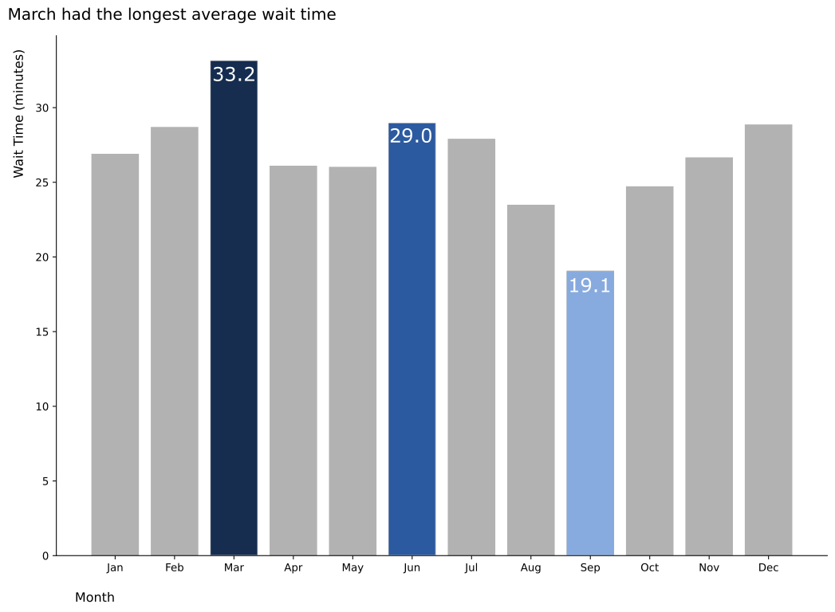
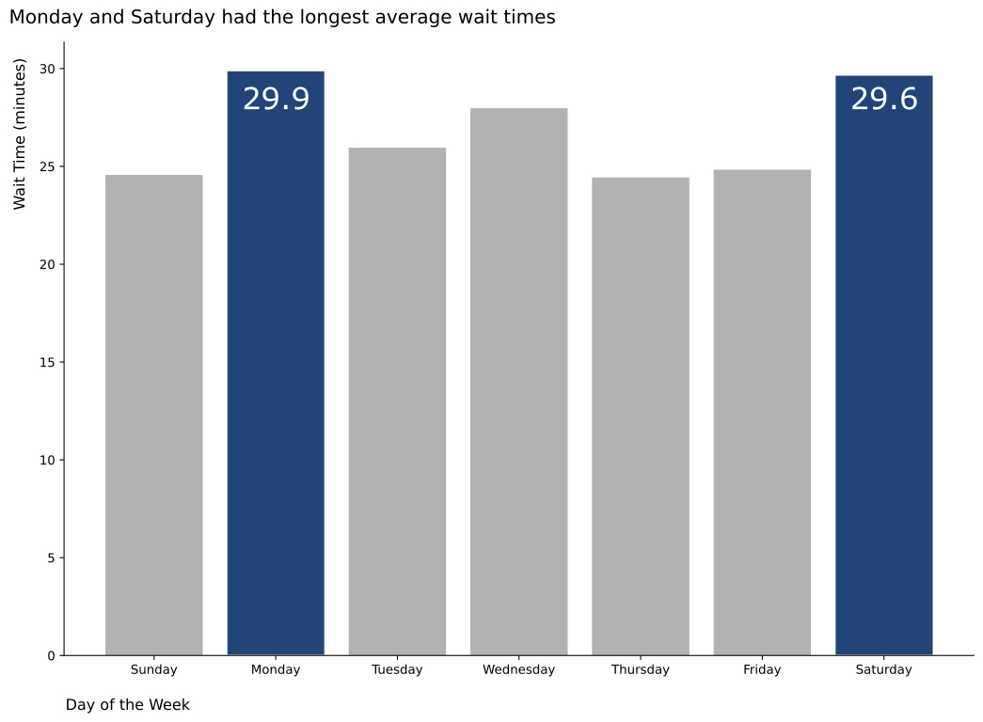
Average wait times

Slide 6
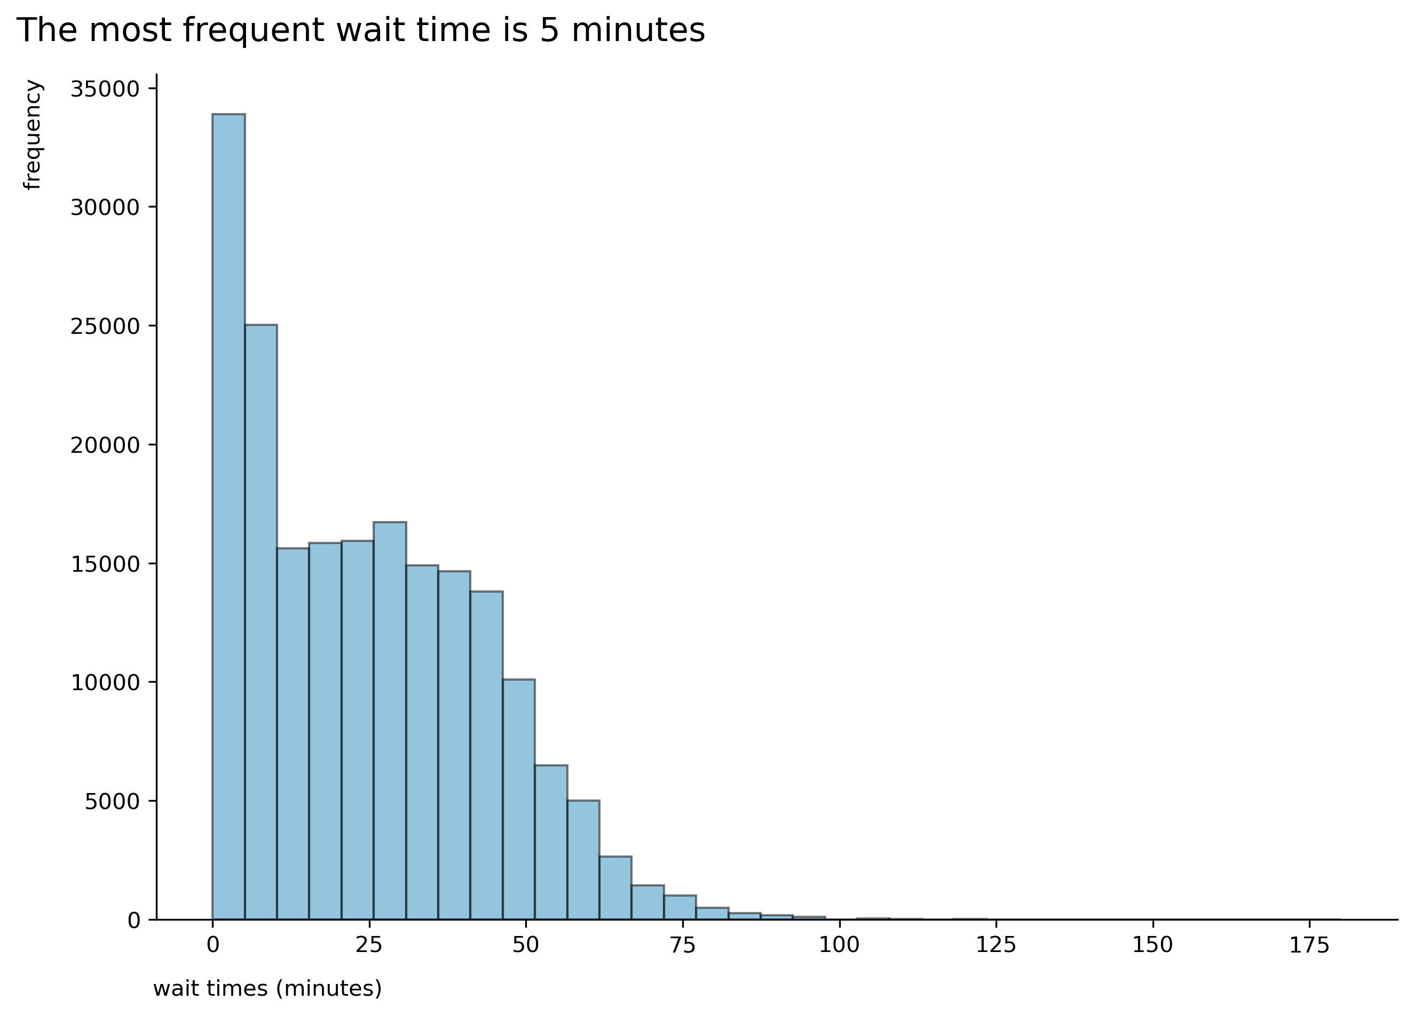
Frequent wait times
Notes:
Most frequent is 5 minute wait. The distribution of the other wait times are very similar up until 45 minutes, then there is a smaller frequency of the longer wait times

Slide 7
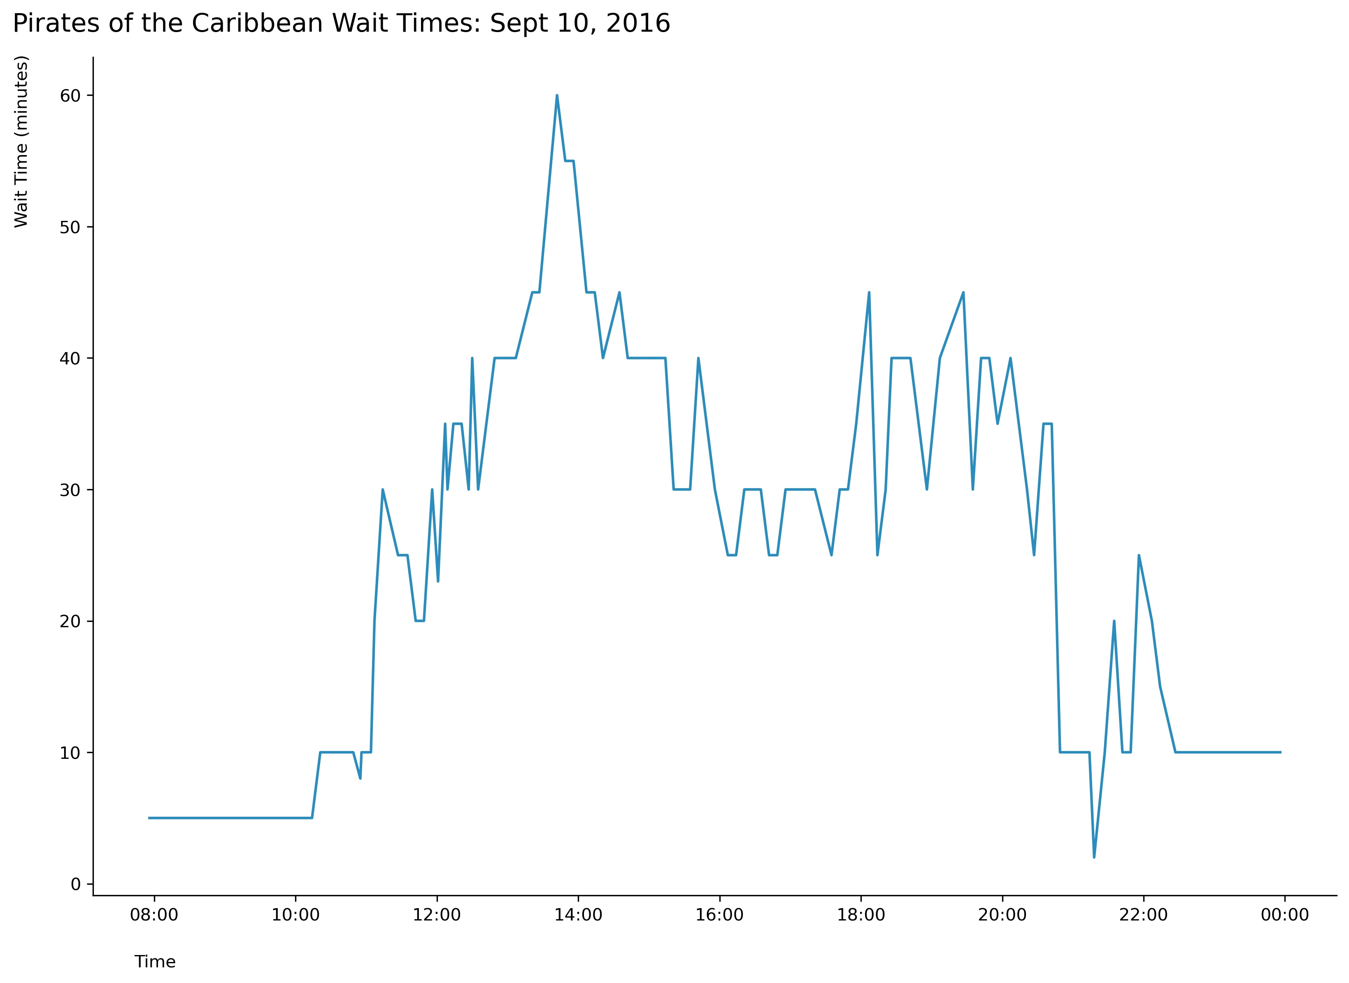
Exploratory Data Analysis
Parade

Slide 8
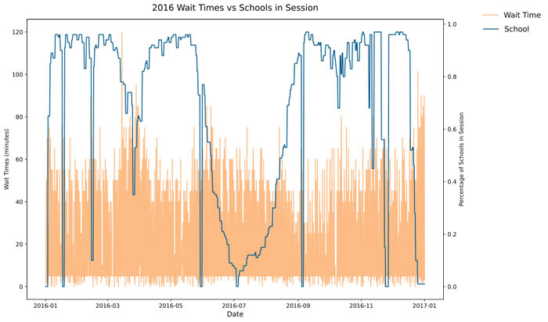
Exploratory Data Analysis

Slide 9
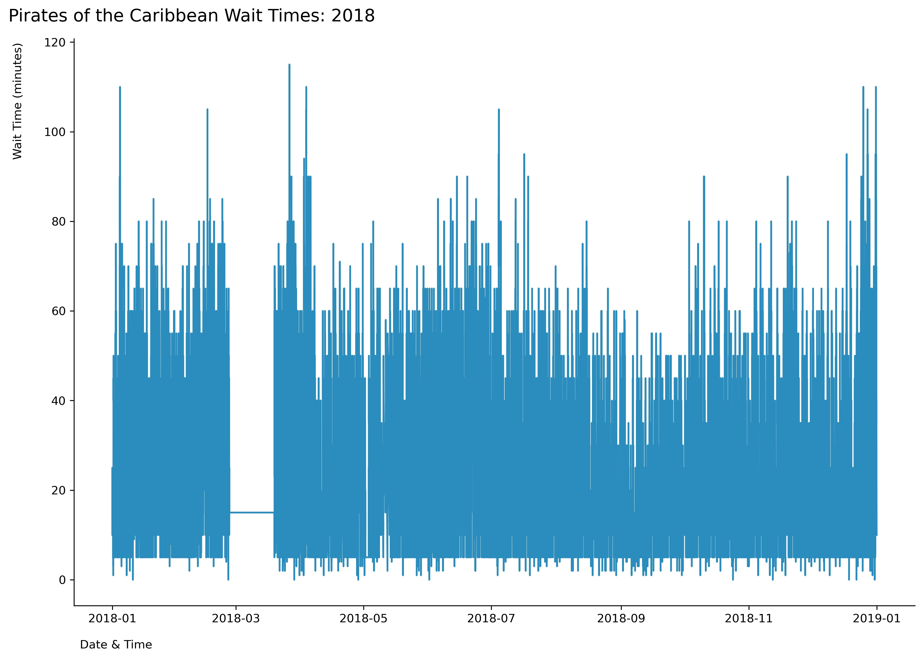
Data Preparation
2018 Ride Updates
Daily Downtime
Notes:
To get the data prepped for modeling, some values were imputed

Slide 10



Variable selection
Time
Month
Day
Sunset Hour
Magic Kingdom
Park Hours
Day Parades
Night Parades
Season
Party
Weather
Max, Min, Avg Temp
% of Precipitation
Outside Factors
School Session
Notes:
11 features

Slide 11




Modeling Methods
Recurrent Neural Network (RNN)
Long Short-Term Memory (LSTM)
Remembers values from time intervals
Handles lags between events
Input Layer
Output Layer
Hidden Layer
Notes:
RNN – not a feed forward network. Use previous timestep activations for the current timestep prediction
[they] keep information about past inputs for an amount of time that is not fixed a priori, but rather depends on its weights and on the input data.
LSTM – good for time series, multivariables

Slide 12


LSTM
Two approaches tested:
1 past timestep predicts 1 future event
4 past timesteps predicts 1 future event
Layer | Output Shape
LSTM | 50
Dense | 1
Train | 2016 & 2017
Test | 2018
Validation | 2019
Notes:
Two approaches tested:
1 past timestep predicts 1 future event
4 past timesteps predicts 1 future event
Tools: Keras

Slide 13
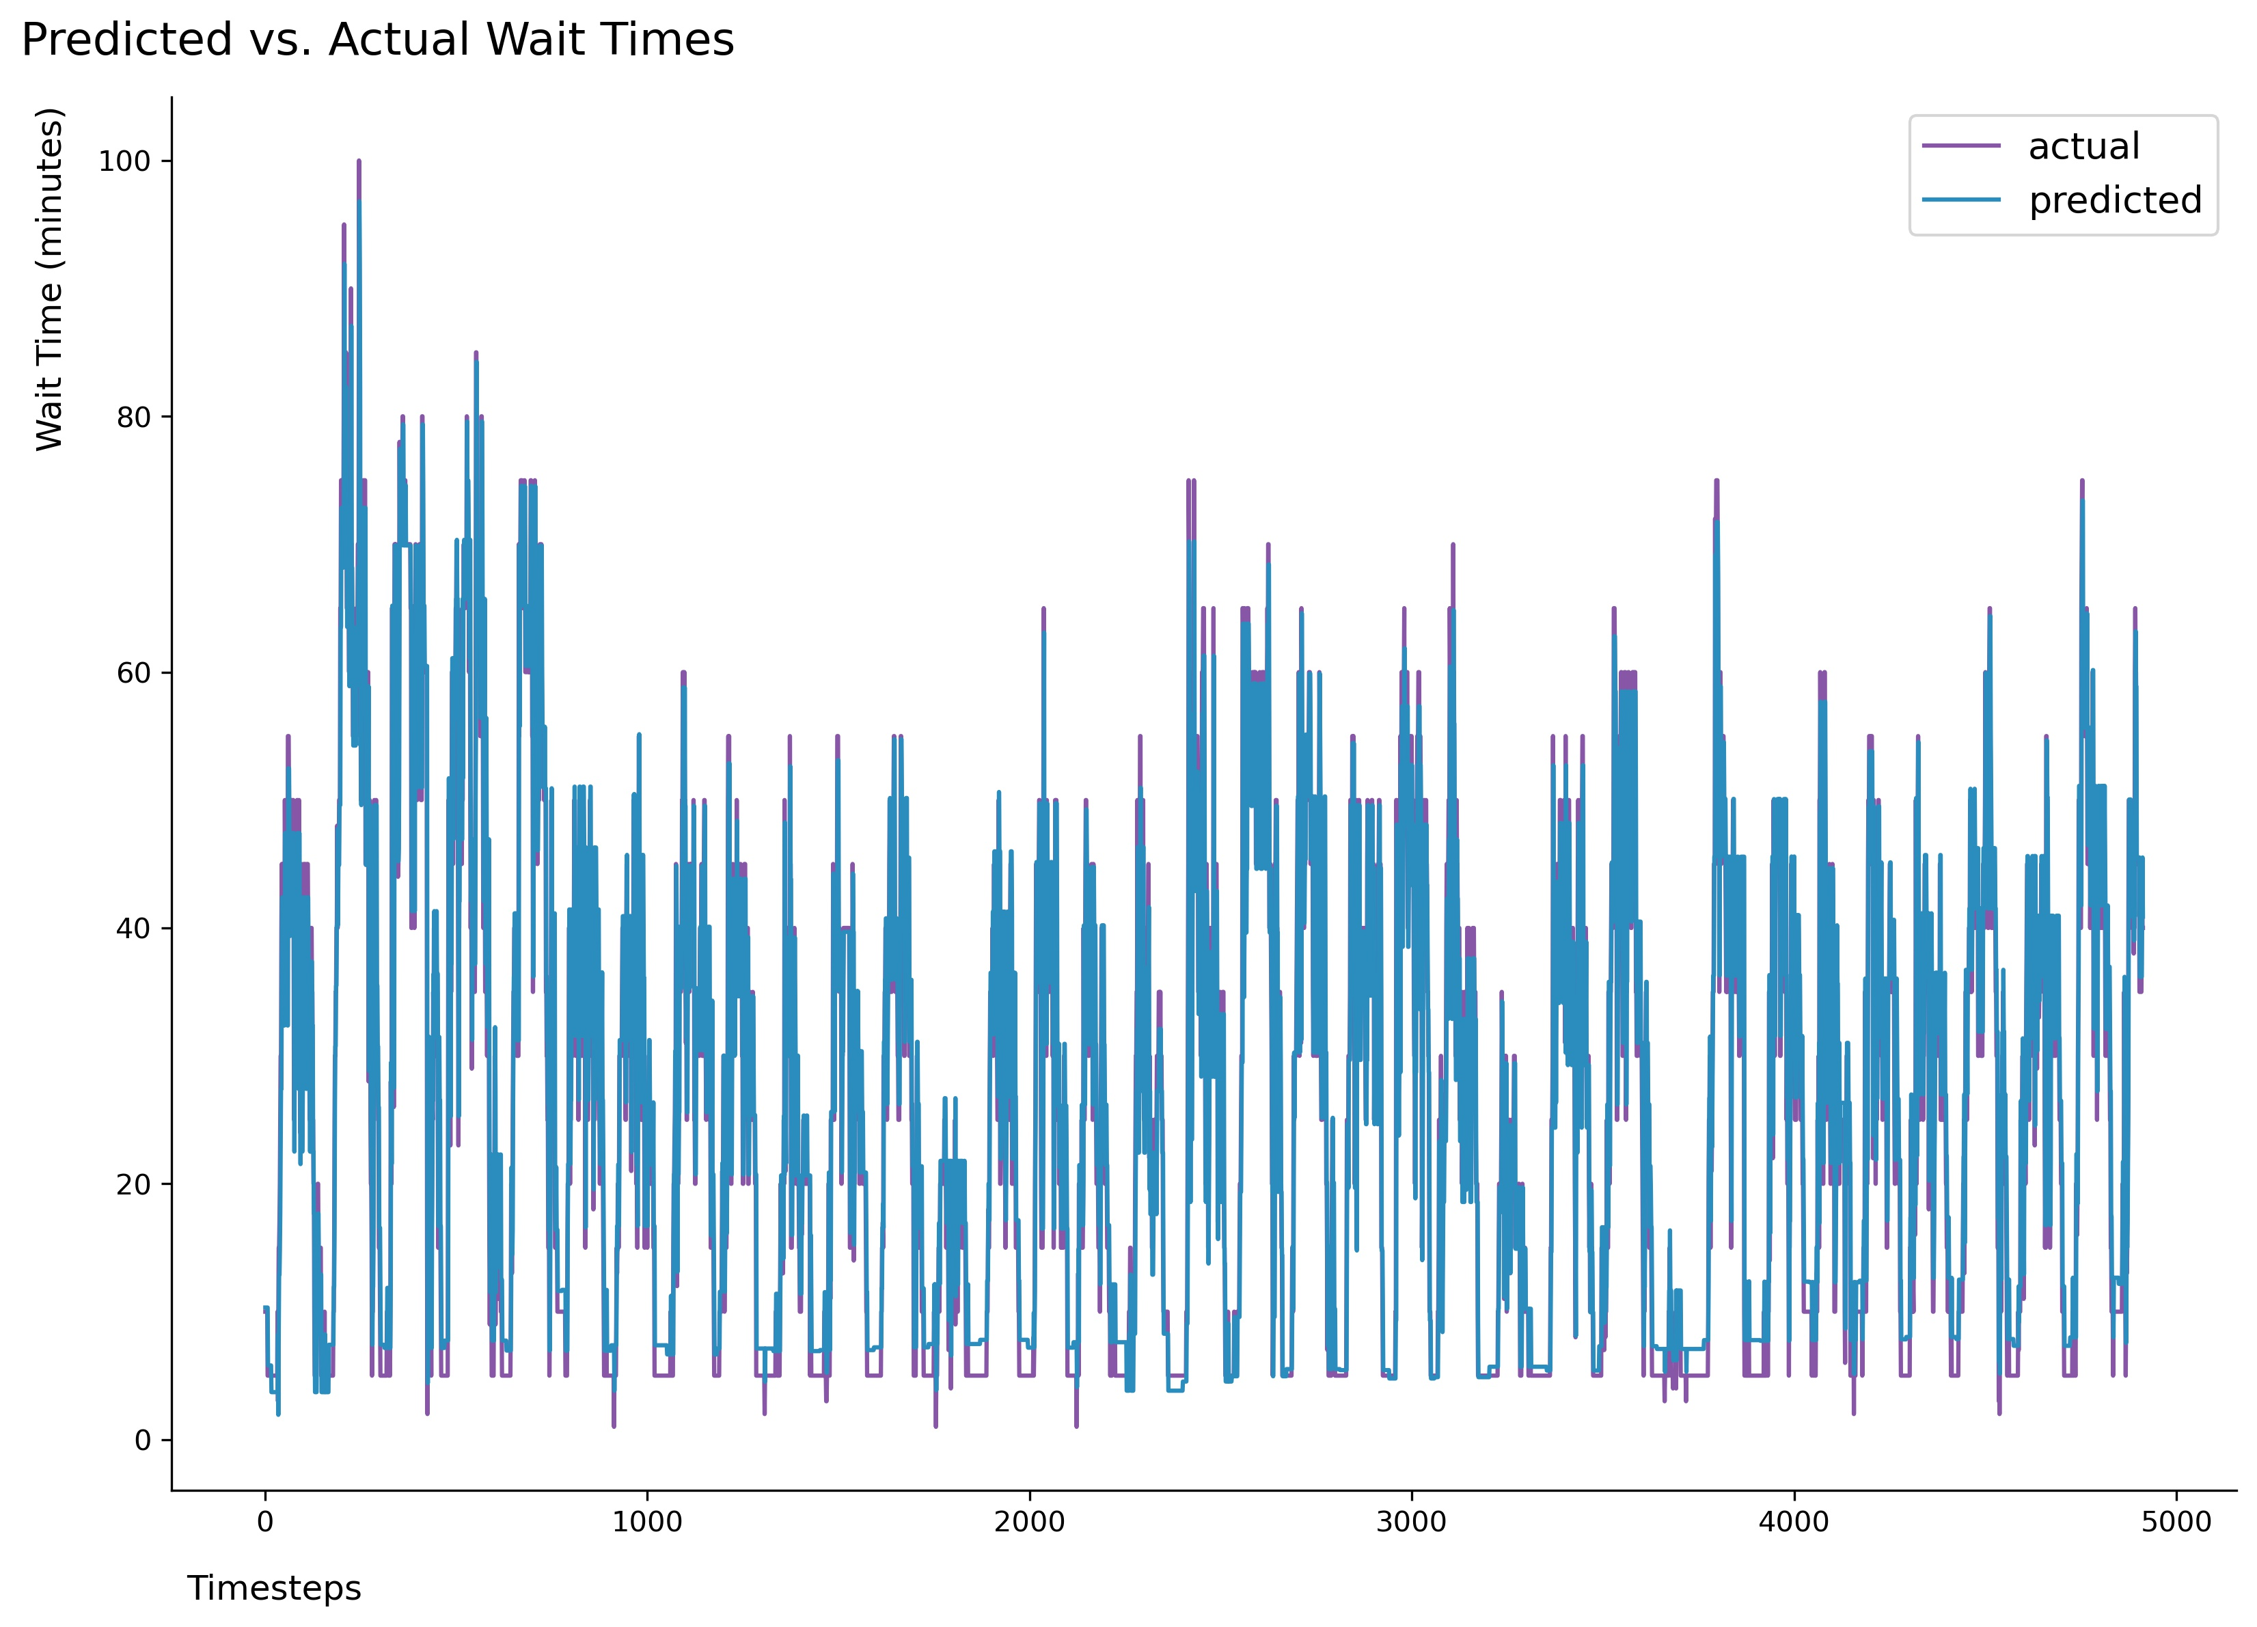
Results
Can predict wait times for Pirates of the Caribbean within 7.14 minutes

Slide 14
Closing
What does 7 minutes mean?
Business
Plan for daily workload staffing
Hiring for busy times of year
Guest
Can over plan their day
Wait longer than expected

Slide 15
Thank you!

