Slide 1
EnCore: Private, Context-based Communication for Mobile Social Apps
Paarijaat Aditya¹, Viktor Erdelyi¹, Matthew Lentz²,
Elaine Shi², Bobby Bhattacharjee², Peter Druschel¹
Max Planck Institute for Software Systems (MPI-SWS) ¹
University of Maryland²
MobiSys 2014, 17th June 2014, Bretton Woods, NH, USA

Slide 2

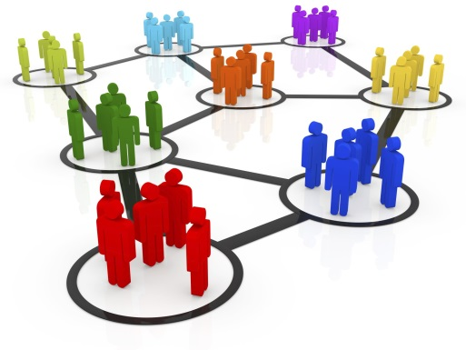



Mobile social apps
Provide services based on users’ location, activity, nearby users
Social discovery
Discover relevant nearby users
Social sharing
Share content with nearby people
Social tagging
Search and organize content by
social context

Slide 3
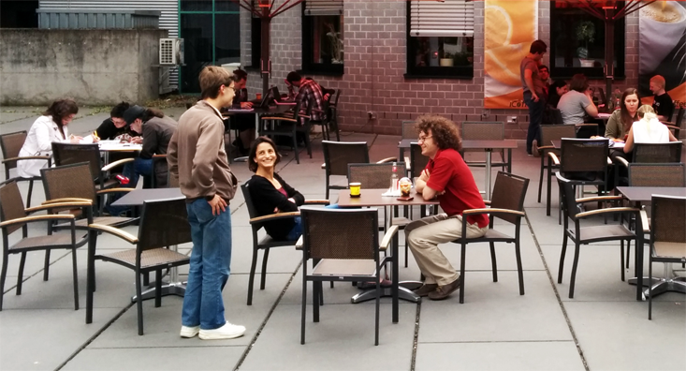

Sitting in a cafe
John
Steve
Andy
You
Julia
Unknown

Slide 4

“Hey, I came across this article ...”
John
Steve
Andy
You
Julia

Slide 5

“I forgot my book in the cafe...”
John
Steve
Andy
Julia

Slide 6
Goal: enable rich functionality while
protecting user privacy
John
Steve
Andy
Julia
Discover friends and strangers
Form socially relevant groups

Slide 7








Implementing mobile social apps
Via app provider
Via short range radio
encrypted content shared via cloud
Info uploaded
Location
Activity
Content
Social profile
Discover presence
Exchange a key
Sensitive info shared
with app provider
Tracking via Bluetooth

Slide 8
Requirements
Our previous work: SDDR
[To appear: Usenix Security ‘14]
Background
Secure encounters
Social Discovery
Events:
groups of socially relevant encounters
This talk
EnCore
Secure communication between event members
Social sharing
Social tagging
Search & organize content by events
In the paper

Slide 9







SDDR - secure encounters
Encrypted with shared-key
Untrusted channel
or
Cryptographic handshake over Bluetooth
Produces a shared-key for each encounter
Secure discovery
Selectively reveal identifiable info
Power efficiency
Identify ‘friends’ while remaining anonymous to all others
Prevents tracking via Bluetooth

Slide 10
Requirements
Secure encounters
Social discovery
Events:
groups of socially relevant encounters
EnCore
Social sharing
Secure communication between event members
Social tagging
Search & organize content by events

Slide 11
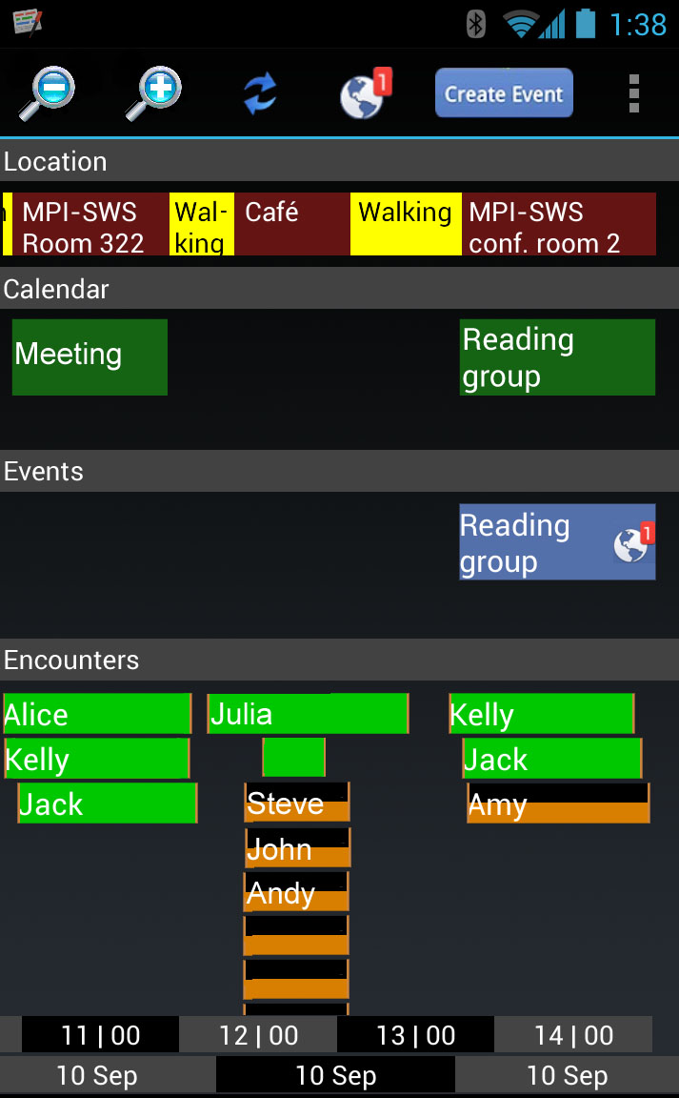
Context App
Events: groups of socially relevant encounters
Location & Activity
Calendar
You
Julia
Events
Known contacts
Duration
Encounters
Unknown
In close proximity
Further away
Unknown
Event 2: stay at the cafe
Identify relevant encounters using
contextual information
Event 1 - discussion
Time and Date

Slide 12
You
Julia
discussion
Unknown
stay at cafe
Discussion
Contextual info helps in identifying
relevant encounters
stay at the cafe
?
Others at the Cafe
Reading group

Slide 13
Requirements
Secure Encounters
Social discovery
Events:
groups of socially relevant encounters
EnCore
Social sharing
Secure communication between event members
Social tagging
Search & organize content by events

Slide 14










Secure communication within ‘Events’
1. Create a group key and a folder
shared key with “unknown”
folder
url
+
Unknown
folder
url
+
You
Julia
folder
url
+
shared key with “Julia”
2. Encrypt with the group key
and upload to the folder
While sharing documents
During event creation

Slide 15
Requirements
Secure Encounters
Social discovery
Events:
groups of socially relevant encounters
EnCore
Social sharing
Secure communication between event members
In the paper
Social tagging
Search & organize content by events

Slide 16
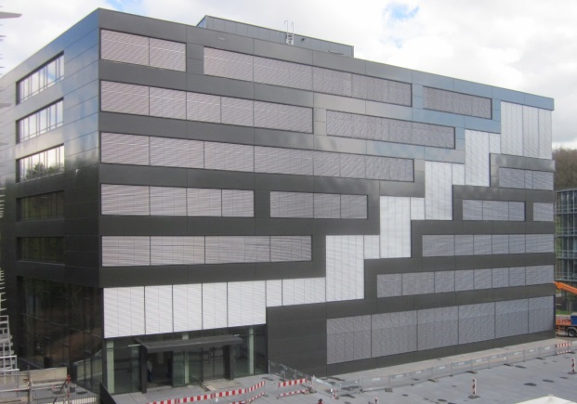

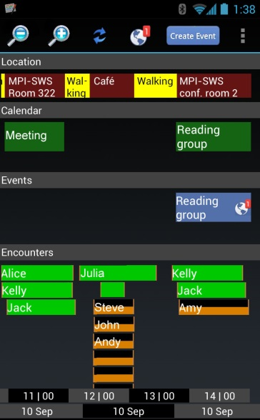
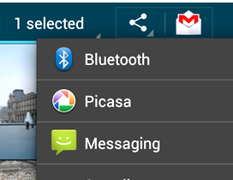
Evaluation – live deployments
4 deployments over 1 year
‘rooted’ devices running the Context app
35 researchers, up to 2 weeks @ MPI-SWS
and as the storage backend
Integrated in the ‘share’ menu
MPI-SWS, Saarbrucken
Context app

Slide 17
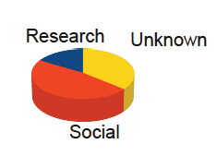
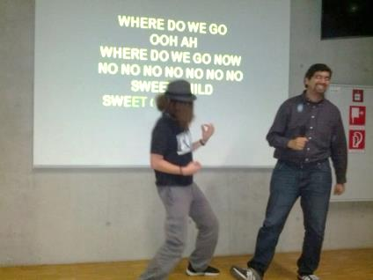
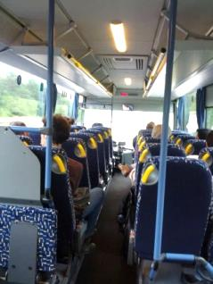
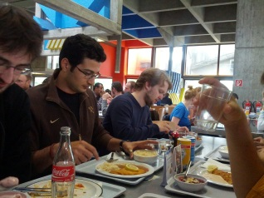


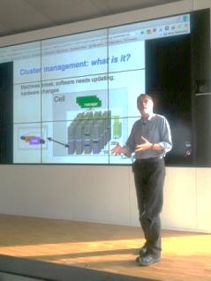
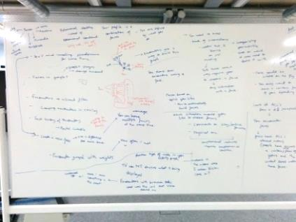
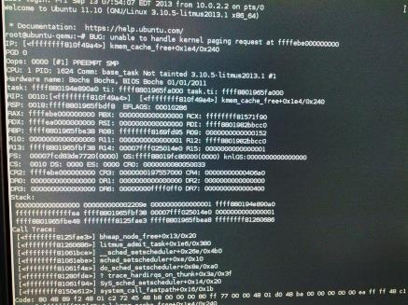
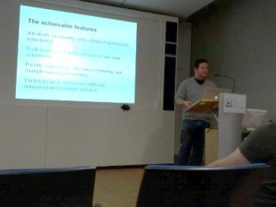
Usage
Types of events created
128 events, 400 posts
Mostly photos and text
“Coffee
anyone?”
Karaoke
Lunch
Bus ride
Taking a break
Lecture
Meetings
Reading group
KVM bug – help!
“Free food!”

Slide 18
Usage
Users automatically resolved conflicts
(multiple events for a single gathering)
Conversations within events continued
even after the actual gathering ended

Slide 19
User feedback
“Can I install it on my phone?”
“Please integrate this with WhatsApp and Gmail!”
“I would rather share pics via this app, than to write an email!”
“Can you make it automatically create events?”

Slide 20


Conclusion
Mobile social apps introduce
significant privacy challenges
EnCore:
platform that enables rich mobile social apps
while putting user in control of their privacy
Users found it useful and found
creative uses that we didn’t anticipate!
mobilesystems.mpi-sws.org/encore

Slide 21
Backup slides

Slide 22

Sharing over individual encounters
Past Encounter
(EncounterID & shared-secret)
Hi, I met you in the Cafe today. Here is the link to the video I mentioned.
Query messages for
EncounterID@mailinator.com
Message Encrypted with shared-secret
Email to EncounterID@mailinator.com
A commercial disposable
email service

Slide 23



SDDR is optimized for power efficiency
Handshake protocol is non-interactive
Handshake info. encoded on Bluetooth low energy (BLE) advertisements
Diffie-Hellman for
shared- secret
Bloom filter for
selective linkability
SDDR’s BLE advertisement
Device awake
CPU awake
Discovering BLE adv.
Forming encounters
Device in sleep mode
CPU asleep
Broadcasting BLE adv.
Adv
Adv
Discovery rate: ~15 sec
Advertising rate: few seconds

