Slide 1
Chapter 14: Pulsed Echo Instrumentation

Slide 2
The ultrasound system has two major functions
Preparation and transmission of electrical signals to the transducer, which creates the sound beam
Reception of electrical signals from the transducer with subsequent processing into clinically meaningful images and sounds

Slide 3
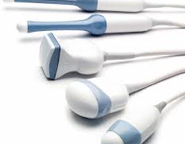
Pulsed Echo Instrumentation
Six interconnected components – information is transferred to and from each component
1. Transducer
Converts electrical energy into acoustic energy during transmission
Converts returning acoustic into electrical energy during reception

Slide 4
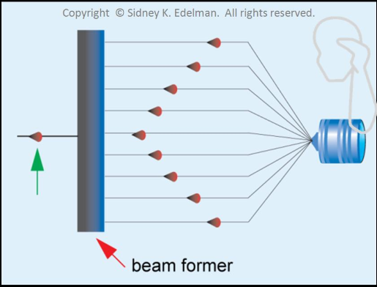
Pulsed Echo Instrumentation
2. Pulser/ beam former
Component that controls the electrical signals sent to the transducer for sound pulse generation
Determines PRF, PRP, and pulse amplitude
Creates the firing pattern for phased array systems. This is called the Beam Former.

Slide 5
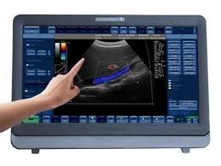
Pulsed Echo Instrumentation
3. Receiver
Electronics associated with processing the electrical signal produced by the transducer during reception and producing a picture on an appropriate display
4. Display
Device associated with the presentation of processed data for interpretation

Slide 6
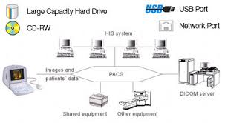
Pulsed Echo Instrumentation
5. Storage
Devices and media that are used to permanently archive data
6. Master Synchronizer
Maintains and organizes timing and interaction of the system’s components (the boss)

Slide 7
Pulser
Function:
Receives timing signal from master synchronizer
Creates electrical signal that will excite PZT crystal
Produces electrical voltage 10-500 volts that excites PZT during transmission
Greater voltage increases sound intensity
The pulser controls transducer output

Slide 8
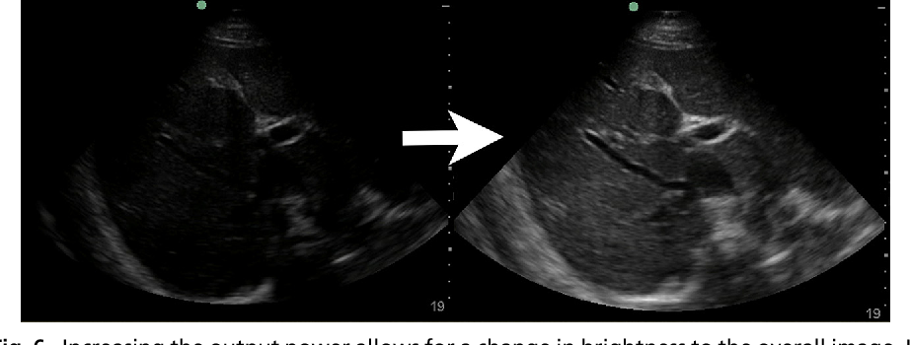
Transducer Output (Power knob)
PZT vibrates with a strength related to the pulser voltage
When you change the transducer output, every pulse changes, image brightness changes
Higher voltage magnitude, higher transducer output, brighter image
Lower voltage magnitude, lower transducer output, darker image

Slide 9
Transducer Output (Power knob) cont'd
Increasing transducer output improves signal to noise ratio.
The meaningful signal strength is improved while the noise level remains constant.
What is noise?
Random disturbance that obscures or reduces clarity of a signal.
May contaminate images with low level, undesirable signals
With ALARA – first attempt to change your output power before changing overall gain if the image is too bright

Slide 10
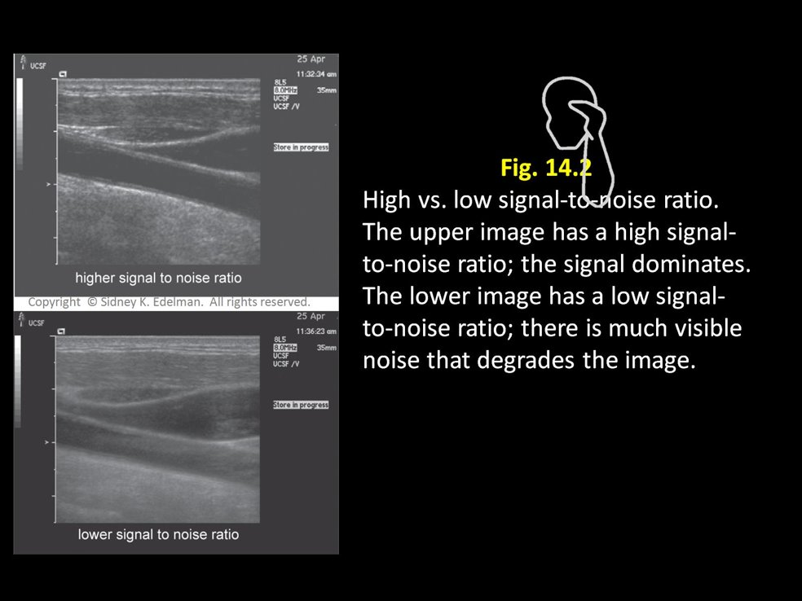

Slide 11
PULSE REPETITION PERIOD
Shallow Imaging | Deep Imaging
Shorter listening time | Longer listening time
Shorter PRP | Longer PRP
Higher PRF | Lower PRF
The pulser also determines the pulse repetition period (PRP)
PRP determines the maximum imaging depth

Slide 12
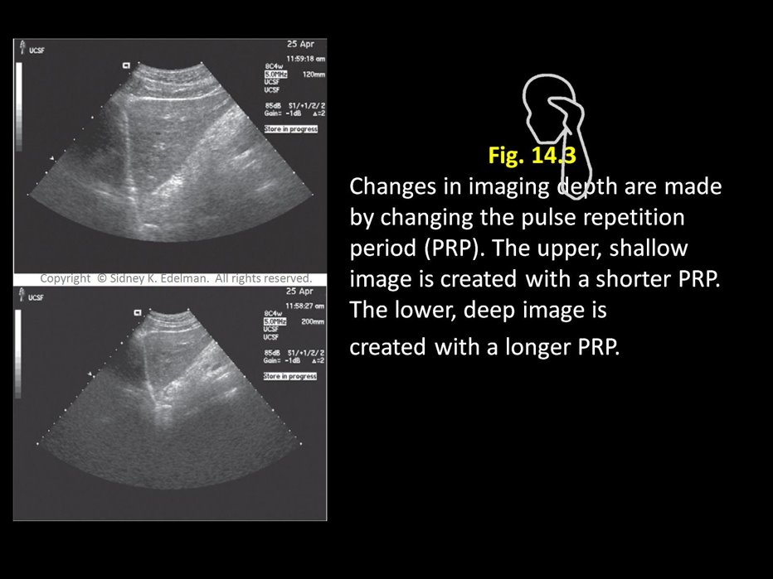

Slide 13
Beam Former
Part of the transmitter
Functions with array transducers
Apodization – reduction of lobe artifacts
Modern systems- digital beam former
Software programming
Stable
Versatile

Slide 14
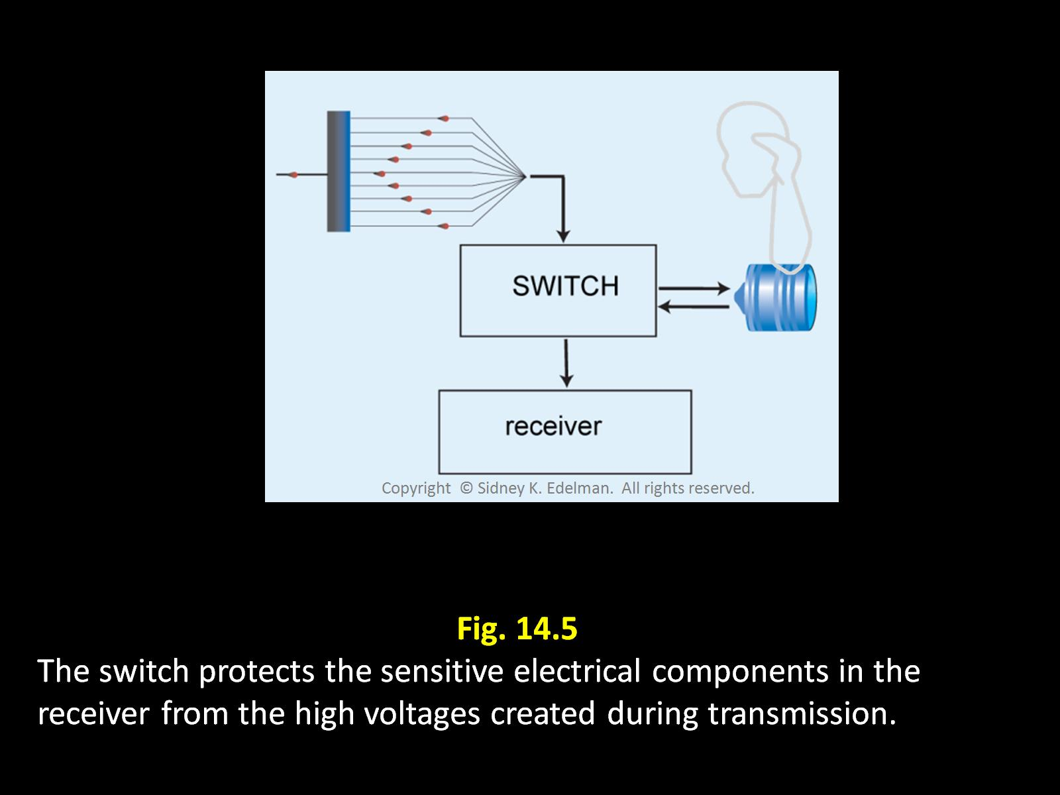
Switch protects the receiver from the extreme signals sent at transmission
Also directs the electrical signals to the appropriate processing component.
CHANNEL

Slide 15
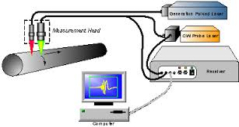
Receiver and its functions
The signals returning from the transducer are extremely weak
The receiver boosts the strength of these signals, processes them and prepares them for display.
The signals returning from the transducer are extremely weak​
The receiver boosts the strength of these signals, processes them and prepares them for display.
Receiver
Display

Slide 16
ORDER OF OPERATIONS IN THE RECEIVER
Amplification
Compensation
Compression
Demodulation
Rejection
You can remember the order that things will happen in because they are in alphabetical order

Slide 17
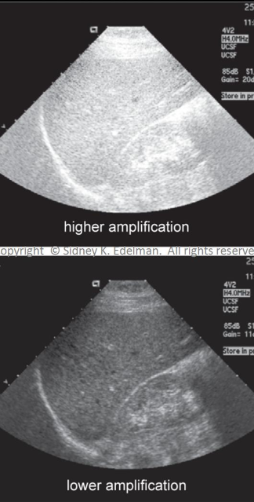
Amplification (Overall gain)
Increases the strength of all electrical signals in the receiver prior to further processing
Synonyms – gain, receiver gain
Can be adjusted by the sonographer
Effect upon image
every signal is treated identically
amplification changes the brightness of the entire image.

Slide 18
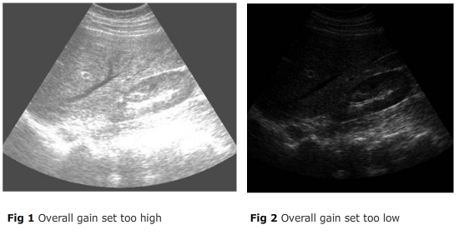
Gain
Increasing overall gain cannot create an image with uniform brightness.
Signal to noise ratio is unchanged when amplification levels change.
Preamplifier-may condition signal before it is amplified-often performed within the probe.

Slide 19
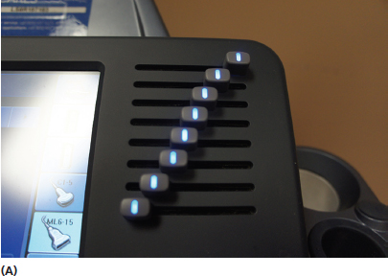
Compensation (TGC)
Purpose: used to create image of uniform brightness from top to bottom.
Since attenuation is strongly related to path length, echoes returning from great depths have lower amplitudes than those returning from shallower depths.
We must account for this in our image.
Compensation makes all echoes from similar reflectors appear identical regardless of their depth

Slide 20
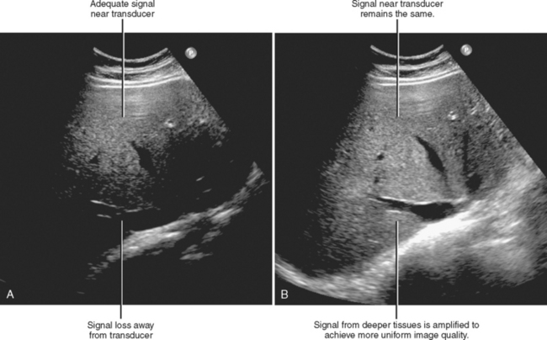
Compensation (TGC)
Synonyms: TGC (time gain compensation), depth compensation, swept gain
Adjusted by the sonographer
Compensation treats echoes differently depending on the depth at which they arise
Compensation makes an image equally bright at all depths

Slide 21
TGC and frequency
Adjustments to TGC are related to transducer frequency:
Higher frequency
beam undergoes more attenuation
More TGC must be used
Lower frequency
beam undergoes less attenuation
Less TGC is needed

Slide 22
TGC AND ATTENUATION
We have to account for the change in attenuation with the TGC controls.
With higher frequency we must account for more attenuation so our TGC controls must be higher
With lower frequency we must account for less attenuation so our TGC controls must be lower

Slide 23
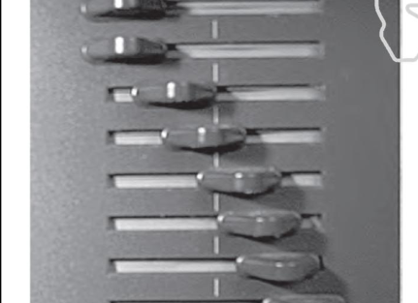
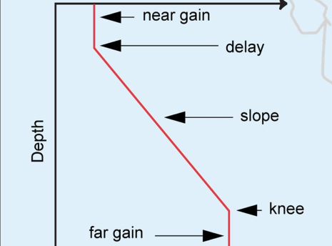
TGC curves
The TGC curve is the arrangement of the tiny knobs or switches in on the TGC
Near Gain – small amount of compensation
Delay – depth where variable compensation begins
Slope – compensation corrects for increasing attenuation
Knee – reflections are nearing maxunum compensation
Far gain – maximum amount of compensation from the receiver

Slide 24
TGC curves
The TGC curve is the arrangement of the tiny knobs or switches in on the TGC
Less Amplification
TGC
More Amplification
Higher frequency curve
Image Depth
Curve shifts up and to the right
Lower frequency curve
Curve shifts downward and to the left

Slide 25
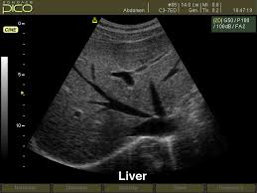
Key Terms
Near field – top of the image, area nearest the probe
Far field – bottom of the image, farthest from the probe
Near field
Far field

Slide 26
EXAMPLE
Sample TGC Registry questions:
What will you do if you cannot see reflectors in the near field of your image? (or the far field)
A: adjust the TGC!!

Slide 27
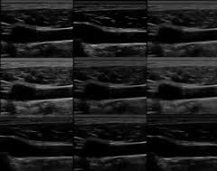
Compression
Alters the grayscale content of the image to one that the human eye can see
Reducing the total range of signals
Smallest to largest signal
How “black and white” an image will appear, versus a wider range of grays within that image

Slide 28
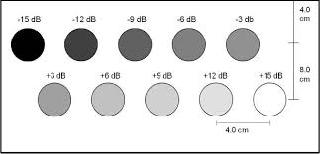
Compression
Purpose: keeps signals within the operating range of the system’s electronics and the gray scale within the range of what the human eye can see
Done without altering the relative relationships between signals: largest stays largest, smallest remains smallest
Decreases the dynamic range of the signals
Effect upon image: changes the gray scale mapping / characteristics of the image

Slide 29
Demodulation
Changes the signal’s form to one more suitable for TV display
Cannot be adjusted by sonographer
Not seen on our images and we cannot adjust it. It is performed automatically by the system.
Has two steps:
Rectification-turning all negative voltages into positive voltages. Corrects for or eliminates negative voltages.
Smoothing or enveloping-puts a smooth line around signal “bumps” to even them out

Slide 30
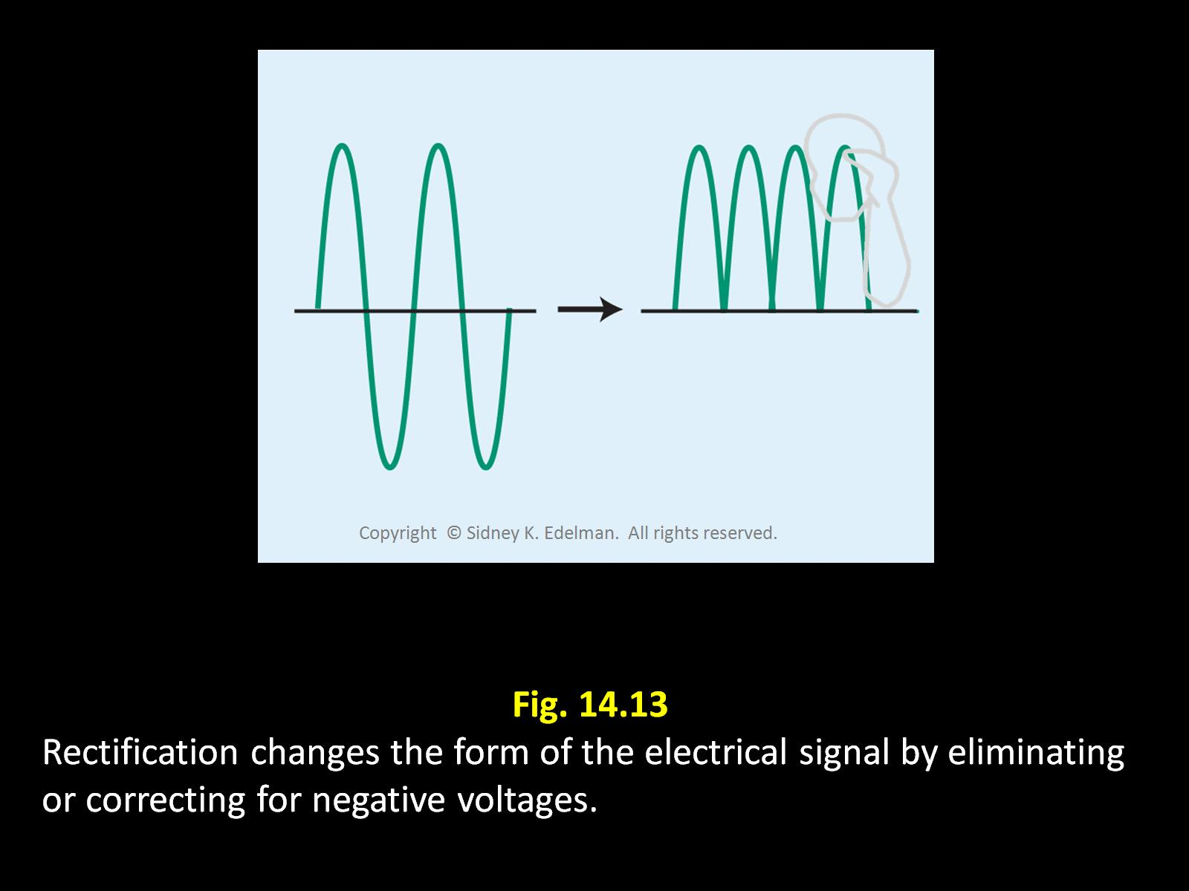

Slide 31
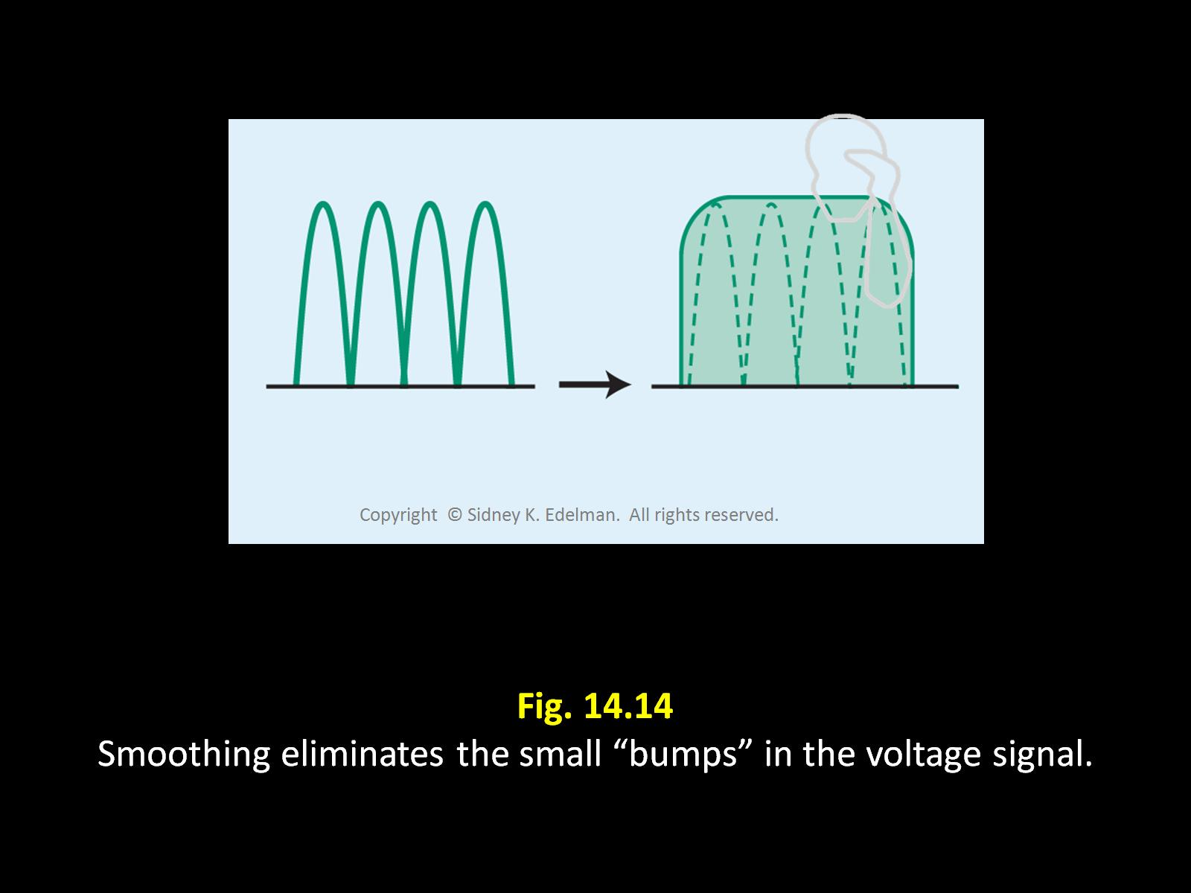

Slide 32
Rejection
Purpose: displays low level echoes only when clinically meaningful
Also known as suppression, threshold
Very low-level echoes may or may not be important. Reject determines whether they appear on an image.
Affects all low-level signals everywhere on the image but does not affect bright echoes.
Is adjusted by the sonographer

Slide 33
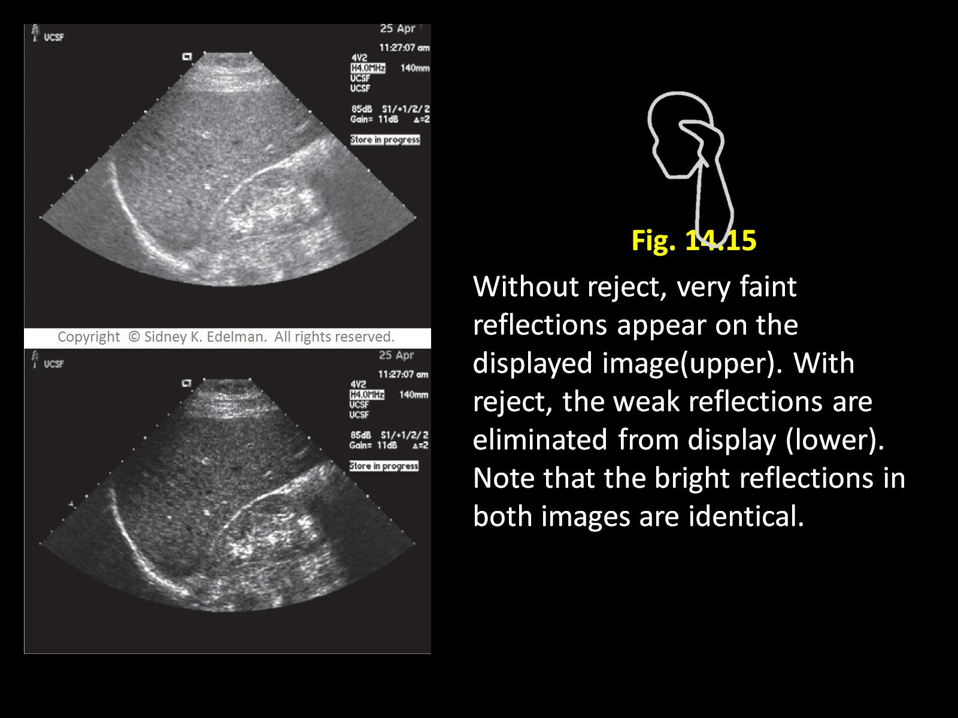

Slide 34
Dynamic Frequency Tuning
Pulses contain a wide range of frequencies
On some us systems, higher frequencies create shallow parts of the image and lower frequencies create deeper parts
Echoes arising from superficial structures are filtered to process only higher frequencies since higher frequencies make better images
Lower frequency signals are used to image deeper structures since the higher frequencies have attenuated and are no longer present.
Takes advantage of the range of frequencies present for optimal imaging

Slide 35
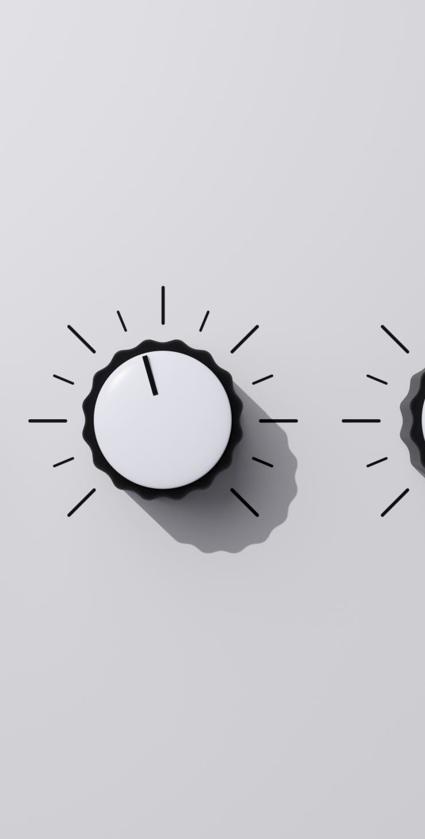
Output Power vs. Receiver Gain
Output power
Affects brightness by adjusting the strength of the sound pulse sent into the body by the transducer
When the pulse is more powerful, the signals returning are stronger and the image is brighter
When the image is too bright, lateral and longitudinal resolution degrade
Receiver Gain
Affects the brightness by changing amplification of the electronic signals after they return
When amplification is increased, the electronic signals in the receiver are boosted and the image is brighter

Slide 36
Output power vs. Receiver gain (cont'd)
Adjustments to either output power or receiver gain change the brightness of an entire image
Put simply, both can control brightness of the image
Power controls intensity of transmitted sound
Gain controls amplification of the signal at reception

Slide 37
Output Power vs. Receiver Gain (cont'd)
How do we determine which to use?
On the registry:
When a term in a question suggests outgoing, the function is probably output power (transmission)
when a term suggests reception or incoming it likely refers to receiver gain (reception)

Slide 38
Alara principle
When scanning:
We use the ALARA principle to determine which to adjust.
As Low As Reasonably Achievable
This means that we always choose the option that minimizes patient exposure while still obtaining a clinically relevant image
If your image is too bright, which should you choose?
Decrease output power ---ALARA!!!!
If your image is too dark, which should you choose?
Increase gain ---- ALARA!!!!

Slide 39
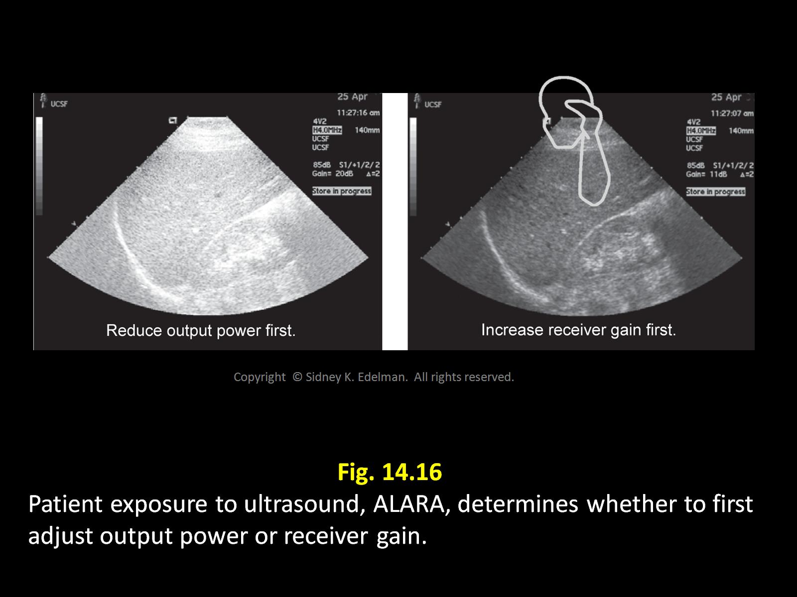

Slide 40
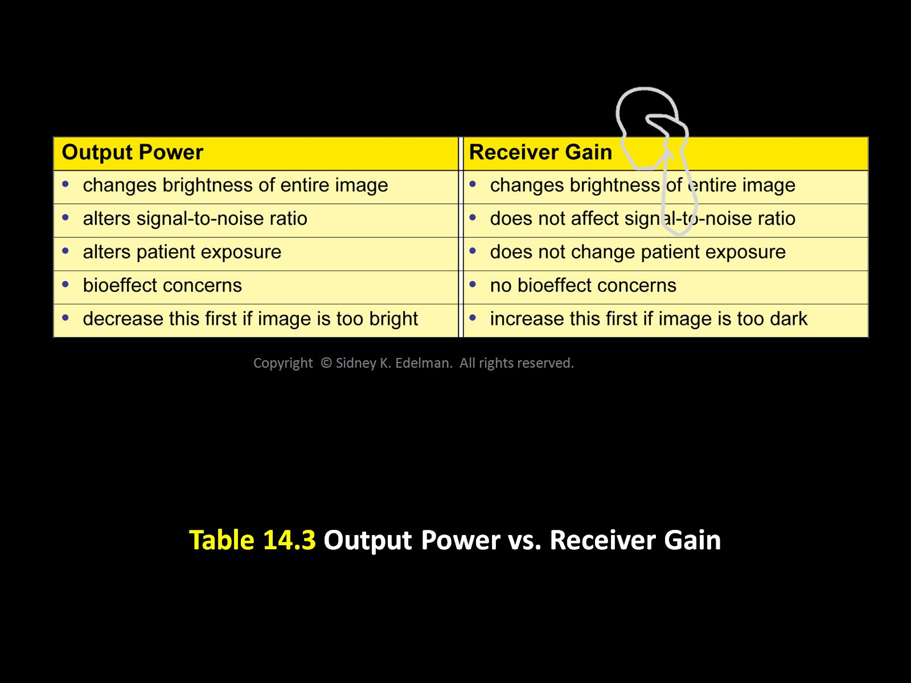

Slide 41
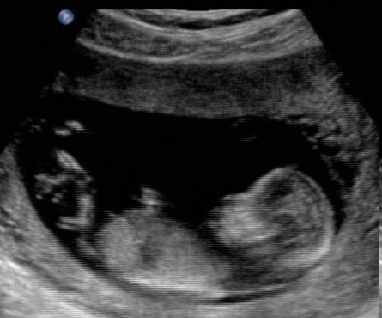
What should you do?

Slide 42
Turn down the power!

Slide 43
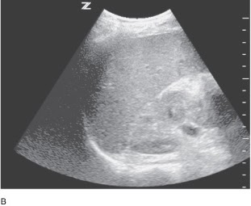
What should you do?

Slide 44
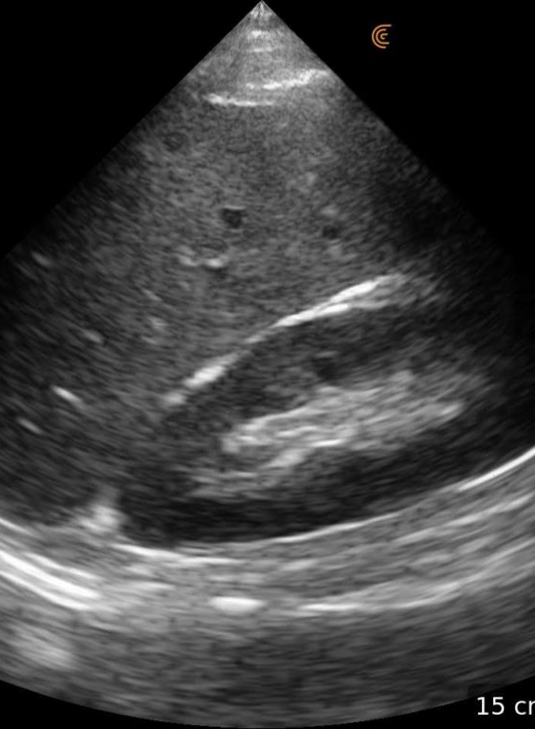
Turn down the gain!

Slide 45
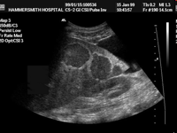
What should you do?

Slide 46
ADJUST THE TGC! (MAKE THE IMAGE UNIFORM BRIGHTNESS FROM TOP TO BOTTOM)

