Slide 1
Chapter 16: Dynamic Range
DMSO 1040

Slide 2
Dynamic Range
Method of describing the extent that a signal can vary but still be accurate
Number of available choices
The ratio of the largest to smallest signal strength that each component processes
Threshold
Saturation
Range of Accuracy

Slide 3
Dynamic Range
Also indicates the number of gray shades.
Units: decibels - a relative measurement
Narrow DR
Bistable
Wide DR
Gray scale
Low contrast

Slide 4
Dynamic Range
Dynamic range or grayscale for a signal decreases the more it is processed.
(just like a copy of a copy of a copy)
Transducer’s dynamic range is greatest of all system components
The Recording device has the lowest dynamic range
Anytime you see a scary looking math problem with the word “volts” it is referring to dynamic range!

Slide 5
Calculating Dynamic Range for Voltages
1. Divide the bigger voltage by the smaller voltage. The result will always be a factor of 10.
2. Count the number of zeroes in the number. Example: 100, 2 zeroes. For each zero present, the dynamic range is 20 dB more

Slide 6
Example #1
A range from 1 volt to 100 volts can be processed accurately by an ultrasound system. What is its dynamic range?
Divide the larger number by the smaller number:
100/1 = 100
Count the zeros in the result
2 zeroes
Each zero represents 20 dB
20 dB + 20 dB= 40 dB
Answer: 40 dB

Slide 7
Example #2
An amplifier increases a voltage from 0.2 to 200 volts. How many decibels of gain is this?
200/0.2= 1000
3 zeroes
20 Db + 20 dB + 20 dB= 60 dB
60 dB!

Slide 8
Compression of DR
Potential errors with system components with varying DR’s
Also human eye DR
Largest signal remains largest
Smallest signal remains smallest
Range of signals is reduced
Sonographer can adjust

Slide 9
Dynamic Range
student | A | B | C | D | F
Jane | 92
Joe |  | 88
Jess |  | 85
Juan |  |  | 75
Jacob |  |  |  | 70
Jill |  |  | 77
Jimmy | 94
If each grade were represented as a shade of gray, all of the A students would be one shade regardless of the differences between the numeric value of their A.
So, what we change with our dynamic range is what counts as an A, B, or C or changing the grading scale!!!!

Slide 10
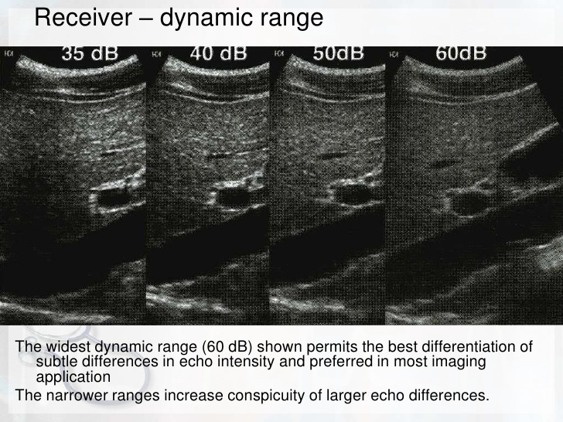

Slide 11
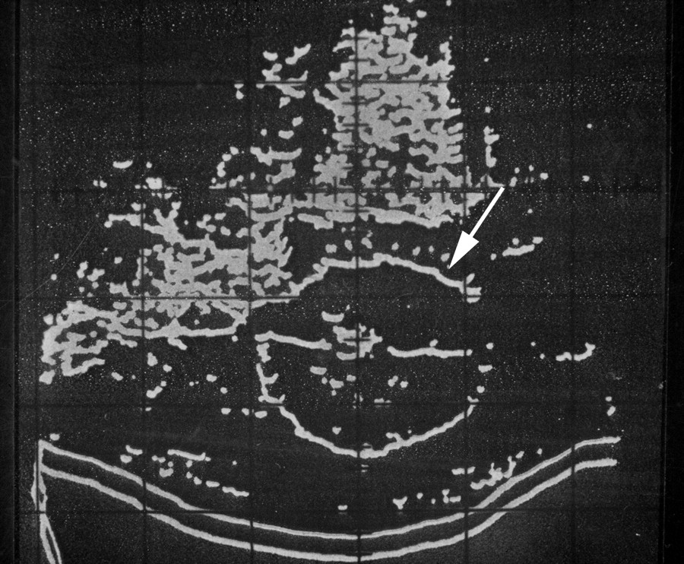
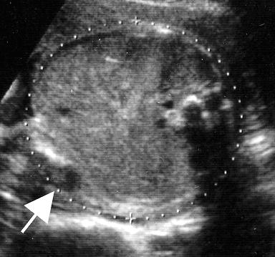
Dynamic Range
Bi-stable
Low DR
High Contrast
Gray scale
High DR
Low Contrast

