Slide 1
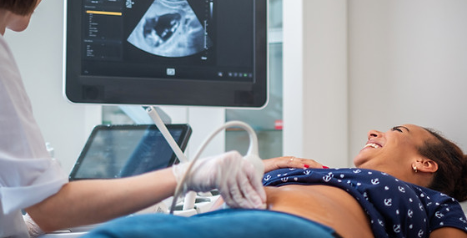
Sonographers in the Clinical Setting
Chapter 23

Slide 2
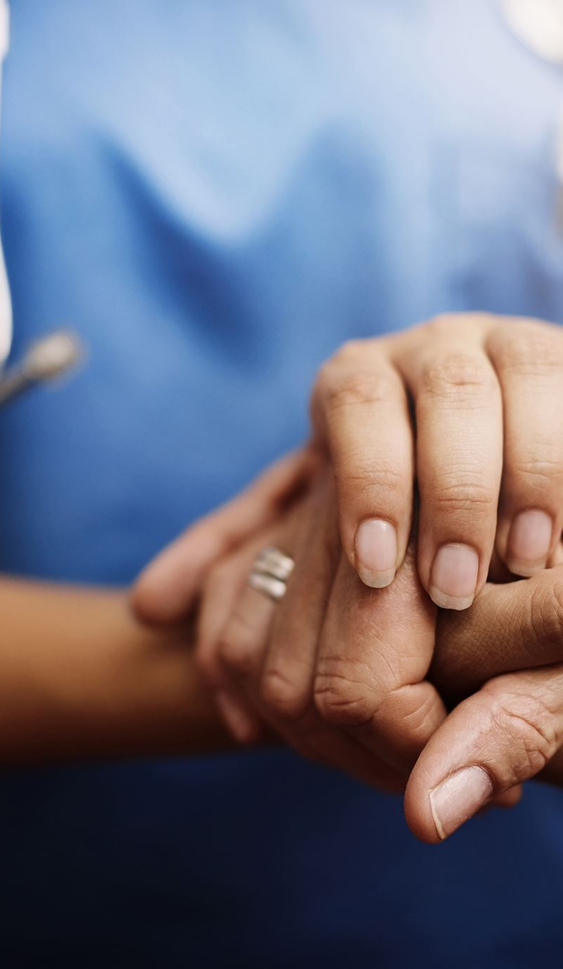
Major Principles of Medical Ethics
Respect for autonomy
The patient has the capacity to act intentionally, with understanding, and with free will.
Informed Consent
Nonmaleficence
Avoid needless harm or injury to the patient.
Beneficence
Actions of the health care providers should benefit the patient.
Justice
Equal treatment regardless of age, gender, educational background, and other factors.

Slide 3
Informed Consent
Patients are educated about the essentials of a medical procedure
Revocation of Consent
A patient may withdraw previously granted consent at any time

Slide 4
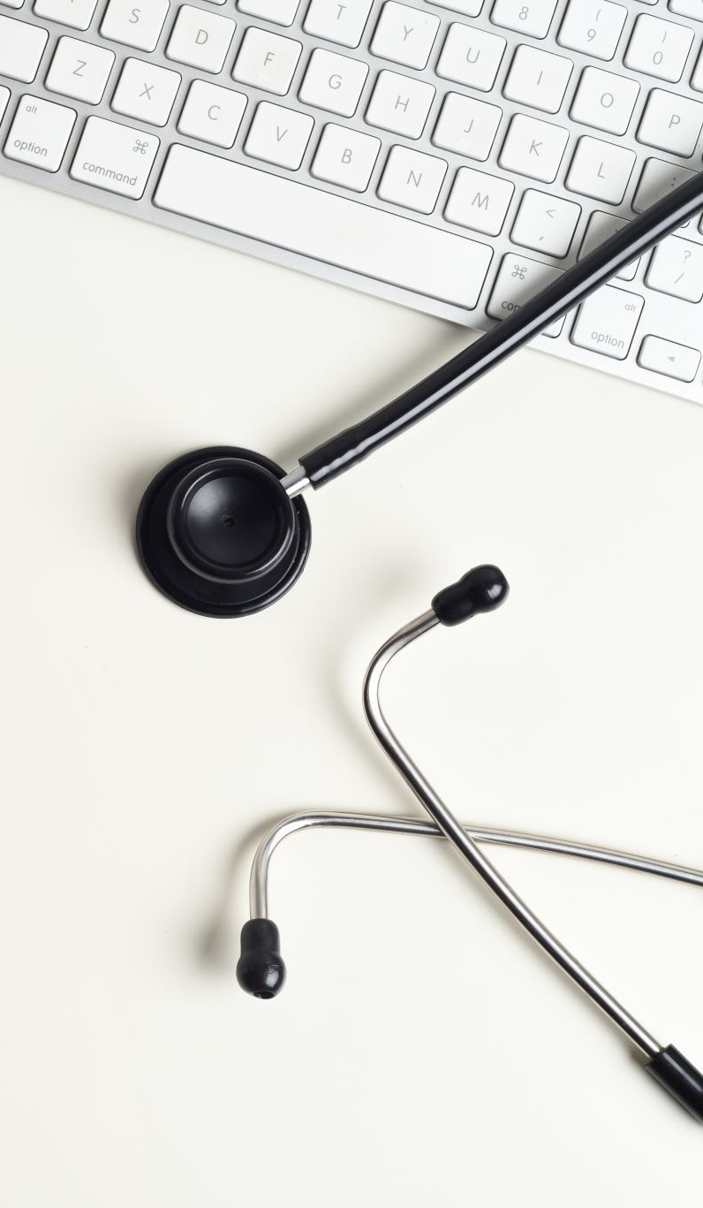
Patient-Sonographer Interaction
Treat the patient respectfully
Identify the patient
Interpretation of the Exam
Must be aware of normal & abnormal findings
Refrain from providing a clinical interpretation to the patient
Patient Dignity
Quality of being worthy, honored or esteemed
Every patient deserves to be treated with dignity
Perception of being in control & having self worth

Slide 5
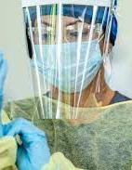
Standard Precautions
Set of guidelines to minimize the exposure and risk of healthcare workers when in contact with the patient
Personal Protective Equipment (PPE)
Occupational Safety and Health Administration (OSHA)
All work should be classified based on potential exposure
SOPs for all activities that have potential exposure
Employers responsible for monitoring workers – documentation of procedures and evaluation of risk criteria

Slide 6
Chapter 24: Bioeffects

Slide 7
Bioeffects
The effects of ultrasound energy upon living tissues
In order to study the effects on living tissues, we must be able to measure the intensity and output of our ultrasound machines

Slide 8
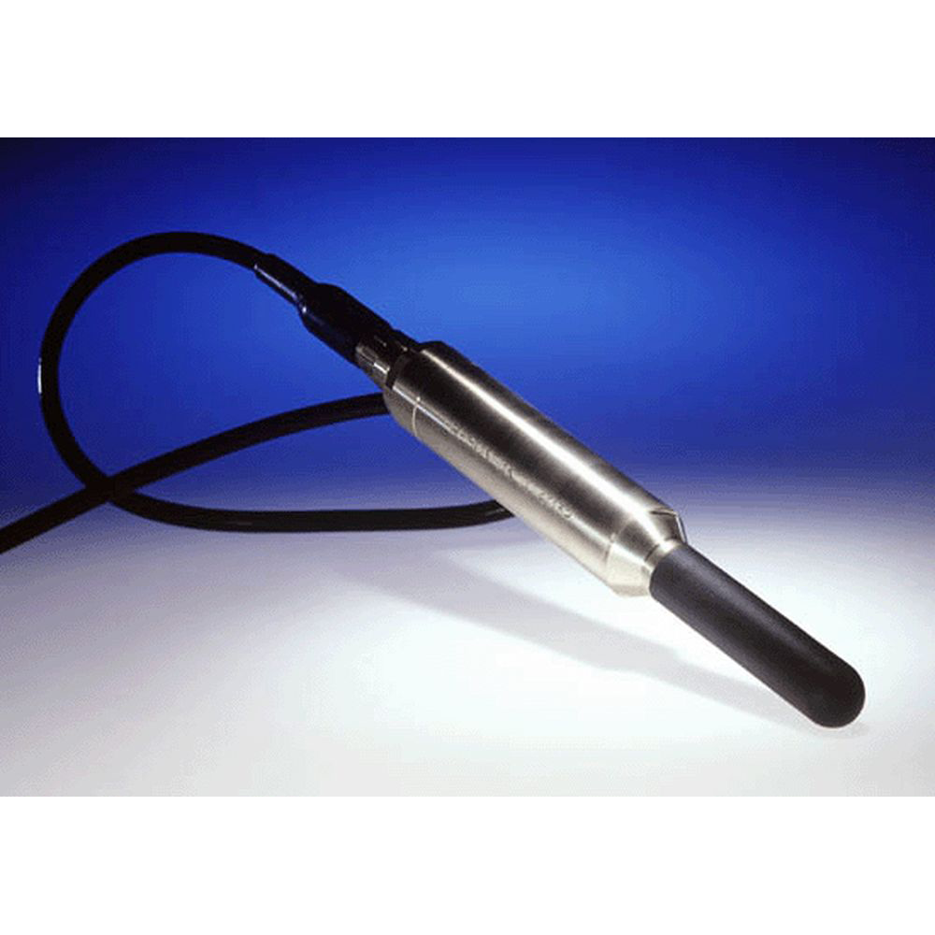
Bioeffects
Measuring the output of ultrasound machines can be done in several ways.
Hydrophone-small needle with a crystal at its end.
Placed in the ultrasound beam.
Attaches to an oscilloscope and displays acoustic signals received by the crystal.
Can quantitate amplitude, period, pulse duration, and pulse repetition period

Slide 9
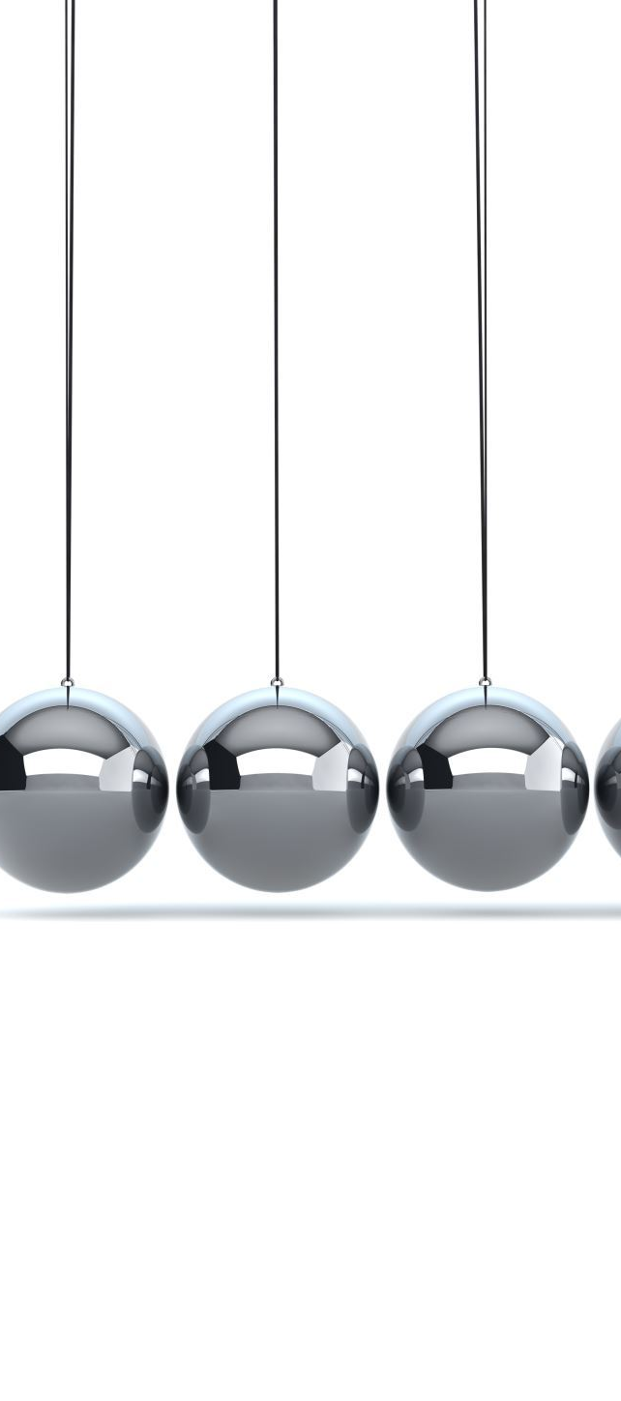
Radiation Force
A sound beam creates a very small force on any object that it strikes.
If the object is a balance or float, we can measure the SATA intensity.
If a small suspended ball is used, we can measure the SPTA intensity.
Essentially when the sound beam is absorbed or reflected, the target can act as a miniature scale.

Slide 10
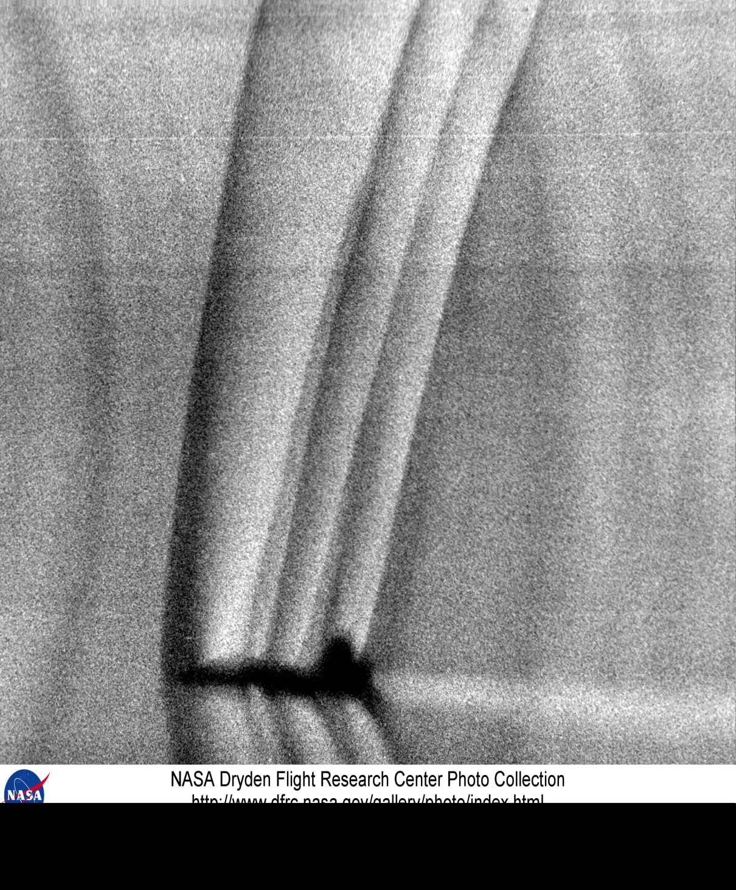
Acousto-Optics
Based on the interaction of two types of soundwaves and light waves.
Quantifies amplitude, period, pulse duration, and pulse repetition period.
A shadowing system called a SCHLIEREN, uses this principle to measure beam profiles

Slide 11
Converting Sound Energy into Heat
Calorimeter – a transducer which turns acoustic energy into heat. When the total heat gain is measured along with the time that it took to obtain the heat, the total power of the US beam can be calculated.
Thermocouple – a small device embedded in an absorbing material. The ultrasound is absorbed, turned into heat, and the thermocouple measures the change in temperature. The US intensity at specific points in space are measured by a thermocouple.
Crystals – cholesteric liquid crystals or starch iodine blue, when struck by different ultrasound intensities, turns different colors. The color of the crystals give us insight into the shape and strength of a beam.

Slide 12
Risk – Benefit Relationship
The first mandate regarding clinical ultrasound is that the benefits must outweigh the risks of the exam.
Extremely high ultrasound intensities can cause damage to biologic tissue.
Low-intensity ultrasound has no known bioeffects at this time.
Under controlled conditions, bioeffects can be beneficial.
Therapeutic ultrasound (heats muscle tissues) or lithotripsy (shock waves to break up kidney stones)

Slide 13
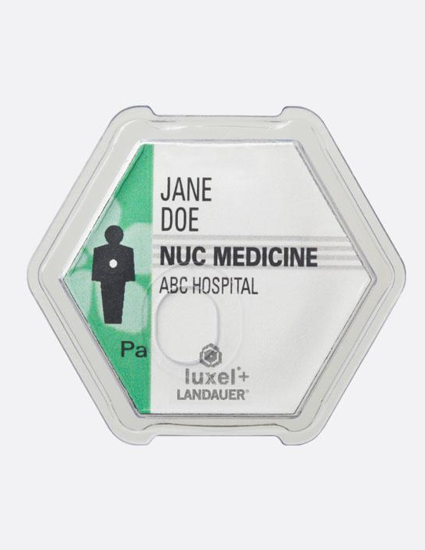
Dosimetry
The science of identifying and measuring those characteristics of an US field which are especially relevant to its potential for producing bioeffects.

Slide 14

In Vivo and In Vitro
Bioeffects studies are conducted in two areas
1) In Vivo – Within the living body
2) In Vitro – Outside the living body
In Vitro studies demonstrate that high intensity ultrasound can cause damage to biologic tissue and cellular death

Slide 15
AIUM – In Vitro Bioeffects
Difficult to study in vivo because of attenuation
According to the official statement by the AIUM, No known causes of Bioeffects or tissue injury in diagnostic imaging at standard intensities
AIUM and FDA’s bioeffects intensity limit (SPTA)
100 mW/cm² unfocused
1 w /cm² or 1000 mW/cm² focused

Slide 16
Bioeffects
Focused vs. unfocused thermal effects
Focused beams are less likely to cause temperature elevation in tissues
Unfocused beams are more likely to cause temperature elevation
This occurs because a narrow beam heats only a small region of tissue and the heat is rapidly transferred and dissipated by surrounding tissues that were not heated by the ultrasound beam.
Intensity limits: AIUM maximum intensity limit is lower for unfocused sound than for focused sound

Slide 17
Bioeffects
Registry question note:
If no information is provided in a question on whether a sound beam is focused or unfocused, chose the lower intensity limit (for unfocused beams) as the lower intensity limit is safe for focused and unfocused beams.

Slide 18
Study Techniques
Two techniques used to study bioeffects:
Mechanistic Approach
Searches for a relationship between cause and effect
Empirical Approach
Searches for a relationship between exposure and response

Slide 19
Study Techniques
Mechanistic approach
Propose a specific physical mechanism that could produce bioeffects
Theoretical analysis to estimate scope of bioeffects and various exposures
Identify cause and effect relationship
Empirical Approach
Acquire or review data from patients or animals
Correlate exposure and effects
Identify exposure-response relationship
STRONGEST CONCLUSIONS ARE MADE WHEN BOTH TECHNIQUES ARE IN AGREEMENT

Slide 20
Mechanisms of Bioeffects : Thermal Mechanism
Proposes that bioeffects result from temperature elevation
As sound propagates through the body energy is converted to heat
Thermal Index (TI) – a calculated number that is used to predict the maximum temperature increase in clinical conditions
Three reported forms of the thermal index are
A) TIS – Soft Tissue
B) TIB - Bone
C) TIC – Cranial Bone

Slide 21
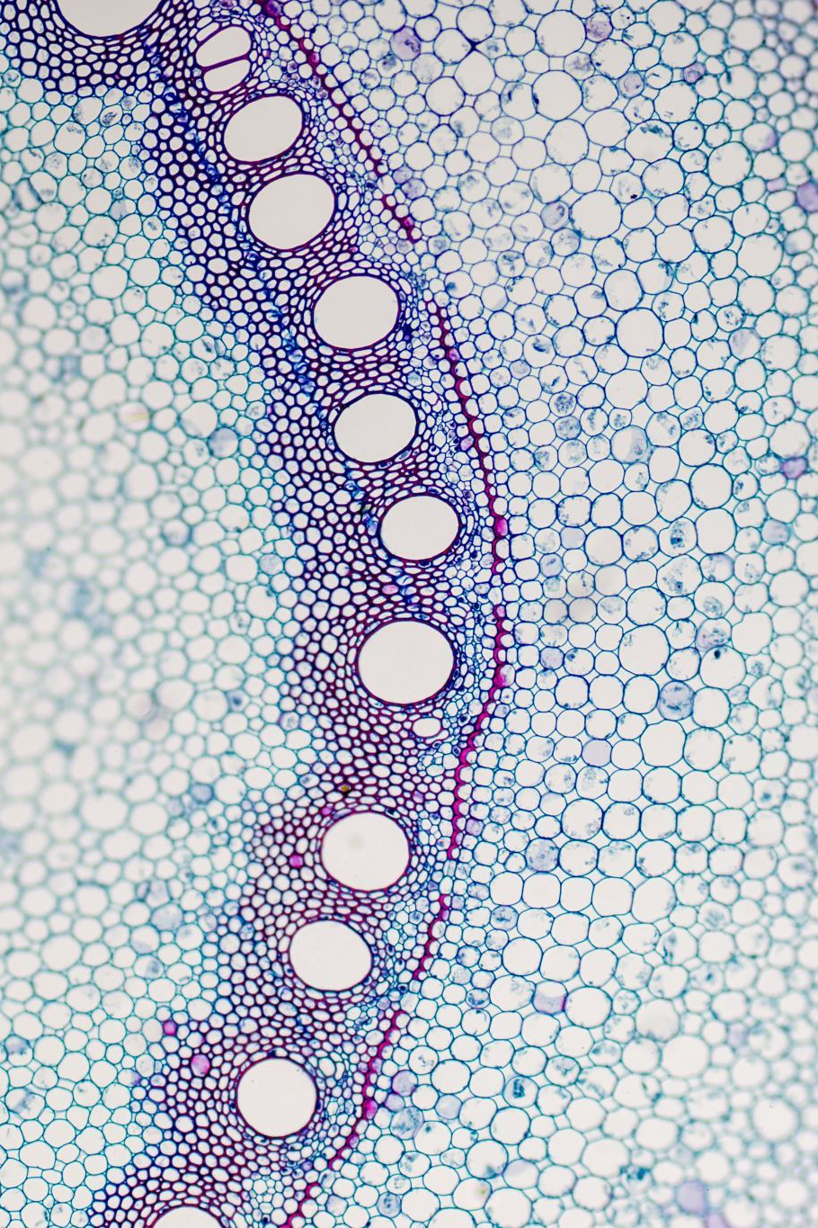
Thermal Mechanism - Empirical Findings
Serious tissue damage occurs from prolonged elevation of body temperature
Tissue heating is related to output characteristics of the transducer
A 2-4 degree rise in testicular temperature causes infertility
Maximal heating is related to the beams SPTA
Fetal tissues are less tolerant of the tissue heating

Slide 22
Thermal Mechanism – Mechanistic Data
Theoretical models appear to correlate with experimental data even though:
The ultrasound beam is quite complex
Diagnostic equipment is diverse
Tissue characteristics are different

Slide 23
Mechanisms of Bioeffects: Nonthermal Mechanism - Cavitation
Cavitation – The interaction of ultrasound and microscopic stabilized gas bubbles in tissue
Two forms of Cavitation
1) Stable – Occurs at lower MI indices, The gaseous nuclei oscillate by do not burst
2) Transient – Occurs at higher MI levels, gaseous nuclei may burst

Slide 24
Stable Cavitation
Bubbles tend to oscillate when exposed to acoustic waves of small amplitude. Bubbles do not burst.
Bubbles that are a few micrometers in diameter double in size.
Effects: shear stresses and microstreaming in surrounding fluid

Slide 25
Transient Cavitation
Bubbles expand and collapse violently.
Bubbles eventually burst!
Depends upon the pressure of the ultrasound pulse.
Threshold only 10% greater than pressure for stable cavitation
Effects are highly localized and violent
Enormous pressures
Colossal temperatures (thousands of degrees)
Under controlled conditions bioeffects are considered beneficial (therapeutic ultrasound)

Slide 26
Mechanical Index
A calculated number related to the likelihood of harmful bioeffects from cavitation
MI is a simple number with no units
Related to two terms:
1) Peak negative pressure
2) Lower frequency

Slide 27
Epidemiology and Statistics
We can study bioeffects with epidemiological studies
Epidemiological studies require large numbers of patients when the occurrence rate of the measured effect is small. (like diagnostic imaging)
Randomized clinical studies require large data sets on each patient to account for other factors which may contribute to the finding.
Using this method, diagnostic US has shown no adverse effects on fetal outcome or birth weight or any other measurement.

Slide 28
Prospective & Randomized Studies
The best study is randomized and prospective
Limitations of epidemiological studies:
often retrospective (looking at past information)
Ambiguities (justification for exam, number of exams)
Other risk factors (maternal age, nutrition, teratogens)
Statistical considerations:
the smaller the effect, the harder it is to detect
requires a large number of patients

Slide 29
AIUM Conclusions
As of March 29, 1995
No confirmed harmful bioeffect from diagnostic ultrasound has ever been reported
It is possible that bioeffects may be reported in the future
The benefit to the patient outweighs the risks
It is appropriate to use diagnostic ultrasound prudently to provide benefit to the patient
It is never appropriate to use diagnostic ultrasound for entertainment

Slide 30
ALARA
As
Low
As
Reasonably
Achievable

Slide 31

Remember:
Benefits should always outweigh risks
Do not perform studies without reason
Minimize exposure time while still performing a complete exam
Always Use minimum output power and highest gain required to create an image

