Slide 1
ECHOCARDIOGRAPHY …From a Sonographer’s Perspective THE NOTEBOOK 8 Chapter VII: Intro to Cardiac Catheterization
Susan King DeWitt, BS, RDCS, RCS

Slide 2
COPYRIGHT INFRINGEMENT IS A SERIOUS CRIME.
Please respect my U.S. Copyright & hard work—do not copy/distribute/edit.
Copyright © 1996, 2002, 2009, 2010, 2011, 2018, 2022. All rights reserved. Library of Congress Catalog Card Numbers: TX0006951179 and TX0008635753.
No part of this publication may be published, shared, edited, voiced over, reproduced, stored in a retrieval system, or transmitted, in any form or by any means, electronic, mechanical, photocopying, recording, or otherwise.
The information in this material is designed to provide education in the field of echocardiography and related topics. It was written, edited, and published by Susan King DeWitt, Author, LLC—a registered cardiac sonographer, not a physician, professional editor, or publishing company. This material does not guarantee a passing grade on the registry exam(s); however, it does discuss most of the test material. References provided do not constitute endorsement of any websites or other sources. Readers should be aware the information and websites listed may change.

Slide 3
ECHO…THE NOTEBOOK 8 & THE WORKBOOK 8
are currently approved by the
Society of Diagnostic Medical Sonography (SDMS)
as a self-instructional activity for
31 CME CREDITS
Please refer to www.echonotebook.com for more details!

Slide 4
VII. INTRO TO CARDIAC CATHETERIZATION
OBJECTIVES
Upon completion of this section, the reader will be able to:
Gain knowledge of the definition, different approaches, indications, and purpose of a cardiac cath.
Provide examples of right and left heart cath interventions, as well as cath treatment modalities.
Recognize the primary coronary arteries.
Compare cath pressure tracings to echo lab findings.
Discuss contraindications and risks associated with cath.

Slide 5
CATH FUNDAMENTALS
DEFINITION & APPROACH catheter →artery or vein in arm/neck/groin designated protocol & equipment needle, guide wire, sheath & stopcocks catheter carefully thread to left or right heart percutaneous femoral artery approach → LEFT HEART femoral vein approach → RIGHT HEART transeptal approach
POP QUIZ!
Name the catheters frequently
used for left & right heart cath.

Slide 6
CATH FUNDAMENTALS
INDICATIONS CAD/IHD LVFX VHD myocardial disease myocardial biopsy verify & support noninvasive data determine the necessity for surgical correction | FLUORO & FILMING fluoroscopy (fluoro) floor pedals cineangiography (cine, 35 mm film) digital (cine-less)
POP QUIZ!
When is myocardial biopsy necessary?

Slide 7
CATH INTERVENTIONS
BENEFITS evaluation & treatment of cardiac disease states & CHD | LEFT HEART LV angiogram (angiography) coronary angiogram angioplasty (PTCA) stenting atherectomy IVUS pressure tracings
RIGHT HEART blood samples (O₂ sat) detect, diagnose & repair shunt calculate CO endomyocardial biopsy pulmonary angiography right heart pressures LAP (PCWP vs transeptal approach)
POP QUIZ!
What is the best cath technique
to evaluate LVFX?
&
How is CO calculated?

Slide 8


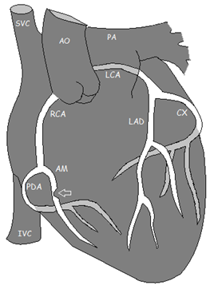


POP QUIZ!
Write out the names
of the coronary arteries
(assume a right dominant system).

Slide 9
POP QUIZ!
Identify the
pressure tracings #1 - 3.

Slide 10
CATH PROCEDURES
PRESSURE GRADIENTS CATH peak-to-peak PG—pressures acquired directly from chambers & peak pressures compared mean transvalvular PG | ECHO Doppler measures velocity, NOT pressure pressure & velocity are related we use velocity acquired via CWD to calculate the PG modified Bernoulli equation [P₁ - P₂ = PG = 4(V)²] max PG—peak instantaneous PG between two chambers at same time mean PG—average PG derived from all velocities within flow between two chambers

Slide 11
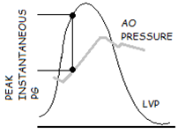
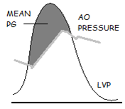
CATH PROCEDURES
PRESSURE GRADIENTS (continued)
POP QUIZ!
Which PG provides the best correlation between echo & cath?

Slide 12
CATH PROCEDURES
CATH & THE STENOTIC VALVE cath pressure tracings are acquired from the chambers proximal & distal to the stenotic valve peak pressures are compared → peak-to-peak gradient more severe the stenosis → greater the PG across valve additional cath data available… some cases → valvuloplasty
POP QUIZ!
What happens to the chambers
proximal & distal to the stenotic valve?

Slide 13
CATH PROCEDURES
CATH & THE REGURGITANT VALVE presence, severity & etiology of regurgitant valve aortography or ventriculography cath pressure tracings acquired from the chambers proximal & distal to the regurgitant valve volume overload pattern can lead to pressure overload pattern additional cath data available… | QA requirement in accredited lab interesting to compare easy to acquire TTE, SE, TEE, cath, angiography, nuclear studies & surgical pathology
POP QUIZ!
What happens to the chambers
proximal & distal to the regurgitant valve?

Slide 14
WHO AM I?
CATH | NORMAL | ECHO CWD peak velocity, mean & max PG
AORTIC STENOSIS (AS)
POP QUIZ!
1) What is the scale on the graph?
2) What pressure tracings are on the diagram?
3) What valve lies between those two chambers?
4) What is the difference between the two tracings & how do they compare to the normal tracing?

Slide 15
WHO AM I?
CATH | NORMAL | ECHO CWD peak velocity, P½t, MVA & mean PG
POP QUIZ!
1) What is the scale on the graph?
2) What pressure tracings are on the diagram?
3) What valve lies between those two chambers?
4) What is the difference between the two tracings & how do they compare to the normal tracing?

Slide 16
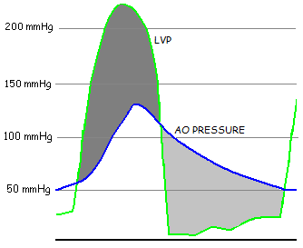
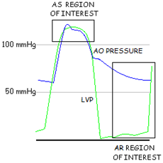
AS & AR
CATH | NORMAL | ECHO CWD AR peak velocity & P½t AS peak velocity, mean & max PG
NOTES
decrease in AO EDP & increase in LVEDP = AR
severe, acute AR presents with equalization of diastolic pressures
systolic LVP is elevated & > systolic AO pressure = AS

Slide 17
MR
CATH | NORMAL | ECHO CWD—peak waveform (even mild or moderate MR has high peak velocity)
NOTES
elevated v-wave in LAP tracing = MR
acute MR → LA has no time to compensate → LAP increases
chronic MR → LAE → beneficial & well tolerated & LAP not driven up

Slide 18
CATH CONTRAINDICATIONS & RISKS
CONTRAINDICATIONS active GI bleed acute renal failure acute stroke allergy to radiographic contrast severe anemia severe HTN ventricular arrhythmia special precautions… | RISKS more bleeding than expected at entry site infection injury to nerve/blood vessel arrhythmia tamponade hypotension reaction to contrast kidney damage/failure from contrast stroke MI death
POP QUIZ!
Are infection, MI & death common cath complications?

