Slide 1
Evaluation of M-Mode
How it works and its importance
Diseases that are diagnosed through its use

Slide 2
What is M-Mode
A time motion display of the ultrasound wave along a chosen ultrasound line.
The first application of Echo utilized
M in M-Mode stands for “Motion”
Referred to as an “ice pick” view because the cursor is passing through the structures of the heart

Slide 3
M-Mode
It is used in combination with 2-D and can be used with color Doppler
Obtained from PLAX, PSAX and AP-4 when assessing the RH or PE
It produces a 1-D image of precise structures within the heart
Sonographer determines the exact location of the M-Mode cursor, and the structures will be displayed in the M-Mode graph
The M-Mode cursor is superimposed on a 2-D image and appears as a dotted line with 1 cm intervals between each ‘dot”.

Slide 4
M-Mode
When the m-line (cursor) is placed through a particular section of the heart, a single plane recording of that area is obtained
M-Mode is helpful since it records movement and depth of structures
It samples at a rate of 1800 frames per second rather than the 30 or so that is used with 2-D imaging (this allows for acquisition of cardiac movements too fast for the human eye to detect otherwise)

Slide 5
M-Mode Graph
Y-axis represents “depth”
X-axis represents “time”
The tracings are placed on a calibrated grid, which allows for timing of cardiac events and measurement of structures

Slide 6
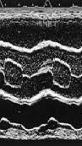
M-Mode @ Ao Valve Level
The m-line is placed through the aorta at the valve level, the RVOT, aortic root, ao valve and the LA are displayed
In systole the valve forms a box-like structure and in diastole it appears as a long, thin line that should be seen in the middle of the root
Premature closure of the aortic valve tracing would appear as a small triangular shape and could suggest possible sub-valvular obstruction
The LA is located posterior to the aortic root and is normally the same size or slightly larger than the ao root

Slide 7
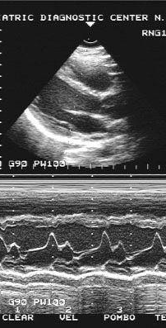
M-Mode @ MV Level
The m-line is moved to the tips of the MV leaflets, and the motion is obtained
The IVS is anterior to the AMVL while the PW lies posterior to the PMVL
RV is visualized anterior to the IVS
The tracing has an “M” configuration which corresponds with the 2 phases of diastole (early/rapid filling and late filling from atrial systole)
Both leaflets should form a “line” when the valve is closed (during systole)

Slide 8
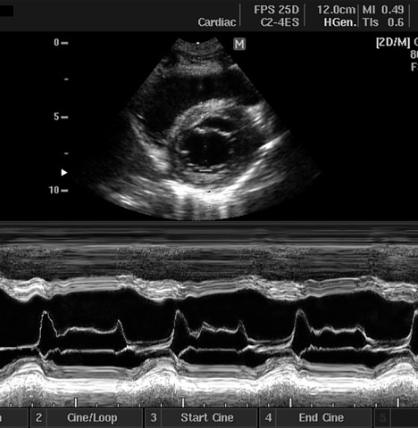
M-Mode @ MV Level
The normal posterior leaflet forms a mirror image to the anterior leaflet
Contains A,C,D,E,F Points
MS (mitral stenosis) and AI (aortic insufficiency) can restrict motion of the AMVL causing an exaggerated EPSS
“B-Bump” or “Notch on AC shoulder” is an indication of elevated LV diastolic pressure

Slide 9
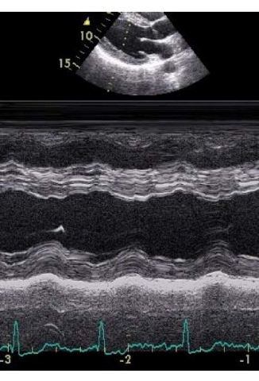
M-Mode @ LV Level
M-line is placed just passed the MVL
RVFW, RV, IVS, LV, Chordae (sometimes), PW (also called the infero-lateral wall) and the Pericardium are viewed
The structures’ size, motion and thickness are evaluated
M-Mode makes it easy to identify Paradoxical motion of the septum due to right heart elevated pressures
Measurements can be taken to obtain the EF (only if wall segments are contracting equally)

Slide 10
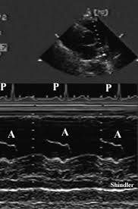
M-Mode of the PV
Rarely done anymore, M-Mode of the PV would be obtained in the SAX view
Usually only able to view one leaflet
A Wave is increased to >7mm in Pulmonic Stenosis
A Wave is decreased to <2mm in Pulmonary Hypertension (Flying “W”)

Slide 11
Pulmonic Valve

Slide 12

Diastole and the Mitral Valve

Slide 13
M-mode at the Mitral Valve
The mitral valve has 2 leaflets – anterior and posterior.
Specific letters corresponding to systole and diastole are assigned to the m-mode tracing of the mitral valve.

Slide 14
EKG Tracing
QRS complex
T-wave
P wave
Systole
Diastole

Slide 15
M-mode at Mitral Valve
Distance
Time
Diastole
Systole

Slide 16
M-mode at the Mitral Valve
Phase of Cardiac Cycle | Assigned Letters
Diastole | d,e,f, and a
Systole | c

Slide 17
M-mode at Mitral Valve
d
D=Diastole/opening
E=Early filling
E-F=decrease in pressure gradient
F=onset of Diastasis
A=Atrial contraction
C=Closure of valve
e
a
Distance
f
d
c
Systole
Diastole
Time

Slide 18
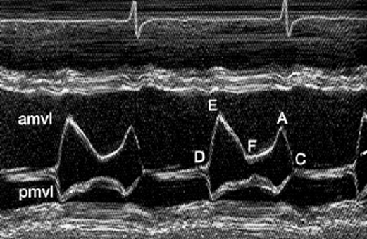
Diastasis
Diastasis is a period of zero-motion (static) condition over a finite time interval where left ventricular (LV) wall mechanics and trans mitral flow are both absent. Equal Pressures.

Slide 20
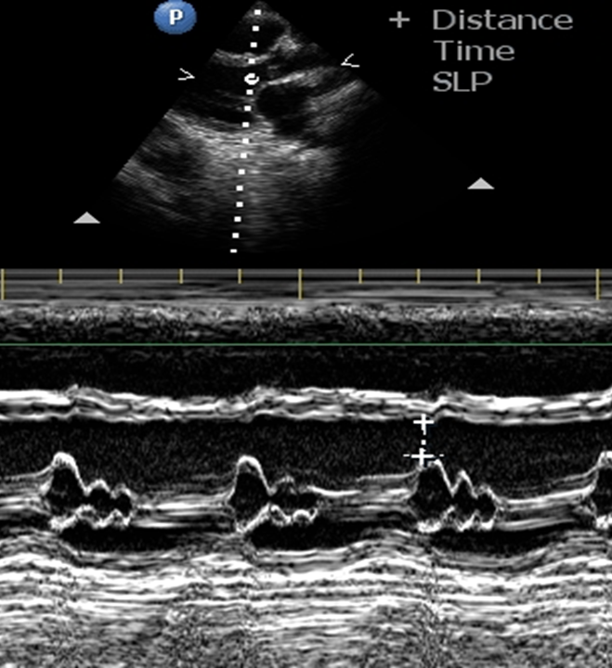
EPSS (E point to Septal Separation)
An increase in EPSS may indicate LV dilation or systolic dysfunction). EPSS >2cm (20mm) suggests <30% EF​

Slide 21
M-mode Findings at the MV
B- bump on the AC shoulder
Premature Closure of the MV
Systolic anterior motion of the AMVL
Mitral Valve Prolapse
Aortic Regurgitation

Slide 22
M-mode Findings at the MV
Flail PMVL
Fluttering of the AMVL
Mitral Stenosis
LA myxoma
Vegetations

Slide 23
M-Mode B Bump on AC Shoulder
Delayed closure of mitral leaflets between the A and C (leaflet coaptation) points, determining a "notch" known as B-bump. Indicates increased left ventricular end-diastolic pressure

Slide 24
M-mode at Mitral Valve
B-bump on the
AC shoulder.
Distance
Time
Diastole
Systole

Slide 25
M-mode at Mitral Valve
Premature Closure
Premature Closure- closure
on or before the onset of the
QRS complex.
Distance
Time
Diastole
Systole

Slide 26
M-mode at Mitral Valve
Systolic anterior motion
of the AMVL
Distance
Time
Diastole
Systole

Slide 27
M-mode at Mitral Valve
MV prolapse
posterior leaflet
Distance
Time
Diastole
Systole

Slide 28
M-mode at Mitral Valve
MV Prolapse –
both leaflet
Distance
Time
Diastole
Systole

Slide 29
M-mode at Mitral Valve
Distance
Flail posterior leaflet
Time
Diastole
Systole

Slide 30
M-mode at Mitral Valve
Distance
Aortic Regurgitation
Time
Diastole
Systole

Slide 31
M-mode at Mitral Valve
Mitral Stenosis
Sinus Rhythm
Distance
Time
Diastole
Systole

Slide 32
M-mode at Mitral Valve
Mitral Stenosis
Distance
Atrial Fibrillation
Time
Diastole
Systole

Slide 33
M-mode at Mitral Valve
Distance
Atrial Myxoma
Time
Diastole
Systole

Slide 34
M-mode at Mitral Valve
Distance
Vegetation
Time
Diastole
Systole

