Slide 1
Venous Return, Stroke Volume and Cardiac Output
Week 13

Slide 2
Cardiac Output
The volume of blood pumped by the right and left ventricles of the heart in one minute.
Equals heart rate multiplied by stroke volume CO = SV X HR
Average resting adult (CO) is about 4-8 L/min.

Slide 3
Stroke Volume is…
The amount of blood pumped by the ventricle in one beat and correlates with:
Preload-The greater the EDV, the greater the amount pumped (SV). According to the Frank Starling Law, the more blood that fills into the ventricle, the more blood will be pumped!
Contractility of cardiac muscle (increased force of contraction) - the harder the heart pumps, the greater the stroke volume and less the ESV
Afterload-the pressure in the ventricle leaving the heart.
.

Slide 4
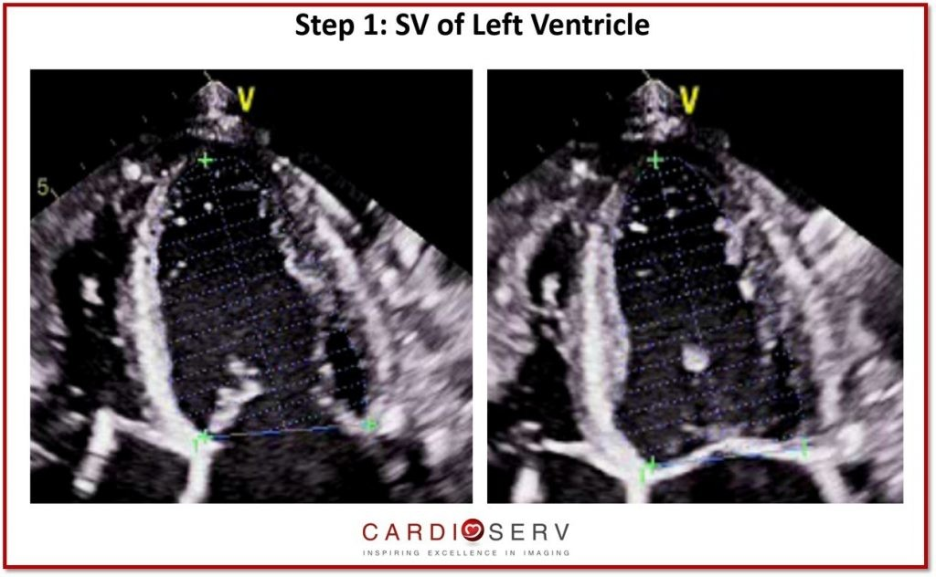
Stroke Volume
Stroke volume can be calculated using measurements of the ventricle volumes from an echocardiogram.
Its' value is obtained by subtracting end-systolic volume from end-diastolic volume for the left ventricle.
SV=EDV-ESV

Slide 5
Venous Return
Venous return (VR) is the flow of blood back to the heart.
Under normal conditions (VR) must equal cardiac output (CO) when averaged over time, this is due to the closed loop nature of the cardiovascular system. If not, blood would accumulate in either the systemic or pulmonary circulations.
More on (CO) to come.

Slide 6
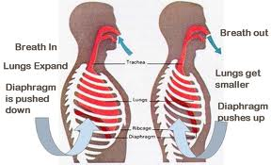
Venous Return: Inspiration and Expiration

Slide 7
Respiration and venous return
The venous system is low pressure
Muscles responsible for respiration alter pressures in the thorax and the abdomen

Slide 8
Breathing and venous return
Breathing affects 2 venous flows:
Venous flow in the legs
Venous return to the heart, which comprises venous flow from the head, arms, and flow from the inferior vena cava

Slide 9
INSPIRATION AND EXPIRATION
INSPIRATION
EXPIRATION
Diaphragm moves upward into the thorax
Thoracic pressure increases
Abdominal pressure decreases
Venous return to the heart decreases
Venous flow in legs increases
Diaphragm moves downward toward the abdomen
Thoracic pressure decreases
Abdominal pressure increases
Venous return to the heart increases
Venous flow in legs decrease

Slide 10
Venous Return: Inspiration and Expiration
Venous flow in the legs correlates with movement of the diaphragm.
Downward movement of the diaphragm (inspiration) decreases venous flow in the legs (downward – decreases)
Upward movement of the diaphragm (expiration) increases venous flow in the legs (upward-increases)
When venous flow in the leg decreases, venous return to the heart increases
When venous flow in the leg increases, venous return to the heart decreases.

Slide 11
Stroke Volume -Inspiration and Expiration
When a person breaths in, the lungs expand which results in:
More blood being pumped to the heart
Increase in venous return
Increase in stroke volume
Expiration has the opposite affect

Slide 12
Cardiac output –Inspiration and Expiration
Since CO = SV X HR we can determine the results….
If CO goes up, SV and HR respond inversely
If SV goes up, HR goes down and CO goes up
If HR goes up, CO goes up and SV goes down
Correlates with the Frank Starling Law-
The more blood that fills into the ventricle, the more blood will be pumped!

Slide 13
Origin of the Valsalva Maneuver
Antonia Maria Valsalva, was a 17th century Italian anatomist. His research focused primarily on the anatomy of the inner ear.
He discovered the aortic sinus and Valsalva maneuver which is used to test the circulatory system.

Slide 14
Valsalva Maneuver
Valsalva maneuver is a forced exhalation against closed airway.
By attempting to forcibly exhale while closing your mouth and nose. It is similar to having a bowel movement or bearing down, as in childbirth.

Slide 15
Purpose of Valsalva Maneuver
It is used with patients that have questionable heart abnormalities. Often combined with echocardiography.
The maneuver is based on specific changes that occur in BP, HR, and venous return (blood returning to the heart).

Slide 16
Purpose of Valsalva Maneuver
In a cardiac setting , doctors will monitor an ECG and listen to your heart with stethoscope, during and after the maneuver.
It’s used to treat or correct abnormal heart rhythms or relieve chest pain.

Slide 17
Physiological Responses
Four phases :
Initial pressure rise
Reduced venous return and compensation
Pressure release
Return of cardiac output.

Slide 18
Phase I Initial pressure rise
At the beginning of the movement, pressure in the chest cavity increases due to the pushing of air.
This forces blood out of the pulmonary circulation into the left atrium.
As this occurs it causes a mild rise in SV.

Slide 19
Phase II reduced venous return & compensation
Return of systemic blood to the heart (venous return) is impeded by the pressure inside the chest cavity.
The output of the heart is reduced and SV decreases.
The decrease in SV causes blood vessels to constrict with some rise in pressure, (15 to 20 seconds). But CO and blood flow to the body remains low.
During this time the HR increases causing compensatory tachycardia.

Slide 20
Phase II (CONT'D)
Phase II can be used to distinguish fixed left ventricular outflow obstruction (aortic stenosis) from dynamic obstruction.
During phase II the murmurs of hypertrophic obstructive cardiomyopathy (HOCM) and mitral valve prolapsed (MVP) may increase as a result of the decreased stroke volume.

Slide 21
Phase III pressure release
As breath is released, this allows the pulmonary vessels and the aorta to re-expand causing a slight fall in SV (20 to 23 seconds) due to decreased left ventricular return and increased aortic volume.
Venous blood can once more enter the chest and the heart, CO begins to increase.

Slide 22
Phase IV return of cardiac output
Blood return to the heart is increased by the effect of entry of blood which had been dammed back, causing a rapid increase in CO (24 seconds on).
The SV usually rises above normal before returning to a normal level.
With return of blood pressure, the HR returns to a normal baseline.

Slide 23
PHASE IV (CONT'D)
Phase IV auscultation is useful in diagnosing left-sided from right-sided murmurs.
Right-sided murmurs (such as pulmonic stenosis) that decrease in intensity during phase II will return to baseline intensity after Valsalva release.
Left-sided murmurs (such as aortic stenosis) require more cardiac cycles to return to baseline.

Slide 24
HOW DOES STANDING, SQUATTING AND THE DRUG AMYL NITRITE AFFECT SV, VR AND CO?

Slide 25
CO and VR while Standing vs. Squatting
Gravitational forces can greatly affect venous return, cardiac output, and blood pressure.
A person who is squatting down and suddenly stands up has gravity act on their vascular volume, so blood accumulates in their lower extremities. This shifts blood volume away from the heart leading to a decline in stroke volume, and thus a decline in cardiac output.
When the cardiac output and arterial blood pressure fall appreciably upon standing from a squat or lying, it’s called orthostatic hypotension.
This can reduce cerebral blood flow to the point of fainting.

Slide 26
Orthostatic Hypotension defined
Orthostatic hypotension is a physical finding defined by the American Autonomic Society as a systolic blood pressure decrease of at least 20mmHg or a diastolic blood pressure decrease of at least 10mmHg within three minutes of standing.
In healthy people, muscle contraction increases venous return of blood to the heart through one-way valves that prevent blood from pooling in dependent parts of the body.
When this mechanism is faulty orthostatic hypotension may occur.

Slide 27
Standing and Squatting Cardiac Physiology
When a person stands up from a squat or lying down, their baroreceptors activate to restore arterial pressure. This helps to ensure that the pressure drop is not more than a few mmHg.
In order to maintain this normal blood pressure, the now standing person must have increased systemic vascular resistance, decreased venous return, decreased stroke volume, increased heart rate, and thus increased cardiac output.

Slide 28
Amyl Nitrite, What is it?
Amyl Nitrite is a potent vasodilator that functions as a source of nitric oxide which signals for relaxation of the involuntary muscles.
It causes an increase in venous return
Decreases peripheral resistance

Slide 29
Amyl Nitrite, What is it used for?
Used in the detection of heart murmurs in conjunction with a squatting vs. standing maneuver. (4TH Heart Sound)
Used to help diagnose Hypertrophic Obstructive Cardiomyopathy.
Used to treat Angina.
Used with Doppler Echo during inhalation.

Slide 30
Amyl Nitrite, Controlled Substance
Has been used as a recreational drug.
Often combined with other drugs like cocaine.
Amyl Nitrite is kept in the echo lab (not all labs), so make sure it is accounted for.

Slide 31
Maneuvers affecting Venous Return
Venous return is decreased from squatting-to-standing.
Venous return is increased from standing-to-squatting.
Some people lack the proper function of the compensatory mechanisms in their baroreceptors, they may suffer from Orthostatic hypotension or edema of the feet.

Slide 32
Are you smarter than a cardiovascular student????
1. Normally, what happens to venous flow in the legs during inspiration?
Increases
Decreases
No changes
2. All of the following occur during expiration EXCEPT:
Venous return to the heart decreases
Venous flow in the legs increases
Abdominal pressure increases
Diaphragm rises into the thoracic cavity
3. During expiration which of the following does NOT occur:
Venous flow in legs decreases
Venous return to the heart decreases
Abdominal pressure decreases
Diaphragm moves upward into thorax

Slide 33
Are you smarter than a cardiovascular student?
In what phase of Valsalva maneuver does compensatory tachycardia happen?
What is the definition of Cardiac output?
What is Valsalva maneuver combined with in a cardiac setting?
What type of abnormality can be detected by the Valsalva maneuver?
If you are lying down and you jump out of bed, does your blood pressure go up or down? What about heart rate?
True/False- Venous return decreases from the squatting to standing position?
True/False-Amyl Nitrite acts as a potent vasoconstrictor that increases blood pressure?

Slide 34
Pressures in the heart velocities in the heart bernoulli's equation
Notes:
Our presentation discusses the pressures and velocities in the heart that enable the pumping of blood and Bernoulli’s equation and how it’s used.

Slide 35
Pressures
Valves open & close w/ the pressure gradient.
Fluid moves from high to low pressure.
What causes the pressure/energy gradient?
Notes:
We know that valves open and close with the pressure gradient; and actually Edelman says in Understanding Ultrasound Physics, if we think about the conservation of energy, which is what Bernoulli’s equation is based on, we should really call it the energy gradient because pressure is just one form of the energy that blood takes on in our bodies; the other forms are kinetic and gravitational.
So, what causes the pressure or energy gradient? The change in pressure from one place to another. Example, when Kinetic energy is high, the pressure is low. When kinetic energy is low, pressure is high. Pressure energy is converted into kinetic energy as blood accelerates.

Slide 36
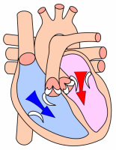
Pressures in Diastole
When atrial pressure > ventricular pressure, AV valves open
AV valves open & close due to blood volume & pressure.
Atrial kick responsible for last amount of blood to ventricles.
Notes:
Since blood follows the energy gradient, when atrial pressure exceeds ventricular pressure, the AV valves open.
During isovolumic relaxation, the pressure in the ventricles drops in preparation for diastole while the pressure in the atria is rising due to the influx of blood, which causes gravitational energy. When the gravitational energy from the volume of blood exceeds the low pressure in the ventricles, the AV valves open and the ventricles are filled.
The contraction in the atria doesn’t come until the end of diastole, the atrial kick is responsible for the last 15 or so percent of blood filling the ventricles during diastole.

Slide 37
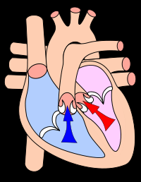
Pressures in Systole
When ventricular pressure > aortic/pulmonic pressure, semi-lunar valves open
Aortic & pulmonic valves open from the pressure of contraction
Aortic & pulmonic valves close from back pressure caused by the recoil of the artery
Notes:
In the same way, when ventricular pressure exceeds aortic and pulmonary artery pressure, the semi-lunar valves open.
But this pressure is different from the primary pressure in the atria, because it comes from contraction. Once the AV valves have closed, obviously there’s no more volume being added to the ventricles; however, isovolumic contraction begins and, although the volume remains constant, the pressure increases from the ventricles squeezing and causing the fluid to rise. Soon the pressure in the ventricles will exceed the pressure in the pulmonary artery and the aorta, and the semi-lunar valves will be forced open.
When the blood is being ejected, the arteries dilate, and then once the ejection has completed and pressure drops in the ventricles, the arteries recoil in order to propel the blood, and this causes some blood to try to backflow. That attempted backflow is what causes the semi-lunar valves to close.

Slide 38
Pressure Gradient
The force that propels blood through the heart or vessels
That force is the difference in blood pressure across the valve or across a vessel length
Can be viewed as the force driving flow (F),
F = ∆P/R
Or can be viewed as a pressure drop
∆P = F x R

Slide 39
Pressure Gradient
Pressure Gradient increases when either:
Flow increases, or
Resistance increases
Flow increases when either:
Pressure gradient increases, or
Resistance decreases

Slide 40
Velocity
Defined by speed and direction
Answers the question: “how fast?”
Measured in distance over time. ( cm/s)
Direction and speed at which something travels.

Slide 41
How velocity is measured?
Doppler echocardiography - is a method for detecting the velocity of moving blood
within the heart.
Notes:
Flow in most of the cardiovascular system, including the heart and great vessels, is normally laminar and rarely exceeds the maximum velocity
of 1.5 m/sec.

Slide 42
Velocity
High
Clots
Turbulence
Low
Deoxygenation

Slide 43
How does pressure affect the velocity of blood through the heart?
If the pressure is then the velocity will be .
If the pressure is then the velocity will be .
Notes:
Now Kim will talk about Bernoulli’s equation and how it relates to pressures and velocities in the heart.

Slide 44
Demonstration of Velocity
Bernoulli’s Principal and Equation

Slide 45
Bernoulli’s Principal
States that as the speed of a moving fluid increases, the pressure within the fluid decreases.
When the speed of the moving fluid decreases, the pressure would increase.
So, the speed and pressure have an inverse relationship…as one goes up, the other goes down.

Slide 46
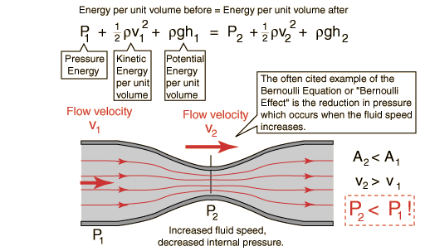
Bernoulli’s Equation
Notes:
Here’s an example: the speed at P1 (before a stenosis) is less than the speed at P2 (at the location of the stenosis); however, the pressure at P1 is greater that the pressure at P2 because the speed of blood increased in the stenosis.
Note in the original formula that energy of location 1, in the 1st part of the equation, equals the energy of location 2 in the second part of the equation.

Slide 47
Bernoulli’s Equation (cont'd)
Bernoulli’s equation is used to find the Peak Pressure Gradient between chambers or in vessels with stenosis.
Spectral Doppler would be used to find the velocity of blood flow.

Slide 48
Bernoulli’s Equation Simplified
4(v)²
Notes:
Fortunately for us, Bernoulli’s equation has been simplified for use with Doppler echocardiography.
Ask class to use 4V2 for Tricuspid regurgitation. Patient has a peak of 4 m/s. 4(4squared)= 4(16)=64m/s. Then add 10MMhg for RAP. 74Mmhg, patient has severe Pulmonary Hypertension!
The velocity would be plugged into the formula 4(v)² If the pressure is outside of normal range, either high or low, that would indicate some sort of disease.

