Slide 1


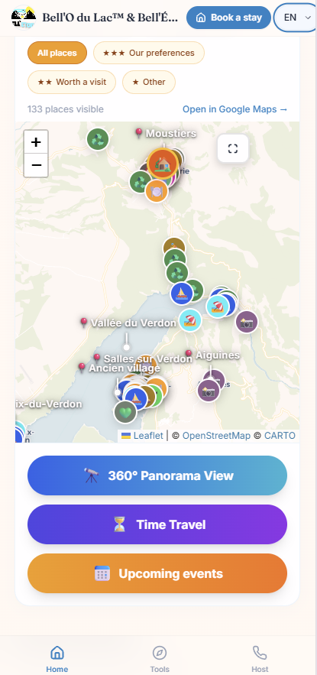
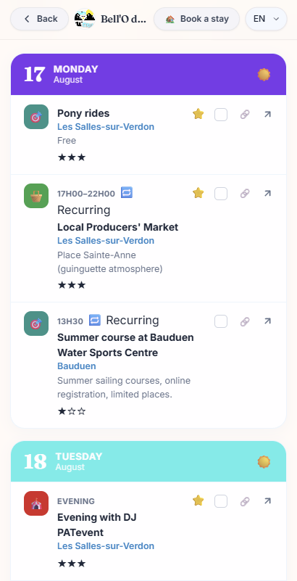
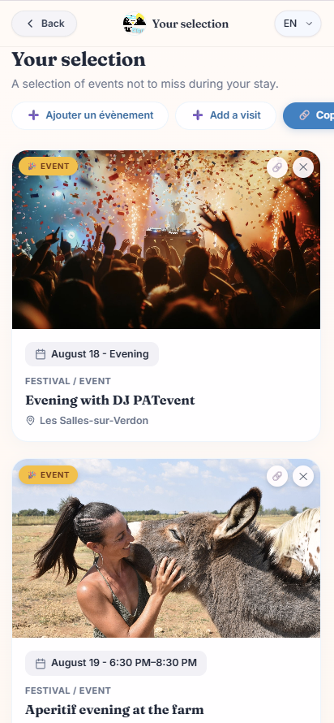
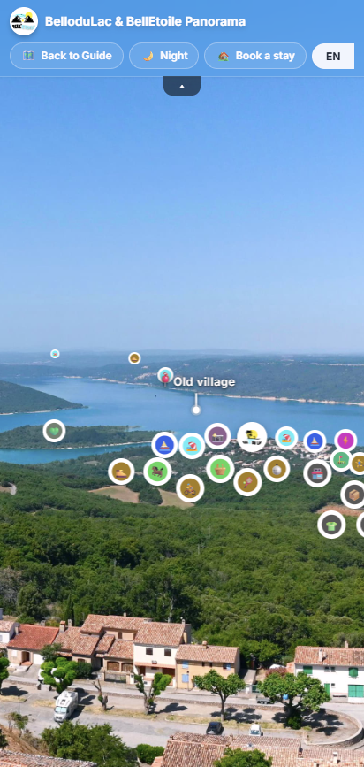
PREPARE YOUR ACTIVITIES
https://bellodulac.vercel.app
SCAN THE QR CODE TO GET STARTED!
Discover more 130 locations to visit around the lake!
See the list of events planned during your stay
A selection tailor-made activities for you!
And much more to discover…

