Slide 1


Slide 2

Ecosistema

Slide 3
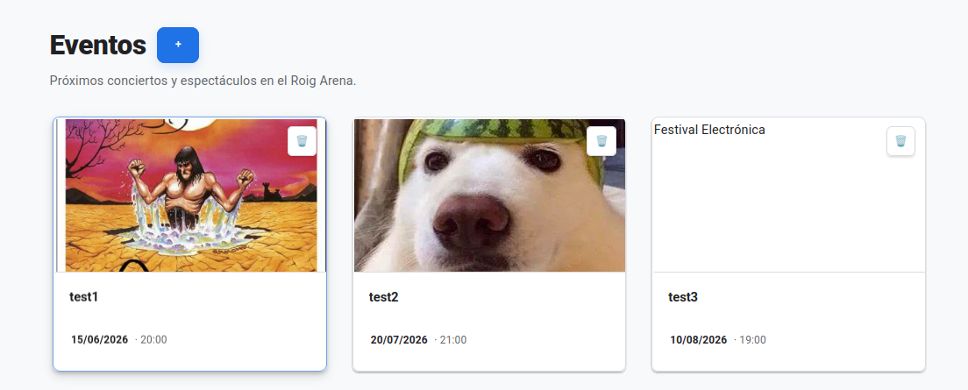
publicar eventos

Slide 4
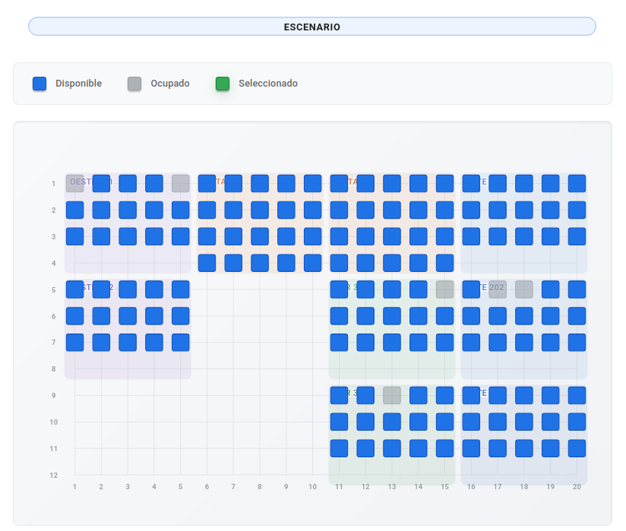
reservar asientos

Slide 5
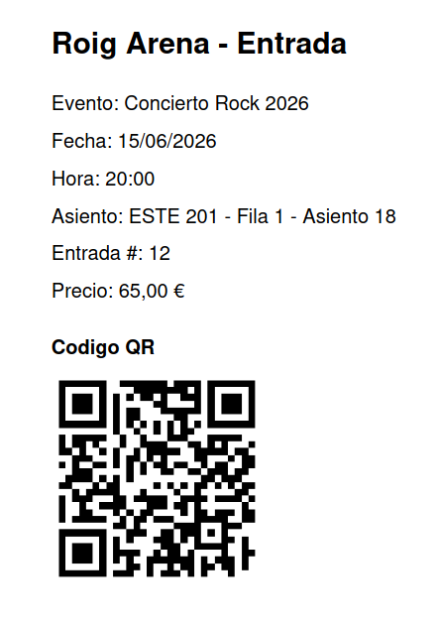

QR

Slide 6
REQUISITOS

Slide 7

docker

Slide 8

sail

Slide 9

laravel

Slide 10

mysql

Slide 11
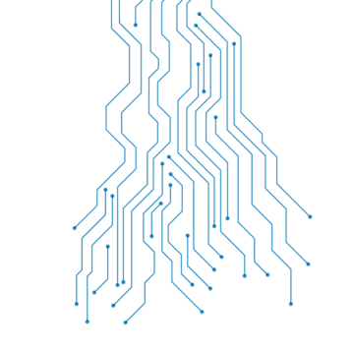
SETUP

Slide 12
setup-arena.sh

Slide 13
.env.example

Slide 14
arena.sh

Slide 15


TESTS

Slide 16
authTest

Slide 17
eventoTest

Slide 18
reservaTest

Slide 19
compraTest

Slide 20
loginRoutesTest

Slide 22
reservaServiceTest

Slide 23
compraServiceTest

Slide 24
LiberarReservasServiceTest

Slide 25
isAdminMIddlewareTest

Slide 26
modeloTest

Slide 27
sectorsDimensionsTest

Slide 28






Slide 29
HOME
http://localhost

Slide 30
LOGIN
http://localhost/login
admin@admin.com / admin
juan@example.com / password

Slide 31
REGISTER
http://localhost/register

Slide 32
EVENTOS
http://localhost/eventos

Slide 33
DETALLE
http://localhost/eventos/2

Slide 34
COMPRA
[ login required ]
http://localhost/compra/2

Slide 35
DASHBOARD
[ login required ]
http://localhost/dashboard

Slide 36
PROFILE
[ login required ]
http://localhost/profile

Slide 37
MIS EVENTOS
[ login required ]
http://localhost/mis-eventos

Slide 38
MIS EVENTOS INFO
[ login required ]
http://localhost/mis-eventos-info

Slide 39
MI EVENTO INFO
[ login required ]
http://localhost/mi-eventos-info/2

Slide 40
PAGOS PENDIENTES
[ login required ]
http://localhost/mis-pagos-pendientes

Slide 41
API usuario
cerrar sesión
cerrar sesión
[ login required ]
POST
http://localhost/mis-eventos-info
DELETE
http://localhost/entadas/2

Slide 42
ADMIN
[ login required + admin ]

Slide 43
crear evento
[ login required + admin ]
http://localhost/admin/eventos/create

Slide 44
actualizar evento
[ login required + admin ]
http://localhost/admin/eventos/2

