Slide 1
Predicting Decisions in Language Based Persuasion Games
Reut Apel, Ido Erev, Roi Reichart, and Moshe Tennenholtz

Slide 2
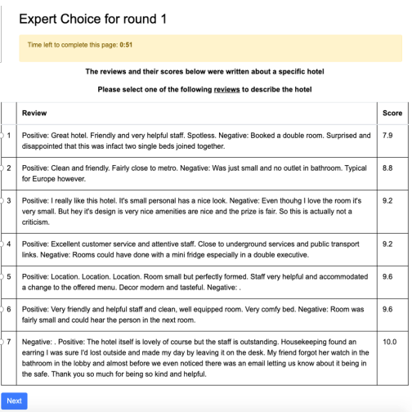
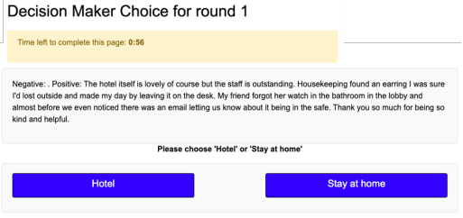
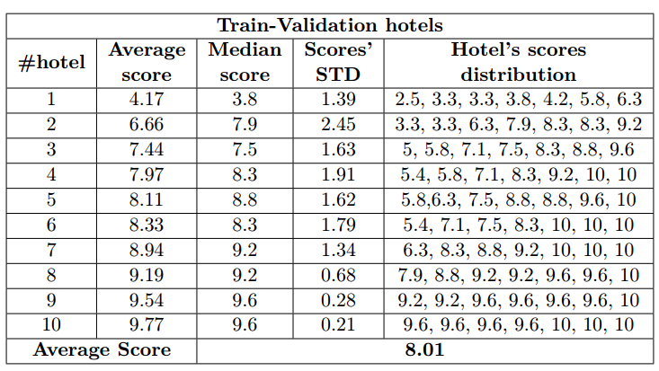
Task

Slide 3
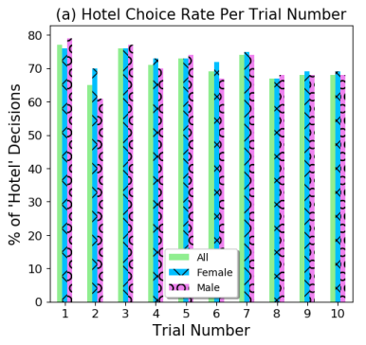
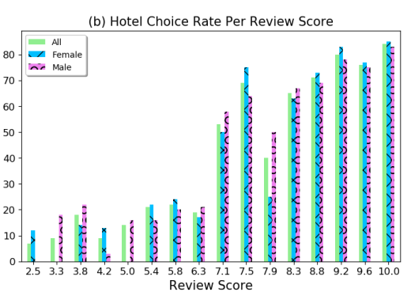
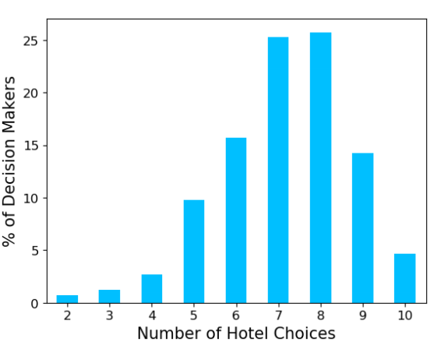
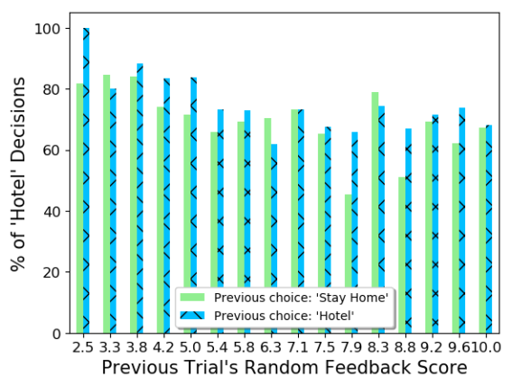
Quantitative Data Analysis

Slide 4
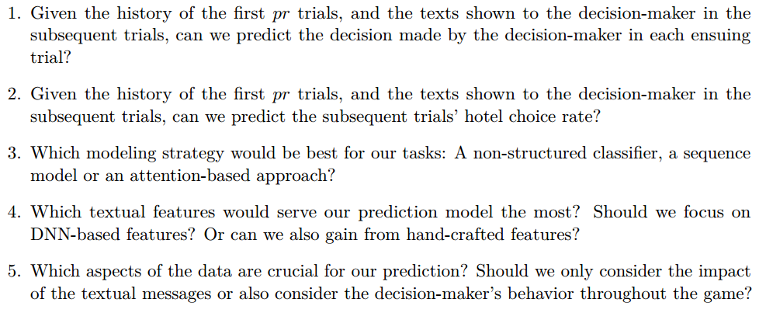
Research Questions

Slide 5
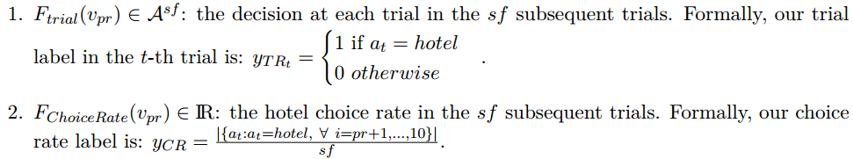


Prediction Task

Slide 6
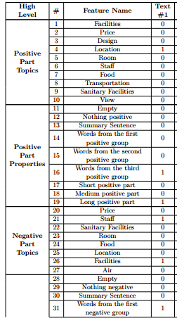

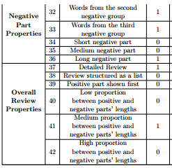
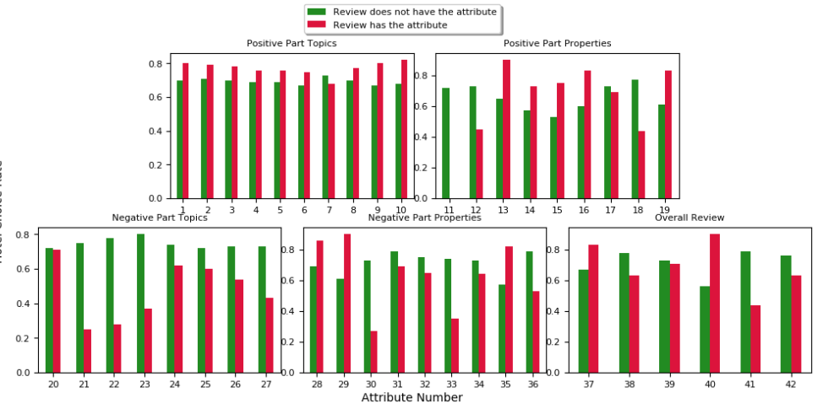
Textual Features

Slide 7
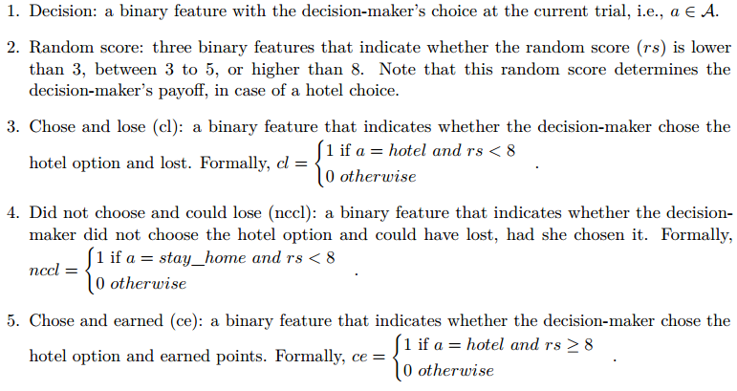
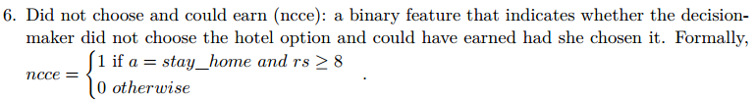
Behavioral Features

Slide 8


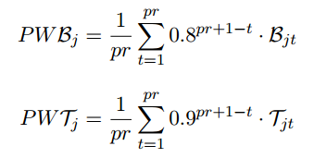
Models
=

Slide 9


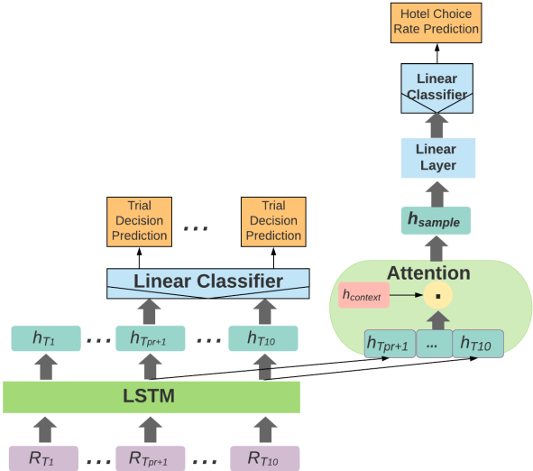

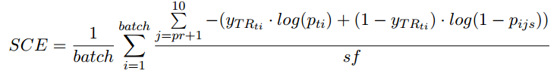


Models
Notes:
CR
The LSTM is sequentially fed with the prefix and
suffix trials’ representations, one trial at a time. The suffix trials’ hidden vectors are fed into a dot
product attention layer, followed by two linear layers with a dropout layer and a ReLU activation
function, in order to predict the hotel choice rate in the suffix trials.
TR
The LSTM is sequentially fed with the prefix and suffix trials’ representations, one trial at a
time. Each hidden state of the suffix trials is fed into a dropout layer followed by a linear layer with
a ReLU activation function, in order to predict the label for each suffix trial.

Slide 10

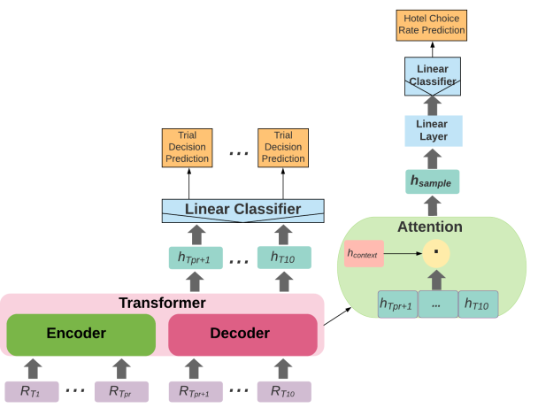
Models
Notes:
the encoder maps the prefix trials’ input sequence to a sequence of continuous representations. Given these representations and an input sequence of the suffix trials, the decoder then generates an output sequence of the suffix trials’ representations fed to our model’s next layers to generate the output predictions

Slide 11


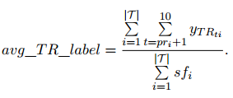

Baselines

Slide 12
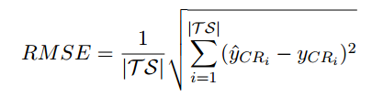
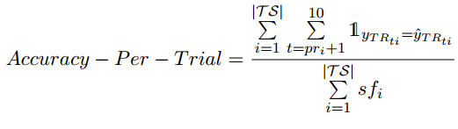
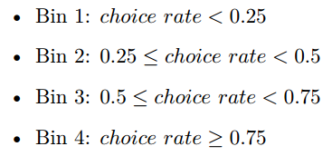
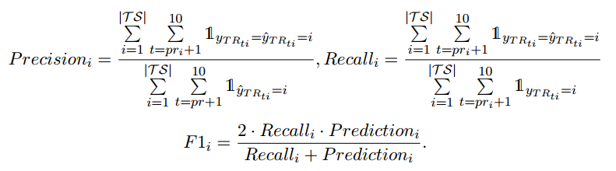
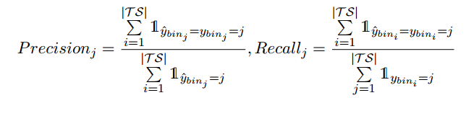



Evaluation Measures

Slide 13
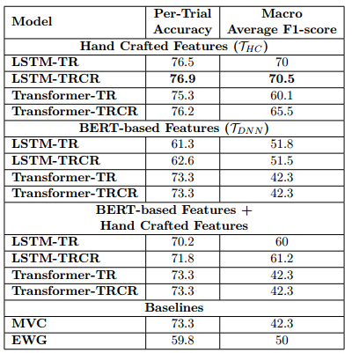
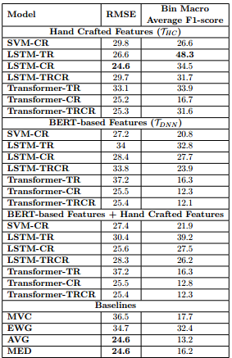
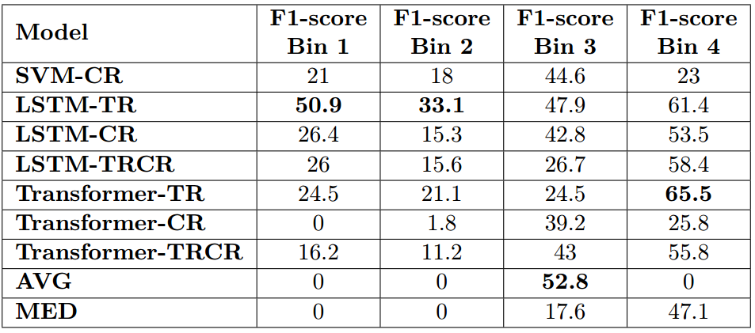
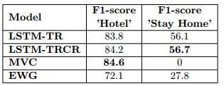
Per-Trial Prediction Results

Slide 14
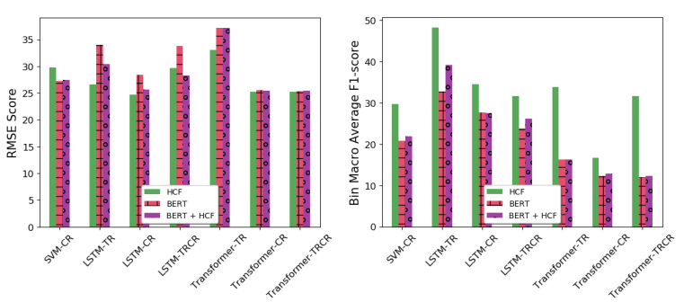
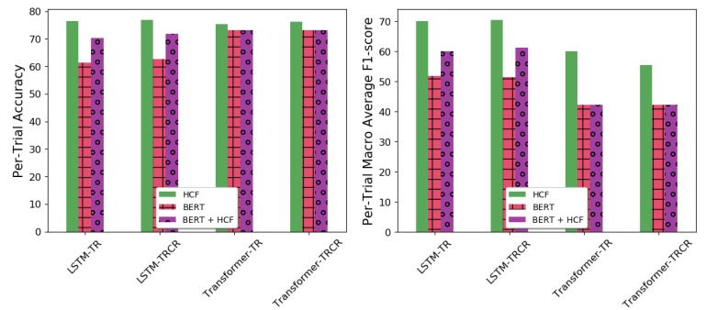
The Impact of Different Textual Feature Sets

Slide 15
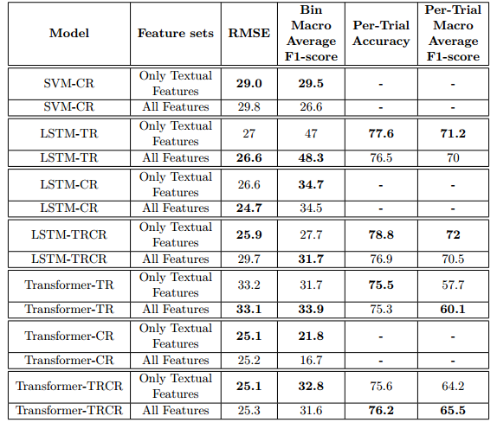
The Complementary Impact of Textual and Behavioral Features

Slide 16
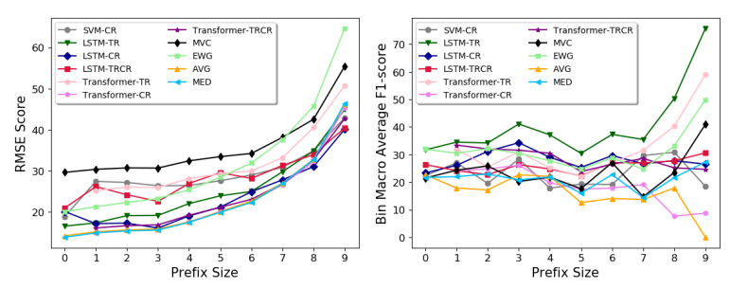
Prefix Size Impact

Slide 17
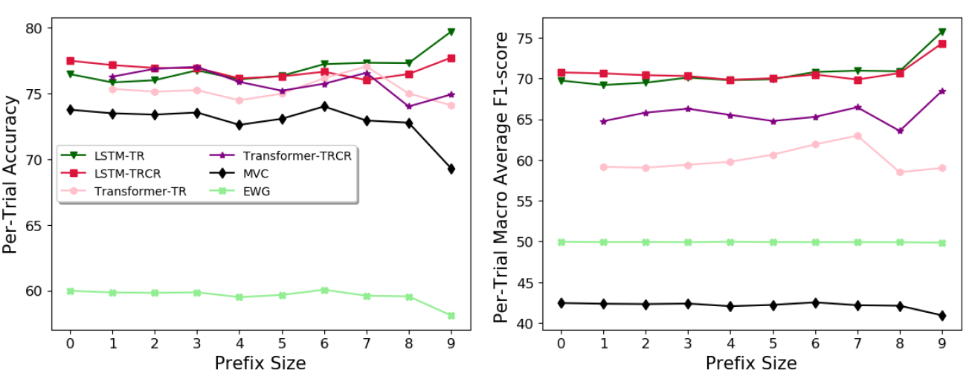
Prefix Size Impact

Slide 18
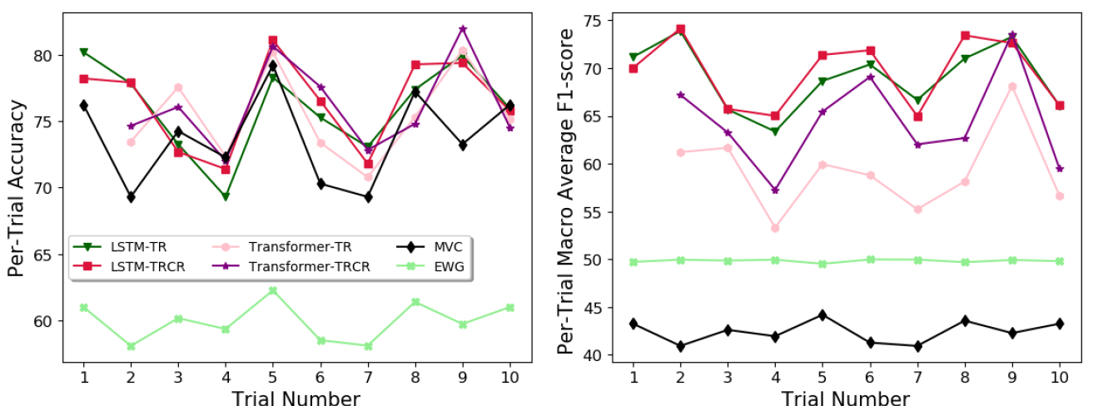
Trial Number Impact

Slide 19
Designing an Automatic Agent for Repeated Language based Persuasion Games
Maya Raifer, Guy Rotman, Reut Apel, Moshe Tennenholtz, Roi Reichart

Slide 20




Method

Slide 21
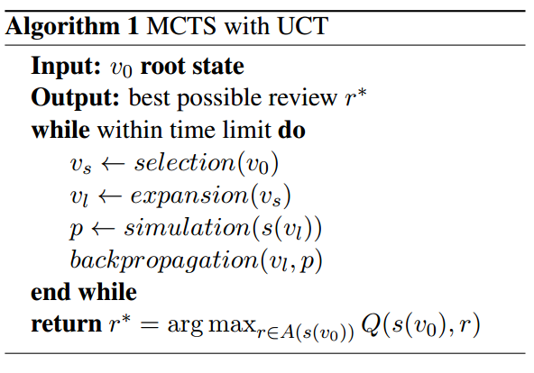
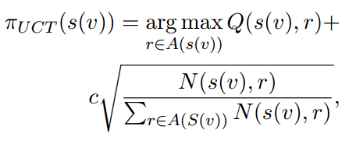
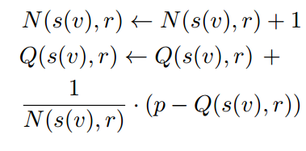
MCTS Algorithm

Slide 22
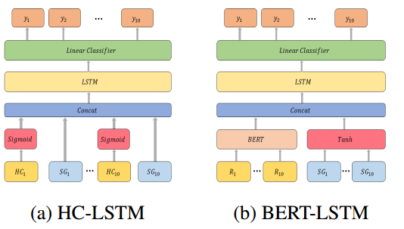
VM and DMM Models

Slide 23
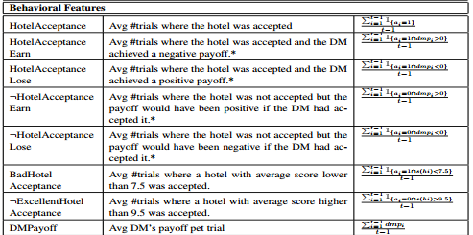
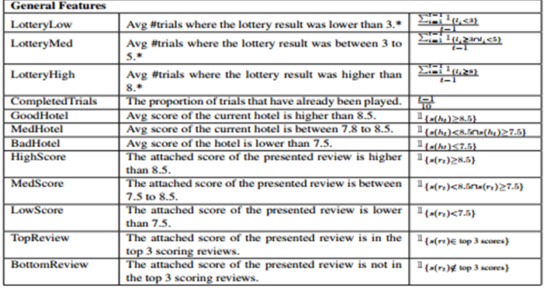
Statistical Features

Slide 24







Baselines

Slide 25
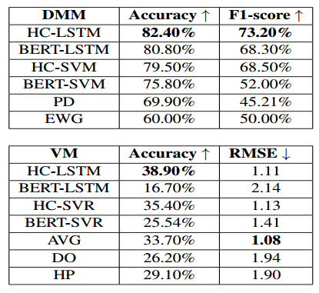
VM And DMM Results

Slide 26
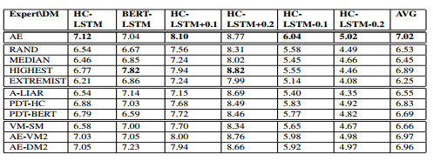
AE Results

Slide 27
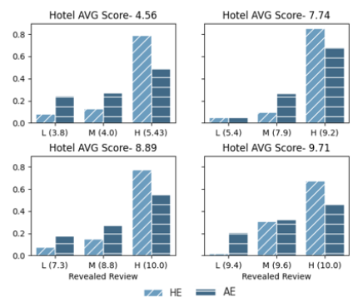
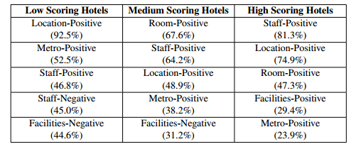
Analysis of AE Personalization

