Slide 1
Approximate Computing Logic Design
Megan Huang

Slide 2
Background
All processors have Arithmetic Logic Unit (ALU)
Crucial component
performs basic arithmetic operations (e.g., addition) and logical operations.
Complex/relevant modern hardware components fundamentally still rely on efficient adders (e.g., Floating-Point Units (FPUs) for AI development)
Optimize for speed, size, power, and purpose
Notes:
All processors have a fundamental component called the Arithmetic Logic Unit (ALU), which performs basic arithmetic operations (e.g. addition, subtraction) and logical operations. Our computers are dependent on this block for everything from instruction decode and execution to memory addressing. Even Floating-Point Units (FPUs), hardware components that are becoming increasingly important for larger scale/faster AI development [1][2], are, at the core, dependent on adders. This makes optimizing the efficiency (speed, size, and power) of adders crucial. One clear and commonly used method of doing this is approximation.

Slide 3
Approximation Techniques
Many methods exist, the following are widely applicable and used:
Bit Truncation
Reduced Carry Propagation
Stochastic
Simplified Logic Gates
Accounting for implementation complexity
Ties to Error Tolerant Adders
Notes:
However, even then many approximation methods exist:
- lookup tables (LUTs),
- bit truncation,
- reduced carry propagation,
- dynamic precision scaling,
- significance-driven,
- hybrid (combining exact and approximate logic within same circuit),
- stochastic,
- voltage overscaling (VOS),
- neural (network)-inspired,
- simplified logic gates,
- custom arithimetic circuits,
- probabilistic computing,
error tolerance adders (ETA), etc.
Due to both the limitations some of these techniques have and the challenges other techniques pose in terms of implementation and testing, I went with the listed methods.

Slide 4
Bit Truncation (Bit Masking)
Examples: image processing, machine learning (neural networks, deep learning accelerators like Google’s TPU)
Pros:
Low overhead, no additional logic, highly scalable
Easy to implement
Widely applicable when lower bits don’t matter as much
Cons:
Less adaptive (doesn’t consider dynamic input importance)
Unsuitable for high-precision applications
Notes:
Real-World Applications: image and video processing, neural networks (ML)
Pros:
- computationally cheap, complexity scales proportionally to bit width retained (no additional logic, low overhead)
- easy to implement
- widely applicable if lower bits less important (e.g. image processing, machine learning)
Cons:
- less adaptive, doesn't consider dynamic input importance (e.g. dynamic precision scaling or significance-driven)
- unsuitable for high precision applications (e.g. floating-point arithmetic)

Slide 5
Reduced Carry Propagation
Examples: energy-efficient processers (IoT/edge devices), error tolerant systems (sensor data processing)
Pros:
Balances precision and complexity
Moderately scalable (adaptations exist for large-scale)
Cons:
More specific to adders/arithmetic circuits
Not as dynamic
Notes:
Real World Applications: energy-efficient processers, error tolerant systems
Pros:
- fine-grained control, balances precision and complexity
- more scalable than some methods
- can adapt to selectively propagate carries in critical paths only (e.g., MSB)
Cons:
- more specific to adders/arithmetic circuits, less applicable on a broader scale (of logic operations)
- less dynamic than some other techniques (e.g. probabilistic carry handling)

Slide 6
Stochastic Approximation
Examples: machine learning (gradient descent), Monte Carlo simulations (modelling real-world systems)
Pros:
Introduces randomness (mimics real-world noise)
Allows error control/tuning approximation levels using parameters
Cons:
Requires random number generation hardware/software
Challenging to implement/mitigate overhead at large scales
Notes:
Real World Applications: machine learning (gradient descent), Monte Carlo simulations (modelling real-world systems)
Pros:
- introduces randomness (mimics real-world noise)
- allows for error control and tuning approximation level using parameters
- moderately scalable with randomness overhead
Cons:
- requires random number generation hardware/software
- higher implementation complexity

Slide 7
Simplified Logic Gates
Examples: signal processing (approx. Fast Fourier Transforms), embedded systems (microcontrollers for smart watches)
Pros:
Direct logic replacement/reduces circuit complexity without requiring structural redesign
Easy to implement, simplification saves energy and area
Cons:
Scalable with constraints (higher precision accumulates error)
Doesn’t account for input significance (less versatility)
Notes:
Real World Applications: machine learning (gradient descent), Monte Carlo simulations (modelling real-world systems)
Pros:
- introduces randomness (mimics real-world noise)
- allows for error control and tuning approximation level using parameters
- moderately scalable with randomness overhead
Cons:
- requires random number generation hardware/software
- higher implementation complexity

Slide 8



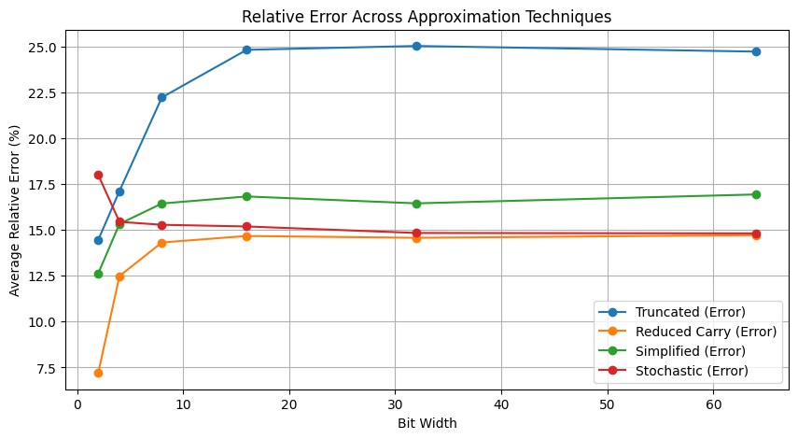
Relative Error Across Approximation Techniques (Ideal)
General Trends:
Highest Relative Error: Truncated for more than 2-bit operations; Stochastic for 2-bit operations
Lowest Relative Error: Simplified & Stochastic for higher bit-widths, latter performance is dependent on error rate
Plateaus for all techniques beyond 16 bits
Notes:
Python direct implementation (theoretical performance based on software)
I also elected to start with a simple full adder to allow for better understanding of the impact of the approximation techniques, with later testing on a ripple carry to better simulate real-world logic. Realistically, most modern processers would use more structurally complex and computationally streamlined adders (e.g. carry lookahead). Lastly, I chose some common bit-widths that would be used in computations: 2, 4, 8, 16, 32, and 64.

Slide 9
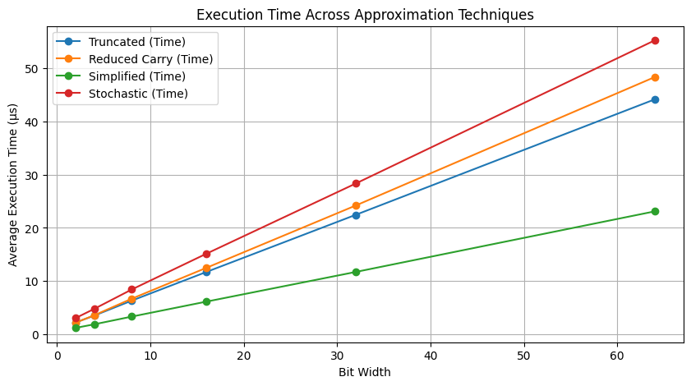
Execution Time Across Approximation Techniques (Ideal)
General Trends:
Longest Execution Time: Stochastic
Lowest Execution Time: Simplified
Linear Scaling with Bit Width

Slide 10
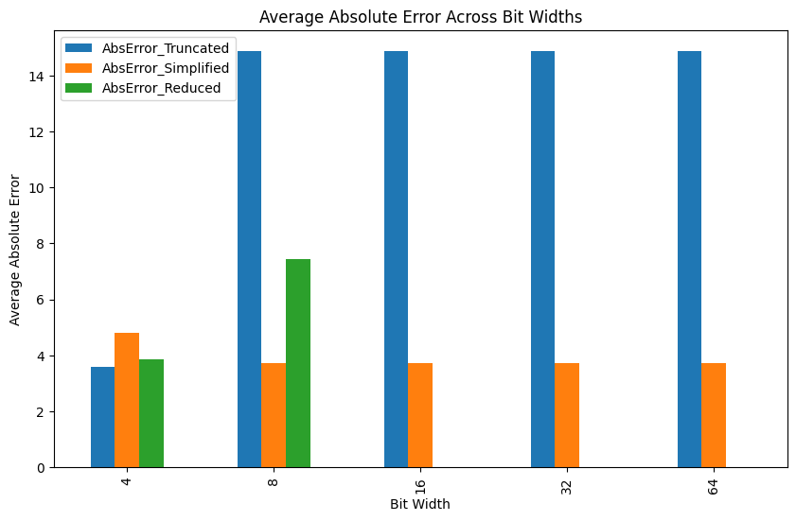
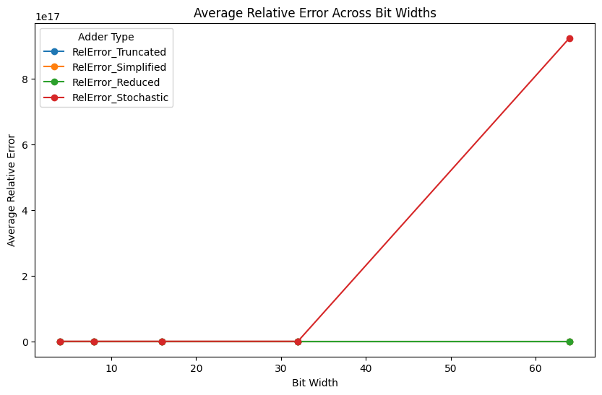
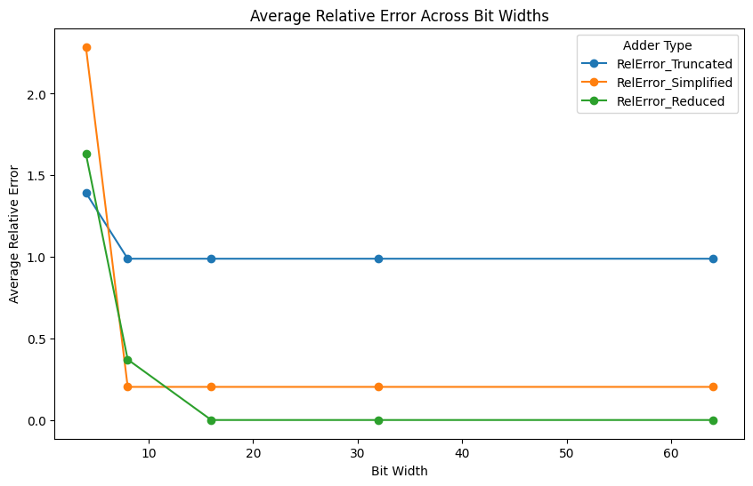
Relative Error Across Approximation Techniques (Hardware Simulation)
General Trends:
Stochastic vastly out-scales all other methods in error as bit width increases
Simplified lowest error except for 4 bits
Notes:
Python direct implementation (theoretical performance based on software)
Stochastic randomness error
Rescaled graphs for better visualization
Simulation limitations disallowed 2-bits

Slide 11
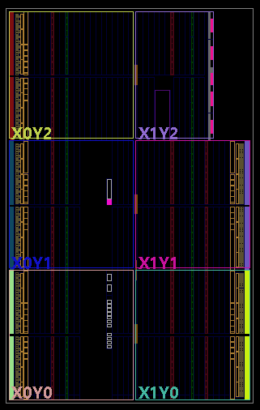
Caveats
Python Hardware Simulation
Intended to synthesize the logic structures in Synopsys → Vivado?
Synopsys: Industry-grade tools; supports ASIC design; more detailed reports on timing, power, and area performance; requires licensing, convoluted setup

Slide 12
Conclusion
Approximation is an effective way of improving arithmetic efficiency at the tradeoff of accuracy
Significant improvement in delay, power, and area; exact numbers depend on implementation and use cases
[1] Approx. 1-bit Adder → 30% reduction in power w/ 15% Root-Mean-Squared (RMS) error
[2] Approx. Full Adder (AFA) → 46.31%, 28.57% reduction in power, area
[3] Approx. Carry Speculative Han-Carlson Adder (ACSHA) → 46% improvement in Area Delay Product (ADP) w/ negligible relative error
There are various methods of approximation, but each has their own application cases
Notes:
Both studies cited are stats for approximate N-bit Ripple Carry Adder (RCA)
ACSHA was error result was for 16 bit

Slide 13
Sources
ChatGPT
[1] C. I. Allen, D. Langley and J. C. Lyke, "Inexact computing with approximate adder application," NAECON 2014 - IEEE National Aerospace and Electronics Conference, Dayton, OH, USA, 2014, pp. 21-28, doi: 10.1109/NAECON.2014.7045768. keywords: {Logic gates;Adders;Approximation methods;Inverters;Probabilistic logic;Power dissipation;Minimization},
[2] Sunil Dutt, Sukumar Nandi, and Gaurav Trivedi. 2017. Analysis and Design of Adders for Approximate Computing. ACM Trans. Embed. Comput. Syst. 17, 2, Article 40 (March 2018), 28 pages. https://doi.org/10.1145/3131274
[3] A. K. Gottem, A. Sundaramoorthy, and A. Alagarsamy, “High Speed Approximate Carry Speculative Adder in Error Tolerance Applications”, IJC, vol. 21, no. 3, pp. 383-390, Sep. 2022.

