Slide 1
Apache Kafka Basics
David Veres

Slide 2
Motivation
Event-driven systems are becoming more popular
Focus on data as events
Producers and consumers are decoupled
Process events, react to them
Needs a single platform
Connects the participants
Real-time
Stores the events

Slide 3






Apache Kafka

Slide 4
Fundamentals

Slide 5
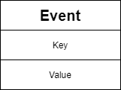
Events
„A thing that has happened”
It can be any kind of thing
A user clicks on a button
A microservice finishes a computation and submits the result
An IoT device sends data
An event has a state
Describes what happened
Stored in structured format (like JSON)
In Kafka it is a key-value pair

Slide 6

Topics
The way of categorizing events
A collection of similar events
We can have multiple topics
The same event can appear in different topics
Topic = log of events
Append only
Events are immutable

Slide 7
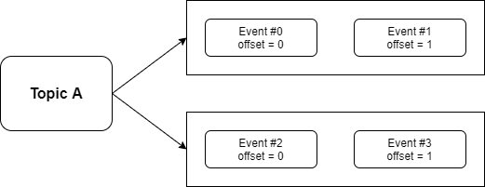
Partitions
A topic can be split into multiple partitions
„Real log of events”
The order of events is strict
This might not true for topics
Every partition has it’s own offset space

Slide 8
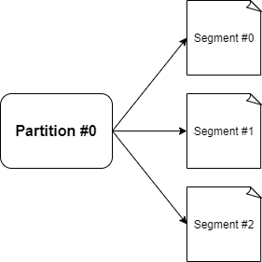
Segments
A partition is broken into multiple segments
These are individual files
Events are stored on the disk in files

Slide 9
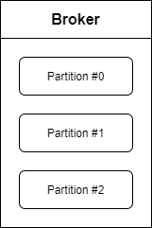
Brokers
Brokers can be
Physical servers
Containers
Cloud instances
Manage partitions
Communicate with other brokers
They are simple
Understand easily
Scale easily
Extend easily

Slide 10
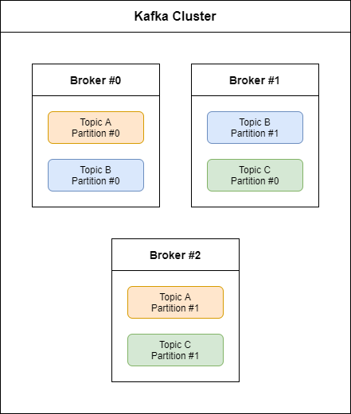
Kafka cluster
Kafka is a distributed system
Good scalability
Many brokers form a Kafka cluster
From outside, we see it as „one” Kafka

Slide 11
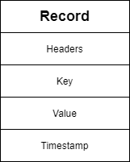
Kafka records
Events represented in Kafka are called records
Structure of a record
Key
Value
Headers
Timestamp

Slide 12
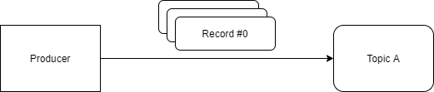
Producers
Applications that we write
Send records to topics (partitions)
Producer API
Connection pooling
Networking
Partitioning

Slide 13
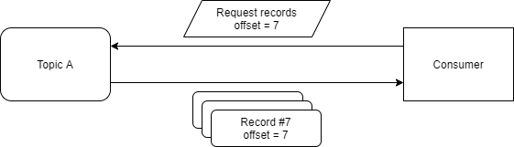
Consumers
Applications that we write
Read (pull) records from topics
Read by offset
Consumer API
Connection pooling
Networking
A record doesn’t get destroyed after read

Slide 14
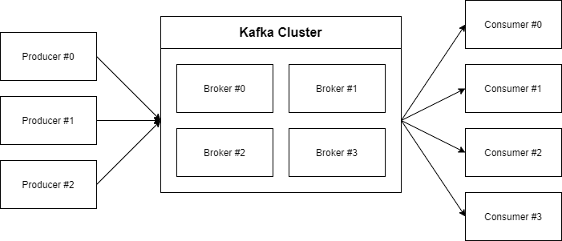
Fundamental parts of Kafka

Slide 15
Let’s take a closer look!

Slide 16
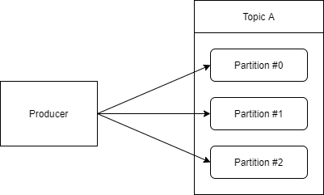
We produce to partitions
Records are sent to partitions
Purpose
Load balancing
Semantic partitioning
Record without key
Round-robin strategy
Record with key
hash(key) % num_of_partitions
Records with same key to same partition
Custom partitioner logic

Slide 17
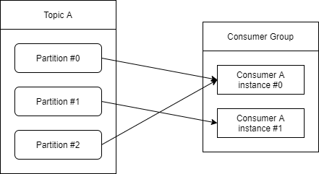
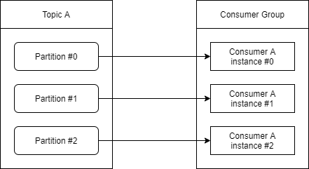
Consumer groups
A consumer reads from partition(s)
We might want to scale a consumer application
Every consumer is part of a consumer group
Kafka handles rebalancing automatically

Slide 18
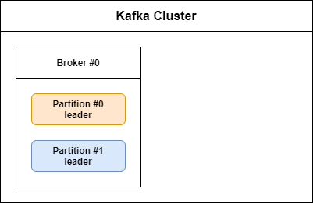
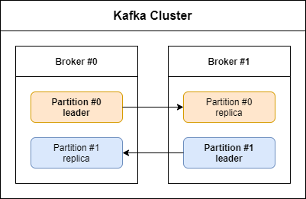
Replication
Brokers store records (in partitions, segments)
Brokers might go down
Replication factor
1 leader partition
N-1 follower partition
Synchronization is automatic
Produce only to leaders
We can configure to read from followers

Slide 19
Producer guarantees
We can wait for an acknowledgement from the broker(s)
Is the record successfully written to disk?
This is a producer configuration
We have 3 options
NONE
Fast, but might lose data
LEADER
Default, data is written for sure
ALL
Slowest option

Slide 20
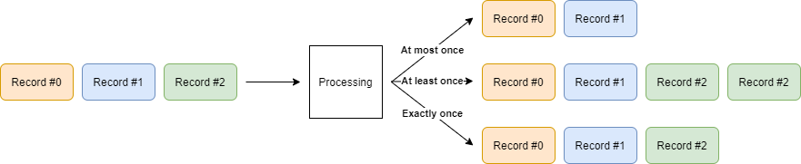
Delivery guarantees
Message processing guarantee categories
At most once
At least once
Exactly once
Kafka provides a transactional API to reach exactly once
Configurable for producer and consumer

Slide 21
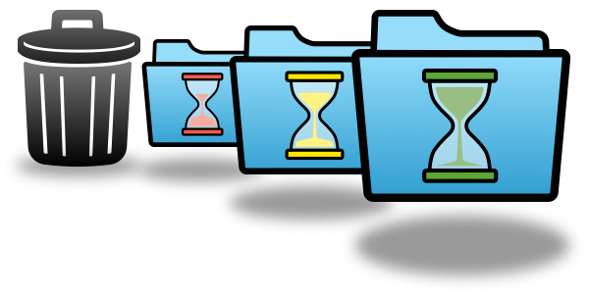
Retention policy
For how long a record should be stored?
Decision factor
Business
Cost
Default: 1 week
Configurable
Globally
Per topic
Data purge happens per segment

Slide 22

Security
Kafka supports data encryption in transit
Supports authentication and authorization
Data stored in disk by Kafka is not encrypted
We can encrypt the disk itslef
We can write a wrapper to encrypt/decrypt a record’s value

Slide 23
The Kafka ecosystem

Slide 24

ZooKeeper
Provides multiple features for distributed applications
Distributed configuration management
Election
Key-value store
Kafka uses ZooKeeper
Leader election
Topic configuration
Access control
KIP-500, Apache Kafka 2.8
We can leave ZooKeeper
Not production ready yet

Slide 25
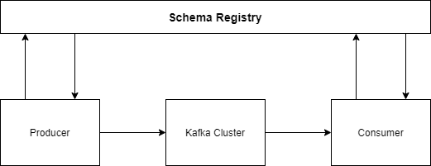
Schema Registry
Schema of or records might change by time
A schema registry is a database of schemas
Supported formats: AVRO, JSON schema, Protobuf, custom
Producers and consumers validate the records
They call the schema registry
Check the compatibility

Slide 26
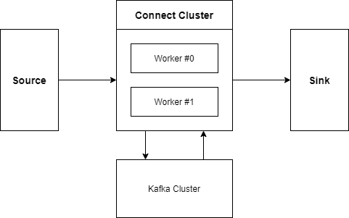
Kafka Connect
We might want to transfer data
From Kafka to another system
Into Kafka from another system
Many existing connectors
Easy to configure

Slide 27
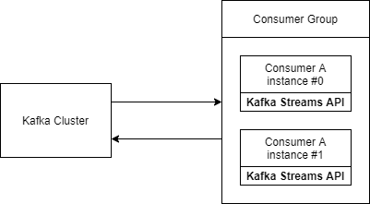
Kafka Streams
The consumer API is very simple
Kafka Streams provides more complex operations
Filtering
Mapping
Aggregating
Fluent functional API
Output is stored in Kafka
Scaleable, fault-tolerant

Slide 28
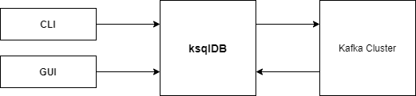
ksqlDB
Another stream processing option
Without programming
Stream processing in an SQL format
Communicate with ksqlDB
CLI
GUI

Slide 29

REST Proxy
Java is the native language for Kafka
Lot of other supported languages
We can use the REST Proxy instead of libraries
HTTP calls for producing and consuming
Useful if our chosen language is not supported

Slide 30
Sources and result
Sources
Confluent - Apache Kafka® Tutorials | Kafka 101
Confluent - Course | Apache Kafka® Fundamentals
https://kafka.apache.org/
Result
https://github.com/veresdavid/apache-kafka-basics

Slide 31
Thank you for your attention!

