Slide 1
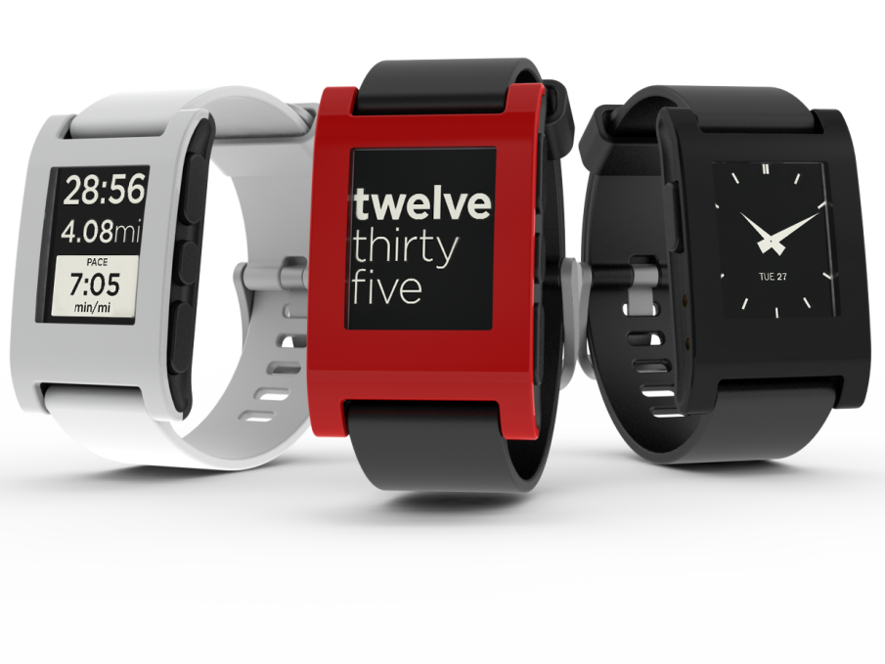
Seattle Wearables Hackathon
July 12-13, 2014
#seawear

Slide 2
Great work!
#seawear

Slide 3

Venue
#seawear

Slide 4

Platinum Sponsor
#seawear

Slide 5


Silver Sponsors
#seawear

Slide 6
Prizes!
Pebble Smartwatches
Basis Fitness Bands
O’Reilly Technical Books
If interested in attending O’Reilly’s big data conf, see the website for a 20% discount
#seawear

Slide 7
Show and Tell Format
Two parts: Share and Q&A
5 minute limit for sharing
Show use of sponsor tech so you can win prizes
#seawear

Slide 8
Show and Tell Time!
#seawear

Slide 9
Projects
oneFLEX
SmartHat
MagnetMen
Carify
Peepee
I Don’t Know
Flippin’ Awesome
Promise
#seawear

Slide 10
Announcing: Startup Weekend Mobile/Wearables July 25-27, 2014
#seawear

