Slide 1
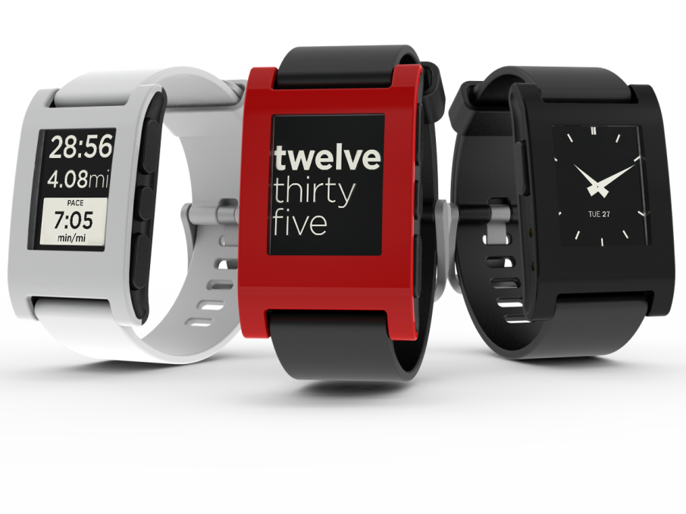
Seattle Wearables Hackathon
July 12-13, 2014
#seawear

Slide 2
Why Are We Here?
#seawear

Slide 3

Venue
#seawear

Slide 4

Platinum Sponsor
#seawear

Slide 5


Silver Sponsors
#seawear

Slide 6
This Weekend
Saturday
Idea pitches
Networking & teaming
Get to work
Workshops
Coaches
Sunday
Finish hacking at 12pm
Share your hack at 1pm
Prizes and wrap-up
Food all weekend!
#seawear

Slide 7
Prizes!
Pebble Smartwatches
Basis Fitness Bands
O’Reilly Technical Books
If interested in attending O’Reilly’s big data conf, see the website for a 20% discount
#seawear

Slide 8
Questions?
#seawear

Slide 9

#seawear

