Slide 1




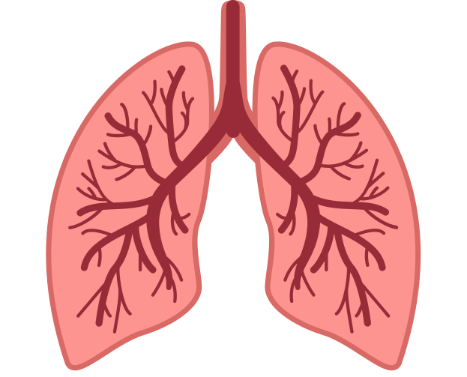

Clinical curiosity case report
Group C6 &D6
Michael Mapongwana CHC

Slide 2



Meet Anna:
58 year old female
Lives in Harare, Khayelitsha
Works as an assistant nurse at a TB clinic

Slide 3





Presenting complaint
PRODUCTIVE COUGH | HEADACHE
7 day history brown green purulent sputum worsens in morning improves with rest pleuritic chest pain | over frontal region radiating to eyes worse in afternoon worse in bending down affects daily functioning

Slide 4



OTHER SYMPTOMS:
hot flushes during day and night mild back pain at onset of cough slight loss of weight

Slide 5



Patient’s perspective
L (limitations) | walking slower: house chores and walking to work affected
I (ideas) | Thinks cough is due to TB Thinks headache is due to fall from last year Thinks hot flushes due to menopause
F (fears) | No fears
E (expectations) | Expects further special investigation like X-ray.

Slide 6







Medical + Surgical history
Arthritis in right knee (dx for 5 years)
1 natural delivery, 2 C-sections
Previous ICD
Penicillin Allergy
Started using eye drops when her headache radiates
Has taken ½ a Grandpa a day for the past week
Social History: Finances
Specifically concerned about her water bill
Does not own a fridge so her diet consists of mainly bread and chips

Slide 7





Social History: Demographics
Unmarried
Lives Alone
Small rented house
Water outside home
Tertiary education
Assistant nurse at TB clinic
Currently working in the paediatric department

Slide 8







Lifestyle
Does not smoke
Drinks every 2nd weekend
Met up with a friend a week before her clinic visit who has TB
Family history
3 sons
Mother and Father passed away
Elder sister died of TB
Elder brother died in car accident
Brother had a history of one stroke
Younger sister is a known diabetic

Slide 9


Clinical examination
Blood pressure | 140/80 mmHg - raised systolic
Heart rate | 92 bpm - normal range
Respiratory rate | 18 bpm - normal range
Temperature | 36°C - normal range
General examination | Normal
Respiratory examination | Scar from ICD(6 years ago) Trachea slightly deviated to right Basal crackles in right lower lobe posteriorly

Slide 10

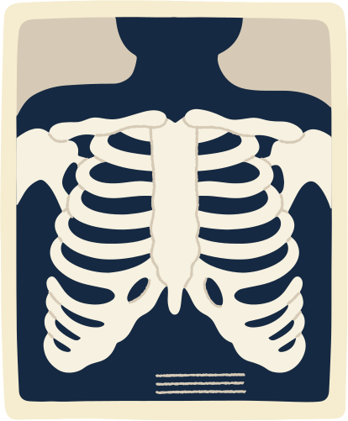

Special investigations:
Sputum TB GeneXpert
Sputum MCS
Chest X-ray
Negative sputum result
can not rule out TB after one week of symptoms
Appropriate to rule out co-infections or bacterial pneumonia
Useful to visualise lung pathology and to assess extent and distribution of disease

Slide 11
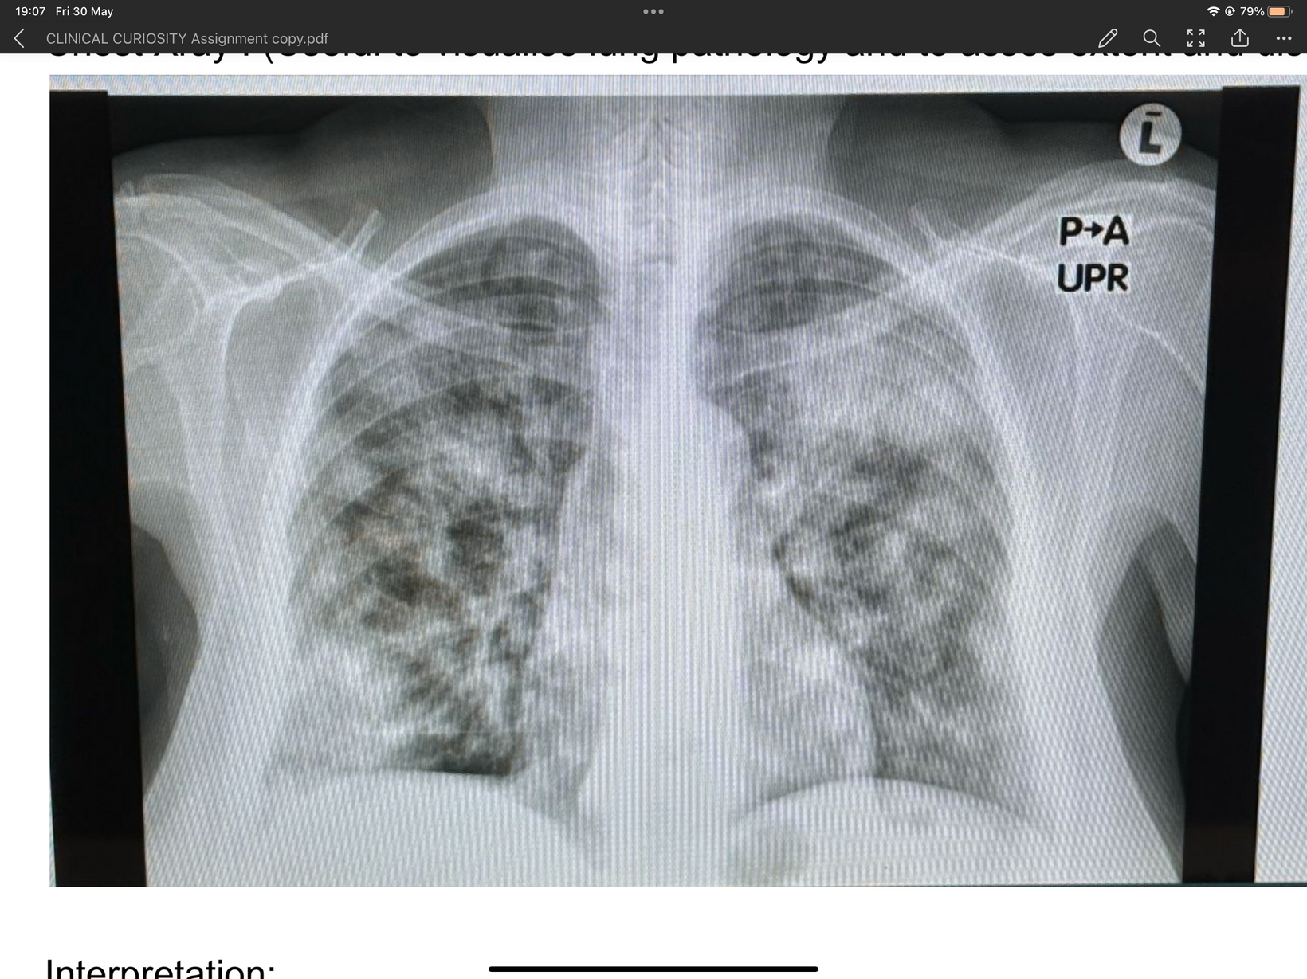

Chest X-ray
trachea deviated to the right
infiltration in left upper lobe
nodular pattern in parenchyma
opacification in most lobes
infiltration in right lower lobe

Slide 12
Special investigations:
Sputum TB GeneXpert
Sputum MCS
Chest X-ray
Negative sputum result
can not rule out TB after one week of symptoms
Appropriate to rule out co-infections or bacterial pneumonia
Useful to visualise lung pathology and to assess extent and distribution of disease

Slide 13

Differential Diagnosis
TB
Pneumonia (Community Acquired Pneumonia)
most likely diagnosis
Negative results could be due to subacute onset of constitutional symptoms
Typically present with :
cough
fever
purulent sputum

Slide 14


Diagnostic tests
Chest X-ray:
used in primary and tertiary setting
non- invasive
affordable
Gene Xpert MTB/RIF:
detects DNA of Mycobacterium Tuberculosis
detects resistance to Rifampicin
results in less than 2 hours
readily available

Slide 15



Diagnostic test described
GeneXpert MTB/RIF
South Africa= one of highest TB burdens globally
Detects the DNA of Mycobacterium Tuberculosis
Detects resistance to TB-drug, Rifmapicin
Can detect extrapulmonary TB as well
TB

Slide 16



Pretest probability
Prevalance =
Number of cases
Population
Pretest probability influenced by:
prevelance of TB in Khayelitsha
clinical symptoms
risk factors like HIV positive
history of contact with TB infected person
4305
=
499931
Prevalance of TB in Khayelithsha = 0,86%

Slide 17

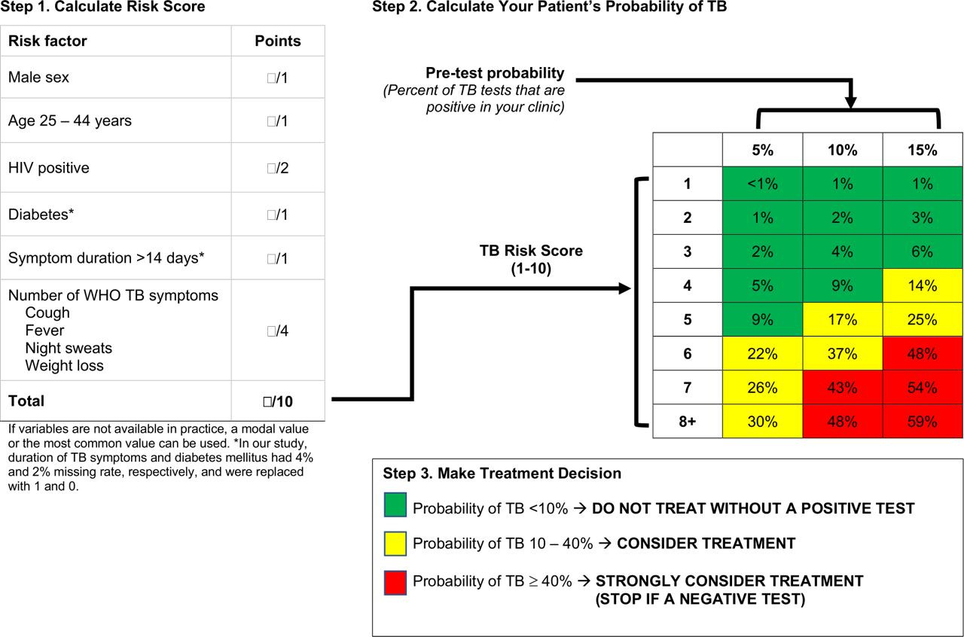


Pretest probability
Calculate your patient’s probability of TB
Score for Anna:
3
loss of weight
cough
night sweats

Slide 18





Sensitivity and specificity GeneXpert:
Specificity: 98%
can be used as rule in test
Sensitivity: 85%
can not be used as rule out test

Slide 19







Accuracy meassures
Sensitivity
Positive likelihood ratio =
1- specificity
=
0.85
1-0.98
=
42.5
1-sensitivity
Negative likelihood ratio =
Specificity
=
1-0.85
0.98
=
0.15

Slide 20
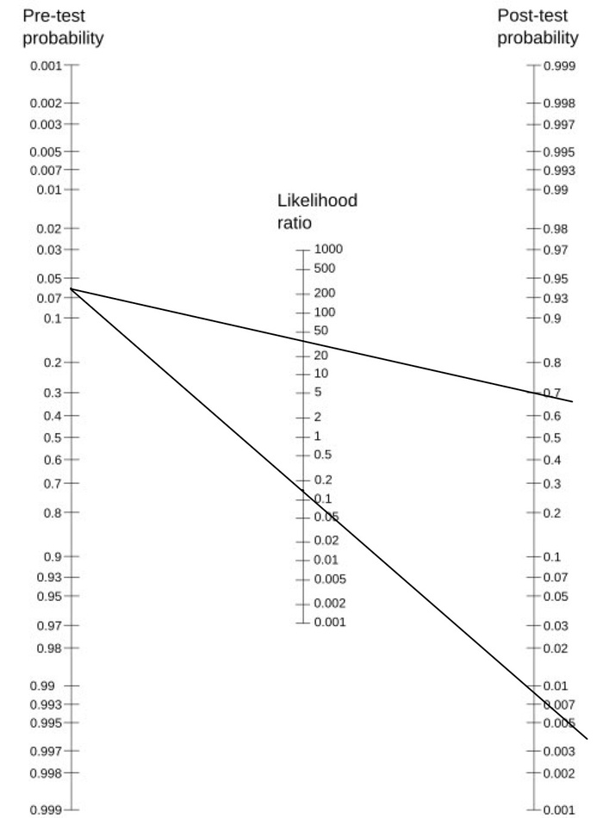


Post test probability
Gene Xpert MTB/RIF
Post test probability = 0.009

Slide 21
GROUP C6
ADAM MORRIS
CARO GILIOMEE
MEGAN BOERLAGE
MUKELANI MKHIZE
Thank you!
GROUP D6
ALMAAZ SALIE
YASMEEN SONDAY
SANELISO KHUMALO
FRANS VERGEEST
MUAAZ ELLEMDIN

