Slide 1
MIPS Single-Cycle Microprocessor Group Project
Peter Le, Vergil Mendizabel, and SethWanderman

Slide 2
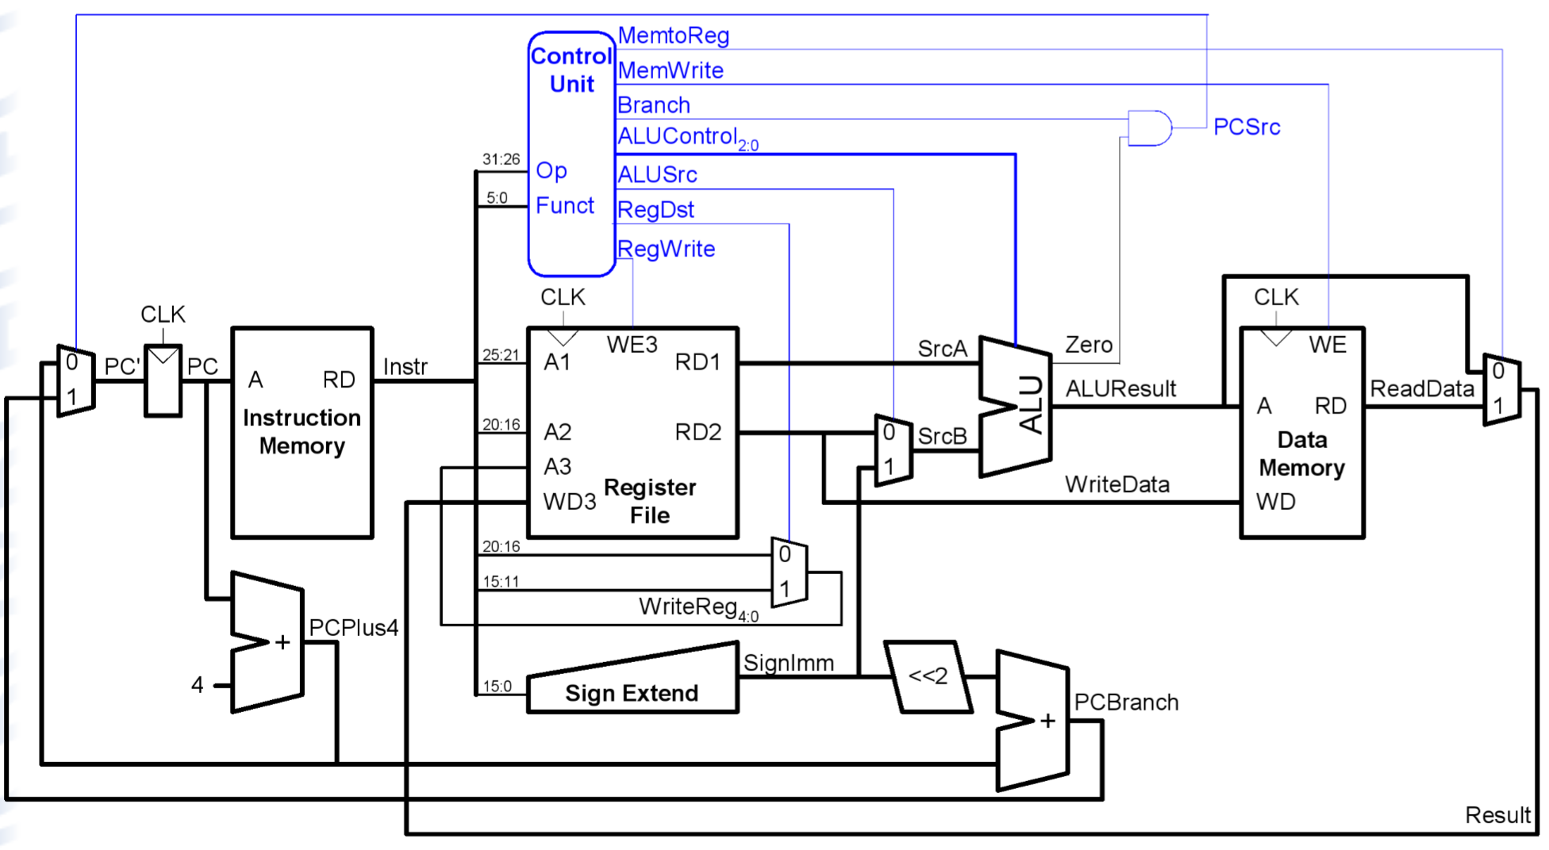
Schematic:

Slide 3
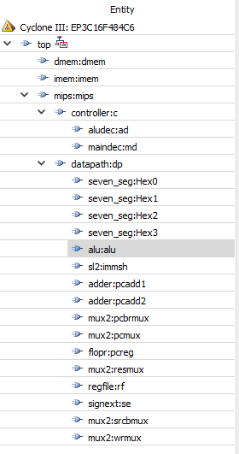
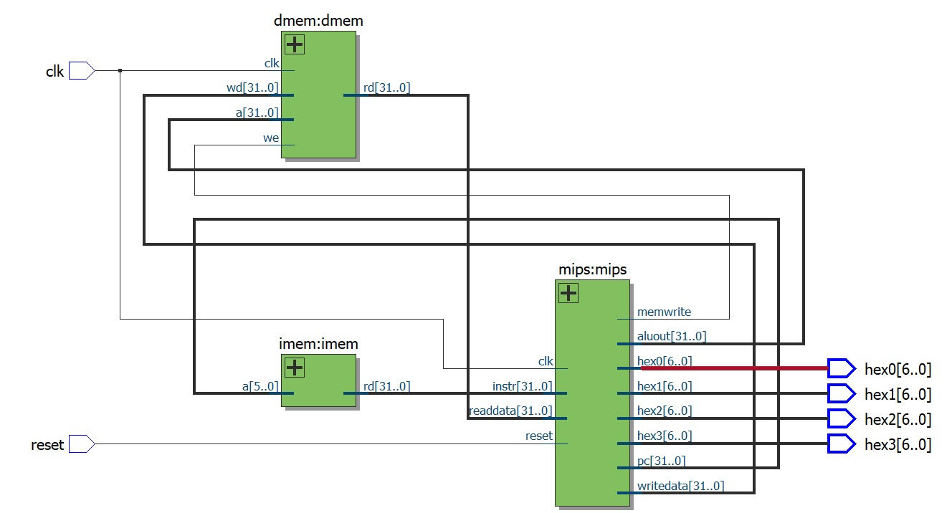
RTL and Hierarchy Diagrams:

Slide 4
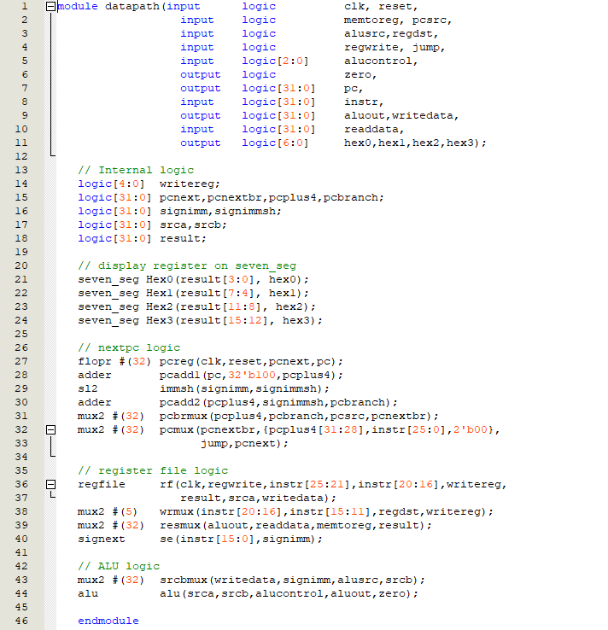
Datapath(System Verilog):
The datapath connects all modules together and keeps track track of the current instruction with a program counter.

Slide 5
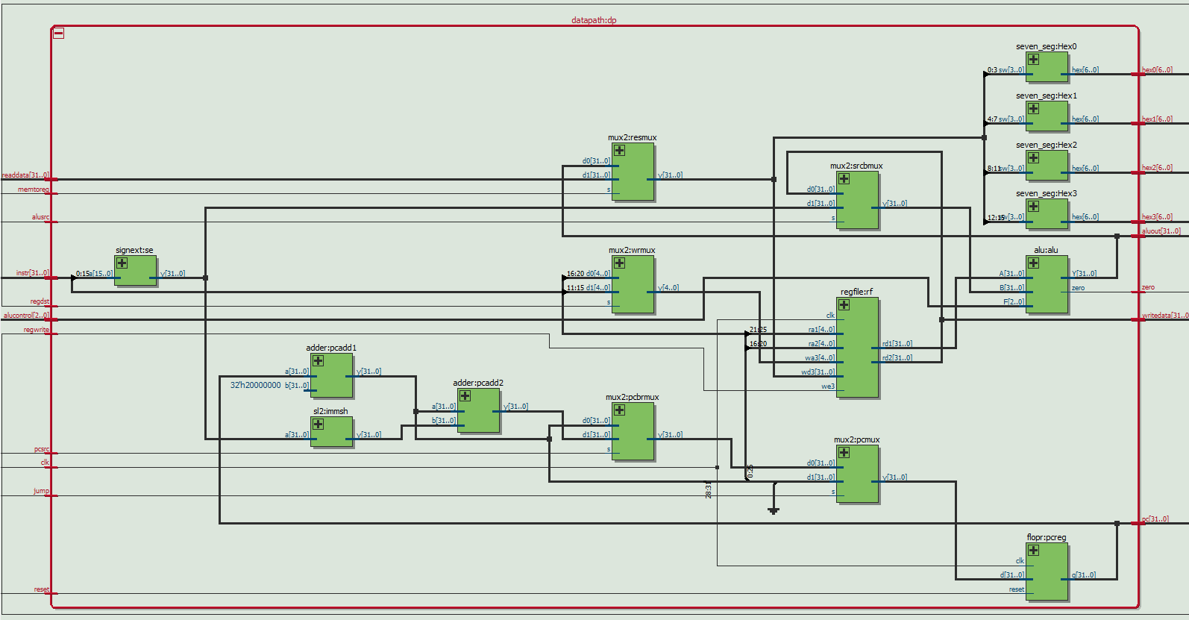

Slide 6
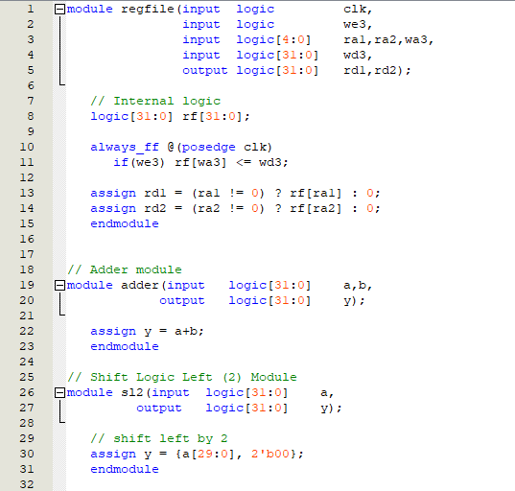
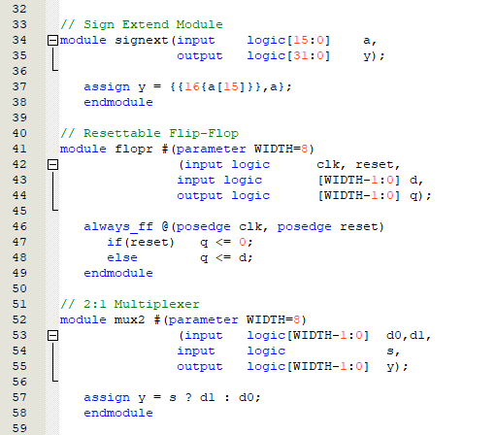
Submodules:
Register File
Adder
Left Shift
Sign Extension
Resettable Flip-Flop
Multiplexer

Slide 7
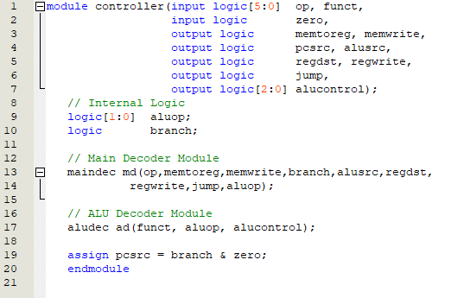
Controller:
Designed to take in the opcode and function inputs to and decodes the given bits to be able to give the correct instructions/bits to each submodule.

Slide 8
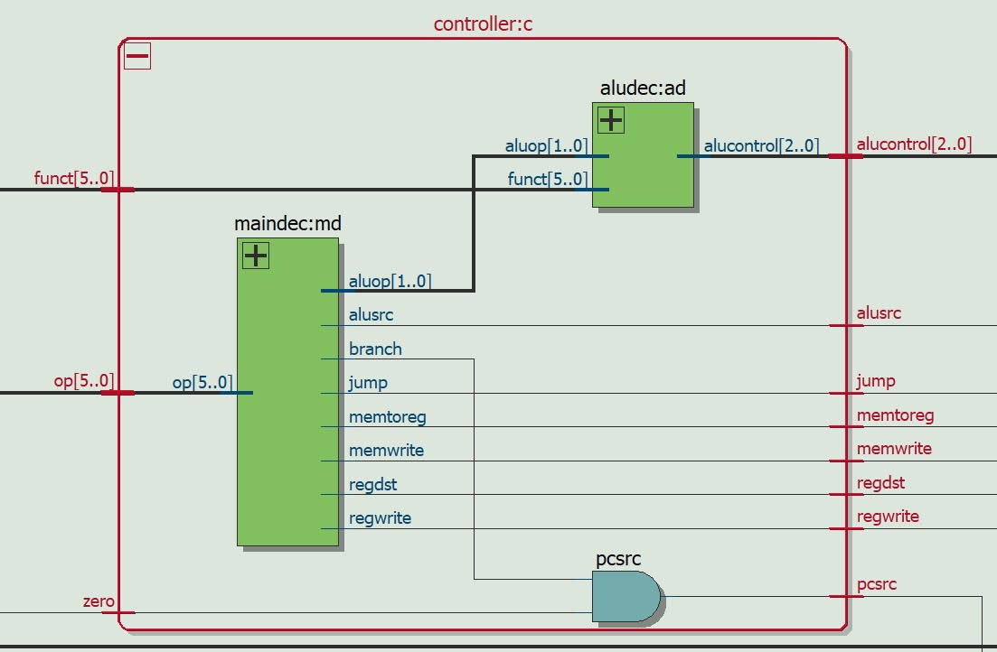

Slide 9
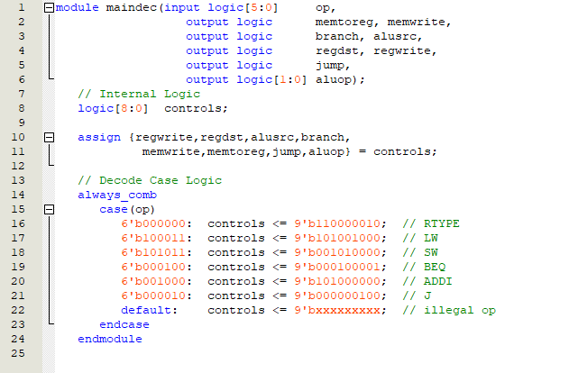
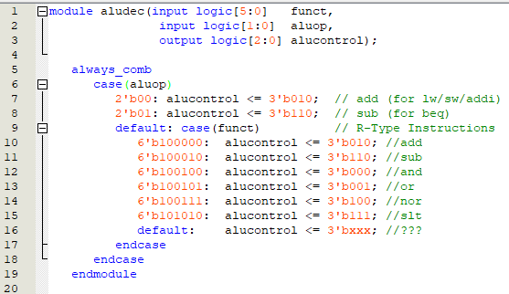
Main and ALU Decoder:
Main Decoder module (maindec) breaks down and gives the correct output for the given 6-bit op input it takes in.
ALU Decoder module (aludec) determines the immediate outputs first (lw/sw/addi/beq) then includes an embedded case for R-Type instructions (add/sub/and/or/nor/slt).

Slide 10
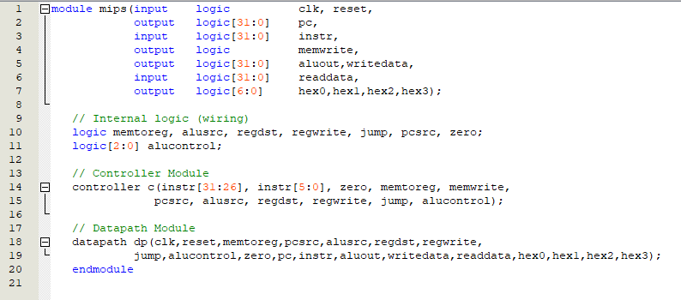
Mips:

Slide 11
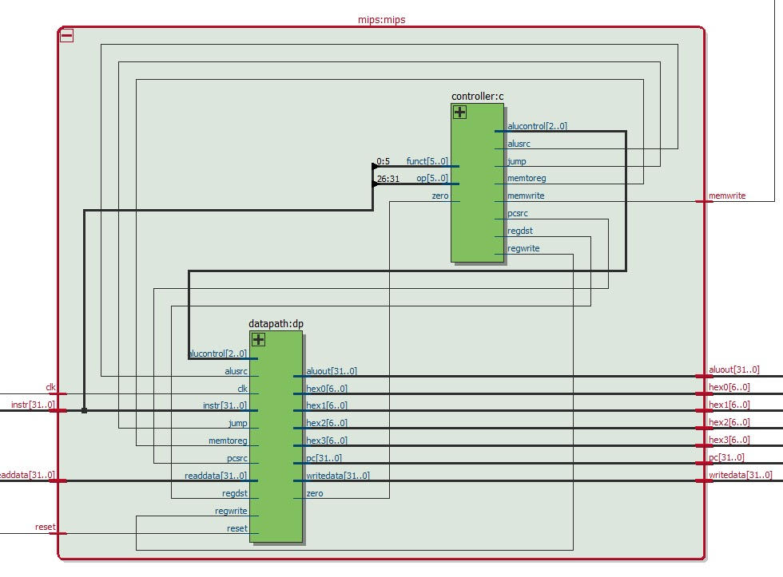

Slide 12
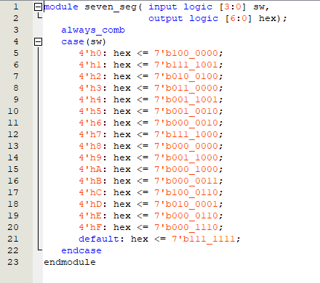
Seven Segment:

Slide 13
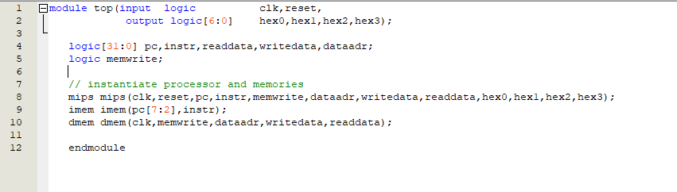
Top:

Slide 14
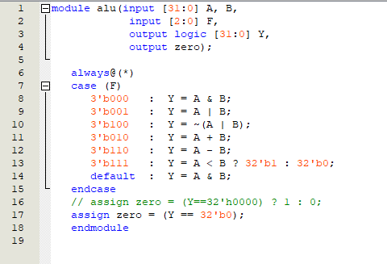
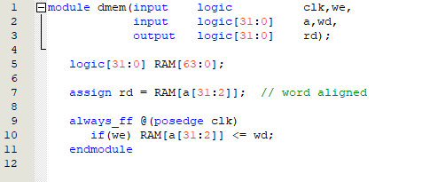
Data Memory:
ALU:

Slide 15
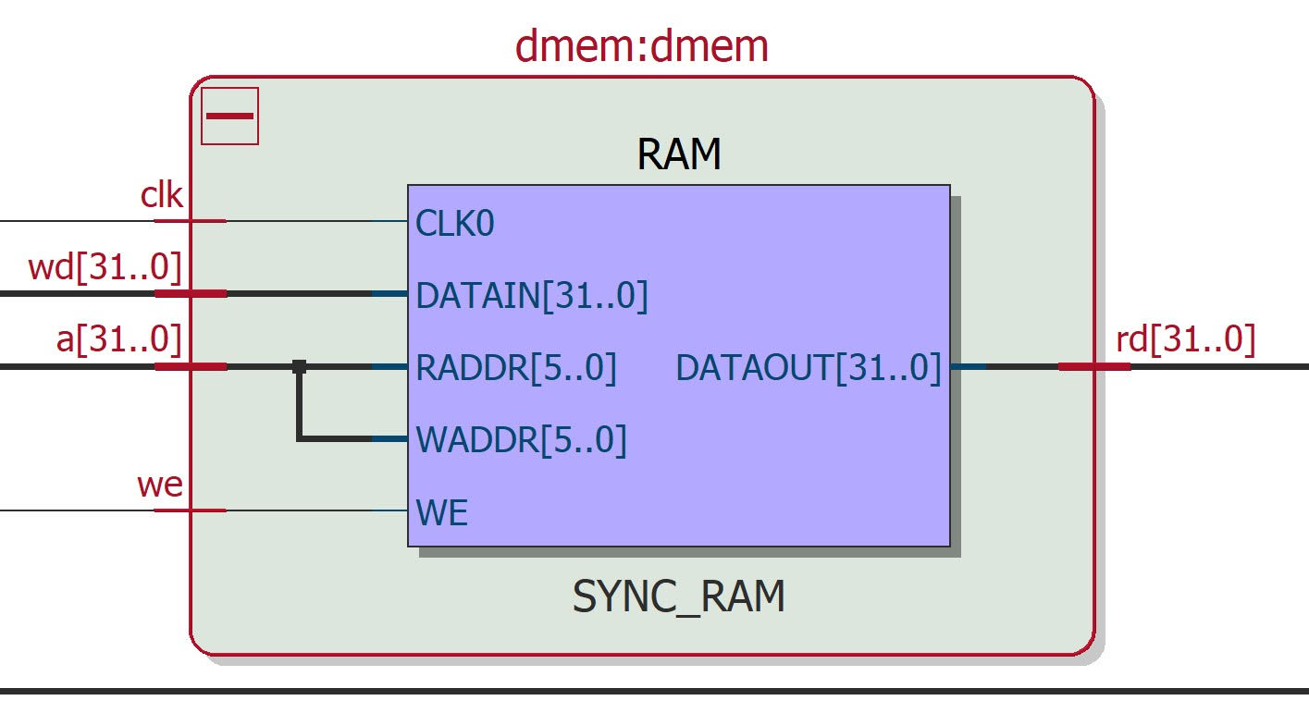

Slide 16
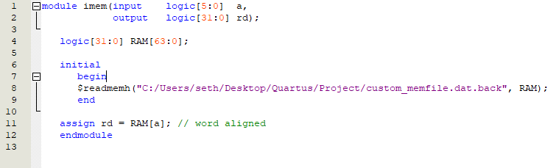
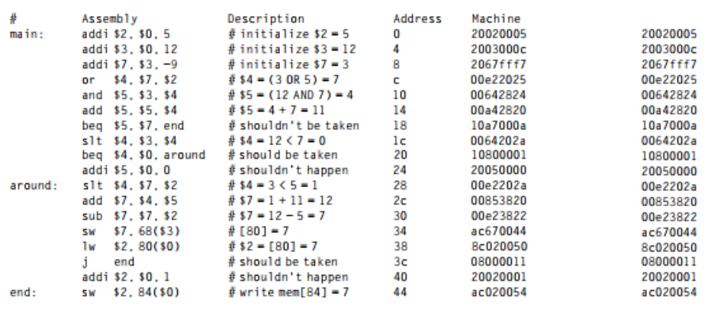
Instruction Memory:

Slide 17
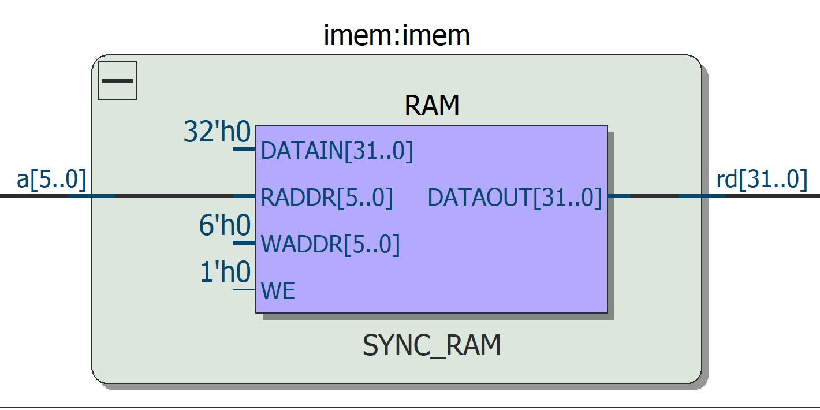

Slide 18
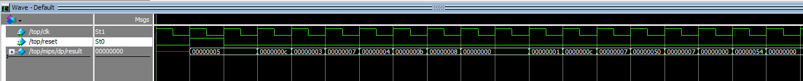
Timing Simulation Results 1
*From testbench given by textbook

Slide 19
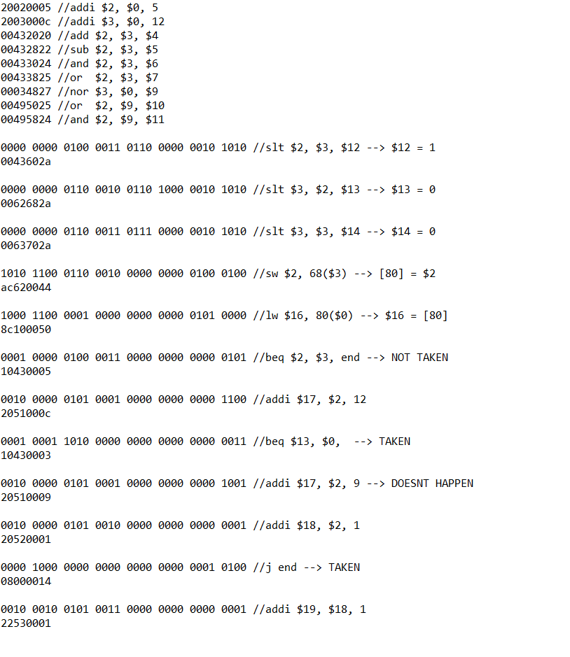
Memfile.dat
For Testbench

Slide 20
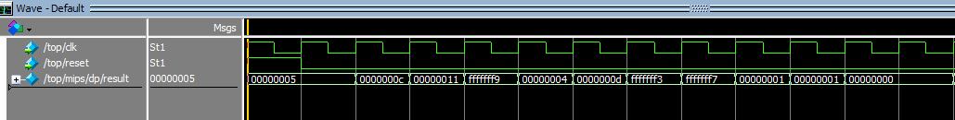
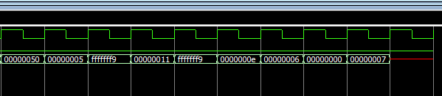
Timing Simulation Results 2
*Custom developed testbench

Slide 21

The Video Demonstration:

