Slide 1
Elasticsearch – Carrier RiskView
Date: May 2017
Contacts: Natnael Getu (natnael.getu@aon.ie)

Slide 2
Problems
We don’t have Full Search Capability
  All fields aren't available as filter
  User doesn’t allow to customize filters
  User doesn’t allow to aggregate the data
  User has just standalone(defined upfront) visualizations in terms of data and Charts
Integrations of New Field (eg. Risk/View Pipeline)
  Change Tables Schema
  Change Stored Procedures
  Change APIs
  Change SPA

Slide 3
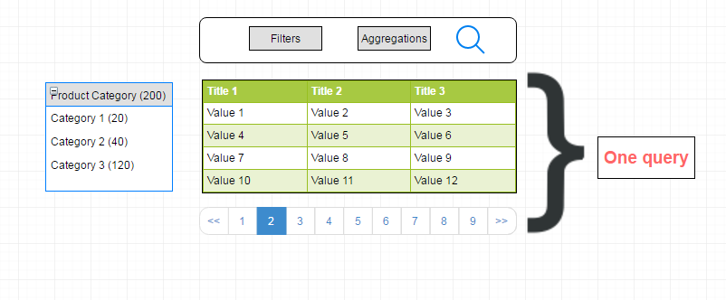
Why Elasticsearch
Standalone Capabilities
  Lucene as Search Engine
  Json Base document
  Schemaless
  Fulltext search
  Powerful Aggregations (Count, Avg, Sum, Standard Deviation, Mean, derivative, Variance, Commutative Sum, etc..)
  Advanced search
  High Availability (Cluster - Nodes)
  Document Relevance
  ….

Slide 4
How to ?
Manage Relational Database
Analysis for Pipeline Risk/View and Other Applications
Performance and Flexibility
Custom Single Endpoint (API) as access Data
Tableau chart Build using D3 and Elasticsearch

Slide 5
Manage Relational Database in Elasticsearch
Elasticsearch
Inner Object
Nested
_Parent/ _child
Terms Lookup
Very Fast to Read - Complex Update Operations
Very Fast to Read, Complex Update Operations
Slow to Read, Fast Insert/Update operations
Fast to Read - Fast Insert/Update operations

Slide 6
Pipeline Opportunities - Use case
Pipeline Opportunities
Appetite In/Out
Notes
Tags

Slide 7
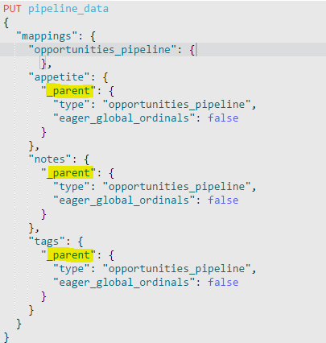
_Parent / Child
Define upfront the Mapping for each Type of your Data by defining who is _parent and child

Slide 8
Architecture Flow – Solutions (based on the current situation)
Application layer
Service Layer
Data Layer
Pipeline
Application
CarrierDB
Appetite
Elasticsearch
Mobile
Authorization
ES
Others
Others
Application Service
CRUD operations
CarrierDB
ES

Slide 9
Performance and DSL Query – Theory behind the scenes
BitSets Filter (bool) (https://en.wikipedia.org/wiki/Bit_array) (https://www.elastic.co/blog/all-about-elasticsearch-filter-bitsets)
    After the first execution the query will be cached since Elastic search has been restarted
    No Query validator
    Support Multiple operations
_Parent /_Child (Join data between different Type of data) (https://www.elastic.co/guide/en/elasticsearch/reference/current/mapping-parent-field.html)
    Better performance Insert/Update Operations
    Reduce size of the Main Document
    [Constraint] One to Many relationship
Relevance – (https://www.elastic.co/guide/en/elasticsearch/guide/current/relevance-intro.html)
    Theory (https://www.elastic.co/guide/en/elasticsearch/guide/current/scoring-theory.html)
    Vector space Model : (https://en.wikipedia.org/wiki/Vector_space_model)
Function score Query – (https://www.elastic.co/guide/en/elasticsearch/reference/current/query-dsl-function-score-query.html)
    Allow to modify the score of the document
    Example : Favourites or Deal Size in Pipeline
Powerful Search / Aggregation Framework
  Aggregations : https://www.elastic.co/guide/en/elasticsearch/reference/current/search-aggregations.html )
  Search : ( https://www.elastic.co/guide/en/elasticsearch/reference/current/search-search.html )

Slide 10

Data Architecture Flow
ETL
Veritas DB
Applications DB
CRUD Operations Event
From the Application Services
Or Application DB
Master Node
Elasticsearch Cluster
Slave Node

Slide 11
Conclusion
Increase Productivity
Performance Improvement
More functionalities
Simplicity
Centralized Search API

