Slide 1

Everything You Wanted to Know About
Java Access Modifiers
this is a a javax0 tutorial, LEVEL: NOVICE, © Peter Verhás 2020
Notes:
This video tutorial is about Java access modifiers. These are very basic and simple things. What is the point to create another tutorial about it? Because you do not know all the details, the nuts and the bolts of Java access rules, because they are complex. If you believe me and start to watch this video, then just after a few minutes you will realize that … HEY!!! I did not know this!!! Is it worth knowing all these fine details? Well, if you are a Java professional then at least you are supposed to know these simply out of pride. If you really know all the bits and pieces, then relax and enjoy the ride. And what can you lose? I will talk about the simple cases that everybody knows. Sorry I cannot skip that. Then we will visit more complex scenarios, like private members of inner classes, protected inner classes. We will also look at the how the JVM handles this type of access and at the end we will look at what jigsaw, the Java Platform Module System is introducing to the Java regarding to access. That is because private is accessible not only from the same class, package private is not the protection level when we are not specifying any modifier, a protected member is not fully accessible from an extending class in a different package and public is not that public after the introduction of Java Platform Module System in Java 9.

Slide 2
There are three access modifiers in Java
private
protected
public
Notes:
There are three access modifiers in Java. These are language keywords that modify the access level of class members. The keywords are __CLICK__ private __CLICK__ protected and __CLICK__ public. With these and with the obvious default case when we do not use any modifier __NEXT SLIDE__

Slide 3
There are four access levels in Java
private
package access (no keyword in classes)
protected
public
Notes:
.. there are four access levels in Java. These are __CLICK__ private __CLCK__ package access, when we do not use any access modifier keyword in front of the member declaration __CLICK__ protected and __CLICK__ public. What are the access levels?

Slide 4

private
is visible only in the same class…
Notes:
What every junior knows is that private members are visible only in the same class … and it is true… almost.

Slide 5
package access
is when we do not specify any modifier, and
is visible only in the same package…
Notes:
Similarly package private is when we do not specify any modifier and it is visible only in the same package…. almost.

Slide 6
protected
is visible only in the same package private and
from classes that extend the defining class
Notes:
Protected is the same as package private and it is also visible from classes that extend the defining class…. Almost. And finally…

Slide 7
public
is visible in the whole Java program
Notes:
Public is visible from everywhere… and again… only almost.

Slide 8
Visualizing it
other package
package
package private
class
class extends
private
protected
Notes:
If we want to visualize this the diagram will look something like this. Even though this structure is only “almost” it is worth understanding it as a first approach because in most of the practical cases it is enough to know these. This is the reason why most of the junior developers only know this. Private is in the class. Package private is in the package. Protected is in the package and child class and public everywhere... almost. After this part you will learn more. But now there is time to have a short demo of all these.

Slide 9
so good so far
demo
Notes:
__ checkout access-modifiers-simple-demo __
I this demo we have a few classes in two packages. There is a package a and a package b under javax0.blog.demo.accessmodifiers
ClassA __OPEN CLASS A__ defines four methods. One private, one package access, many times referred to as package private or default, a protected and a public. There is also a main that calls these methods.
We also have a class MainCallingClassAMethods __OPEN THE FILE__ that also contains a main with the same code trying to call the same methods. In this file there is an error as signaled by the IDE. The private method cannot be invoked because this code is in a different top-level class and therefore it cannot access the private method, which is in a different top-level class.
__ comment out the error line __
We also have a class named MainExtendingClassACallingClassAMethods which is the same as the previous one, but this one is extending the original class, ClassA. There is no surprise, we are in the same package but in a different class, we can call any method except the private one.
__ comment out the error line __
We also have a ClassB, which is in the package B. We, again, try to call the methods from here. We can call from here only the public method.
__ comment out the error lines all __
Finally we have a class ClassExtendsClassA that is in the package B but it extends the class A. In this case, because we extend the class ClassA we can call the protected method as well. However, be warned that this is a simple case, we will see later that this is not that simple. Nevertheless the code above works after commenting out the error lines.
__ comment out the error lines all __
Now we can start the main methods one after the other and see that the methods are really invoked.
__RUN ClassA.main() __
When we run the local main method, which is in the same class where out methods are then the output shows that all the methods were invoked.
__RUN MainCallingClassAMethods.main() __
When we run the main method from the other class then only the private method, that we had to comment out is not invoked.
__RUN MainExtendingClassACallingClassAMethods.main()__
When we run the main method from the other class that extends the original class then we get the same result.
__RUN ClassB.main()__
Running the main method of the class in the other package we can only invoke the public method.
__RUN ClassExtendsClassA.main()__
Finally running the main method of the class that is in the other package but extends the original class we can invoke the public method and also the protected method.

Slide 10
Let’s talk about private first
Junior -> Senior level
Notes:
Let’s talk about private first and as a warm-up let’s discuss something that really should be obvious for every junior, but after many hundred technical interviews I can says that it is actually not. At first it was a surprise for me, but then I had to learn, that many junior developer thinks …

Slide 11
private misconception
is visible in the same class and
NOT ONLY FOR THE SAME OBJECT / CLASS INSTANCE
demo ‘EqualsImplementingClass’
Notes:
that private fields can only be accessed if the code is executing on the same object, the same class instance. This is not true. If the code is running in a static method, or if the code is running in an instance method, or in a constructor or in some initializer block and the code has a reference to an instance of the class then the code can read and modify the private field using the object reference even if it is not the same as the actual object, which is referenced by the ‘this’ keyword. By the way, the same is true for private methods with the small correction that in case of a method we cannot talk about reading and modification. The operation in case of a method is invocation, in other words we can call the private method on the other object.
If you believed so far that private is instance bound and the code cannot access private members of a different instance, then let’s have a look at how the equals() method is implemented in a Java class.

Slide 12
DEMO PLACEHOLDER CUT IT OFF
Demo CUT IT OFF FROM THE VIDEO
EqualsImplementingClass
Notes:
__CHECKOUT equals-implementing-class__
__OPEN THE CLASS__
Here we have a simple class that contains two private, a protected and a public field. There can be other fields and methods in a real life code. In our case we only want to compare the instances of this class based on the equality of the values of these fields. Let's create an equals() method.
__ press Command-N and select with the down arrow equals() and hashCode()__
We will use the editor built-in code generator to create the code for us. Every IDE has this functionality and they usually generate appropriate code. The IDE does not offer the generation of the equals() method without the hashCode() because equals() and hashCode() have to be implemented in a consistent way and this way the IDE does not promote the generation of the one without the other. However, equals() and hashCode() are a whole other topic, that we may talk about in a different tutorial.
__press next__
__press next__
__press next__
We select all fields as guaranteed as non-null. Do not think too much about it. We only do that to have a code from the generator that is simpler missing the null checks that are none of our concerns now. But only now, in real life it is a crucial issue.
__ select all the fields one by one and press next__
By now we are not interested in the hashCode method.
__COLLAPSE THE hashCode method__
What we see is a more or less conventional and standard equals() method. It returns true if the two objects are the same or if the two object are instances of the exactly same class or the other class is a subclass of our class and the fields are equal. In case of primitives the equality is checked using the equal operator, in case of objects the equality is checked calling the equals method.
What we have to notice here is that the method can access all the fields on the 'this' instance but also on the 'that' instance. Even in case of private fields, the access is not forbidden, and it is not restricted to the same object.

Slide 13
private … almost
“is visible only in the same class”
is NOT
what the
Java Language Specification says
Notes:
When we discussed first ‘private’ we said that a private member is visible only in the same class… almost. Why is this “almost”? __CLICK__ because the Java Language Specification says something different and the case when the code accessing the field, method and so on is in the same class is only a special case.
__CLICK__
The Java Language Specification does not say that it is the same class. It says it a bit differently.

Slide 14

https://docs.oracle.com/javase/specs/jls/se14/jls14.pdf
Notes:
You can download the Java Language Specification from the URL above and you can use the QR code with your phone, so you do not need to type in the URL. What does the Java Language Specification say on the page 176, in the example 6.6-5?

Slide 15
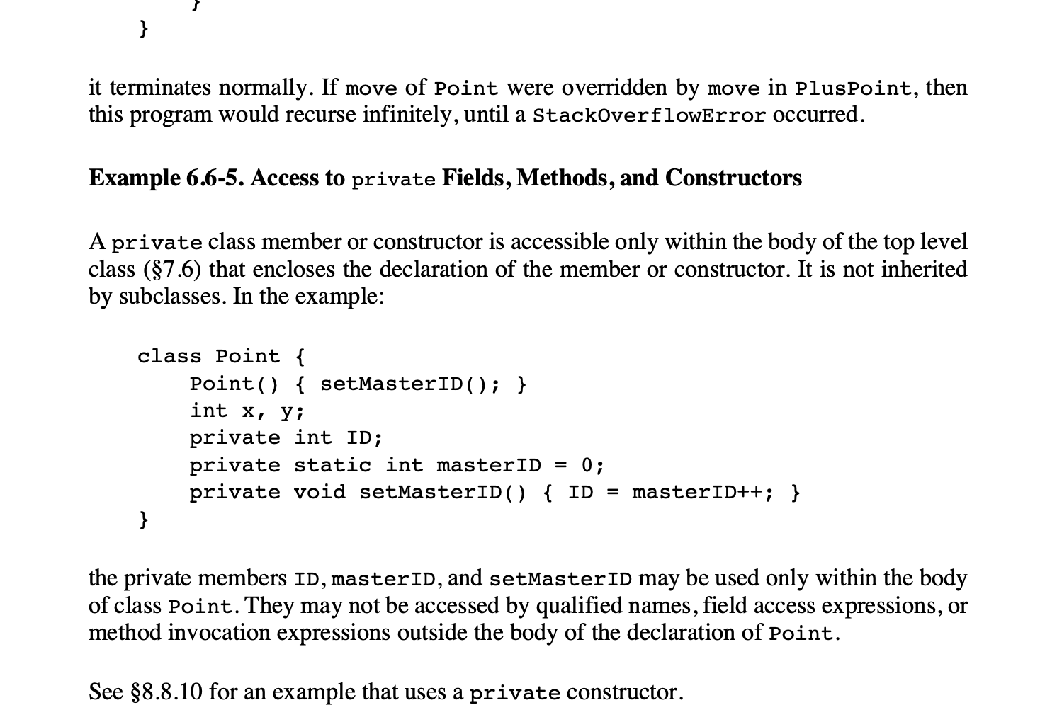
Notes:
It says that private class members, in other words methods, fields, inner classes, inner interfaces, inner enums and in addition to the members the private constructors, so essentially everything that can be declared private and can happen to be inside a class are accessible if the code calling, or accessing the private member is in the same top level class as the member itself.
__CLICK__
Either or both the code accessing the member and the member itself can be in an inner class or interface or enum, the private members are accessible if they are in the same top-level class. In other words private is visible from the same source file.

Slide 16
Visualizing it
top-level class
inner class
private
private
inner class
private
Notes:
This is depicted on this rudimentary picture. Such an access makes sense. When the developer edits a Java source file they edit something that has high cohesion. These things belong together. If they do not belong together they should not be in the same file. But if they belong together there is no reason to hide anything using access control inside one single source file.

Slide 17
private… DEMO
Notes:
__CHECKOUT compound class demo__
In this demo we have a top level class that contains two inner classes out of one also contains a third inner class. All the methods are private and all the four classes that we have in this single source file have a public static void main method that calls all the private methods and they just print out
method top
method Inner1
method Inner2
method InnerInner
and they have no problem calling these method just from any class any level.

Slide 18
package access … almost
“when we do not specify any modifier”
is only when we are in a class or enum
The default in an interface is public.
Notes:
Here the “almost” is not that big of an issues, but with some Java developer position on some interviews this small thing may still make the difference between getting the job or a refusal. The statement that “the default access is package access when we are not specifying any modifier” is only true when the member is in a class. If the member is in an interface then the default is public.

Slide 19
protected … almost
is visible only in the same package private and
from classes that extend the defining class
“only by code that is responsible for the implementation of that object.”
Notes:
The “almost” in case of the protected is that a protected member is visible outside of the package only in subclasses only by code that is responsible for the implementation of that object.

Slide 20
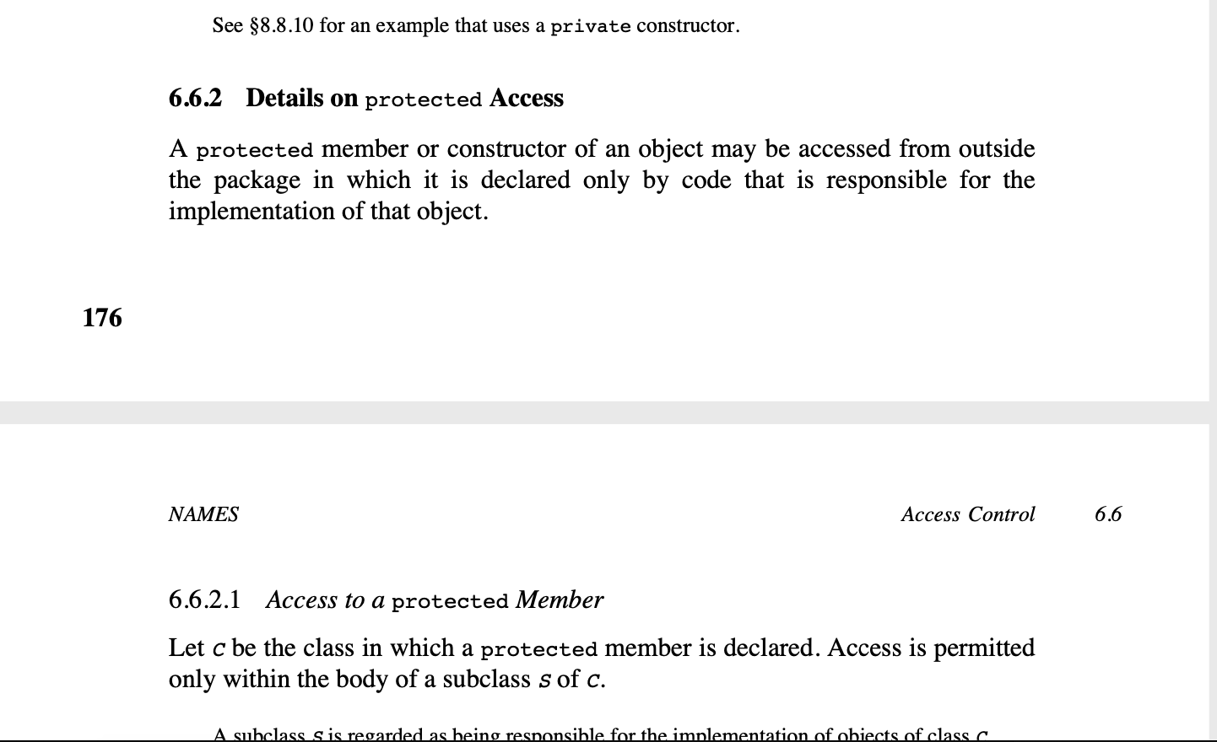
Notes:
On the page 176 the specification says that a protected member or constructor of an object may be accessed from outside the package in which it is declared only by code that is responsible for the implementation of that object. There is a sample code on two pages later

Slide 21
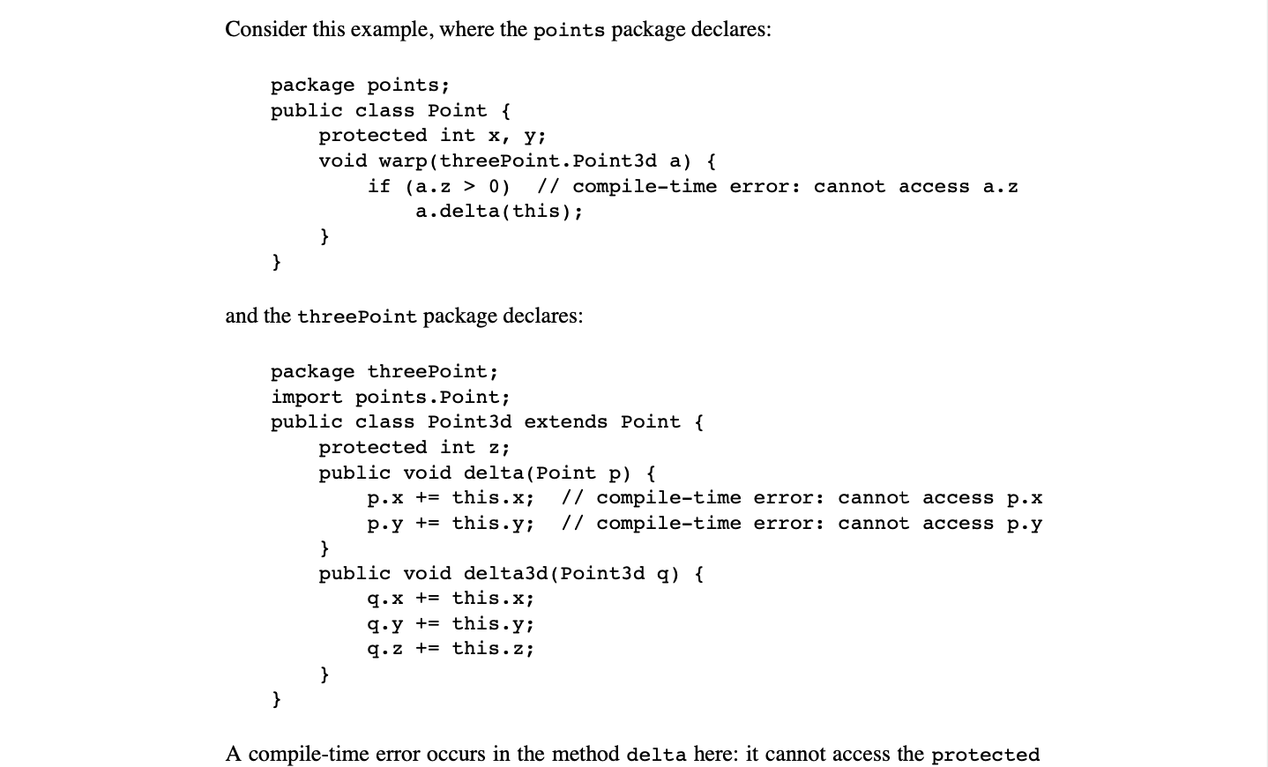
Notes:
__WAIT A FEW SECONDS AND THEN WE SWITCH TO THE DEMO OF THE SAME CLASSES __

Slide 22
protected … DEMO
PLACEHOLDER TO BE REMOVED FROM THE VIDEO
Notes:
__OPEN BRANCH 3points-demo__ __CLOSE LOWER PART OF THE EDITOR__ __SPLIT HORIZONTAL__
In the demo project we have reproduced this example. We have the packages "points" and "threePoints" and the classes "Point" and "Point3d".
Point3d extends the parent class Point. In this the method 'delta()' cannot access the protected members 'x' and 'y' of the parameter 'p' because this code is not involved in the implementation of Point.
The method delta3d can access the protected members of its parameter q, because the class Point3d is a subclass of Point and is involved in the implementation of a Point3d.
__open branch protected-self-demo__
__OPEN ClassA and ClassExtendsClassA__
We have already seen the main method in this class. The inherited protected method can be called as well as the public method. Now let's have a look at the callerMethod().
__COLLAPSE main()__
Here we have an instance of ClassA. Because the callerMethod() is not part of the implementation of ClassA, it is only part of the implementation of a subclass, thus it cannot call the protected method on this instance. What we can do is to call this method on an object that is an instance of ClassExtendsClassA, that is the child class or on an object that is an instance of a subclass of this class.
__COPY PASTE FROM HERE AFTER THE ERRONEOUS LINE
protectedMethod();
super.protectedMethod();
new ClassExtendsClassA().protectedMethod();
new ClassExtendsClassA(){}.protectedMethod();
__END__COPY__
In these examples we call the protected method on the actual object, we call it using the 'super' keyword, which means the same as the previous because we have not overridden the method in this child class, we call the method on a different object that is an instance of the ClassExtendsClassA class and also on an object that is the instance of an anonymous class that is technically the subclass of our example class. These are all valid and allowed invocations.
__UNCOMMENT sut1.protectedMethod() CALL__

Slide 23
Visualizing it
other package
package
class A
class extends
protected
<<inherited>>
protected
calling code
Notes:
Visualizing it we have a class and another class that extends the class A and this second class is in a different package. The code in this class __CLICK__ cannot call a protected method in class A on an object that is the instance of class A even though the calling code is in a class that extends the class A. __CLICK__ That is because you can only call protected methods from a code that implements the class on which you call the method. On the other hand we can call __CLICK__ the same method on the subclass as it is inherited from class A. In this case the calling code is part of the implementation of the class on which we call the protected method.

Slide 24
protected … almost almost
you cannot call inherited protected methods even from the same package
BUT
you can call inherited and OVERRIDDEN protected methods from the same package
Notes:
The “almost” in case of the protected is that a protected member is visible outside of the package only in subclasses only by code that is responsible for the implementation of that object.

Slide 25
protected inheritance … DEMO
PLACEHOLDER TO BE REMOVED FROM THE VIDEO
Notes:
__open branch protected-self-demo-inherit__
__OPEN ClassA and ClassExtendsClassA and CallingClass__
In this example we have the classes that we had before, but in this example, we also have a protected method called protectedMethodToOverride().
__OPEN ClassA expand protectedMethodToOverride __
This method is overridden in the subclass.
__OPEN ClassExtendsClassA and show the overridden method__
We also have a class named CallingClass also in the package B.
__OPEN CallingClass __
From this class we can call the overridden method because it is protected and is defined in the packaged as the calling code, but the same time we cannot call the method, which is protected, defined in a different package and is only inherited by a class in the same package. We cannot call this method even on the subclass. This method is not in the same package, it is protected and the calling code is not part of the implementation of the subclass.

Slide 26
Visualizing it
other package
package
other class
class A
class extends
protected1
<<inherited>>
protected1
calling code
protected2
<<inherited>>
protected2
protected2
Notes:
This diagram shows this in a visual format. We have the two classes in two different packages and we also have a calling code in a class in the other package. The calling code cannot call __CLICK__ the inherited protected method. __CLICK__ But it can call __CLICK__ the one that is overridden, because with the act of overriding the method is defined in the same package.

Slide 27
public … almost
is visible in the whole Java program
was partially true before Java 9 and JPMS
Notes:
The statement that public members and constructors are visible in the whole Java program was only true and only partially before Java 9. Partially because you can only access a public member only if the member is inside of a class that is also visible from outside. And it is not the absolute truth after Java 8 because public members are visible only if we do not use Java Platform Module System or the module exports the package that contains the class that contains the public member.

Slide 28
public hidden in … DEMO
PLACEHOLDER TO BE REMOVED FROM THE VIDEO
Notes:
__OPEN BRANCH public-closed-licked__
__OPEN ClassA__
In this example our class named ClassA is not public. It has package access and thus only visible from within the same package.
The calling class __OPEN CallingClass__ does not have access to the class itself and thus it cannot call the method on the class. Simply we cannot even call the constructor to have an instance. However, this is not the end of it. We can have other means to get a reference to an instance of a class, not only calling the constructor. There are many way. For example we can have a factory that creates an instance and returns it to us. __OPEN Factory__
The factory is a public class and as simple as you can see on the screen.
__SWITCH to CallingClass__
__EDIT var sut = Factory.makeA();
also press Command+Alt+L to reformat and delete the unused import
__
Now we can have a reference to an instance of ClassA and thanks to the type inference introduced in Java 10 using the var predefined type we have a local variable that is the type ClassA even though this type is not visible in this class.
__PRESS COMMAND KEY AND MOVE the mouse over the variable name sut__
The variable S. U. T. is of the type ClassA but we cannot call the private method. However if we create a ClassB that extends ClassA in the package where ClassA is
__CREATE ClassB unsing the editor features and typing extends ClassA __
and we create an instance of ClassB and not ClassA then we are all fine.
__Change the Factory calling line to var sut = new ClassB(); __
and the red underlyning signalling the error just disappeared.
__

Slide 29
Visualizing it
calling code
public
Notes:
As a summary you can call or access a public member if you can get access through all the surrounding classes the member is in.

Slide 30
public … and JPMS
modules do not export all packages
module-info.java should export on module level
non-exported modules are implementation details
encapsulation +
information hiding
Notes:
The fact that public classes and members were visible from anywhere in the whole program before Java 9 Java Platform Module System was actually a big problem. Libraries offering an API to the library client code calling the API had no means to hide the code that was meant to be public only from within the library. The developers using the library started to use the classes and interfaces that were not part of the API but were available. This is an issue when you start to use some functionality of a library or framework that is not part of the API but rather part of the implementation. Any library should be free to modify the implementation without effecting users of the library.
Java Platform Module System introduced modules and every module should have a module-info.java file that defines which packages are exported from the module. In other modules only those public classes are visible that are either inside the actual module or are exported from some of the modules the current module requires.

Slide 31
public hidden in … DEMO
PLACEHOLDER TO BE REMOVED FROM THE VIDEO
Notes:
__OPEN BRANCH jpms-public-demo__
__OPEN ClassA__
In this example we have ClassA and ClassB. Both are public and both have a public method. They are defined in the module __OPEN module-info.java__ module dot exporting. This module, however, exports only one package. It exports the package that ClassA is and does not exports the package that contains ClassB.
There is another module __OPEN module-info.java of the other module__ module dot using. This module requires the module dot exporting named module. That way the class CallingClass __OPEN CallingClass__ can call the public method of ClassA. It cannot call the public method of the public class ClassB because it is in a different package that is not exported by the module it contains it.
This is just a simple example and the Java Platform Module System is much more complex than this. Here we only scratched the surface a bit to demonstrate that after JPMS public is not that public any more.

Slide 32
takeaway
what you knew about private, protected, default and public is okay
there is more
Notes:
With this we have reached the end of the subject of this tutorial. What you should remember that what you already knew about private, protected, public and the package access level is more or less correct. Generally what you know is not wrong, !!! just … this is not the whole picture.

Slide 33
summary
we have discussed
topics related not discussed
access levels and modifier the simple case
access levels when the case is not that simple, especially
protected
JPMS
change access levels on subclass
JVM handling access levels
Notes:
Private is visible from other classes if in the same file, not specifying any access modifier is package access only in classes but it is public in interfaces and protected can be referenced in different package only from code that implements the extending class. In addition to that there is Java Platform Module System that introduces encapsulation on the module level, thus adding another layer hiding public classes and methods that are in non-exported packages.
There are also other topics that are not discussed in this tutorial. For example how the access levels can be modified in extending classes. How the JVM implements private access between separate inner classes creating synthetic bridge methods or using class nesting in newer JVMs.

